Slide 1
Topics Presentation
Presented by
Mohtshim Ali
1

Slide 2
Contents
Ensemble Learning
Bagging and Boosting
2
Notes:
In 1991 the PowerBook 100 became the worlds first modern laptop
40mb Hard drive
8mb RAM
2500$

Slide 3
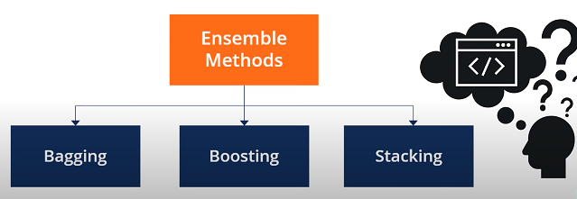
Ensemble Learning
Emsembles techniques combines individual models together to improve the stability and predictive power of the model. Its combines different machine learning models to make one predictive model which has a low variance.
3
Notes:
They are often used in offices and in big companies

Slide 4
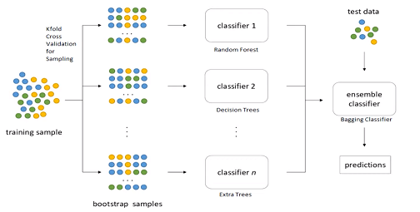
How Bagging works?
4

Slide 5
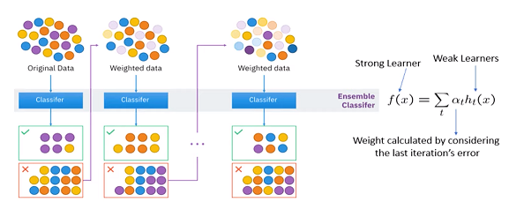
How Boosting works?
5

Slide 6
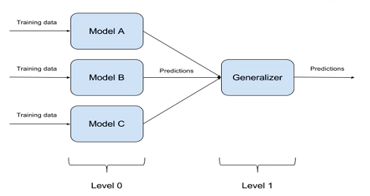
How stacking works?

