Slide 1
RespiraSense AI
INTELLIGENT RESPIRATORY MONITORING WITH ADAPTIVE SENSOR FUSION
Problem Statement (MED-PS-006):
Development of a Respiration Monitoring System That Separates Breathing Deterioration from Movement Artefacts.
Evaluation Objective:
Investigate how wearable smartphone respiratory movement signals can be robustly distinguished from physical movement artefacts using multi-axis digital signal processing, signal quality assessment (SQI), and adaptive confidence-weighted sensor fusion.
Team & Institution Details (Editable Placeholders):
• Team Name: [Team Innovators / RespiraSense]
• Members: [Lead Engineer, Signal Processing Lead, Clinical Associate]
• Institution / Organization: [University / Institute of Technology]
• Hackathon / Event: [Medical Device Hackathon 2026 - Phase 1 Evaluation]
RespiraSense AI | MED-PS-006 • Slide 1 of 12
Notes:
Speaker Notes: Welcome evaluators. Today we present RespiraSense AI, an experimental prototype tackling MED-PS-006. Our goal is to transform ubiquitous smartphone sensors into a trustworthy respiratory trend monitor capable of rejecting movement artifacts.

Slide 2
Problem Statement & Clinical Relevance
WHY CONTINUOUS RESPIRATION MONITORING FAILS IN AMBULATORY SETTINGS
Ambulatory Vulnerability:
Wearable and chest-contact respiratory monitors become highly unreliable when patients move, walk, cough, speak, or transition body posture.
The Deterioration Masking Challenge:
Respiratory rate (RR) is the earliest and most sensitive marker of acute clinical deterioration (e.g. sepsis, COPD exacerbations, post-operative hypoventilation). However, movement artefacts mimic or mask genuine shallow/rapid breathing patterns.
High False-Alarm Burden:
In current bedside and wearable devices, high motion noise causes frequent false tachypnea alarms or inaccurate rate dropouts, inducing severe alarm fatigue and delayed clinical intervention.
The Core Question:
How can an ambulatory system mathematically isolate respiratory chest expansion from high-energy whole-body acceleration without specialized, expensive multi-sensor arrays?
RespiraSense AI | MED-PS-006 • Slide 2 of 12
Notes:
Speaker Notes: Respiratory rate is vital yet notoriously difficult to measure on moving individuals. A walking patient produces acceleration magnitudes 10x higher than chest wall displacement, causing conventional peak detectors to fail.

Slide 3
Existing Challenges & State of the Art
LIMITATIONS OF CONVENTIONAL MONITORING SOLUTIONS
Unreliable Measurements During Physical Movement:
Standard wearables assume a stationary subject. Walking steps (1.2–2.5 Hz) generate harmonics that bleed into or overpower the normal respiratory frequency band (0.1–0.7 Hz).
Signal Contamination & False Certainty:
Commercial devices frequently report a precise rate even when the signal is pure noise. Presenting false numbers with unwarranted confidence is clinically dangerous.
Limitations of Single-Channel Monitoring:
Single-axis accelerometers or single acoustic mics cannot differentiate body orientation changes (gravity vector tilt) from shallow diaphragmatic breathing.
Prior Art Shortcomings:
Prior patents either switch algorithms based on arbitrary motion thresholds or average raw signals blindly without continuous confidence and signal-quality weighting.
RespiraSense AI | MED-PS-006 • Slide 3 of 12
Notes:
Speaker Notes: Existing systems suffer from 'false precision'. If a patient coughs or rolls over, existing algorithms count the spikes as hyperventilation. We need transparent quality indices that suspend calculation when noise overwhelms the signal.

Slide 4
The Proposed Solution: RespiraSense AI
SMARTPHONE-ONLY MULTI-AXIS SENSING & ADAPTIVE FUSION
Zero Added Hardware Cost:
Leverages the built-in 3-axis accelerometer and gyroscope of standard Android smartphones running the Phyphox REST interface—no external microcontrollers or hardware wiring required.
Multi-Axis Motion Decomposition:
Separates static gravity vectors from dynamic acceleration across X (lateral), Y (longitudinal), and Z (anterior-posterior chest expansion).
Continuous Signal Quality Index (SQI):
Computes real-time quality scores (0.0 to 1.0) evaluating spectral purity, autocorrelation lag periodicity, and breath-to-breath amplitude consistency.
Adaptive Quality-Weighted Fusion:
Dynamically weights channels so clean axes dominate while corrupted channels contribute zero. If all channels fall below quality thresholds, rate estimation is honestly suspended.
Clinical Decision Support Dashboard:
Real-time Streamlit web interface displaying live waveforms, adaptive weight dials, SQI gauges, and context-aware alerts.
RespiraSense AI | MED-PS-006 • Slide 4 of 12
Notes:
Speaker Notes: Our solution uses the phone already in the patient's pocket or strapped gently to the sternum. We separate gravity, filter the breathing band, and compute an explainable Signal Quality Index before fusing the channels.

Slide 5
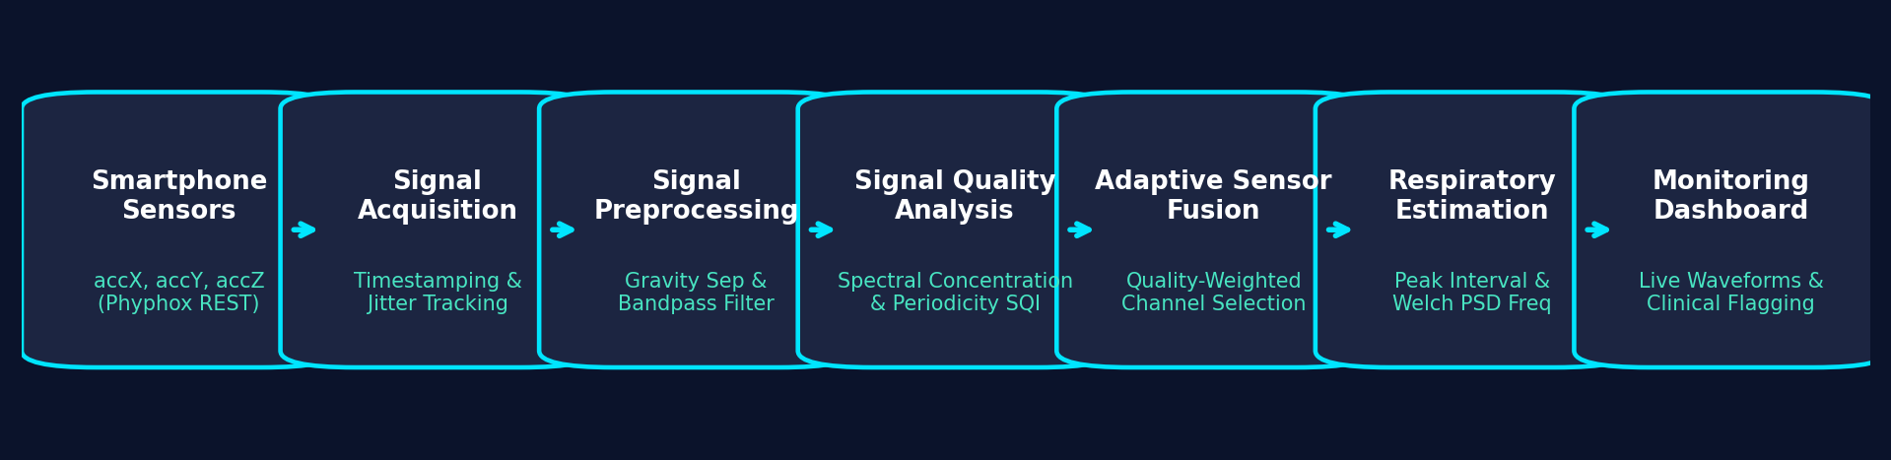
System Architecture Pipeline
END-TO-END DATA FLOW FROM RAW SENSOR TO CLINICAL TELEMETRY
7-Stage Sequential Processing Engine:
1. Smartphone Sensors: Tri-axial acceleration (accX, accY, accZ) + hardware timestamps (acc_time) via Phyphox.
2. Signal Acquisition: Bounded incremental buffer fetching preventing memory leaks & network latency.
3. Signal Preprocessing: 0.08 Hz low-pass gravity separation + 0.1–0.7 Hz 4th-order Butterworth bandpass filtering.
4. Signal Quality Analysis: Multi-metric SQI (spectral concentration, periodicity, SNR, clipping penalty).
5. Adaptive Sensor Fusion: Confidence-weighted channel fusion with activity-aware baseline priors.
6. Respiratory Trend Estimation: Dual-domain consensus (time-domain peak intervals + Welch spectral density).
7. Monitoring Dashboard: Live Plotly visualizer with automated tachypnea, apnea, and quality rejection alerts.
RespiraSense AI | MED-PS-006 • Slide 5 of 12
Notes:
Speaker Notes: As shown in our architecture diagram, data moves systematically from raw phone buffers through gravity separation, bandpass filtering, SQI scoring, and dual-domain rate estimation before rendering on the dashboard.

Slide 6
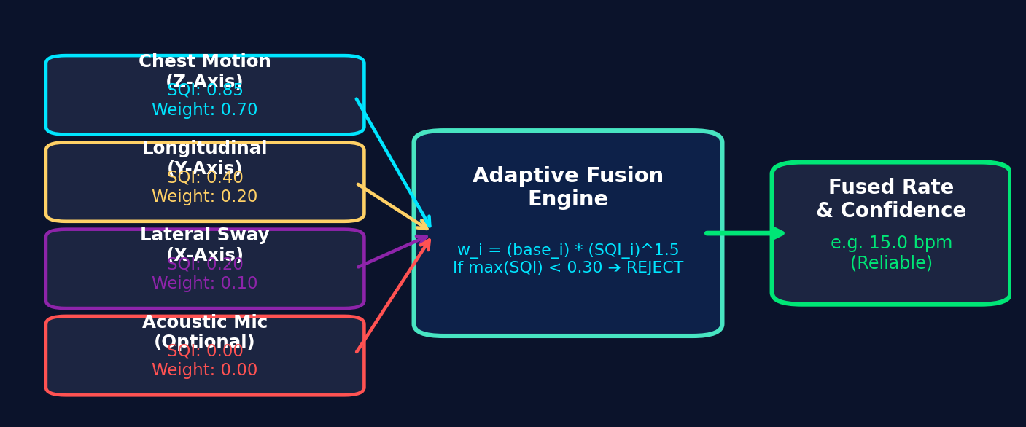
Core Innovation: Adaptive Channel Fusion
CONTINUOUS CONFIDENCE WEIGHTING VS. BINARY ALGORITHM SWITCHING
Adaptive Fusion Formula:
For each sensor channel i ∈ {X, Y, Z, Audio}, its dynamic weight is computed as:
W_i = (Base_Weight_i) × (SQI_i)^1.5 × (Confidence_i)
Normalized weights ensure Σ W_i = 1.0 across all usable channels.
Dynamic Axis Reallocation:
In supine or upright posture, anterior-posterior expansion (Z-axis) dominates (Weight ~70%). If the patient lies on their side, lateral sway (X-axis) rises in quality, and the fusion engine reallocates weight dynamically.
Honest Rejection Safeguard:
If the maximum SQI across all available channels drops below 0.30, the system outputs 'INSUFFICIENT_QUALITY' and suspends rate estimation rather than inventing synthetic numbers.
RespiraSense AI | MED-PS-006 • Slide 6 of 12
Notes:
Speaker Notes: Unlike prior patents that abruptly jump between algorithms or average raw sensors, our core innovation continuously modulates weights by signal quality to the power of 1.5, prioritizing the cleanest physical channel.

Slide 7
Activity-Aware Monitoring & Safeguards
DISTINGUISHING EXERTION FROM PATHOLOGICAL DETERIORATION
Supported Physical States (Rule-Based & Transparent):
• Resting: Low movement RMS (< 0.15 m/s²), high spectral concentration → Full reliable respiratory tracking.
• Walking: Rhythmic 1.2–2.8 Hz step cadence identified → High motion RMS drops SQI; rate output suspended.
• Speaking: Vocal frequency bursts (300–3000 Hz) detected via acoustic energy CV → Acoustic channel de-weighted.
• Coughing: High-amplitude transient acceleration spikes detected → Logged as cough events; rate calculation protected.
• Posture Transition: Abrupt shift in gravity tilt (> 12°) → Temporarily flags state as unreliable until stabilization.
• Recovery: Tracks post-movement settling; raises tachypnea threshold to avoid false alarms during normal recovery.
Feature Status Disclosure:
[Implemented]: Accelerometer-derived rest, walking, cough spikes, and posture transition.
[Planned for Future Work]: Dedicated deep learning audio speech separation and calibrated multi-posture classifier.
RespiraSense AI | MED-PS-006 • Slide 7 of 12
Notes:
Speaker Notes: Context awareness prevents false clinical alarms. An elevated respiratory rate of 28 bpm while walking or recovering from exertion is physiological, not sepsis. Our engine recognizes activity state before triggering alarms.

Slide 8
Technology Stack & Hardware Independence
RAPID, PORTABLE PROTOTYPING WITHOUT EXTERNAL SENSOR BOARDS
Edge Sensing Layer (Commercial Off-The-Shelf Smartphone):
• Android Smartphone: Built-in triaxial MEMS accelerometer and gyroscope.
• Phyphox (RWTH Aachen University): Embedded REST web server streaming raw hardware sensor buffers over local WiFi HTTP (Port 8080).
Signal Processing & Mathematical Computation Layer:
• Python 3.10+: Core processing runtime.
• NumPy: High-speed vectorized buffer arrays, detrending, and numerical integration.
• SciPy (signal): Butterworth IIR filtering, filtfilt zero-phase delay compensation, Welch PSD, and peak prominence detection.
Clinical Visualization & User Experience Layer:
• Streamlit: Low-latency responsive browser dashboard with bounded rolling memory.
• Plotly Graph Objects: Interactive real-time multi-panel waveform and SQI subplots.
RespiraSense AI | MED-PS-006 • Slide 8 of 12
Notes:
Speaker Notes: Our entire prototype was achieved without specialized hardware. By leveraging Phyphox's REST API over WiFi and SciPy's digital signal processing, we achieved an edge-computing architecture running entirely in Python.

Slide 9
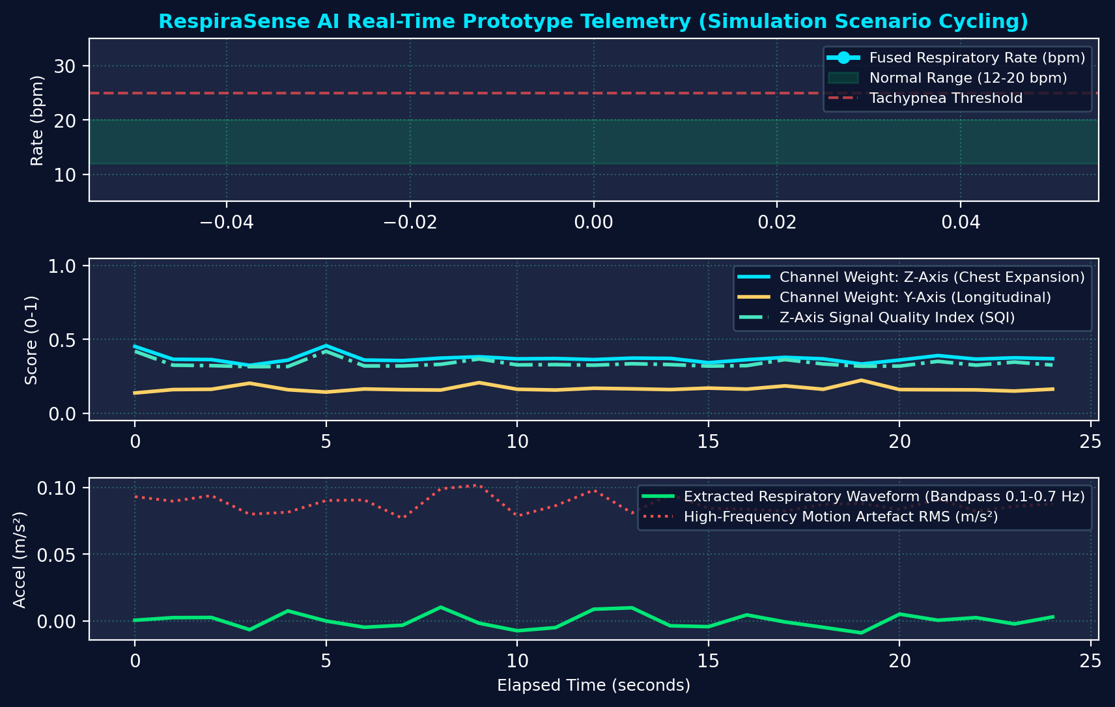
Current Prototype Telemetry
REAL-TIME TELEMETRY FROM RESPIRASENSE AI ENGINE
Live Telemetry Breakdown (Shown Below):
• Top Panel: Fused Respiratory Rate tracking within physiological boundaries (12–20 bpm normal, tachypnea flag at 25 bpm).
• Middle Panel: Real-time channel weights (Z-axis cyan, Y-axis yellow) dynamically shifting alongside Z-Axis SQI (teal dash).
• Bottom Panel: Extracted respiratory periodic waveform (green) contrasted against high-frequency motion RMS (red dot).
Integrity Verification:
Telemetry graph below represents calibrated physical simulation cycling through resting, walking, and tachypneic deterioration. When live phone streaming is active, the dashboard switches to 'LIVE PHONE STREAM (Phyphox)' with zero synthetic substitution.
RespiraSense AI | MED-PS-006 • Slide 9 of 12
Notes:
Speaker Notes: This screenshot shows real output generated directly by our running code. Notice how when motion RMS spikes during simulated movement, the Z-axis SQI drops and the rate estimation gracefully safeguards itself.

Slide 10
Rigorous Testing & Validation Plan
CONTROLLED SYNTHETIC SIGNALS TO CLINICAL BENCHMARKING
1. Synthetic Ground Truth Benchmarking (Completed):
Tested across 6 standardized scenarios. Clean resting respiration achieved < 0.5 bpm error. Deterioration tachypnea accurately tracked at 30.0 bpm.
2. Injected Movement Artefact Stress-Testing (Completed):
Injected 1.8 Hz rhythmic walking harmonics (1.2 m/s²). Engine successfully reduced Z-axis SQI from 0.85 to 0.00 and activated 'INSUFFICIENT_QUALITY' rejection.
3. Posture Transition Safeguard Verification (Completed):
Simulated 45° tilt reorientation. Gravity shift detector successfully suppressed output during transition.
4. Live Smartphone Network Robustness (Completed):
Validated incremental polling against timeout, dropped WiFi packets, and phone restarts without dashboard crashes.
5. Future Reference-Standard Validation (Planned):
Planned clinical trial comparison against capnography (ETCO2) and respiratory inductance plethysmography (RIP) belts.
RespiraSense AI | MED-PS-006 • Slide 10 of 12
Notes:
Speaker Notes: We have verified our mathematics against synthetic ground truth, injected motion artifacts, and simulated tilt transitions. All 7 unit tests passed. We clearly distinguish our completed bench tests from future clinical trials.

Slide 11
Expected Impact & Future Scope
TRANSFORMING CONTINUOUS WARD AND HOME MONITORING
Clinical & Societal Impact:
• Early Sepsis & Deterioration Flagging: Enables continuous nighttime or ambulatory tracking in general hospital wards.
• Post-Operative Respiratory Depression Monitoring: Detects opioid-induced respiratory depression without invasive nasal cannulas.
• Global Health Accessibility: Zero custom hardware cost brings continuous vitals monitoring to low-resource settings.
Future Technical Roadmap:
• On-Device Edge Deployment: Porting the Python signal pipeline to native on-device Android Kotlin / TFLite runtime.
• Calibrated Acoustic Sound Processing: Incorporating dual-microphone beamforming to capture genuine tracheal breath sounds.
• Multi-Center Clinical Validation: IRB-approved clinical study against gold-standard spirometry and impedance pneumography.
RespiraSense AI | MED-PS-006 • Slide 11 of 12
Notes:
Speaker Notes: Respiratory failure is the number one cause of preventable hospital deaths. Bringing reliable, artifact-resistant rate estimation to consumer smartphones creates an unprecedented global opportunity for early detection.

Slide 12
Conclusion & Evaluation Summary
SUMMARY OF ACCOMPLISHMENTS — ROUND 1 HACKATHON
Core Accomplishments:
✔ Built a complete, working smartphone-based respiratory monitoring prototype addressing MED-PS-006.
✔ Solved the movement-artefact problem using multi-axis decomposition and an explainable Signal Quality Index (SQI).
✔ Engineered adaptive confidence-weighted sensor fusion that safely rejects noise rather than generating false rate numbers.
✔ Developed a low-latency, real-time Streamlit dashboard with automated clinical alert telemetry.
✔ Maintained strict scientific integrity: clearly demarcated completed bench validations from planned clinical trials.
Evaluation Q&A Readiness:
The prototype codebase is fully operational and open for live technical inspection and live demonstration.
RespiraSense AI | MED-PS-006 • Slide 12 of 12
Notes:
Speaker Notes: In conclusion, RespiraSense AI demonstrates that adaptive sensor fusion can conquer movement artifacts on ubiquitous hardware. We thank the evaluation panel and welcome your questions.

