Slide 1


Technology Partner
Bank of Baroda Hackathon - 2022
Your Team Name : KuberNaive
Bio : We Are All 4 Members Aiming For Higher Visions From Bottom Of Our Heart To Fulfill The Needed Advancement.
Date : 19-09-2022

Slide 2

Problem Statement?
Why did you decide to solve this Problem statement?
AI Powered Virtual Assistants are getting hyped for their abundant
features towards every sector. Banking Sector is not an exceptional
in this list. VA provides speed, consistency, deep understanding with customers, Frictionless Service Banking Adoption. This will bring huge revolution for sure. These stuffs made us to opt for this Problem
Statement and we are really looking forward to provide a most
promising solution.

Slide 3
User Segments & Pain Points
Which user /advertiser segment would be early adopter of your product & why?
We are still Students and not in the situation for joining hands with the Early Adopters for Testing our Product. We Test our Product on our own.
We Assure you that our Testing follows Standard Procedure that are usually followed the Lighthouse Customers. Every aspects of our product will be designed based on Standard Procedure and rules that are to be followed.

Slide 4
Pre-Requisite
What are the alternatives/competitive products for the problem you are solving?
Every AI Powered Platforms , Like Nvidia and Robopic are having Their Standard VA’s as a solution for any sectors especially the banking sectors.
Hence, we are here with the same Idea of solution With Our Flavour of Approach. WE ASSURE THAT OUR PRODUCT
WILL BE QUITE IMPRESSIVE FOR SURE.

Slide 5
Azure Tools and Resources
Azure tools or resources which are likely to be used by you for the prototype, if your idea gets selected…
We Got our hands dirty with Amazon Web Services, and currently using them for building the admirable and outstanding Product that we gonna provide.
If our plan goes well and if you liked our approach, Azure Tools is our Next Targeted Platform. Azure Resources are yet to be used for the enhancement of our Product.

Slide 6
Any Supporting Functional Documents
Present your solution, talk about methodology, architecture & scalability
The solution workflow is as follows:
Customers Initiates the Service By voice Input Enabled By Web Audio API To capture
And process Mic inputs.
User Authentication Is Made by Amazon Cognito, and Web RTC API For Capturing
Webcam Feed.
Inputs are Translated To Default Language(Here English), From Customer’s Language
By help of Amazon Translate intermediated by Amazon Sumerian.
Sumerian Bridges All Other Services Of AWS. Input Now Triggers The Respective Lambda Function by Crossing Amazon Lex and
Polly.
Function Returns Value To The User From Retrieving Data at Amazon DynamoDB.
Amazon Sumerian triggers Amazon Lex with the utterance to classify the intent. After the intent is classified, Amazon Lex elicits
the required slots and intent got Fulfilled.

Slide 7
The solution workflow is as follows:
Each Request Is Stored As Log Files. Customer’s Banking Details Are Stored In An Encrypted Service Amazon S3 as well as
Amazon DynamoDB.
E-mail Service Is Enabled By Using Amazon SES Service ,Whenever A Customer Is found Completing A Successful Request,
A Processed E-mail Is Sent To Him Regarding The Respective Transaction Undergone.
SCALABILITY :
Expands Upto Preferable Choice of Requested Metrics By Organisation. Unaffected Service Even For Bigger Enterprises and Organisation.
Holds Up to 10,000 Users Simultaneously with all services Provided.

Slide 8
Key Differentiators & Adoption Plan
How is your solution better than alternatives and how do you plan to build adoption?
Key Differentiators :
Set Of Pre-defined Intents are Included For Fulfilling Every Possibility Of Inputs By the User And Thus Enables Less Amount Of non-Empty Return Value.
E-mail service adds Extra Layer Of Connectivity which Establish strong Relationship with Customers.
Seamless Service By The Cloud Deployment Nature , Providing Smooth Environment To Customers.
Interacting Voice Is Enhanced With Proper Volume Definition, and Human-Emotion Tracker Is Enabled and thus Resulting in Real-time Interaction among User Group.

Slide 9
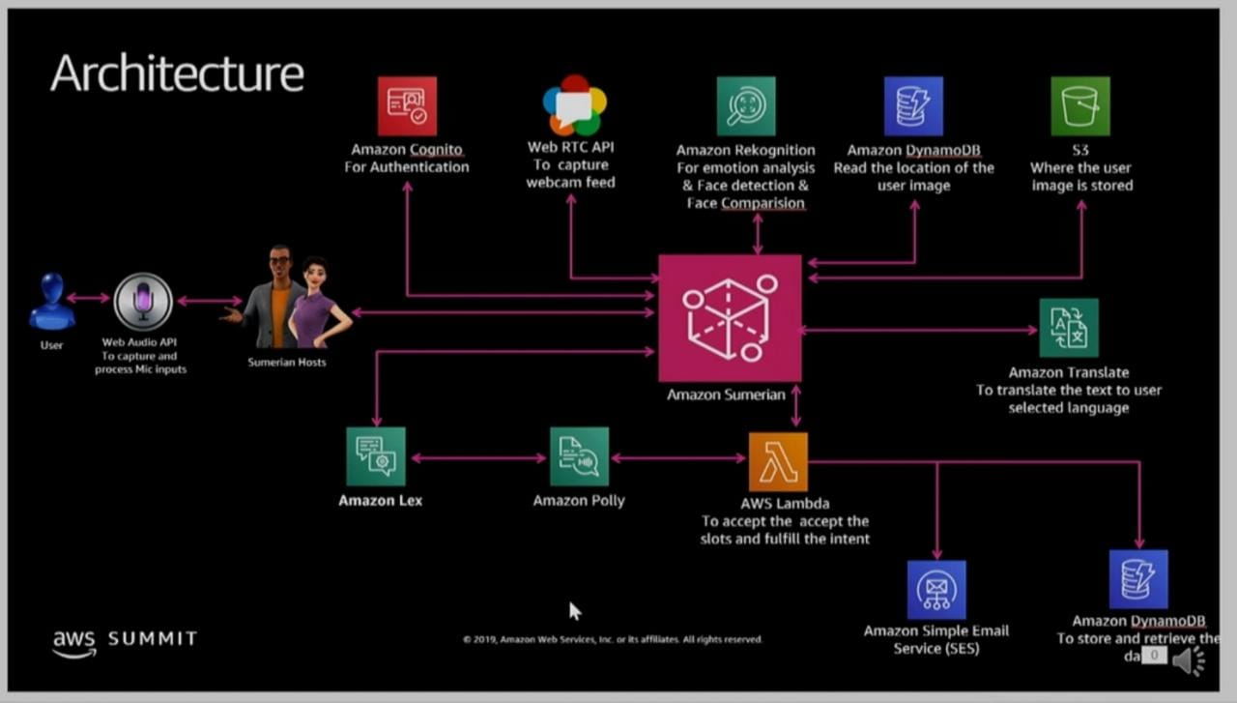
GitHub Repository Link & supporting diagrams, screenshots, if any
How far it can go?

Slide 10
Thank You
Team member names
Mohamed Adil (Team Leader)
Manimaran
Kevin Harris
Jeyanth
Young Minds Doesn’t Disappoint…

