Slide 1
Black Obesity Rates in America Explained: Exploring Black obesity in America as a product of social and economic dynamics, through graphic visualizations
Mohamad Zakaria

Slide 2
Project Description:
While we see the statistics, we don't split them by state. When we split them by state, we don't split them by race. When we split them by race, we don't split them by a social factor. When we split them by a social factor, we don't split them by an economic factor. I think you get the point.. there is always a story behind the numbers one sees at the surface. One set of statistics is always influenced by another set of statistics.
In this project, I aim to visually display the proportionality in being black and being obese in states around the country. I aim to do this by comparing black state obesity rates to white state obesity rates, white state obesity rates to average state obesity rates. Then, I will split Black state obesity rates and White state obesity rates by factors such that disproportionately harm Black people such as population, income inequality and incarceration rates.

Slide 3
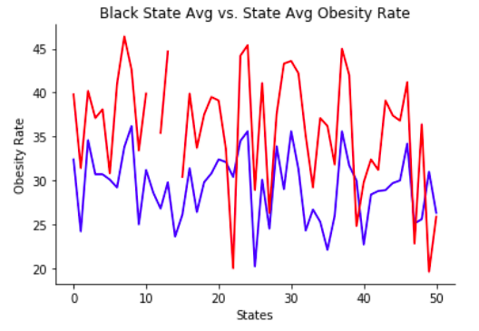
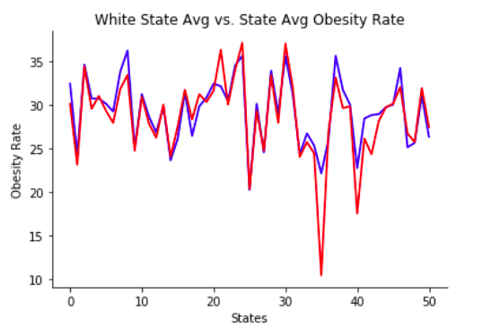
GRAPH: BLACK OBESITY RATE BY STATE VS AVG OBESITY RATE BY STATE
GRAPH: WHITE OBESITY RATE BY STATE VS AVG OBESITY RATE BY STATE

Slide 4
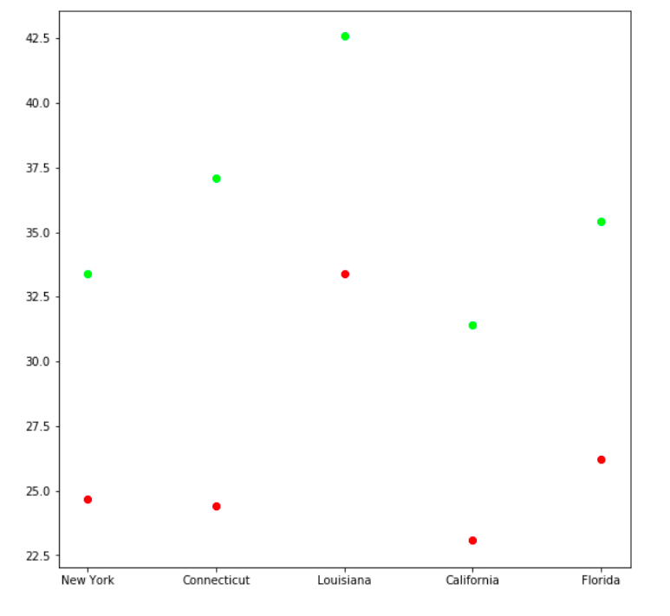
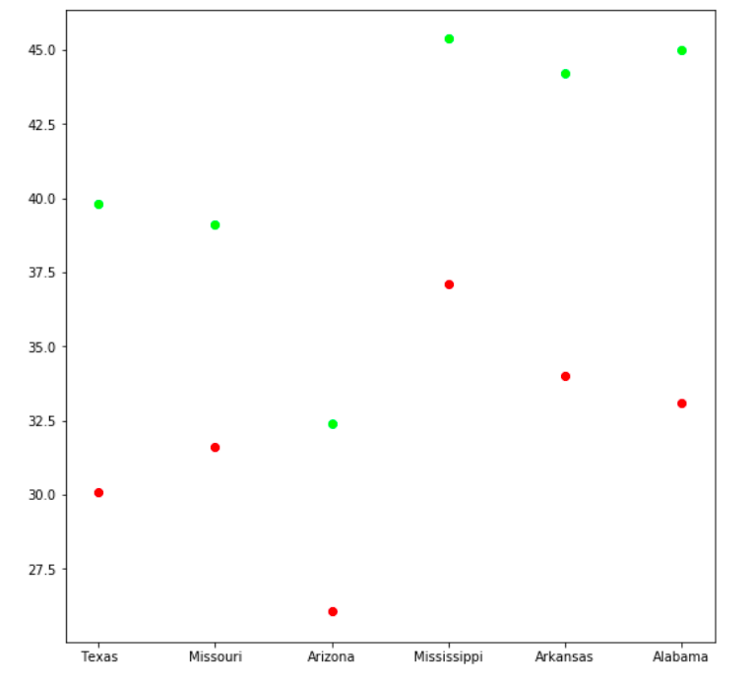
GRAPH: WHITE OBESITY RATE BY STATE VS BLACK OBESITY RATE BY STATE, BY INCOME GAP
GRAPH : WHITE OBESITY RATE BY STATE VS BLACK OBESITY RATE BY STATE, BY INCARCERATION RATE

Slide 5
Conclusion
The conclusion is, when you split state obesity data by race, Black obesity rates are higher than White obesity rates. Additionally, when you split state obesity data by social factors such as incarceration rates and income inequality rates, Black obesity rates are higher than White obesity rates.
The ultimate point is, the obesity epidemic that disproportionately affects Black people in America is no mere coincedince, and can be explained by socioeconomic that are marring Black communities across the countries. Thus, to tackle obesity, one must not start with a simple nutritional education, but to tackle other fundamental areas where Blacks are struggling, for a decrease in obesity will follow.

