Slide 1
Machine Learning for
predicting the Fatigue strength of steels
ME 793- 2022
Stage III Presentation
Team ID: 09
Latika Jitendrakumar Patel
Moitreyee Sarkar
Polamreddy Mithun Balram

Slide 2
CONTENT
BACKGROUND 1-2
OBJECTIVE 3-5
METHODOLOGY 6
WORK DONE 7-26
CONCLUSION 27

Slide 3
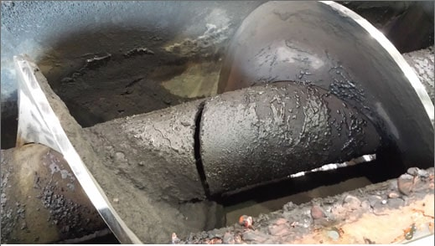
Background
1
Where did we find it?
We wanted to apply Data-driven and Machine Learning techniques to predict material property. One with great significance and challenge in materials science was accurate prediction of fatigue strength of steels. We found only a few papers in this domain which predicted fatigue strength of steel.

Slide 4
Background
2
Why it’s important?
Fatigue strength is the most important and basic data required for design and failure analysis of a material. It is reported that fatigue accounts for over 90% of all mechanical failures of structural components.
Here, we have selected Steel as the subject as it is a crucial metal from construction and transportation point of view.
Accurate prediction of fatigue strength of steels is of particular significance in materials science because of the extremely high cost and time of fatigue testing and often debilitating consequences of fatigue failures.
Notes:
fatigue damage develops under the magnitude of the stresses below the material’s yield strength, and therefore tends to covertly manifest without deforming or showing obvious “warning signs”. The rate at which a fatigue crack grows is dependent on the material’s properties as well as the intensity and cycle frequency of the applied load.

Slide 5
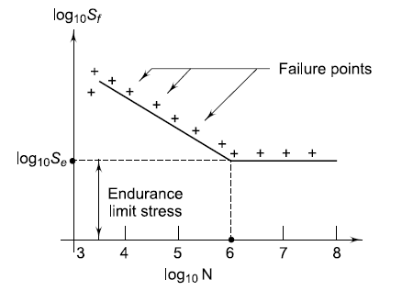
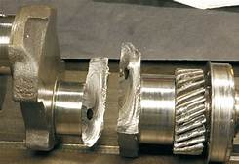
OBJECTIVES
3
1) Predicting the fatigue endurance limit from auxiliary data
2) Estimating the S-N graph from the endurance limit

Slide 6
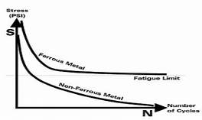
Predicting the Fatigue Endurance limit from auxiliary data
4
The data includes chemical composition of steel, processing, heat treatment conditions & some mechanical properties like hardness, charpy impact value etc.
We will train a regression to predict the endurance limit i.e. the threshold stress below which the material will have infinite life.

Slide 7
Estimating the S-N curve from the Endurance limit
5
The S-N curve of steel can be modelled using 2 straight lines
We directly get the second line from the endurance limit.
For the first line, we can get its y-intercept i.e. yield strength by performing a uniaxial tensile test & intersect it with the endurance limit at 10⁶ cycles.
This is much easier than performing the much more complex fatigue tests for different values of N

Slide 8
METHODOLOGY
6
NIMS data
Understanding the data
Feature ranking & selection
Training regression models & evaluation
Model
Preprocessing
Feature selection
Predictive modelling
Evaluation
Train data
Preprocessed data
Final data
Test data

Slide 9
WORK DONE
Load and Check Data
7
The data used in this work has
437 instances/rows
25 features/columns (composition and processing parameters)
1 target property (fatigue strength)
The 437 data instances include 371 carbon and low alloy steels, 48 carburizing steels, and 18 spring steels. This data pertains to various heats of each grade of steel and different processing conditions
3 grade Steels

Slide 10
Load and Check Data
8
Fatigue Dataset for Steel from National Institute of Material Science (NIMS)
Chemical composition - %C, %Si, %Mn, %P, %S, %Ni, %Cr, %Cu, %Mo (all in wt. %)
Upstream processing details - ingot size, reduction ratio, non-metallic inclusions
Heat treatment conditions - temperature, time and other process conditions for normalizing, through-hardening, carburizing-quenching and tempering processes
Mechanical properties - YS, UTS, %EL, %RA, hardness, Charpy impact value (J/cm2), fatigue strength
Corresponding endurance limit stress

Slide 11
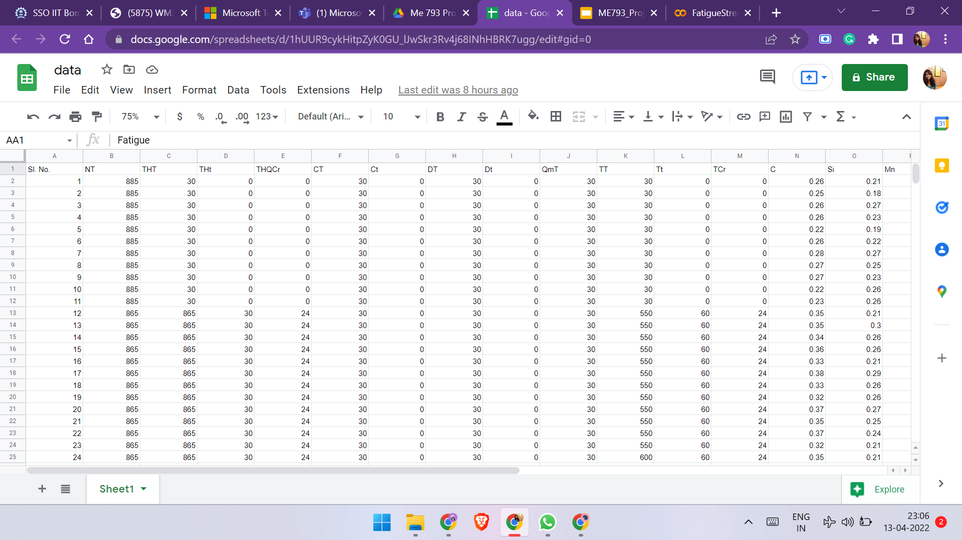
Load and Check Data
9

Slide 12
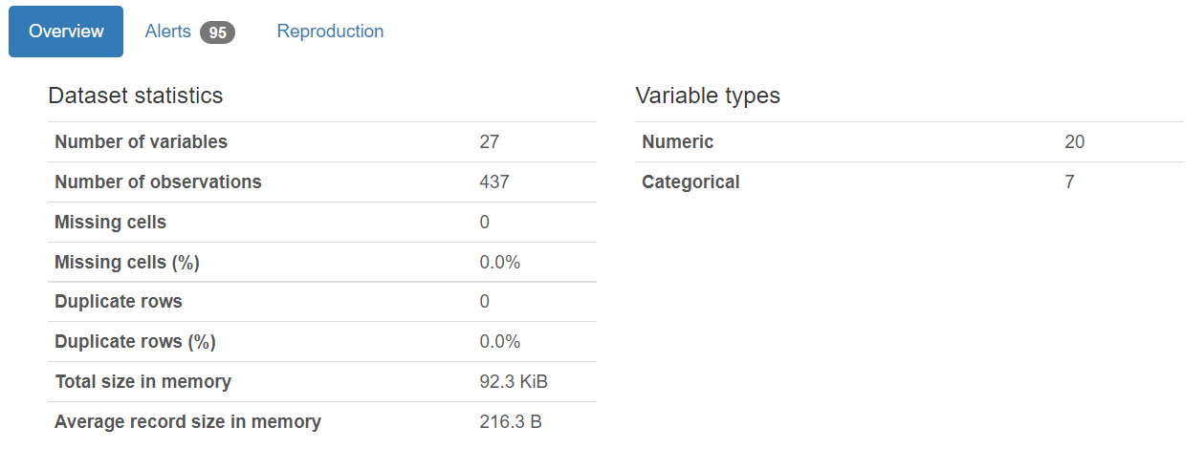
WORK DONE
2. Visualization
10
Profile Report of Dataset

Slide 13
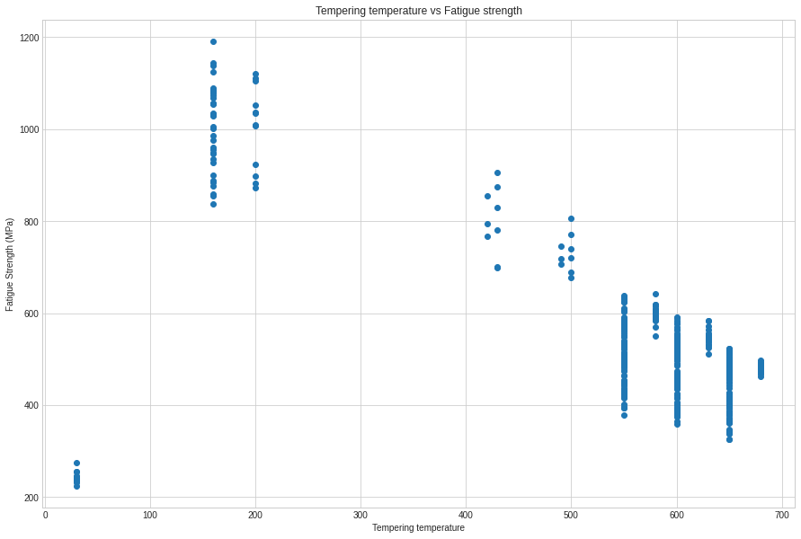
2. Visualization
11
Tempering temperature vs Fatigue strength

Slide 14
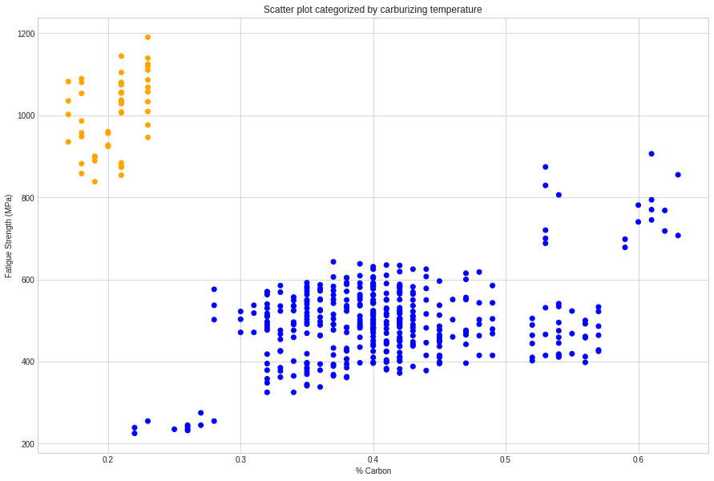
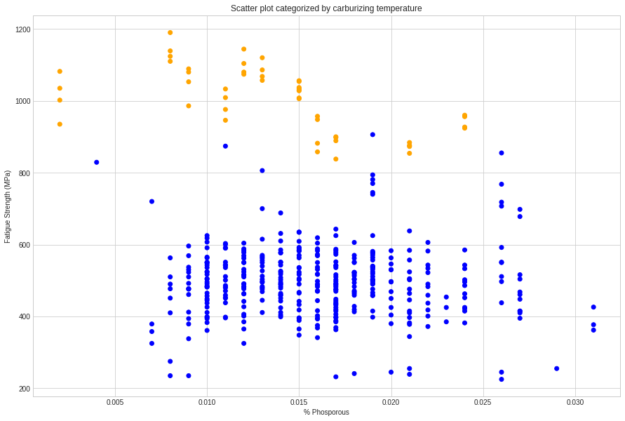
2. Visualization
12
% Carbon
% Phosphorus
Scatter plot categorized by carburizing temperature

Slide 15
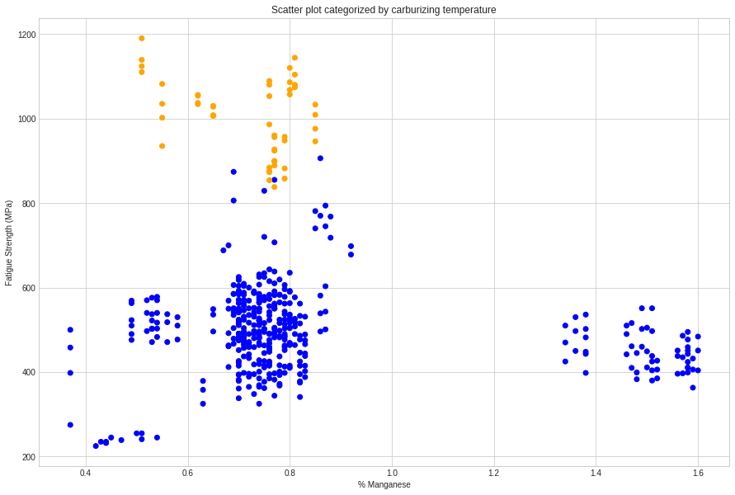
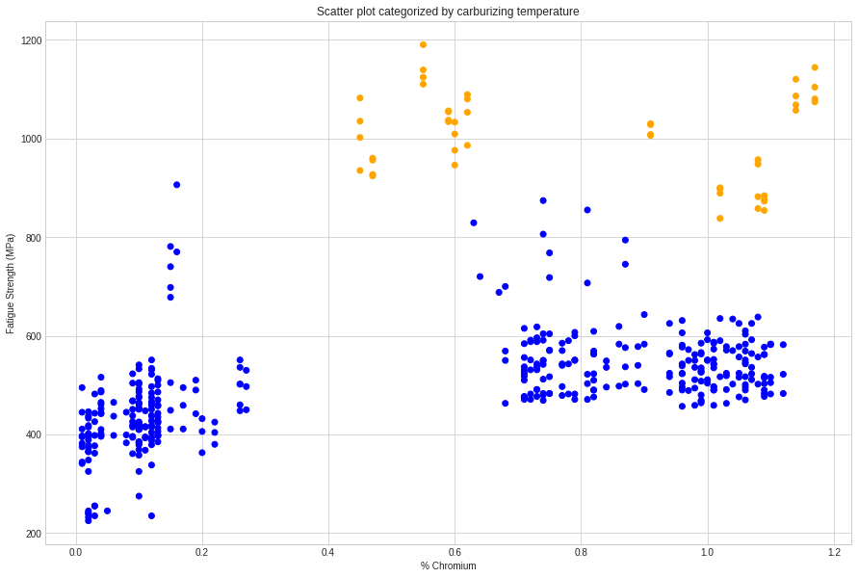
2. Visualization
13
% Manganese
% Chromium
Scatter plot categorized by carburizing temperature

Slide 16
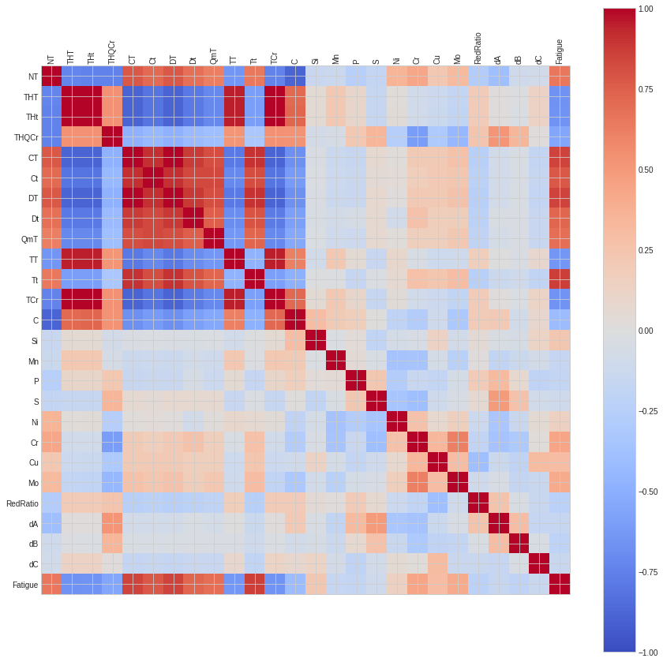
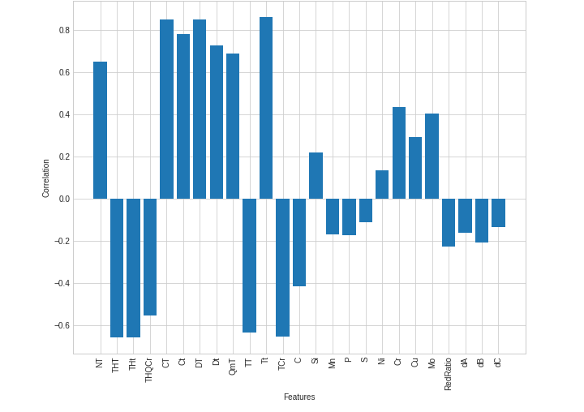
2. Visualization
14
Correlation Matrix
Correlation of Features with Fatigue Strength
Notes:
Here we have plot the correlation matrix to observe the correlation between different features of the dataset. Especially we want to observe the correlation of the features with the target variable - Fatigue Strength. As can be seen from the second graph, many of the features have high correlation with our target variable. It is useful to note that features processing parameters like Tempering temperature and time, Carburizing and diffusion temperature and time etc have high correlations with the fatigue strength as expected since the dataset contains multiple grades of steel with different processing parameters. For example, tempering temperature for through hardened tempered without carburization is around 400 degrees while with carburization is around 200 degree , which lead to large dif in fatigue. Thus tempering has a significant effect reflected by tempering time.

Slide 17
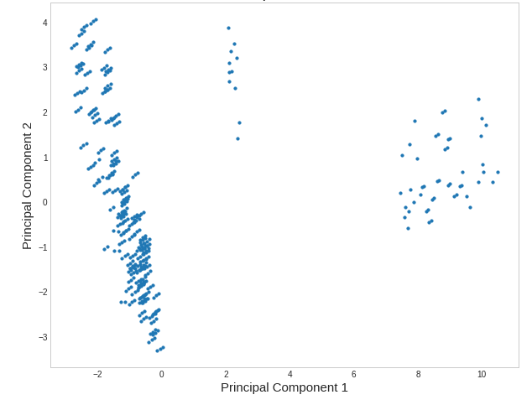
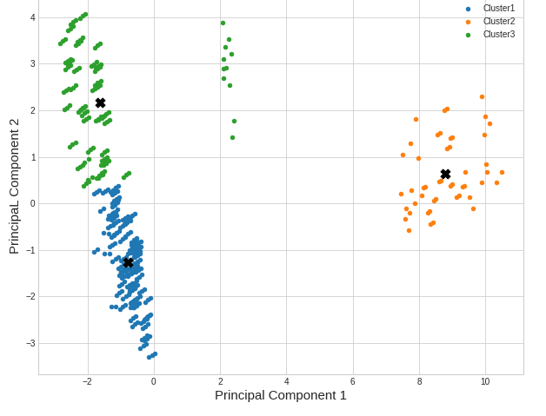
2. Visualization
15
PCA
n =2
K-means clustering
k=3
Notes:
The dataset was analysed for visible clustering using the K-means technique. As expected from the dataset, we can observe inherent clustering in the dataset. The distinct clustering is representative of the three grades of steel in our dataset - carbon and low alloy steels, carburizing steels, and spring steels. There are not sufficient data points in each of these clusters and hence we have built the models for the entire dataset and not separate clusters.

Slide 18
WORK DONE
3. Feature Selection
16
There are two ways for dimensionality reduction-
Feature Extraction
Transforms the existing features into new ones based on combinations of the raw features.
These higher level features are difficult to understand as can’t be directly linked to original
Feature Selection
We can compute information gain for each feature individually with respect to the fatigue strength & rank the available features.
We can discard some features with very less information gain to avoid overfitting the data.
Finding the best features helps extract valuable information and discover new knowledge.
Notes:
We implemented Information gain based feature selection for our project as follows

Slide 19
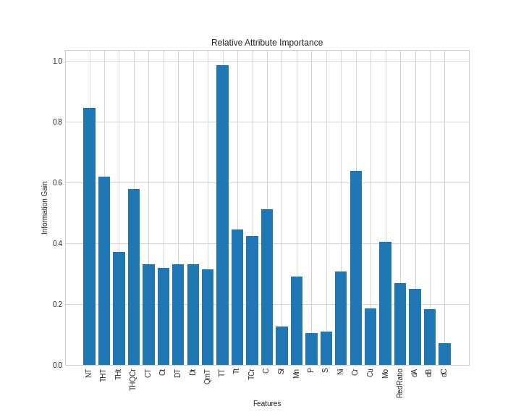
3. Feature Selection
17
Features with high predictive potential
TT - Tempering temperature
NT - Normalization temperature
THT - through Hardening temperature
Features with relatively lower predictive potential
dC- Area proportion of Isolated Inclusions
P - % Phosphorus
S - % Sulphur
Si - % Silicon
21 Best Features selected for modelling
Notes:
We implemented Information gain based feature selection for our project as follows. Mutual information is calculated between two variables and measures the reduction in uncertainty for one variable given a known value of the other variable.
The scikit-learn machine learning library provides an implementation of mutual information for feature selection with numeric input and output variables via the mutual_info_regression() function

Slide 20
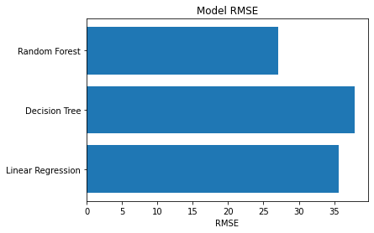
WORK DONE
4. Modelling
18
We have currently trained 3 ML models namely:
Multilinear regression
Decision Trees
Random Forests
We have evaluated the models using Leave one out cross-validation (LOOCV) since, the dataset is pretty small. The RMSE scores of the models indicate that random forest is the best model.

Slide 21
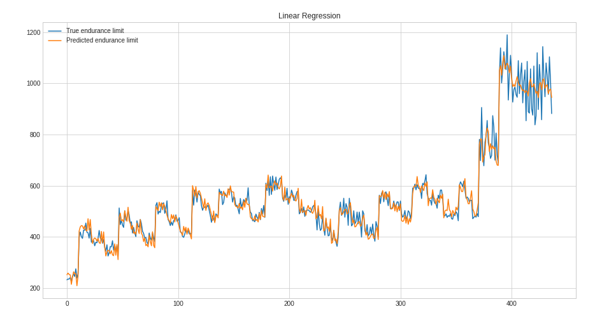
4. Modelling
19
Now let’s look at the model prediction & true values & analyze any overfitting or underfitting the models we have trained
Baseline Linear regression model

Slide 22
4. Modelling
20
Endurance Limit Stress
We can clearly see that the linear regression model somewhat captures a simple model & ignores some fluctuations and just make them smooth. This is evident in the right part where the predicted values are more or less the mean.
Data instance
Linear Regression

Slide 23
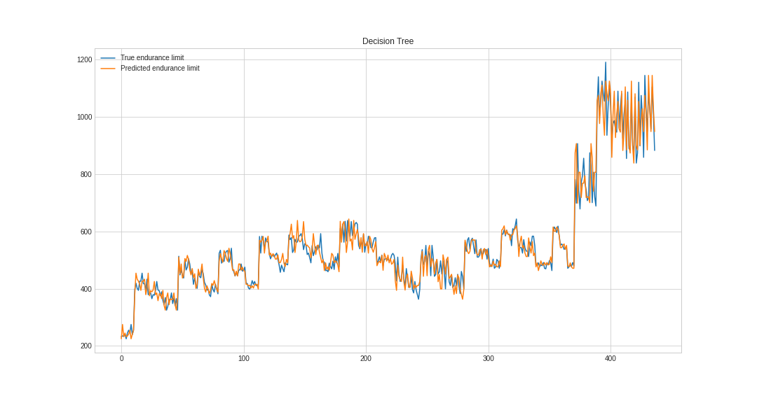
4. Modelling
21
The decision tree model fluctuates more than the true values indicating high variance which is observed when overfitting to the training data. This is clearly visible on the right part where the fluctuations are much more than the true values
Decision Tree

Slide 24
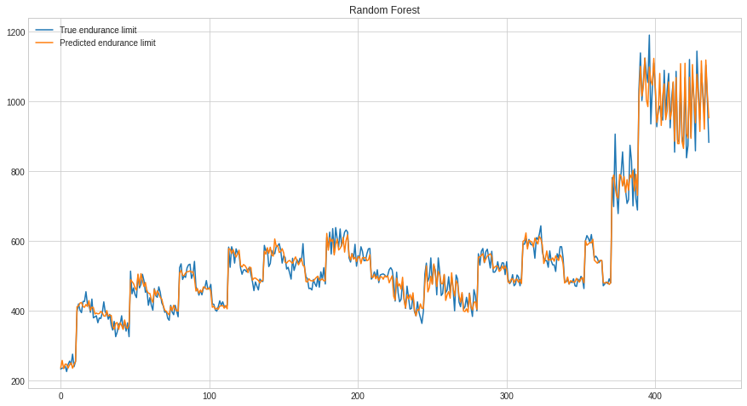
4. Modelling
22
The random forest model is more complex than linear regression & more simpler than decision tree hence, it has a lower RMSE compared to other models.
Random Forest

Slide 25
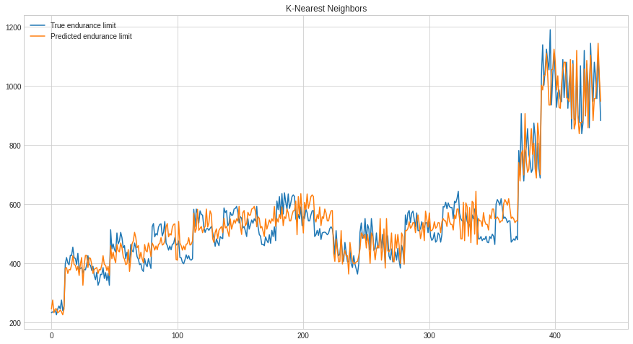
4. Modelling
23
KNN is underfitting for low carbon steels and underfitting for high carbon steels. Hence, it has a high RMSE and a low R2 score.
KNN

Slide 26
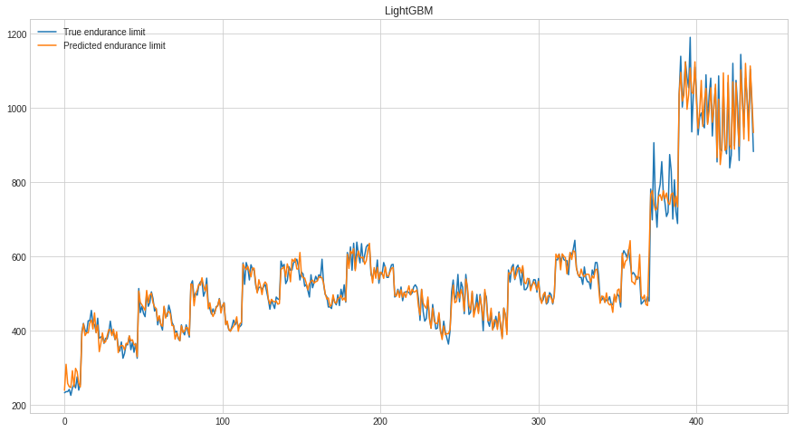
4. Modelling
24
LightGBM is the best model in terms of RMSE, it fits almost perfectly to data and also generalises well on unseen data.
LightGBM

Slide 27
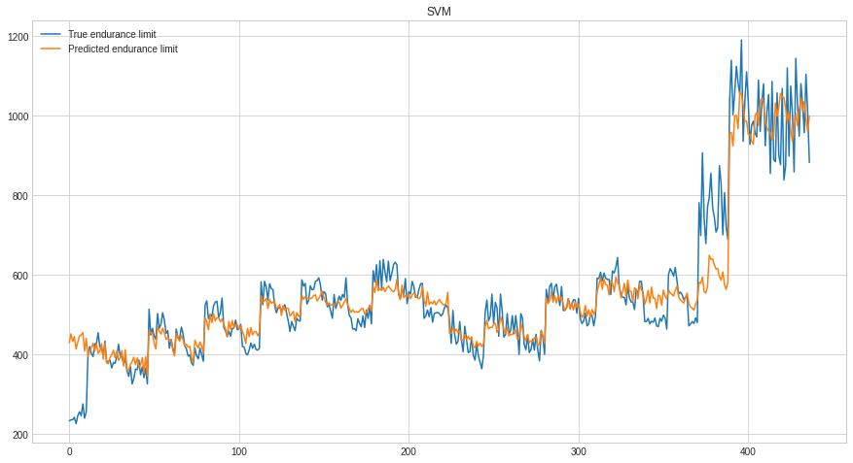
4. Modelling
25
SVM had the highest value of RMSE among all the other models due to underfitting. So adding more data points would help increase the accuracy of SVM and also, the variables are highly correlated.
SVM

Slide 28
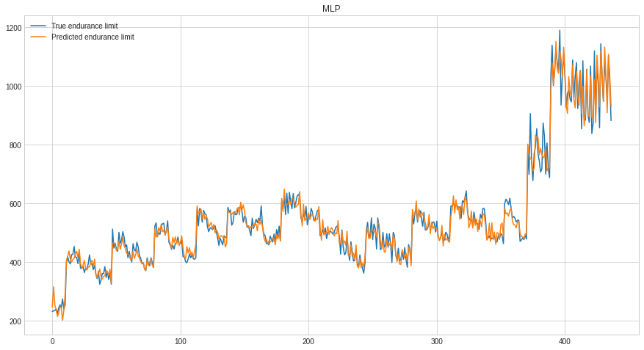
4. Modelling
26
While the model is able to capture most of the values shown by the low RMSE, it still shows some amount of fluctuation in the right side. However, with some hyperparameter tuning, the RMSE can be improved as Neural networks can capture complex non-linear relationships.
Neural Network - MLP (35,35)

Slide 29
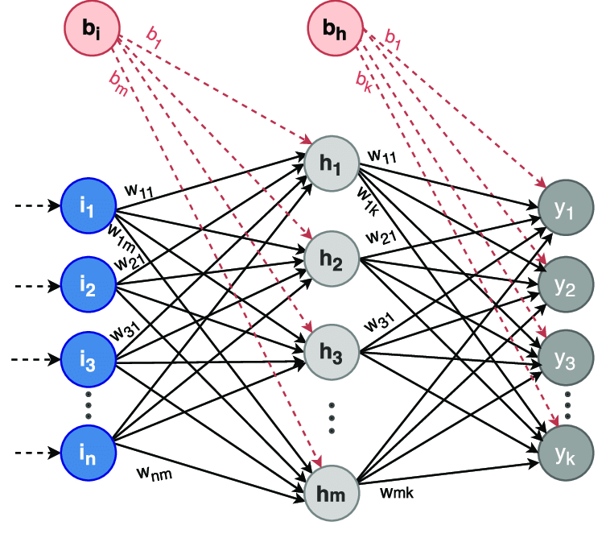
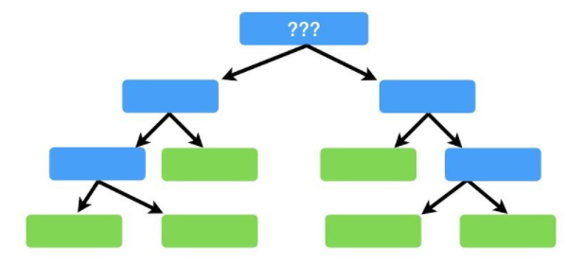
CONCLUSION
27
Model | RMSE Value
Linear Regression | 35.69
Decision Tree Regression | 37.89
Random Forest Regression | 27.14
K Nearest Neighbors | 52.29
LightGBM | 25.93
SVM | 64.31
MLP | 29.04

Slide 30
References
Lei He, ZhiLei Wang, Hiroyuki Akebono, Atsushi Sugeta, Machine learning-based predictions of fatigue life and fatigue limit for steels, Journal of Materials Science & Technology, Volume 90, 2021, Pages 9-19, ISSN 1005-0302, https://doi.org/10.1016/j.jmst.2021.02.021
Agrawal, A., Deshpande, P.D., Cecen, A. et al. Exploration of data science techniques to predict fatigue strength of steel from composition and processing parameters. Integr Mater Manuf Innov 3, 90–108 (2014). https://doi.org/10.1186/2193-9772-3-8
Shibanuma, K., Ueda, K., Ito, H., Nemoto, Y., Kinefuchi, M., Suzuki, K., & Enoki, M. (2018). Model for predicting fatigue life and limit of steels based on micromechanics of small crack growth. Materials & Design, 139, 269-282. https://www.sciencedirect.com/science/article/pii/S0264127517310122
Furuya, Y., Nishikawa, H., Hirukawa, H., Nagashima, N., & Takeuchi, E. (2019). Catalogue of NIMS fatigue data sheets. Science and Technology of Advanced Materials, 20(1), 1055-1072.https://www.tandfonline.com/doi/full/10.1080/14686996.2019.1680574

Slide 31
Thank You

