Slide 2

Hands on Maven

Slide 3
What is Maven and Why?
Maven philosophy :
visibility, reusability, maintainability, and comprehensibility
Maven is Just NOT a build tool:
Can built, test, package, document and deploy your project.
e.g. use maven-surefire-report-plugin in pom.xml for report generation
Maven provides general approach common across different projects.
E.g. compile->test->package->Install

Slide 4
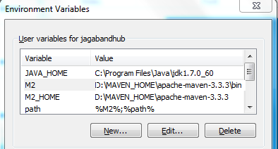
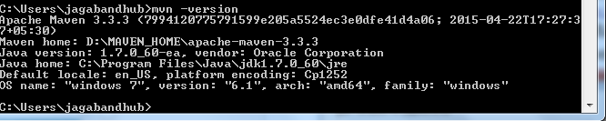
Maven Installation and configuration?
Download the maven zip archive from:
http://mirror.fibergrid.in/apache/maven/maven-3/3.3.9/binaries/apache-maven-3.3.9-bin.zip
Unzip in a local directory: e.g. D:\MAVEN_HOME\
Set the environment variable as below:
4. Go to console : mvn -version

Slide 5
Maven build lifecycle : Default, Clean and Site
Default
validate | validate the project is correct and all necessary information is available.
initialize | initialize build state, e.g. set properties or create directories.
generate-sources | generate any source code for inclusion in compilation.
process-sources | process the source code, for example to filter any values.
generate-resources | generate resources for inclusion in the package.
process-resources | copy and process the resources into the destination directory, ready for packaging.
compile | compile the source code of the project.
process-classes | post-process the generated files from compilation, for example to do bytecode enhancement on Java classes.
generate-test-sources | generate any test source code for inclusion in compilation.

Slide 6
1.Default Life cycle….
process-test-sources | process the test source code, for example to filter any values.
generate-test-resources | create resources for testing.
process-test-resources | copy and process the resources into the test destination directory.
test-compile | compile the test source code into the test destination directory
process-test-classes | post-process the generated files from test compilation, for example to do bytecode enhancement on Java classes. For Maven 2.0.5 and above.
test | run tests using a suitable unit testing framework. These tests should not require the code be packaged or deployed.
prepare-package | perform any operations necessary to prepare a package before the actual packaging. This often results in an unpacked, processed version of the package. (Maven 2.1 and above)
package | take the compiled code and package it in its distributable format, such as a JAR.
pre-integration-test | perform actions required before integration tests are executed. This may involve things such as setting up the required environment.
integration-test | process and deploy the package if necessary into an environment where integration tests can be run.
post-integration-test | perform actions required after integration tests have been executed. This may including cleaning up the environment.
verify | run any checks to verify the package is valid and meets quality criteria.
install | install the package into the local repository, for use as a dependency in other projects locally.
deploy | done in an integration or release environment, copies the final package to the remote repository for sharing with other developers and projects

Slide 7
2. Clean Life Cycle
pre-clean | execute processes needed prior to the actual project cleaning
clean | remove all files generated by the previous build
post-clean | execute processes needed to finalize the project cleaning
3. Site Life Cycle
pre-site | execute processes needed prior to the actual project site generation
site | generate the project's site documentation
post-site | execute processes needed to finalize the site generation, and to prepare for site deployment
site-deploy | deploy the generated site documentation to the specified web server

Slide 8
Build lifecycle phase execution process
mvn install vs mvn clean install
mvn install will execute all the phases prior to install phase before install phase of default life cycle
Mvn clean install : will execute first clean phase of clean life cycle PLUS will execute all the phases prior to install phase before install phase of default life cycle

Slide 9
Hooke a specific task to your pre-defined phase through goal
E.g.:
<!-- Copy c4k_bsw_release_notes.txt to root directory -->
<execution>
<id>copy-c4k-bsw-release-notes-x86_64</id>
<phase>prepare-package</phase>
<goals>
<goal>copy-resources</goal>
</goals>
<configuration>
<outputDirectory>${project.build.directory}/products/compose4ksar.bsw/win32/win32/x86_64</outputDirectory>
<resources>
<resource>
<directory>.</directory>
<includes>
<include>${c4k_bsw_release_notes.name}</include>
</includes>
</resource>
</resources>
</configuration>
</execution>

Slide 10
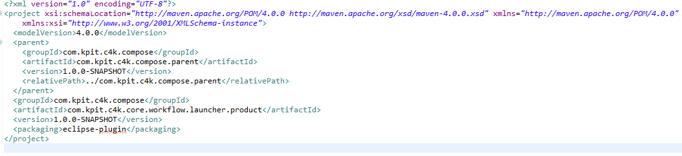
POM file basics
Minimal pom.xml: must have 4 things(1 element and it’s 3 fields)
<project>..</project> element
<groupId>..</groupId> field
<artifactId>..</artifactId> field
<version>..</version> field

Slide 11
POM file basics
Inheritance and Aggregation
Inheritance:
<parent>
<groupId>com.kpit.c4k.compose</groupId>
<artifactId>com.kpit.c4k.compose.parent</artifactId>
<version>1.0.0-SNAPSHOT</version>
<relativePath>../com.kpit.c4k.compose.parent</relativePath>
</parent>
Aggregation:
<project>
<modelVersion>4.0.0</modelVersion>
<groupId>xxx.yyy.zzz</groupId>
<artifactId>abc-def</artifactId>
<version>1.0.0</version>
<packaging>pom</packaging>
<modules>
<module>../my-plugin-1</module>
<module>../my-plugin-1</module>
</modules>
</project>

Slide 12
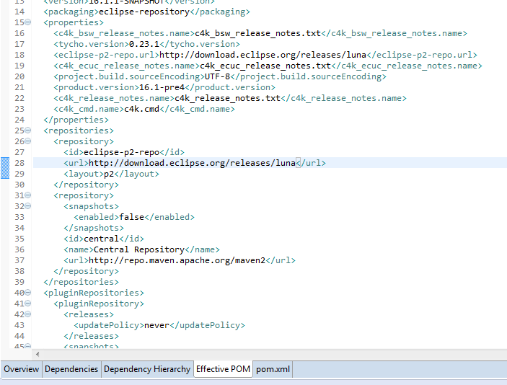
POM file basics
Super pom.xml: mvn help:effective-pom (console command)

Slide 13
POM file basics
groupId, artifactId and Properties
<properties>
<tycho.version>0.23.1</tycho.version>
</properties>
<plugin>
<groupId>org.eclipse.tycho</groupId>
<artifactId>tycho-maven-plugin</artifactId>
<version>${tycho.version}</version>
<extensions>true</extensions>
</plugin>
groupId - the id of the project's group.
artifactId - the id of the artifact (project name)
<groupId>com.kpit.c4k.compose</groupId>
<artifactId>com.kpit.c4k.compose.parent</artifactId>

Slide 14
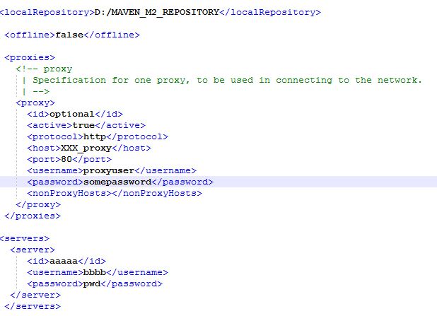
settings.xml file
Global settings($M2_HOME/conf/settings.xml)
User settings(${user.home}/.m2/settings.xml)

Slide 15
Maven Repositories and Dependency search process
Local
Central
Remote
End
yes
Found in local
Found in Central
Start
Yes
no
no
Check If Remote repository provided
Found in Remote
yes
yes
Stop processing and throws error (Unable to find dependency
no
no

Slide 16
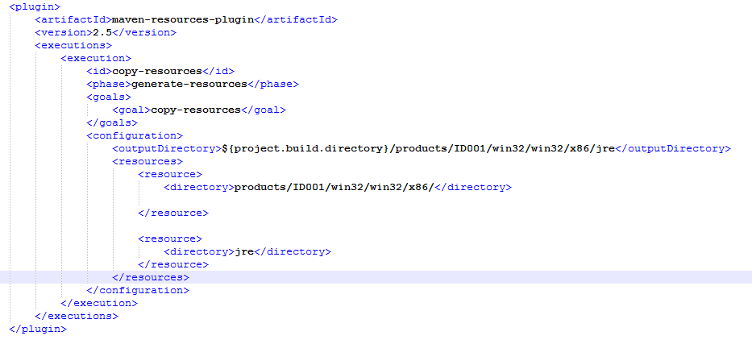
Maven plugins
Maven plugin : Every task is done by a plugin in maven. e.g to copy jre folder
*** Maven will download the plugin if not found in the local repository

Slide 17
Maven Archetype
Maven archetype is a mechanism to generate project structure from predefined templates on the fly.
Caution : This is just to provide a template but not fully fledged working maven project. User has to update manually later on.
e.g. command : mvn archetype:generate
*** Maven will download the plugin if not found in the local repository

Slide 18
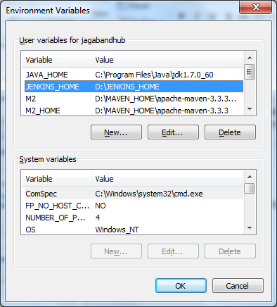
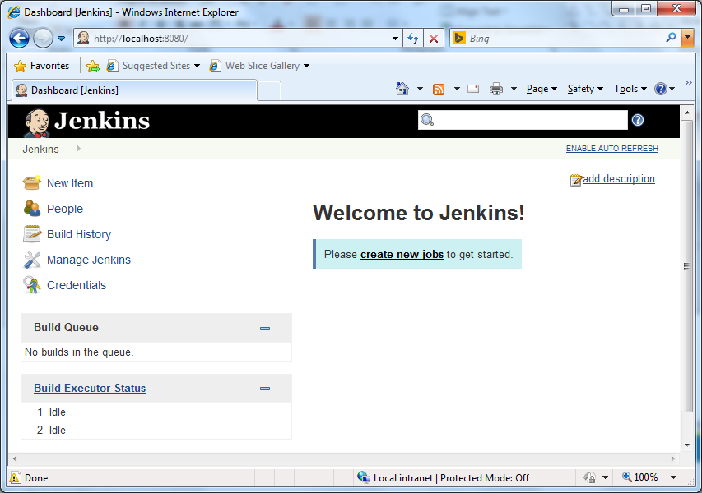
Jenkins for Continuous Build Integration
Installation :
Download Jenkins.war from https://jenkins-ci.org/
Create an environment variable :
Go to jenkins.war through console and
apply : Java –jar Jenkins.war
Jenkins will be running on localhost:8080
Once up and running open the below link in browser
http://localhost:8080
*** Maven will download the plugin if not found in the local repository

Slide 19
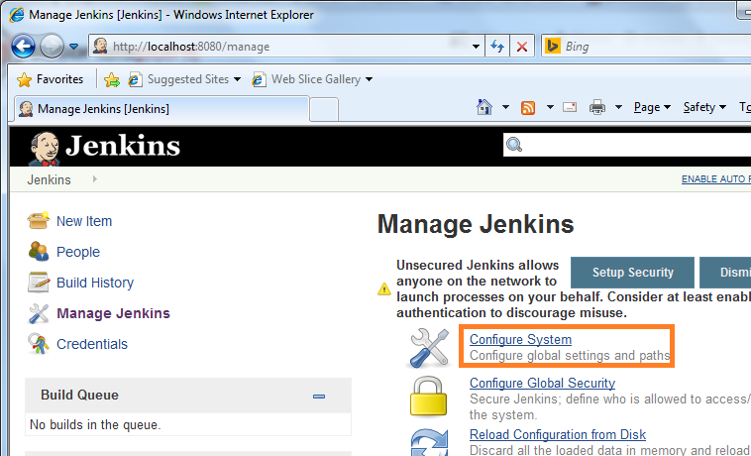
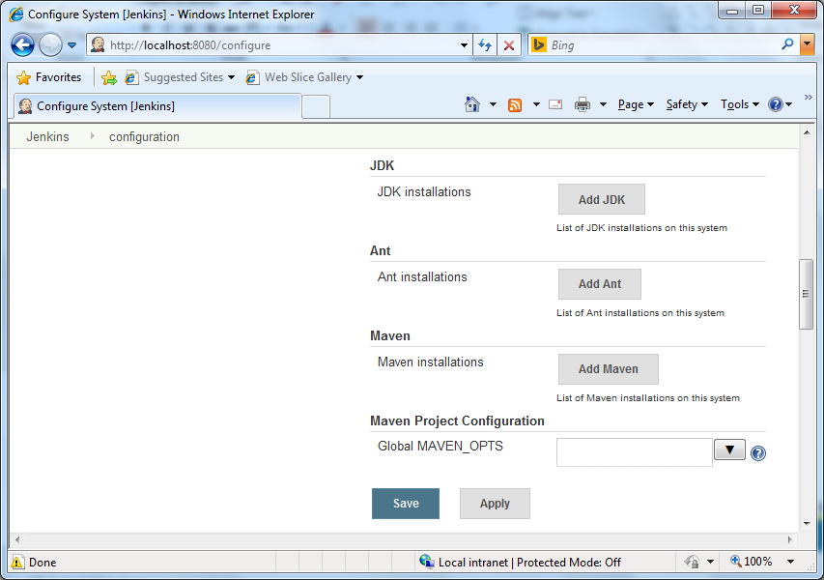
Jenkins for Continuous Build Integration…
Configure java ,maven and other settings :
Click “Manage Jenkins” :
*** Maven will download the plugin if not found in the local repository

Slide 20
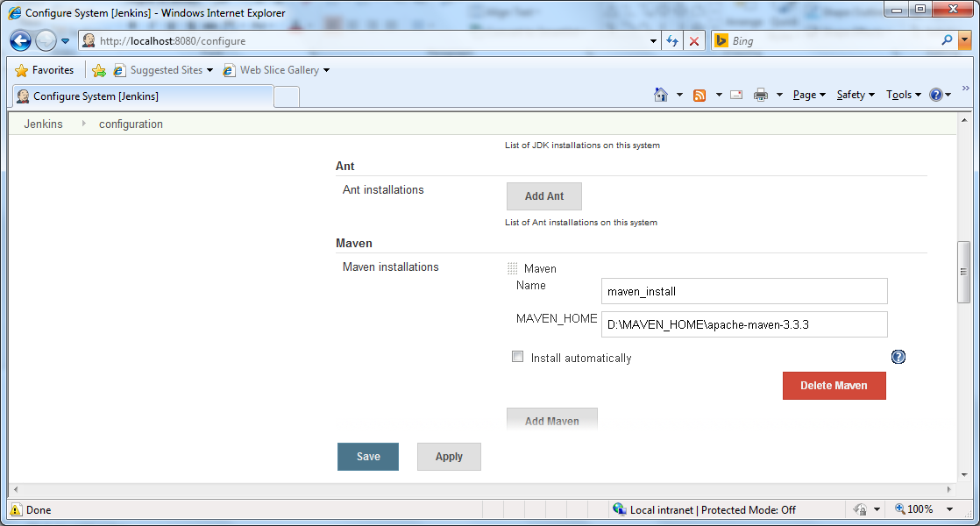
Jenkins for Continuous Build Integration…
Configure Maven
Click “Add Maven” and fill the details as below and save:
*** Maven will download the plugin if not found in the local repository

Slide 21
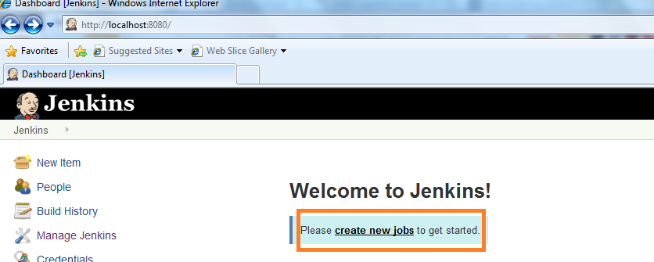
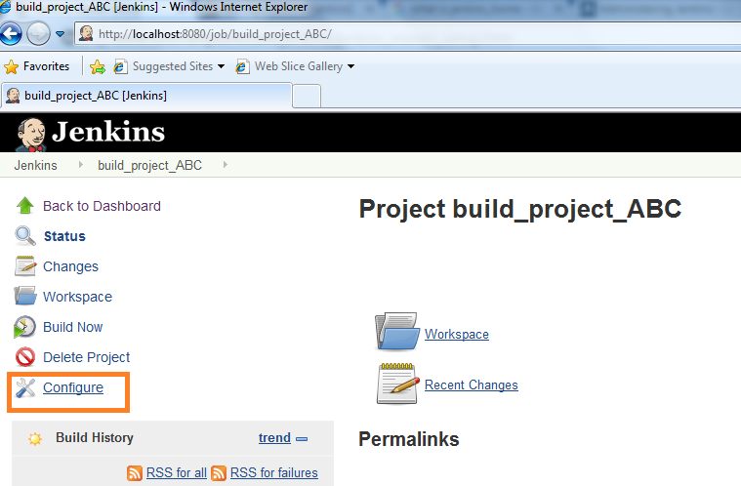
Creating Job and Scheduling
*** Maven will download the plugin if not found in the local repository

Slide 22
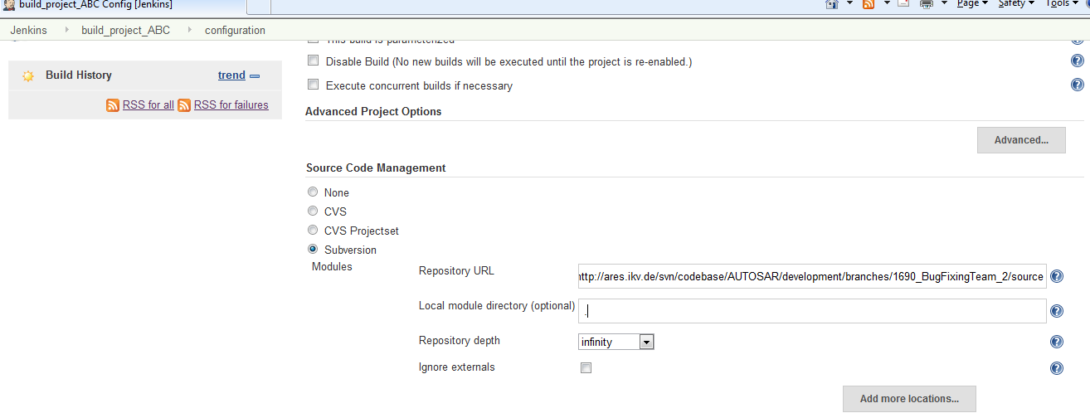
SCM Integration
*** Maven will download the plugin if not found in the local repository

Slide 23
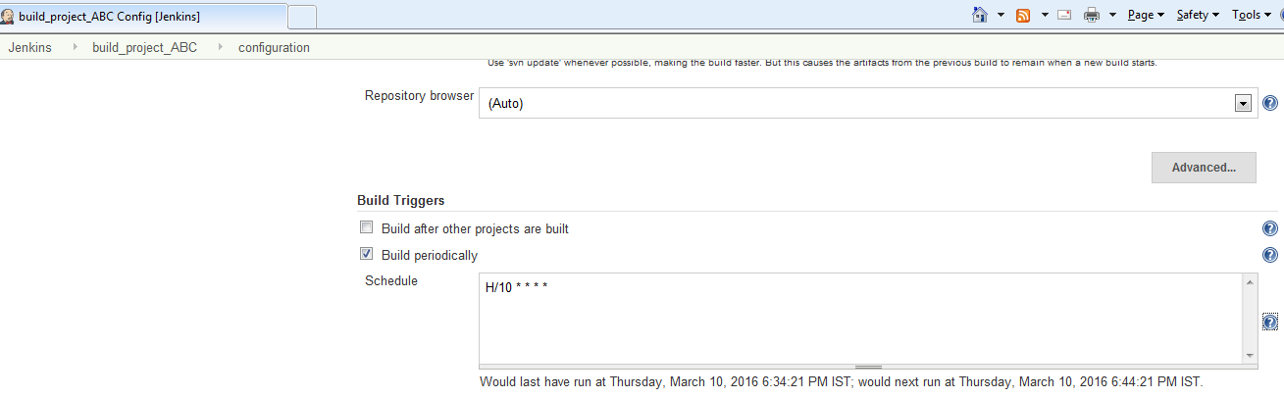
Schedule the build periodically
Above example will build the project every 10 minutes periodically.
Pattern MINUTE HOUR DOM MONTH DOW

Slide 24
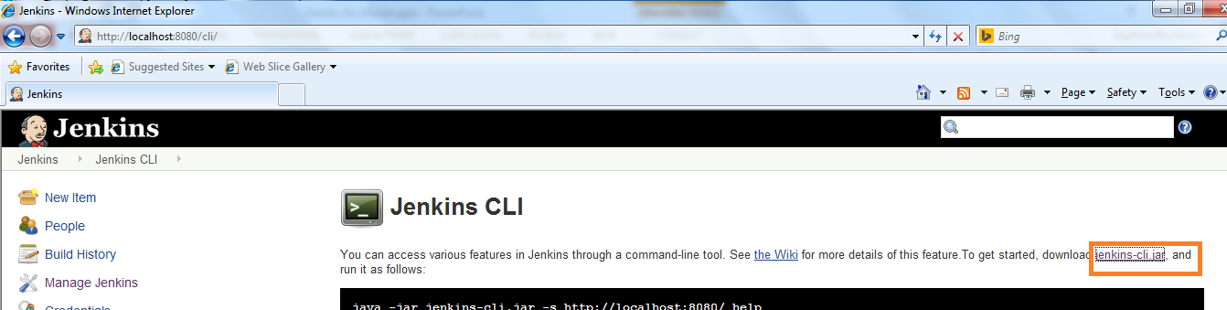
Jenkins CLI(Command Line Interface)
Download the jenkins-cli.jar
Open the running Jenkins cli in following format http://localhost:8080/cli/
Trigger the build from console:
java -jar jenkins-cli.jar -s http://localhost:8080/ build 'project_ABC'

Slide 25
Questions?

