Slide 2
KSAR Hands-on session

Slide 3
K-SAR Editor Tool Workflow
Legacy
Legend
AUTOSAR ARXML
DBC
FIBEX
LDF
ODX
Editor
Input/Output Files
Product Plugin
Extern
Tool Process
K-SAR Editor based on Artop
Import
System
ECU Extract
Application Modeling
Application Editor
Application SWC
ECU
Parameter Editor
ECU harmonization
ECU Config Generation and Validation
ECU Requirement
ECU Platform Editor
ECU Resource
RTE & BSW Generator
Generated AUTOSAR ARXML
AUTOSAR
Standard
AUTOSAR Platform Editor
PDF
BSWMDT
Build Setup
Editor
Static BSW modules
Generated RTE & BSW source
Development Support Generator
Configuration Management
Application Source
Build Output
DLT and M&C

Slide 4
K-SAR Embedded and K-SAR Editor Workflow
ECU Extract
Software/System file
K-Sar Editor Tool
Configuration
.C and .H file
Generation Tool
Generation
Static
Code
Generated Code
Compilation and Linking
Build
Post Build Tool
Testing
Testing

Slide 5
K-SAR Editor– ARTOP Based - layered architecture
K-SAR Editor (KPIT Technologies Ltd.)
ARTOP AUTOSAR (ARTOP User Group)
Integrated AUTOSAR Tool Environment
Reuse from Artop and Java leads to cost benefit
Better Interoperability of tools
Faster Time to Market, by quick prototyping tool development
Platform Independent Tool installation, Windows or Linux support is available
Rich Client Platform
Graphical Modeling Framework (GMF)
EMF Compare
Eclipse Modeling Framework (EMF)
Eclipse Platform (Eclipse Foundation)
Workbench
JFace
SWT
OSGi
Java VM

Slide 6
Benefits of K-Sar Editor tool on ‘Efficiency’
K-Sar Editor tool supports legacy workflow
Conversion from legacy file format to AUTOSAR format
Standard legacy formats support: DBC, LDF, ODX, FIBEX
(note: These conversion may not be 100%, Customer use case details needed)
Custom plugin can be developed to support Legacy Conversion
K-Sar Editor tool supports flexible workflow
No intermediate file format or data base, pure AUTOSAR standard
BSW Module level arxml configuration can be exported
K-Sar Editor tool support efficient work flow
Harmonization/Automation of BSW software
COM stack including MCAL is configured automatically from ECU extract
OS task and Runnable are automatically configures from SWC import.
DCM and DEM is configured automatically from ODX import
Progressive ECU extracts from OEM and Manual configuration retention
Analysis of difference between two ECU extract
Analysis of difference between two ECU description
Efficiency

Slide 7
Overview: The software provides a PC based GUI environment for the user to specify the ECU Configuration and generate the ECU Description. This is the proposed tool that shall facilitate user interfaces to specify the ECU Configuration. Parameter Definition File: This is an XML file which shall contain the ECU Configuration Parameter Definition. This file shall provide the structural information on how the ECU Configuration Description and the kind of restrictions that needs to be respected for the individual configuration elements. This file shall form the basis for the tool to create a platform for the respective ECU configuration. Cont….

Slide 8
ECU Description: This shall be an XML file holding the ECU Configuration. This file shall be generated based on the user configuration specification. The tool shall also provide a provision to import an ECU Configuration. Environment: K-SAR Editor Powered by ARTOP Software runs on Windows. Windows 7 and Windows 8. System Requirements The following are the minimum hardware and software requirements for installation and optimum functioning of K-SAR Editor Powered by ARTOP Software. 32 bit Java Runtime Environment (JRE) Version 6.0 Pentium 4 Processor, Intel core 2 duo, 2.4 GHz, 3 GB minimum RAM Screen Resolution of 1280x768 .

Slide 9
K-SAR Editor Powered by ARTOP Software Features

Slide 10
Creating a New AUTOSAR project Cut, Copy, Paste, Delete, Undo, Redo options Delete of Project, module, container, sub-container, ARPackage, system file Clear Validation Errors Close Project Copy path of Parameter Copy Text of Project name, module name , container name, sub –co ntainer name, ARPackage, System file or any other .arxml file. Create Multiple instances in both ECU and System Editors Create New System Description file Compare ECU Extract Reports Compare with Local History Cont…

Slide 11
Configure common Value for all the instances Configuring a reference E2E Protection Configuration ECU Configuration Report for CAN, LIN and Flexray ECU Description File Compare Comparison of any two .arxml files (CompareWithEachOther) Configuration of the parameters ECU Extract Report Edit Default Value Exit the workspace Expand and Collapse Export of BSWMD file Export of the project into local system Cont…

Slide 12
Generate Summary and Detailed report of Module or ARPackage of ECU Global update of the parameter Harmonization of the all the stacks with respect to their input file(s) Help Contents Hex Conversion, Decimal Conversion Import of BSWMD file Import of Custom PDF Import of DBC Import of FIBEX Import of LDF Import of multiple files Import of ODX Import of Software file Cont..

Slide 13
Import of System file Insert Copy of Container, Sub-Container in ECU configuration and System Configuration editor's Memory Stack Configuration Open existing project into workspace Open with Text Editor Regenerate Handle id(s) Refreshing of Project or workspace RTE ExclusiveAreaMech Automation RTE Mapping Runnable to Task mapping Runtime Validation Save and Save all Search and Replace Cont…..

Slide 14
Flexray Joblist editor Generate Description file (Module wise and Stack wise) Generate ECU Extract Generate report of the System file Generate Source and Header files Version Details Switch Workspace Sharing a project(s) into SVN Can Hardware Object Mapping

Slide 15
Can_HW_Object_Mapping

Slide 16
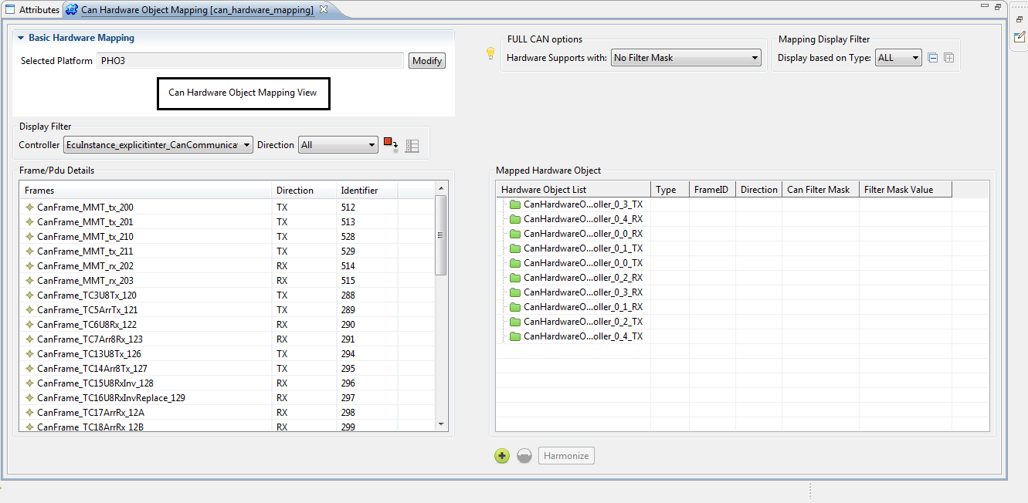

Slide 17
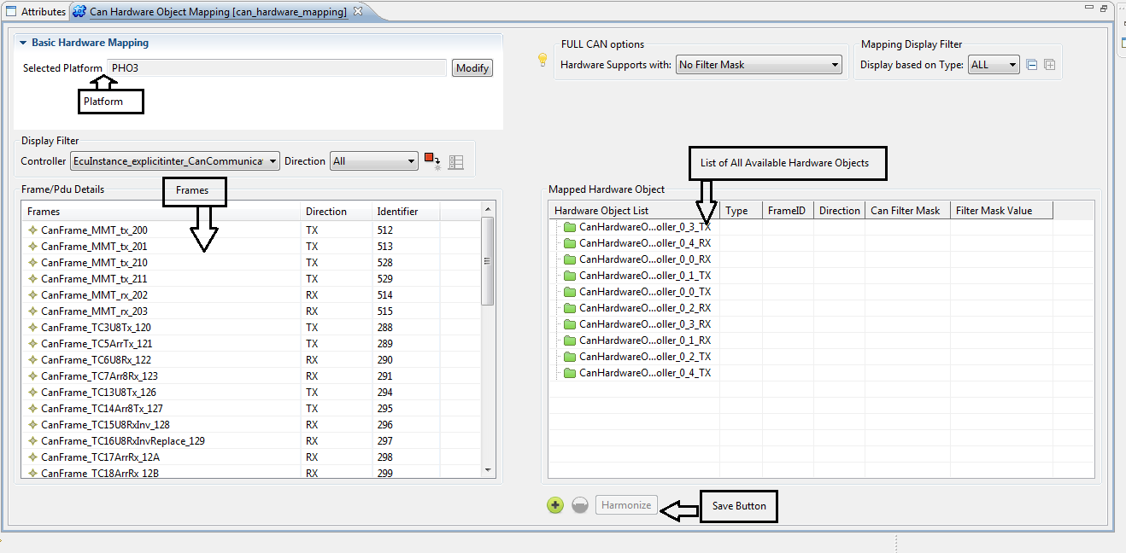

Slide 18
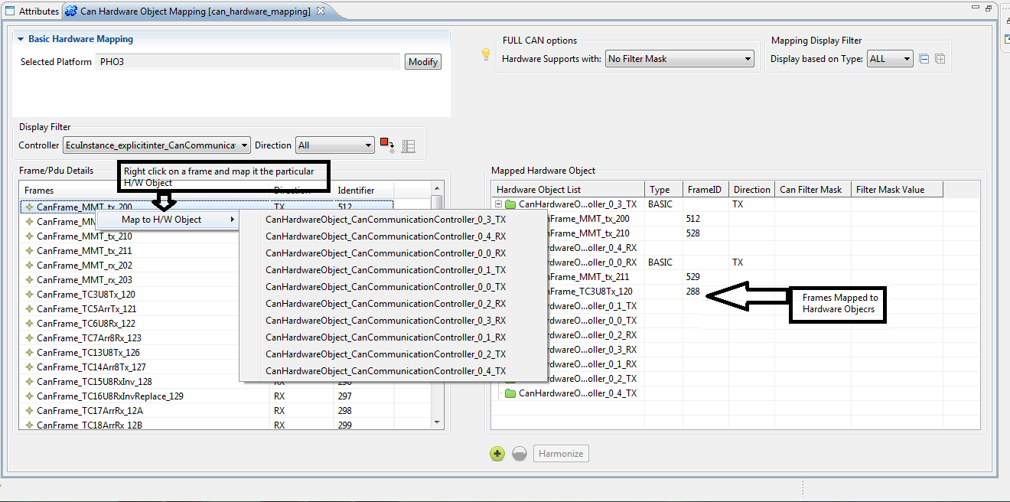

Slide 19
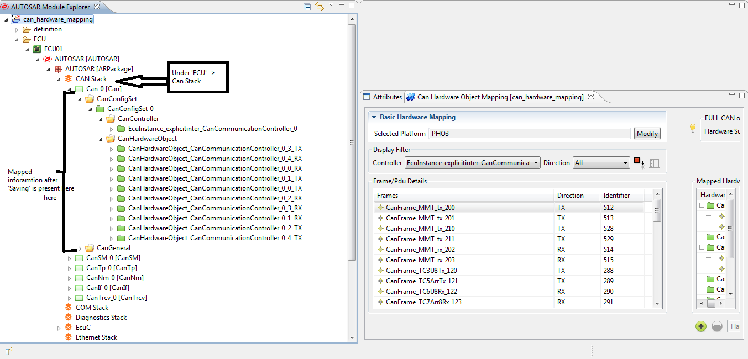

Slide 20
Data Mapping

Slide 21
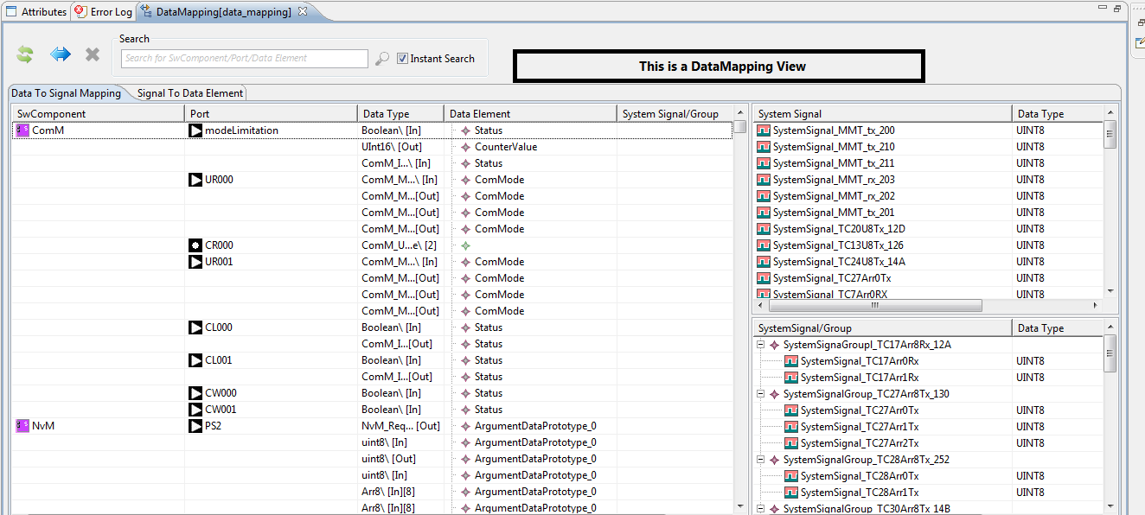

Slide 22
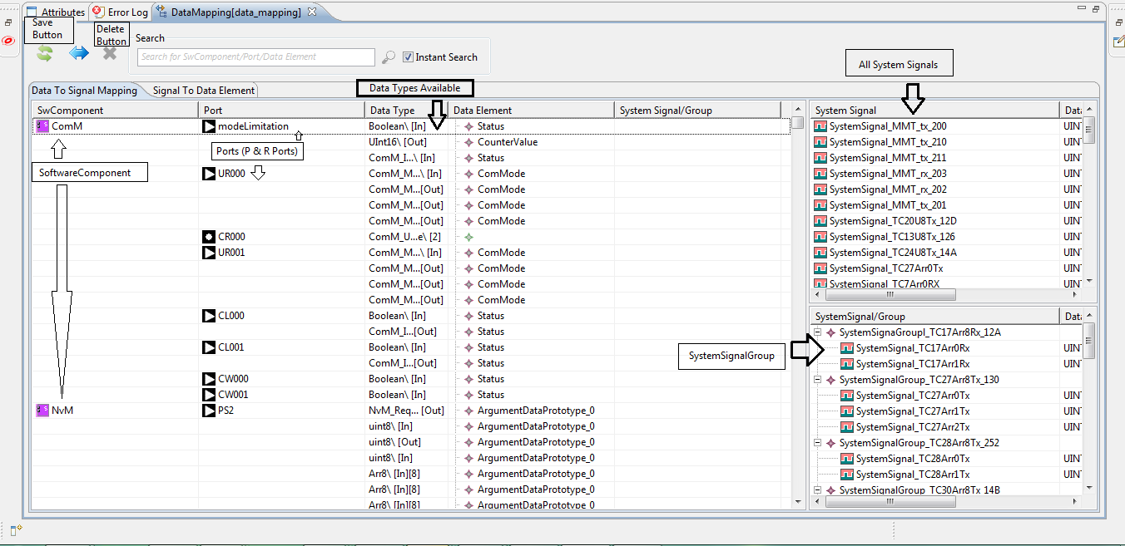

Slide 23
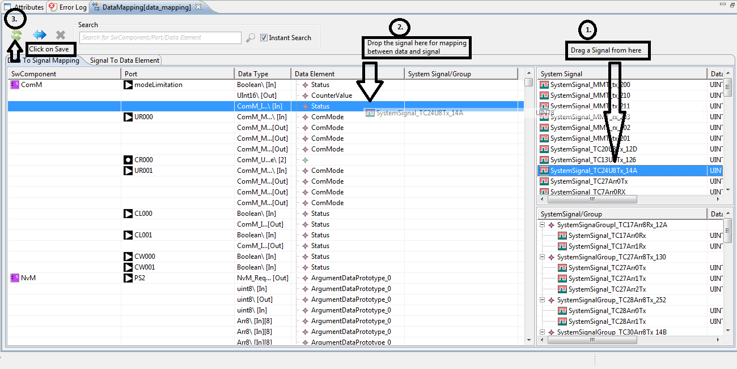

Slide 24
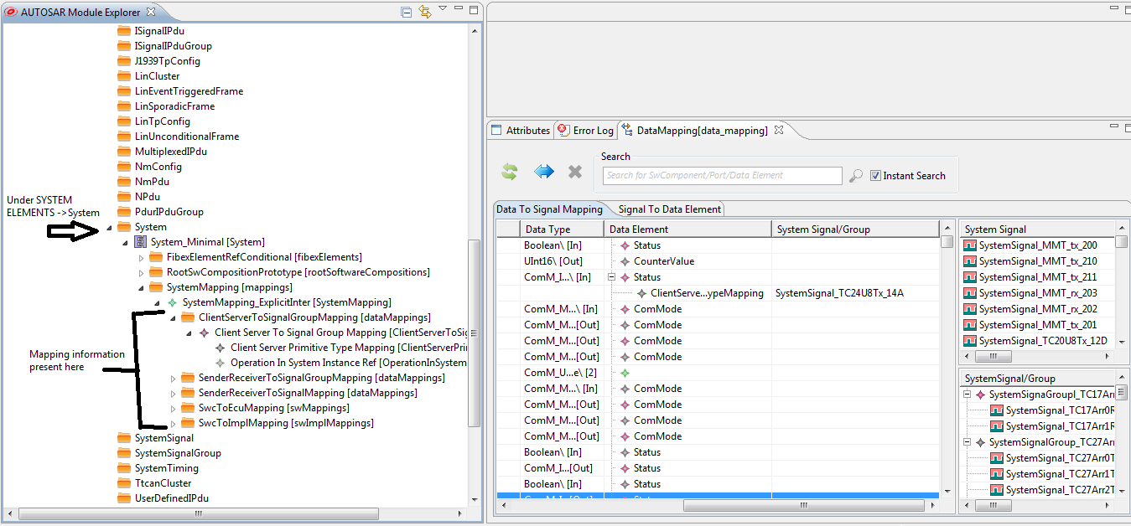

Slide 25
Flexray_Joblist_Editor

Slide 26
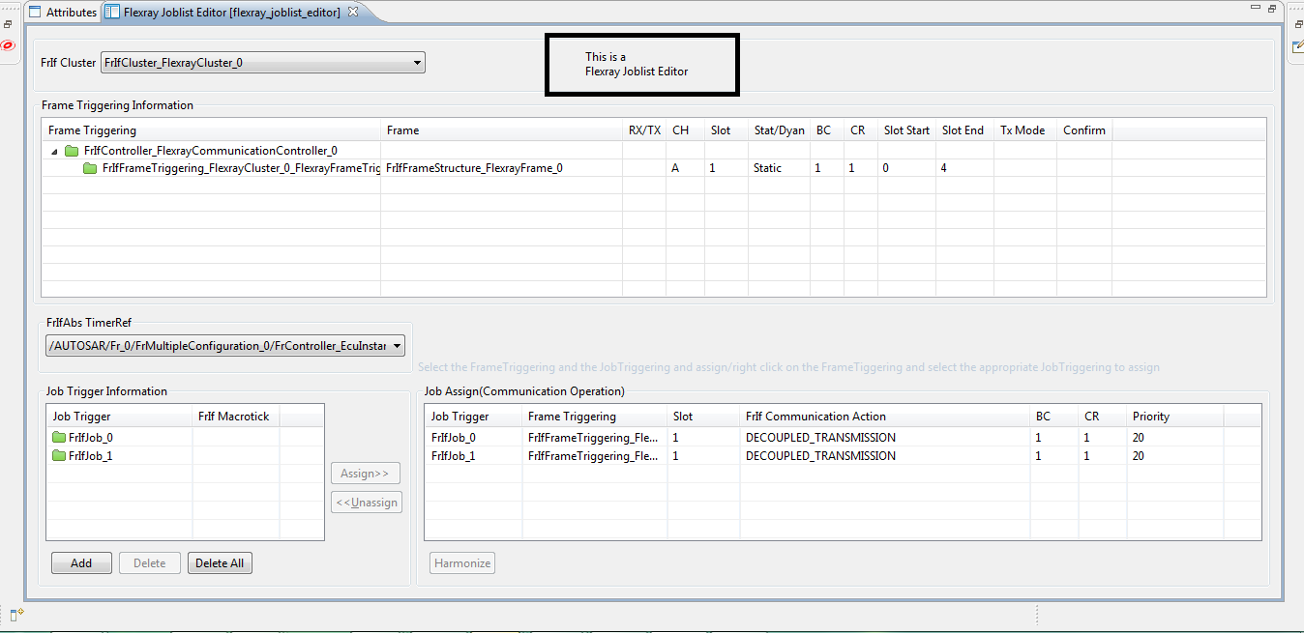

Slide 27
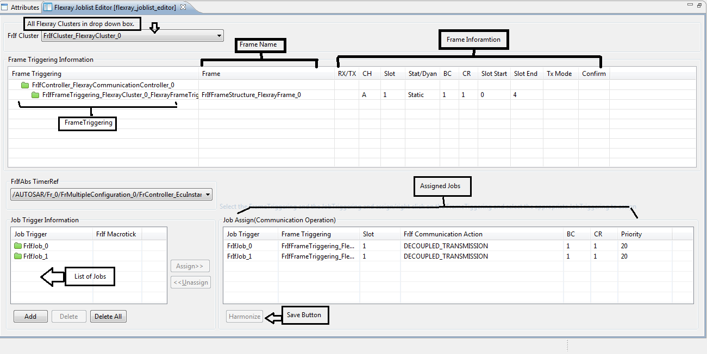

Slide 28
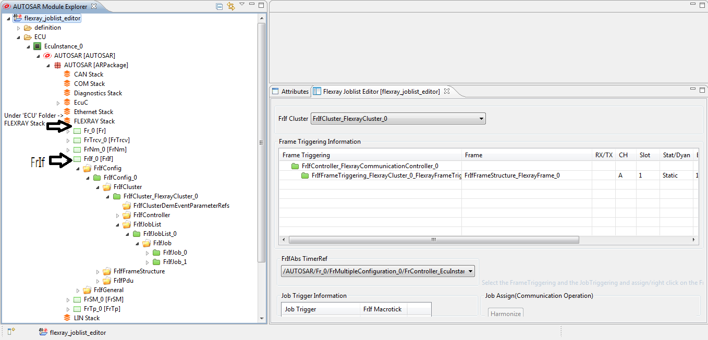

Slide 29
Memory_Stack_Configuration

Slide 30
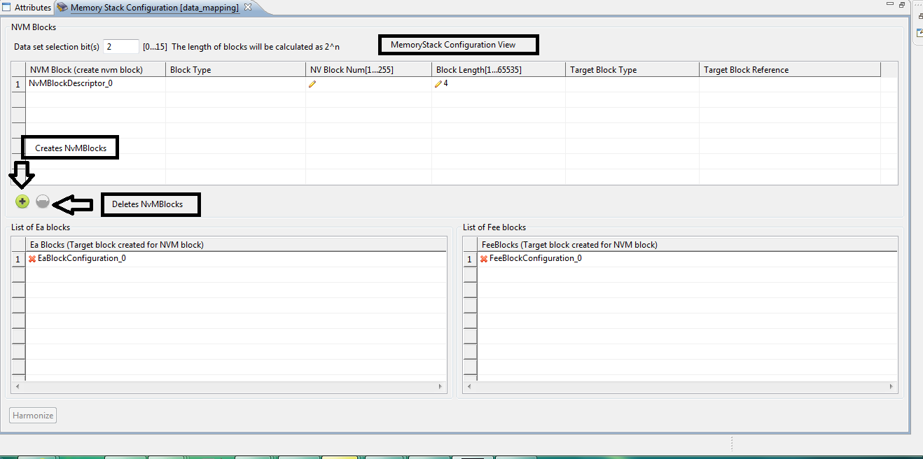

Slide 31
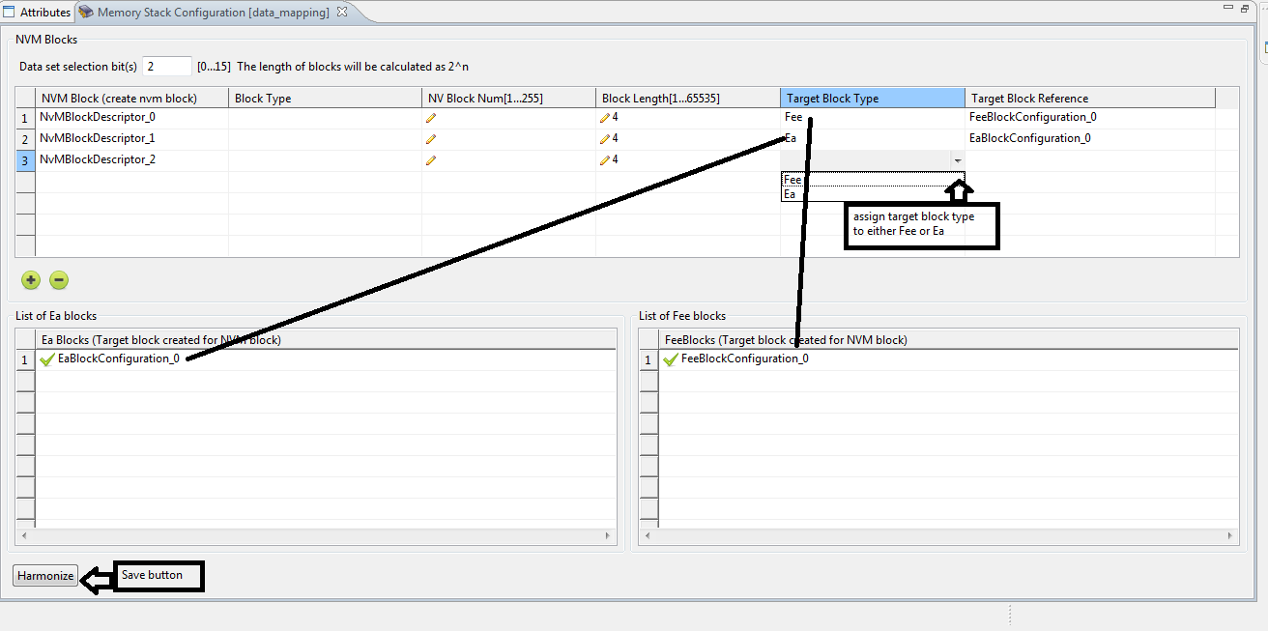

Slide 32
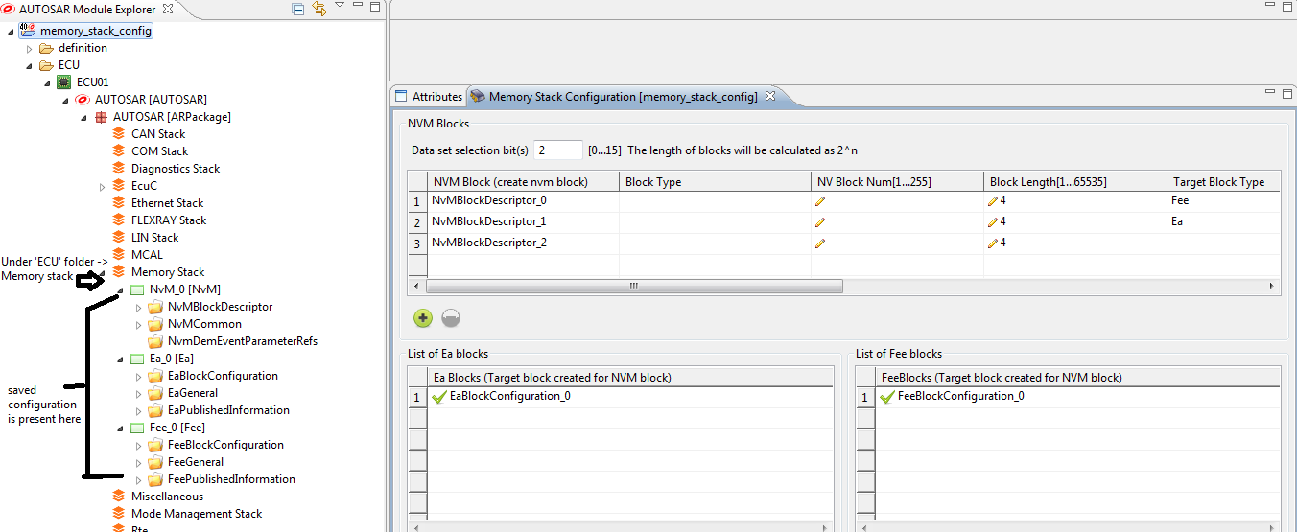

Slide 33
Port_Connection (SWConnnectionUtility)

Slide 34
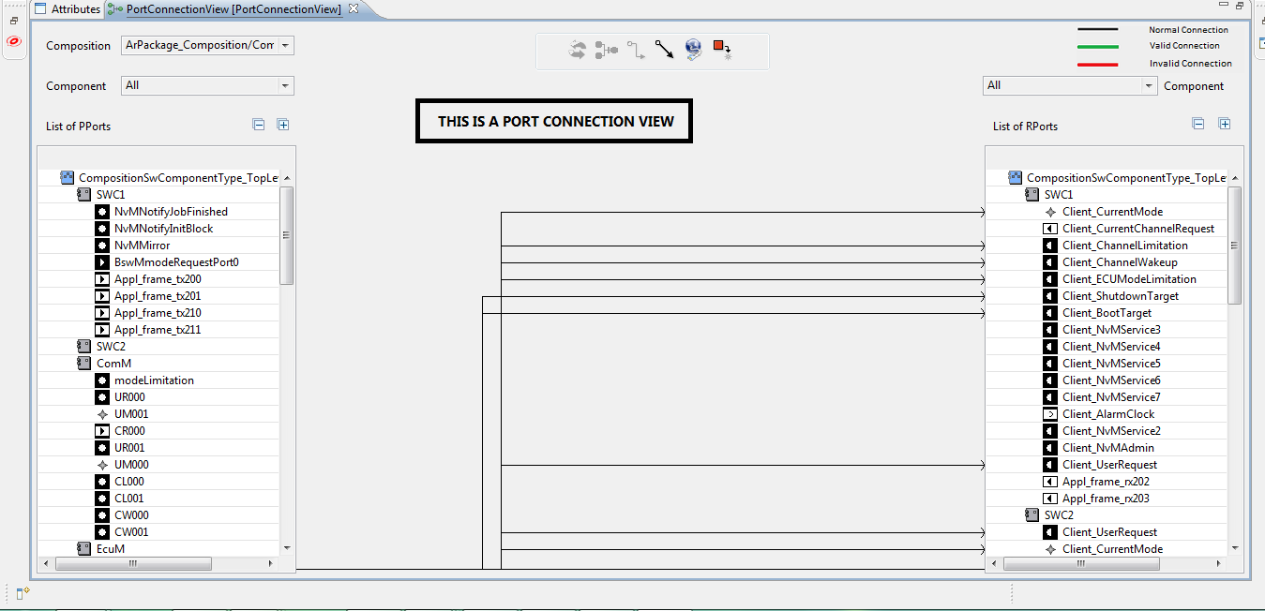

Slide 35
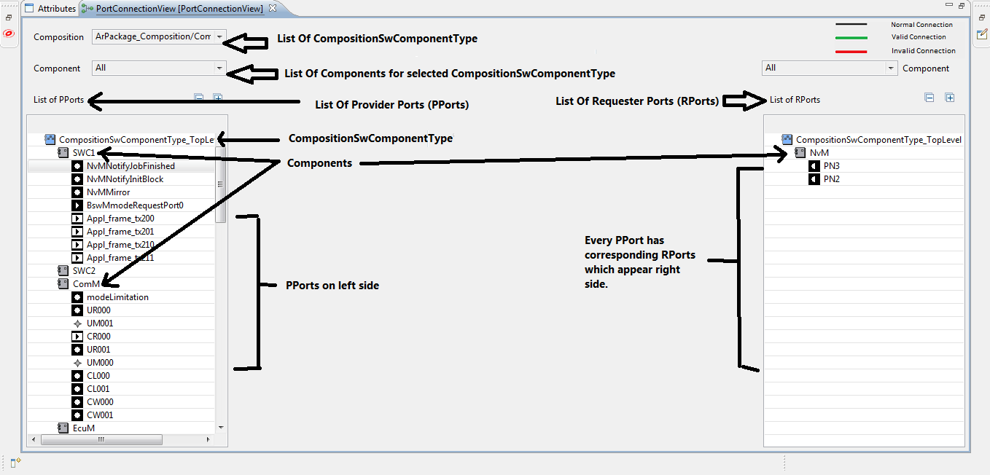

Slide 36
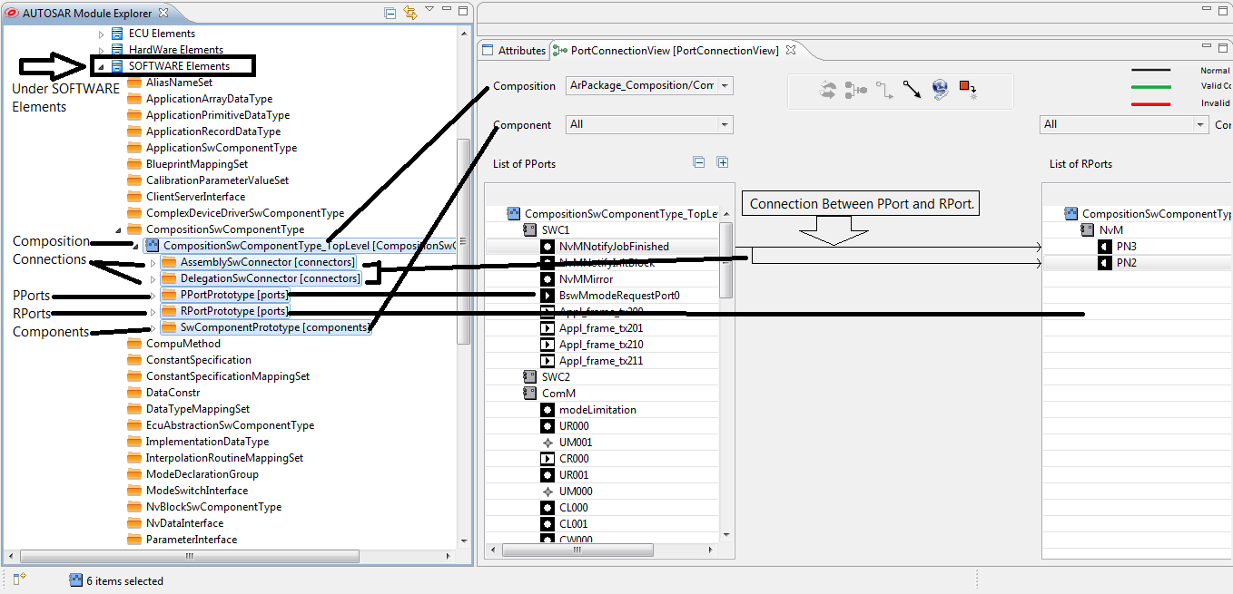

Slide 37
Runnable_To_Task_Mapping

Slide 38
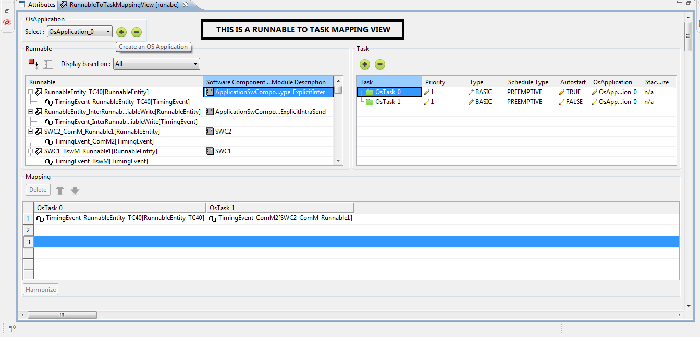

Slide 39
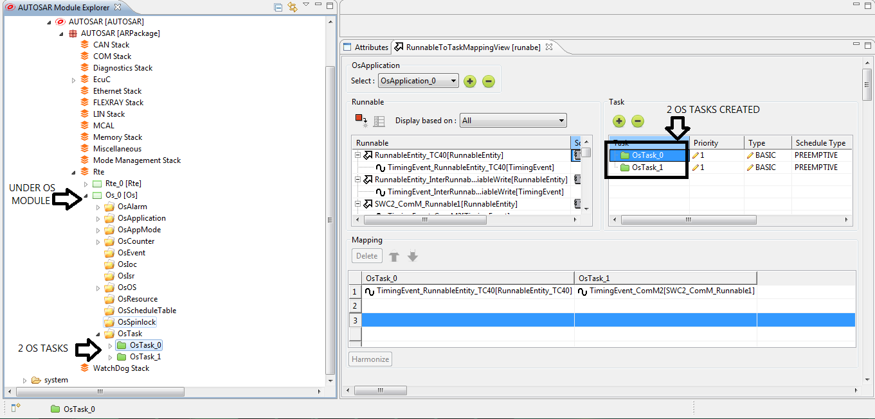

Slide 40
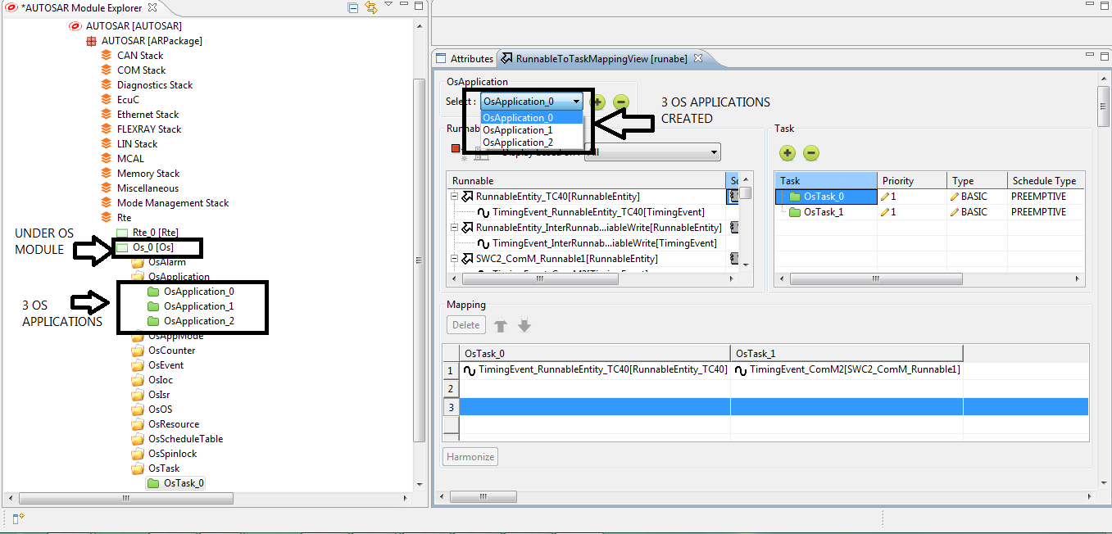

Slide 41
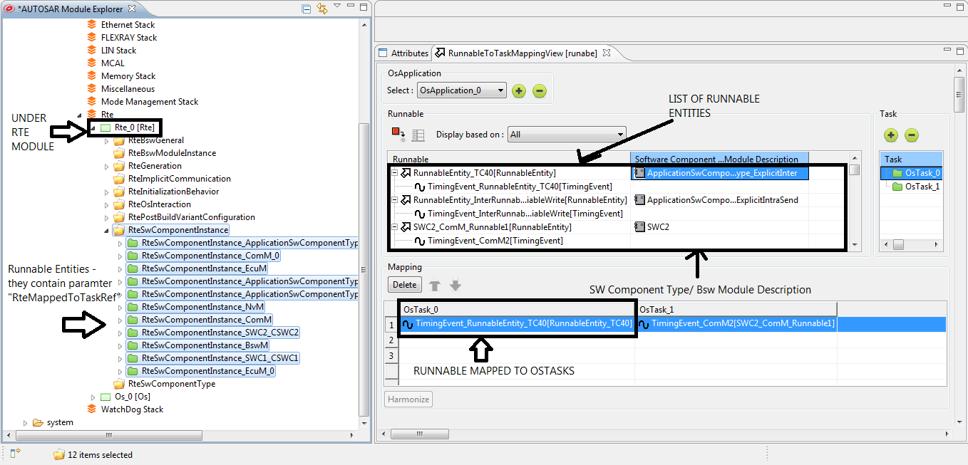

Slide 42
DBC_File_Import

Slide 43
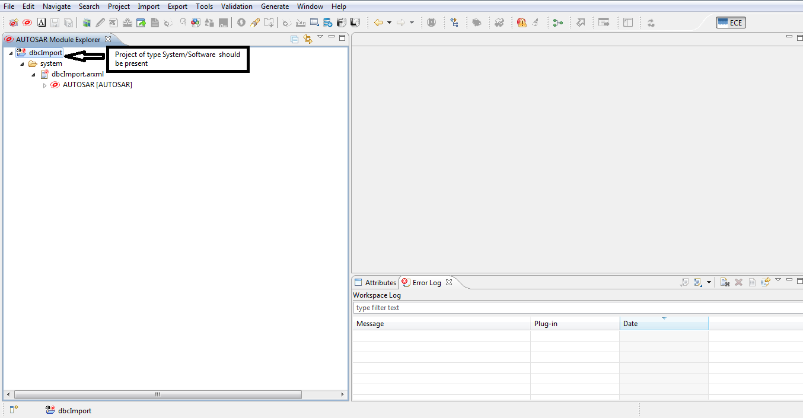

Slide 44
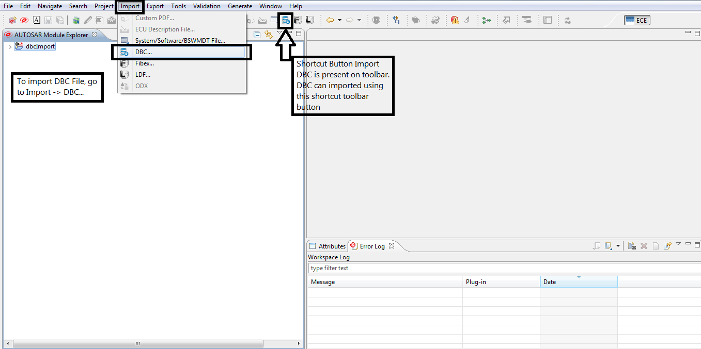

Slide 45
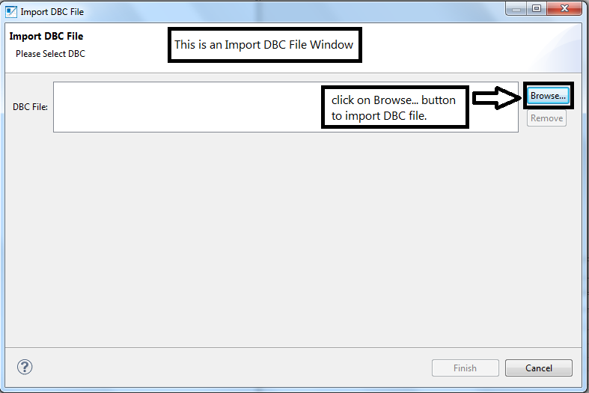

Slide 46
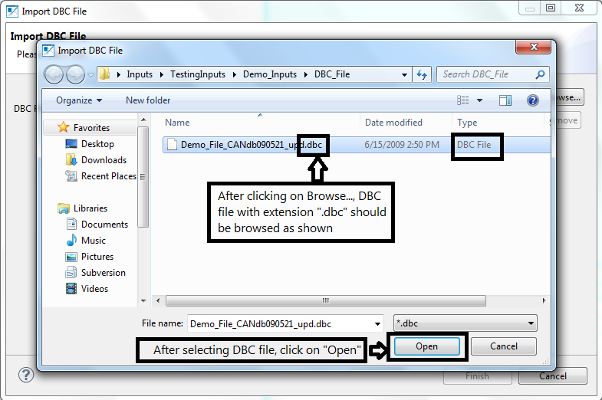

Slide 47
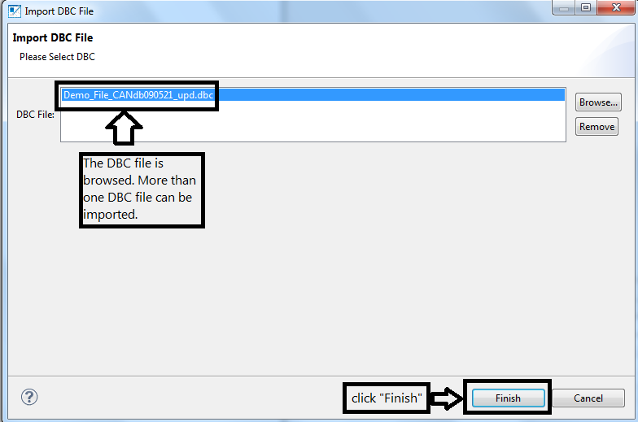

Slide 48
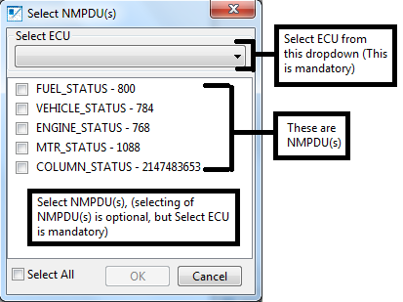

Slide 49
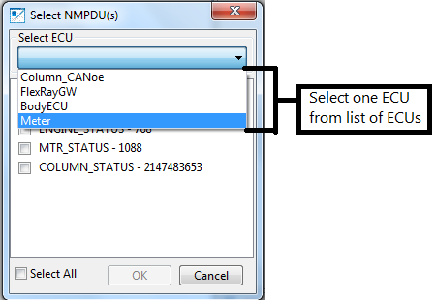

Slide 51
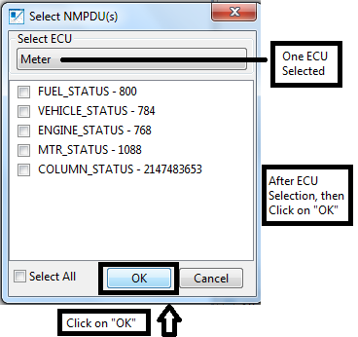

Slide 52
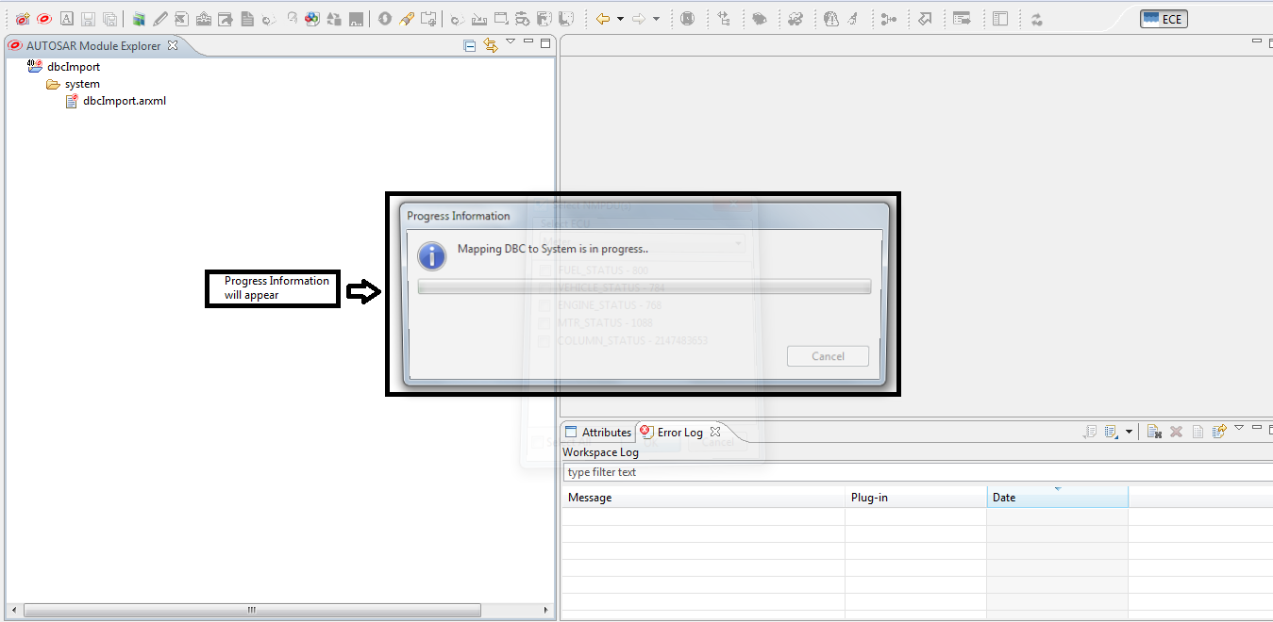

Slide 53
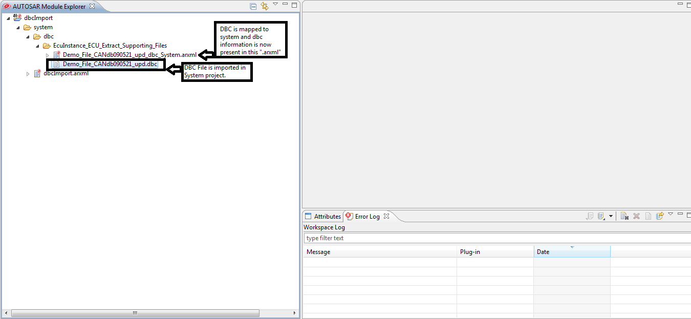

Slide 54
Fibex_File_Import

Slide 55
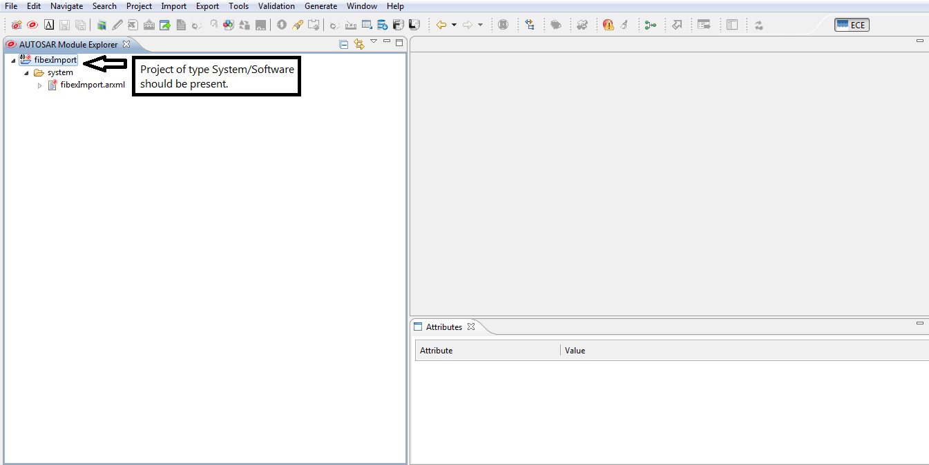

Slide 56
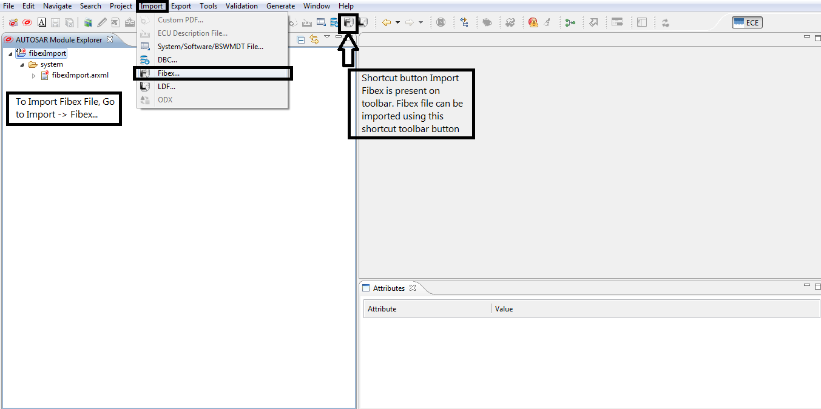

Slide 57
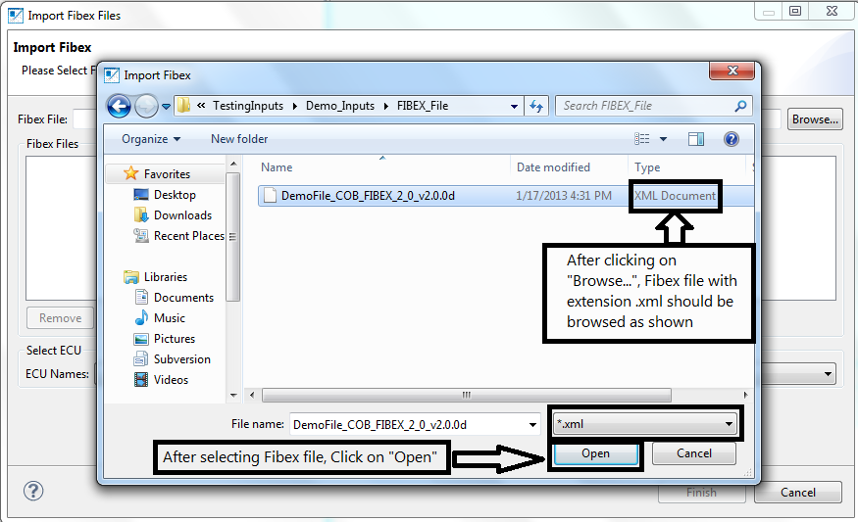

Slide 58
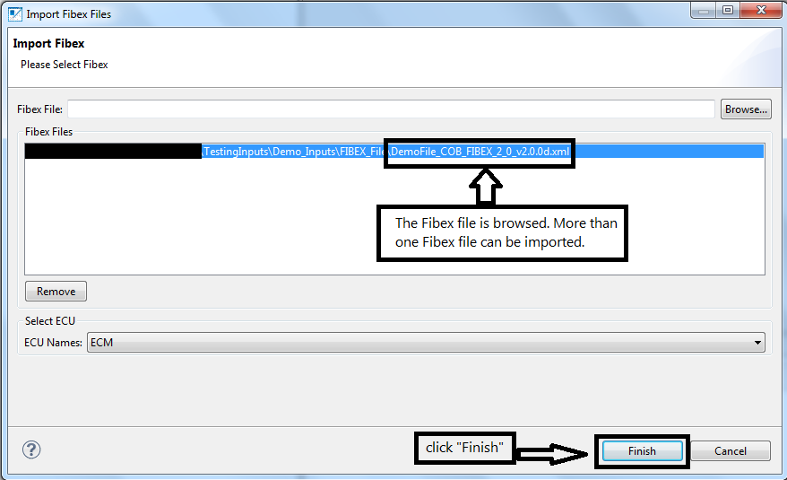

Slide 59
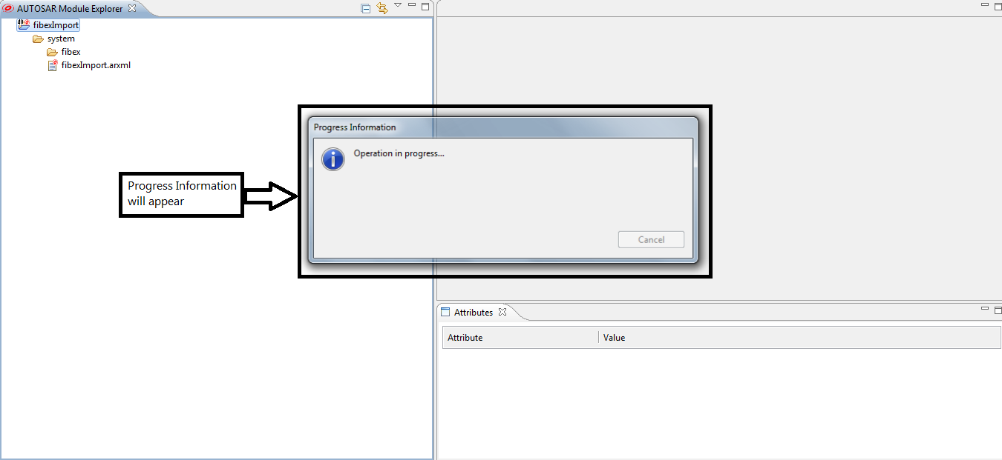

Slide 60
