Slide 1
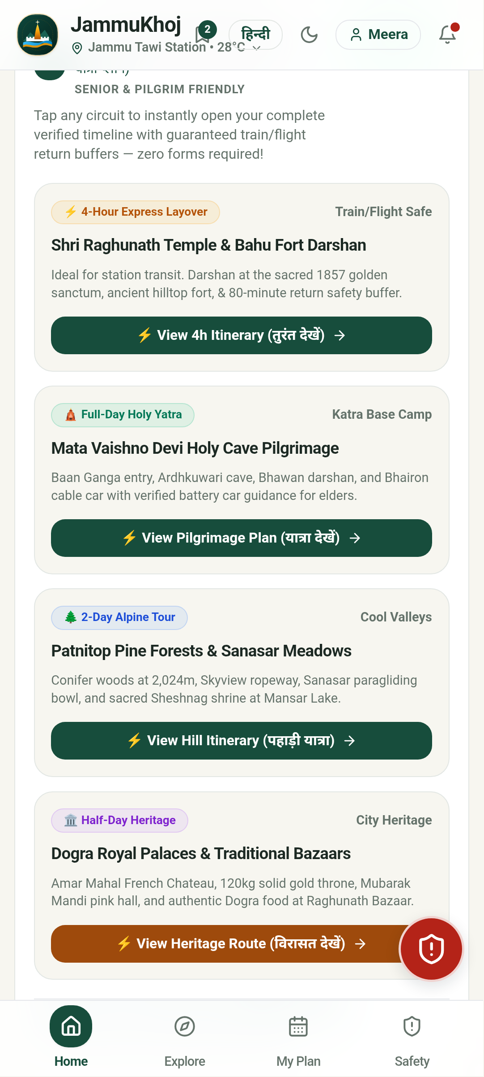
OFFLINE-FIRST CIVIC TRAVEL INNOVATION • JAMMU DIVISION & VAISHNO DEVI
JammuKhoj
जम्मू खोज • Your Jammu Journey, Made Simple.
A production-ready progressive web app & Android platform engineered for transit layovers and Mata Vaishno Devi pilgrims across the Jammu Division. 100% offline-ready with conservative train/flight safety buffers, transparent transport fare matrices, step-free senior guidance, and zero-tracking privacy.
⚡ 1-Tap Buffer Planner
4h, 8h & 24h layover circuits
📶 100% Offline IndexedDB
Vector maps & full routing offline
🚌 Transparent Transit
Matadors (₹10-25), Autos & Taxis
🧓 Senior & Pilgrim Ease
Step-free, battery cars & 112 SOS

Slide 2
02 • PROBLEM STATEMENT
The Transit Anxiety & Information Vacuum in Jammu
Why millions of pilgrims pass through Jammu with friction, fear, and zero local discovery.
🚨 Transit Anxiety & Time Fear
Fear of Missing Onward Trains / Flights
• Pilgrims face 4 to 12 hour layovers at Jammu Tawi or IXJ Airport.
• Fear of mountain highway bottlenecks traps families on railway platforms.
• Zero existing tools compute guaranteed conservative safety return buffers.
💸 Transport Gouging & Haggling
Unregulated Fares & Commuter Harassment
• Unsuspecting yatris routinely charged ₹800–₹1,500 for a ₹150 taxi ride.
• Matador mini-bus stages and route numbers are completely opaque to outsiders.
• Zero visibility into official prepaid auto/taxi union rate cards.
📴 Cellular Blackouts & Accessibility
Mountain Dead Zones & Elder Strain
• Cloud-based travel apps crash in Shivalik foothill tunnels and dead zones.
• Senior citizens face unexpected steep stairs without wheelchair/battery-car guidance.
• Emergency hotlines and National ERSS 112 are scattered across fragmented websites.
JammuKhoj • Smart Tourism & Pilgrim Companion • Live App: https://jammukhoj.in

Slide 3
03 • ECONOMIC & CULTURAL GAP
The 10-Million Pilgrim Paradox: Direct Transit Bypass
Immense visitor footfall that completely bypasses Jammu's cultural and economic ecosystem.
10,000,000+
Annual pilgrims transit through Jammu Tawi & Katra to reach Shri Mata Vaishno Devi Shrine.
< 2 Hours Average Dwell
Over 85% of yatris treat Jammu as a mere train-to-bus transit hallway, unaware of rich Dogra heritage minutes away.
Four Costly Tourism & Economic Gaps
🏛️ Heritage Neglect
Mubarak Mandi Palace (Dogra royal seat), Bahu Fort (3000 yrs), and Amar Mahal witness only a tiny fraction of their visitor potential.
🛍️ GI Craft Exploitation
Authentic Dogra crafts (Basohli Paintings, Pashmina, Basohli Tweed, Bhaderwah Rajmash) lose sales to roadside highway fakes with no verified directory.
🍲 Forgotten Culinary Economy
Indigenous nutritious Dogra delicacies (Kaladi Kulcha, Dogra Dham, Sund Panjeeri) lose out to generic highway fast-food stalls.
📉 Lost Municipal Revenue
Estimates show Jammu City loses over ₹300 Crores annually in potential local hospitality, craft, and transportation income.
JammuKhoj • Smart Tourism & Pilgrim Companion • Live App: https://jammukhoj.in

Slide 4
04 • THE SOLUTION ARCHITECTURE
JammuKhoj: An Intelligent, Resilient Local Guide
A human-centered progressive application tailored for zero-data environments and time-critical pilgrims.
⚡ 1-Tap Buffer-Safe Engine
Deterministic layout generator tailored to traveler's exact layover window (4h Express, 8h Cultural, 24h Valley trail). Enforces a strict 45-min rail buffer & 150-min air buffer, eliminating missed departures.
🚌 Transparent Transit Intelligence
Verified stage-by-stage Matador mini-bus routes, Smart City E-bus stops, and prepaid union matrices for auto-rickshaws and taxis to end passenger overcharging.
📶 100% Offline Vector Stack
Entire knowledge graph (36+ attractions, road topologies, timetables, dialer hotlines) bundled in local IndexedDB. Operates with zero SIM or data roaming in mountain valleys.
🧓 Elder & Accessibility Care
Step-free badges, walking load indicators (Low/Med/High), verified Vaishno Devi 5-stage trek manual, battery-car regulations, and 1-tap ERSS 112 WhatsApp location SOS.
JammuKhoj • Smart Tourism & Pilgrim Companion • Live App: https://jammukhoj.in

Slide 5
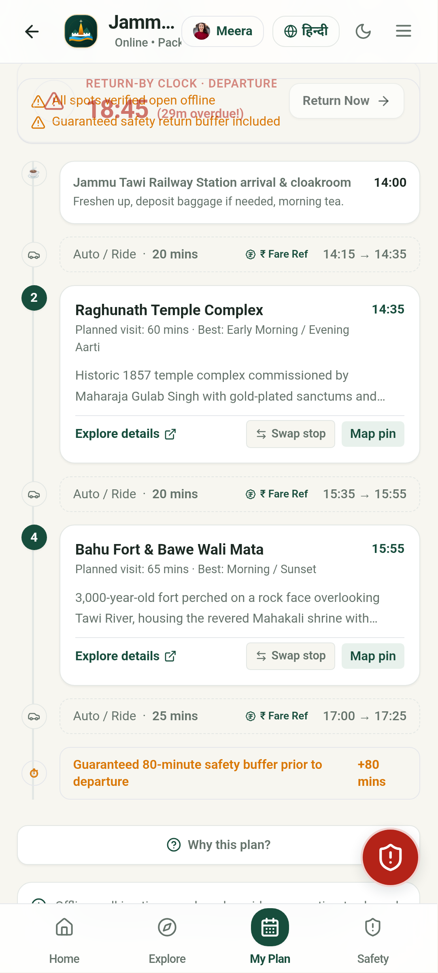
05 • SEAMLESS USER JOURNEY
From Station Arrival to Holy Darshan in 5 Frictionless Steps
Designed for immediate value without forced registration, heavy downloads, or steep learning curves.
STEP 1: 1. ARRIVAL AT STATION / AIRPORT
Yatri steps off train at Jammu Tawi (JAT) or IXJ Airport. Opens jammukhoj.in directly with 1 tap. Zero mandatory login barrier.
STEP 2: 2. 1-TAP ITINERARY GENERATION
Selects layover: '4-Hour Express' from station. App automatically reserves 45-min departure buffer and crafts a 2.5-hr curated temple circuit.
STEP 3: 3. TRANSPARENT LOCAL TRANSIT
Checks Matador Route #1 to Raghunath Bazaar. Boards with exact ₹15 fare; avoids cab touts quoting ₹400 for the same distance.
STEP 4: 4. CULTURAL DISCOVERY & PURE VEG FOOD
Offers prayers at Raghunath Mandir, tastes authentic Kaladi Kulcha with Jain/Pure Veg filter, and visits verified Basohli craft cooperative.
STEP 5: 5. SAFE ONWARD DEPARTURE
Returns to station with 50 minutes to spare. Boards onward Vande Bharat Express to Katra for holy darshan with complete peace of mind.
JammuKhoj • Smart Tourism & Pilgrim Companion • Live App: https://jammukhoj.in

Slide 6
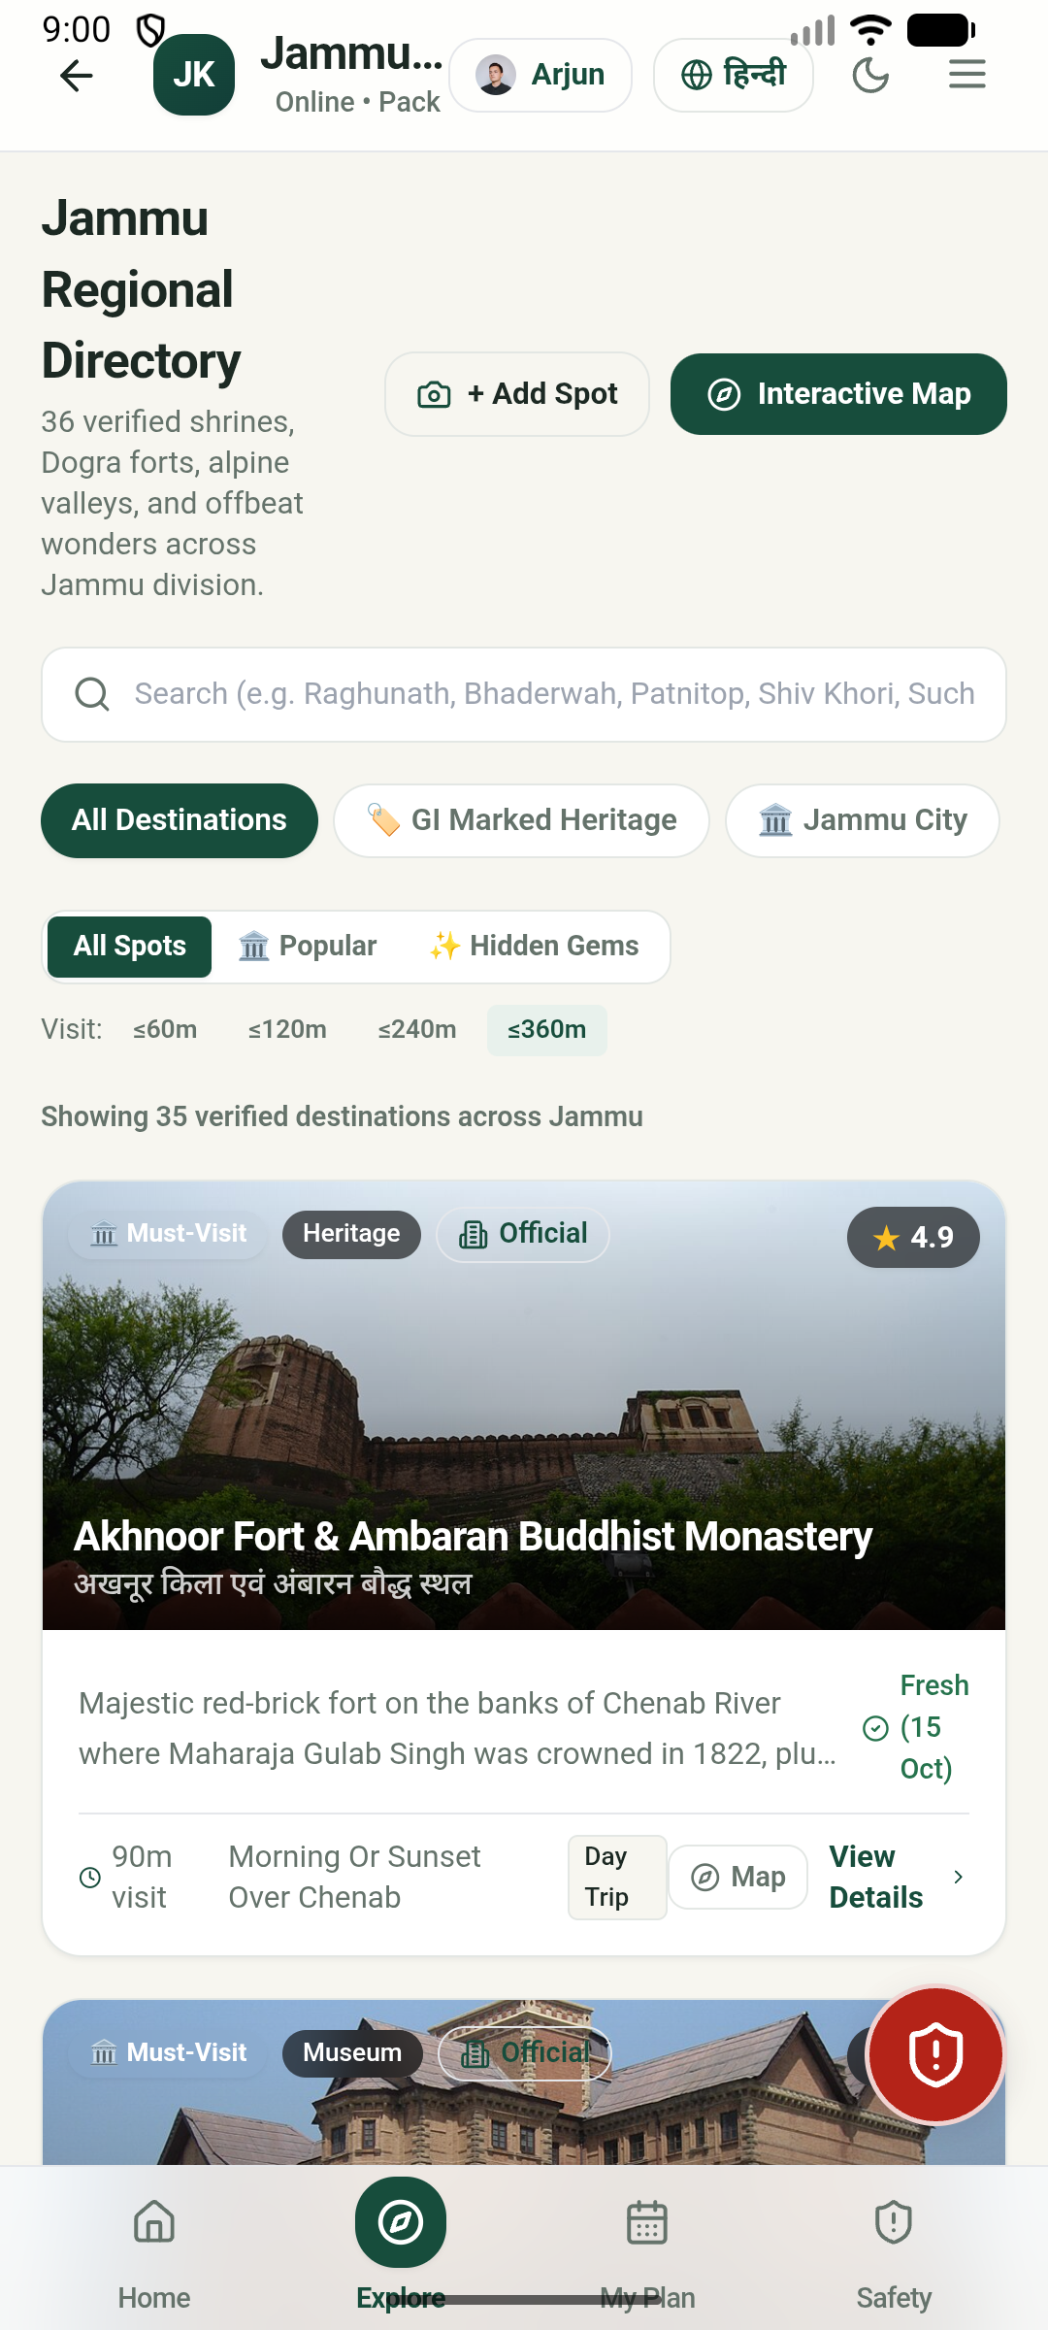
06 • COMPETITIVE DIFFERENTIATION
How JammuKhoj Outperforms Generic Travel Platforms
Direct comparison against Google Maps, MakeMyTrip, and generic travel blogs.
Dimension | Google Maps | MakeMyTrip / OTAs | JammuKhoj (Our App)
Offline Autonomy | Fails in mountain tunnels & valleys | 100% online only; unusable offline | 100% On-Device IndexedDB
Safe Buffer Planner | Ignores train layover deadlines | Rigid commercial packages only | 45m rail & 150m air locks
Transit Tariffs | No Matadors; no fare benchmarks | Commercial cabs at high markup | Matadors (₹10-25) + Taxi matrices
Senior & Pilgrim Care | No stair counts or walking load | Generic packages | Senior Ease Mode & step-free tags
Privacy & Data Safety | Ad-tracking & location profiling | Monetizes user contact data | Zero cookies, zero surveillance
JammuKhoj • Smart Tourism & Pilgrim Companion • Live App: https://jammukhoj.in

Slide 7
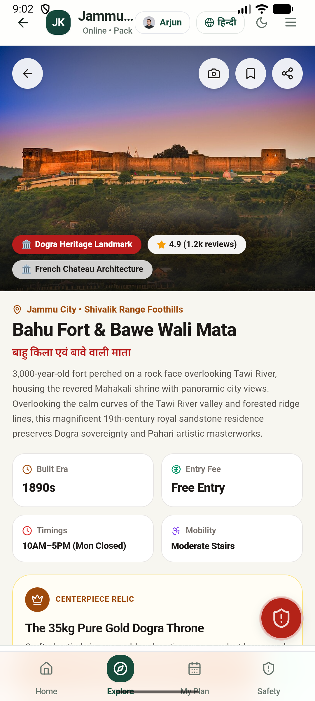
07 • IMPACT & METRICS
Measurable Economic, Civic, and Social Outcomes
High-leverage socio-economic returns for pilgrims, local businesses, and municipal transit.
3x
Dwell Multiplier
Extending stay from <2h to 6-8h via safe circuits.
₹150 Cr+
Economic Target
Direct injection into local Dogra food, crafts & transit.
₹1,200
Family Savings
Preventing exploitative cab fares and fake crafts.
0
Missed Departures
100% adherence to safety return buffers.
🏛️ Cultural & GI Heritage Renaissance
Empowers Basohli painters, Pashmina weavers, and Bhaderwah farmers with verified outlet discovery and fake-identification guides. Pilgrims purchase authentic GI certified heritage at fair benchmark prices directly supporting cottage industries.
🛡️ Public Safety & Yatra Welfare
1-Tap WhatsApp GPS SOS dispatcher and offline dialers for ERSS 112, SMVDSB Shrine Helplines, and women's assistance. Real-time dynamic temple crowd meters and aarti timings prevent stampedes and reduce elder exhaustion during Navratri surges.
JammuKhoj • Smart Tourism & Pilgrim Companion • Live App: https://jammukhoj.in

Slide 8
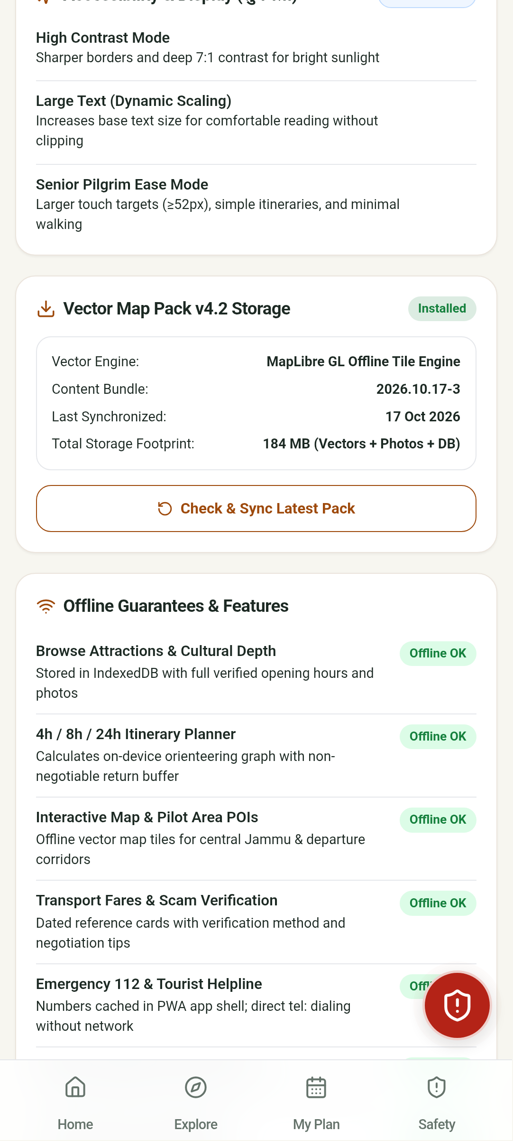
08 • EXECUTION ROADMAP
4-Stage Scalable Deployment Plan (2026 – 2027)
From proven progressive web app & Android build to institutional statewide rollout.
Phase 1: Foundation (COMPLETED & LIVE)
Live on jammukhoj.in • 100% offline PWA & Android APK • 36+ attractions & 44 automated tests passing • 1-Tap buffer planner & transit matrix.
Phase 2: Transit Node Pilot (Q1-Q2 2027)
QR code touchpoints at Jammu Tawi & Katra concourses • J&K Smart City e-bus live status integration • Onboard 50+ verified local dhabas & GI artisans • Target: 50,000 monthly users.
Phase 3: Institutional Sync (Q3 2027)
Official endorsement by J&K Tourism Directorate • SMVDSB Katra battery-car & RFID status tie-in • Railway Yatri Niwas booking cross-links • Target: 250,000 active yatris.
Phase 4: Ecosystem Scale (Q4 2027+)
Expansion to Bhaderwah, Kishtwar, Poonch & Rajouri • Audio heritage guides in Dogri, Hindi & English • Open-source blueprint for other pilgrim hubs (Varanasi, Tirupati).
JammuKhoj • Smart Tourism & Pilgrim Companion • Live App: https://jammukhoj.in

Slide 9
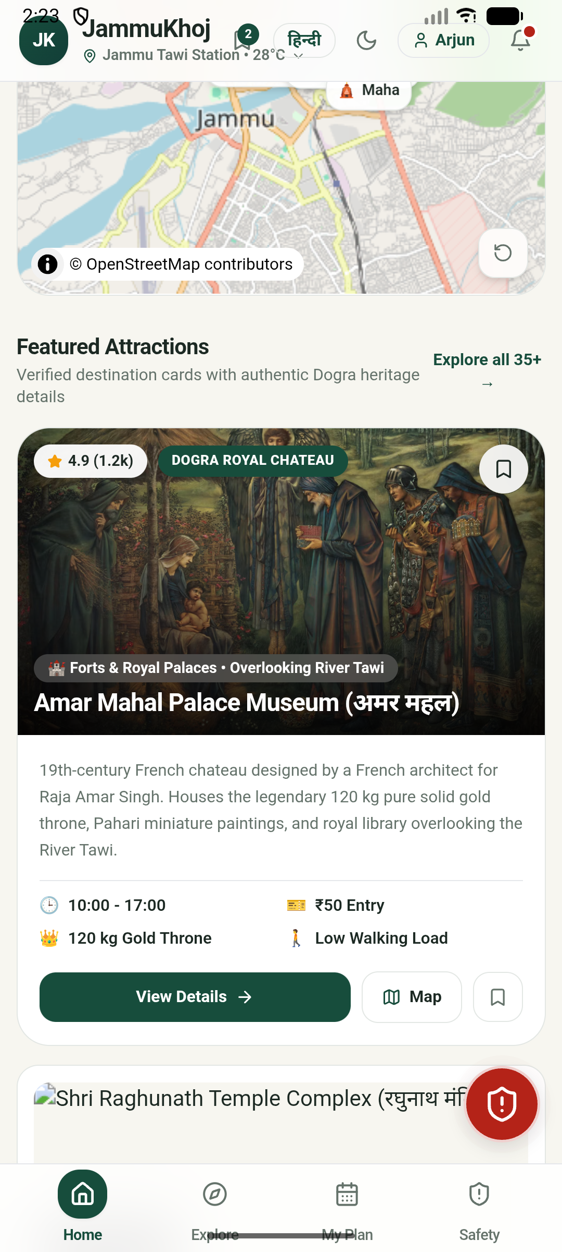
09 • TRUST & SUSTAINABILITY
Civic Integrity, Zero-Surveillance Privacy & Low Footprint
Built to protect user privacy and operate sustainably without predatory data monetization.
🔒 Zero-Knowledge Privacy (Google Play Compliant)
• 100% of user data, bookmarks, and custom plans remain strictly on-device in IndexedDB.
• Zero tracking cookies, zero third-party telemetry, zero location data monetization.
• 1-Tap permanent account & local storage wipe button directly in Settings.
🌱 Ultra-Low Resource Footprint
• Lightweight 5.5 MB APK and <2 MB compressed web bundle.
• Runs smoothly on budget ₹6,000 Android phones without thermal throttling.
• OLED-friendly dark mode and high-contrast WCAG 2.1 AA modes save battery during travel.
🤝 Sustainable Public-Private Civic Model
• Non-commission directory preventing price distortion for travelers.
• Verified artisan and homestay listings supported by J&K Tourism development authorities.
• Open-source data structures contributing back to OpenStreetMap and civic archives.
JammuKhoj • Smart Tourism & Pilgrim Companion • Live App: https://jammukhoj.in

Slide 10
CLOSING PITCH • PILOT CALL TO ACTION
Partner with Us to Transform Jammu Tourism
Let's turn a hurried 2-hour transit rush into an enriching, safe cultural gateway.
1. Transit Signage Pilot
Permission for QR code info panels at Jammu Tawi (JAT) and SVDK Katra station concourses to give yatris instant offline guide access.
2. Tourism Dept Data Link
Official co-branding and verification link with Directorate of Tourism, Jammu (TRC) to keep fare tables and festival schedules authoritative.
3. Shrine Board Sync
Collaboration with SMVDSB Katra to integrate battery-car status, aarti timings, and emergency medical aid coordinates.
🌐 Live Application: https://jammukhoj.in • ✉️ Contact: support@jammukhoj.in
Open Source • 100% Offline Progressive Web App & Android Ready • Built with Pride for Jammu

