Slide 1
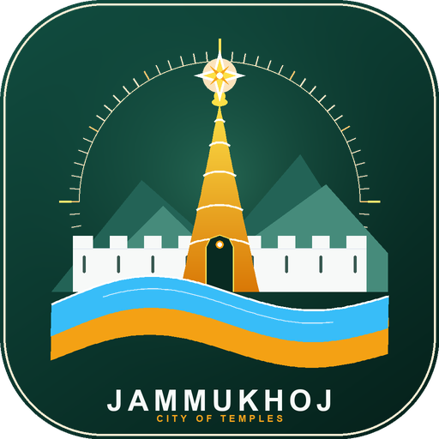
OFFLINE-FIRST CIVIC TRAVEL INNOVATION • JAMMU DIVISION & VAISHNO DEVI
JammuKhoj
जम्मू खोज • Your Jammu Journey, Made Simple.
A production-ready progressive web app & Android platform engineered for transit layovers and Mata Vaishno Devi pilgrims. 100% offline-ready with conservative train/flight safety buffers, transparent transport fare matrices, step-free senior guidance, and zero-tracking privacy.
⚡ 1-Tap Buffer Planner
4h, 8h & 24h layover circuits
📶 100% Offline IndexedDB
Vector maps & full routing offline
🚌 Transparent Transit
Matadors (₹10-25), Autos & Taxis
🧓 Senior & Pilgrim Ease
Step-free, battery cars & 112 SOS
Production Release • October 2026 • Live Demo: https://bucolic-buttercream-966135.netlify.app/ • Domain: https://jammukhoj.in

Slide 2
02 • PROBLEM STATEMENT
The Transit Anxiety & Information Vacuum in Jammu
Why millions of pilgrims pass through Jammu with friction, fear, and zero local discovery.
THE CORE DILEMMA: Jammu is treated as a high-friction railway transfer point rather than a cultural destination.
Over 10 Million yatris enter annually, yet fear of missing departures keeps them trapped on waiting platforms without guidance.
🚨 01. The Transit Panic
Fear of Missing Onward Trains / Flights
• Pilgrims face 4 to 12 hour layovers at Jammu Tawi or IXJ Airport.
• Fear of mountain highway bottlenecks traps families on railway platforms.
• Zero existing tools compute guaranteed conservative safety return buffers.
• Result: Over 85% of visitors never step outside the station compound.
💸 02. The ₹1,200 Haggling Tax
Unregulated Fares & Commuter Harassment
• Unsuspecting yatris routinely charged ₹800–₹1,500 for a ₹150 taxi ride.
• Matador mini-bus stages and route numbers are completely opaque to outsiders.
• Zero visibility into official prepaid auto/taxi union rate cards.
• Result: Tourists feel exploited within their first hour in Jammu.
📴 03. The Mountain Blackout
Cellular Dead Zones & Elder Strain
• Cloud-based travel apps crash in Shivalik foothill tunnels and dead zones.
• Senior citizens face unexpected steep stairs without wheelchair/battery-car guidance.
• Emergency hotlines and National ERSS 112 are scattered across fragmented websites.
• Result: Families with elders experience high physical and mental stress.
JammuKhoj • Smart Tourism & Pilgrim Companion • Live Demo: https://bucolic-buttercream-966135.netlify.app/

Slide 3
03 • ECONOMIC & CULTURAL GAP
The 10-Million Pilgrim Paradox: Direct Transit Bypass
Immense visitor footfall that completely bypasses Jammu's cultural and economic ecosystem.
10,000,000+
Annual pilgrims transit through Jammu Tawi & Katra to reach Shri Mata Vaishno Devi Shrine.
< 2 Hours
Average transit dwell in Jammu City. Over 85% of yatris treat Jammu as a mere train-to-bus transit hallway.
₹300+ Crores
Estimated annual municipal revenue lost in local hospitality, authentic craft, and cultural transit.
Where the Visitor Value Is Lost
🏛️ Heritage Neglect
Mubarak Mandi Palace (seat of Dogra dynasty), Bahu Fort (3000-yr landmark), and Amar Mahal witness <5% of pilgrim footfall due to missing structured half-day circuits.
🛍️ GI Craft Exploitation
Authentic Dogra crafts (Basohli Paintings, Pashmina, Basohli Tweed, Bhaderwah Rajmash) lose sales to roadside counterfeit stalls because visitors lack a verified artisan directory.
🍲 Forgotten Culinary Economy
Indigenous nutritious Dogra delicacies (Kaladi Kulcha, Dogra Dham, Sund Panjeeri) lose out to generic highway fast food due to lack of hygienic, verified food trails.
📉 Transit Inefficiency
Public Matador mini-buses and E-buses run with irregular passenger loads while private touts crowd station gates, driving congestion and commuter dissatisfaction.
JammuKhoj • Smart Tourism & Pilgrim Companion • Live Demo: https://bucolic-buttercream-966135.netlify.app/

Slide 4
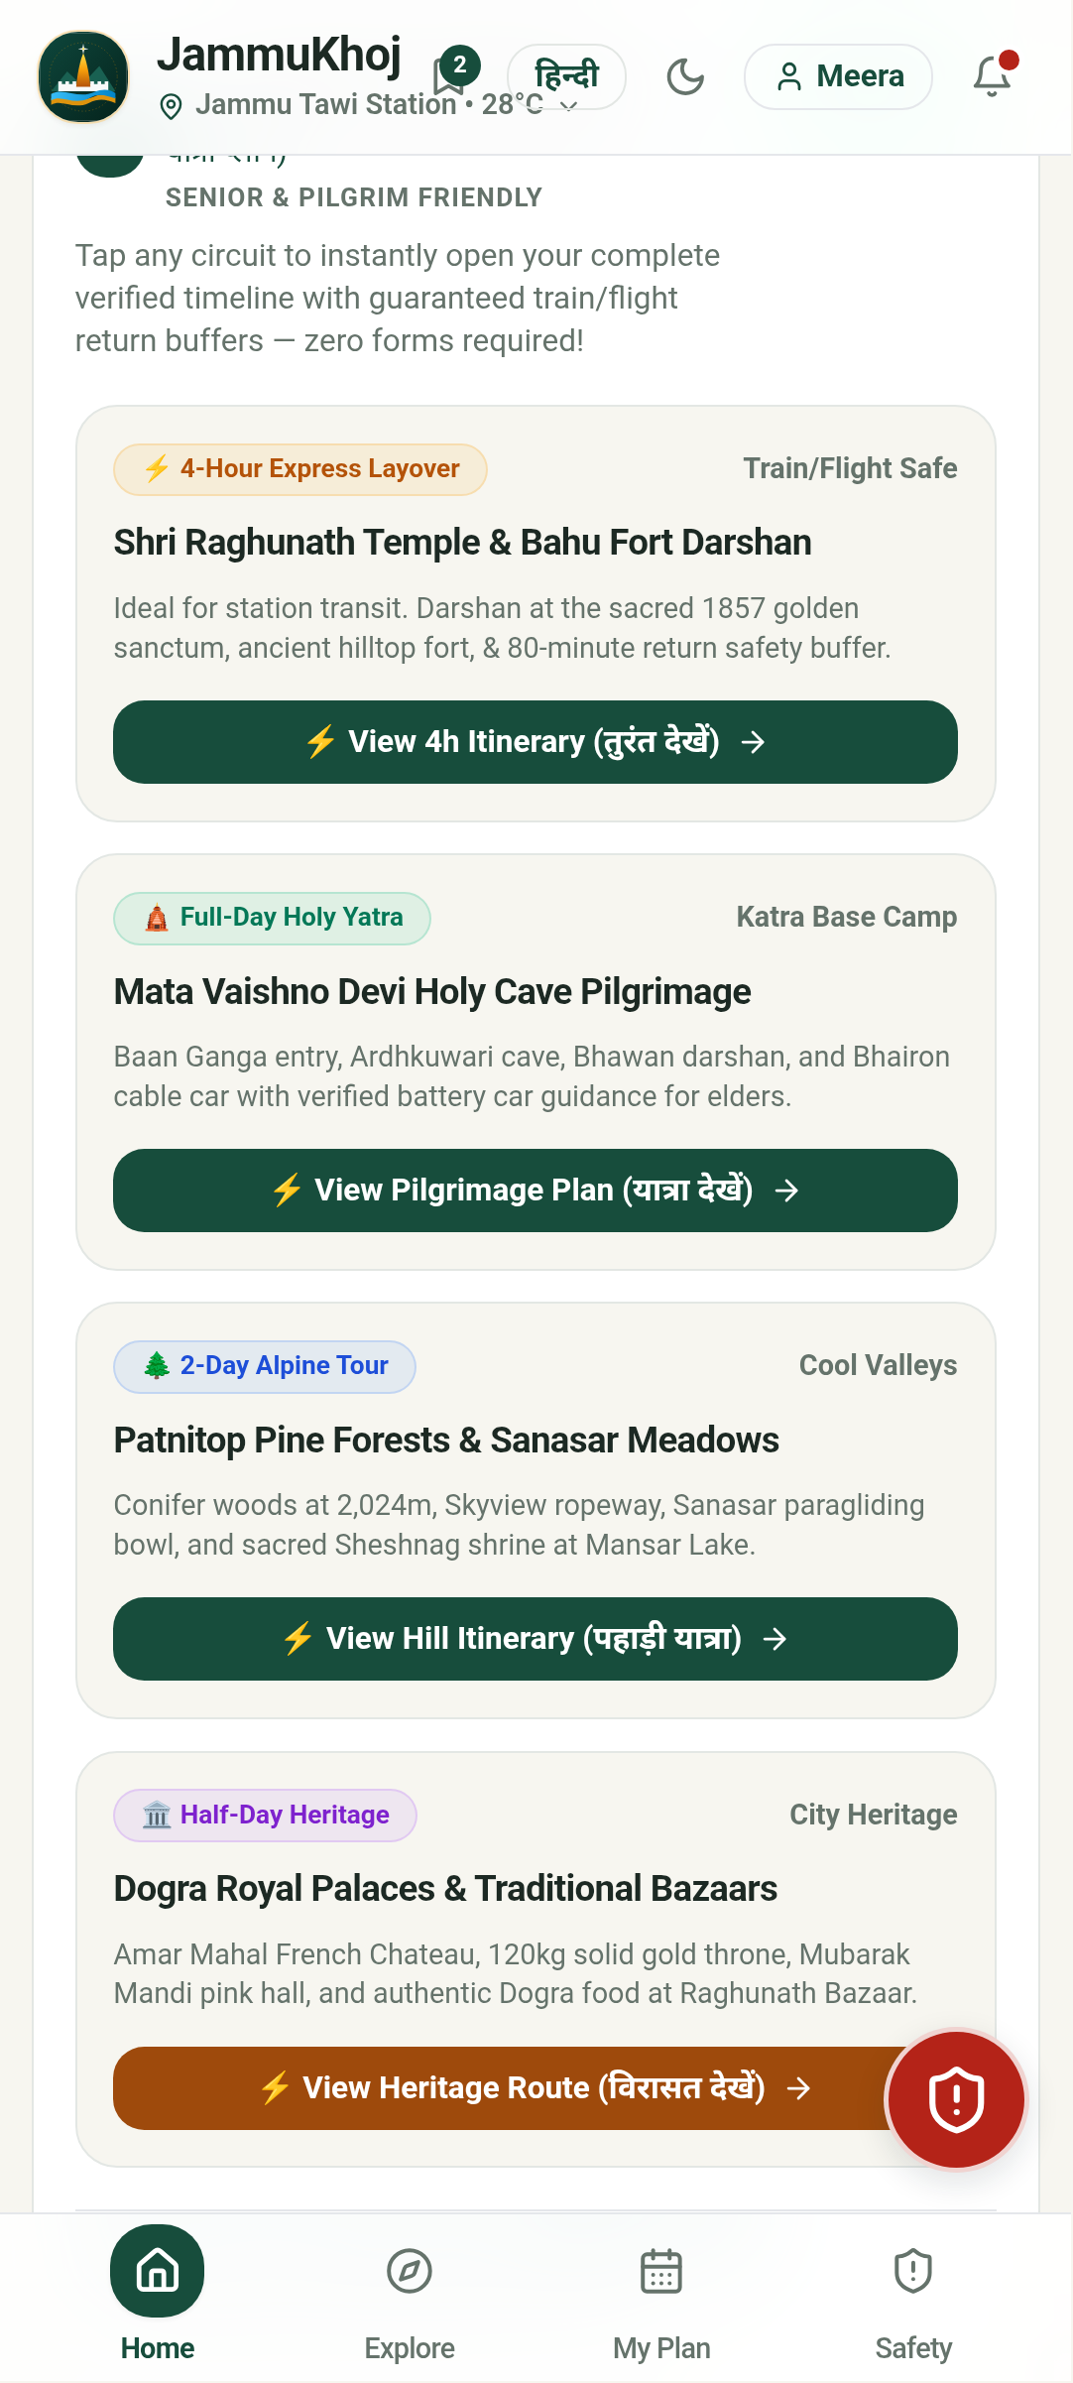
04 • THE SOLUTION ARCHITECTURE
JammuKhoj: An Intelligent, Resilient Local Guide
A human-centered progressive application tailored for zero-data environments and time-critical pilgrims.
⚡ 1-Tap Buffer-Safe Engine
Deterministic layover itinerary engine tailored to traveler's exact departure deadline (4h Express, 8h Cultural, 24h Valley trail). Enforces a strict 45-min rail buffer & 150-min air buffer, eliminating missed departures.
🚌 Transparent Transit Intelligence
Verified stage-by-stage Matador mini-bus routes, Smart City E-bus stops, and prepaid union matrices for auto-rickshaws and taxis to end passenger overcharging.
📶 100% Offline Vector Stack
Entire knowledge graph (36+ attractions, road topologies, timetables, dialer hotlines) bundled in local IndexedDB. Operates with zero SIM or data roaming in mountain valleys.
🧓 Elder & Accessibility Care
Step-free badges, walking load indicators (Low/Med/High), verified Vaishno Devi 5-stage trek manual, battery-car regulations, and 1-tap ERSS 112 WhatsApp location SOS.
JammuKhoj • Smart Tourism & Pilgrim Companion • Live Demo: https://bucolic-buttercream-966135.netlify.app/

Slide 5
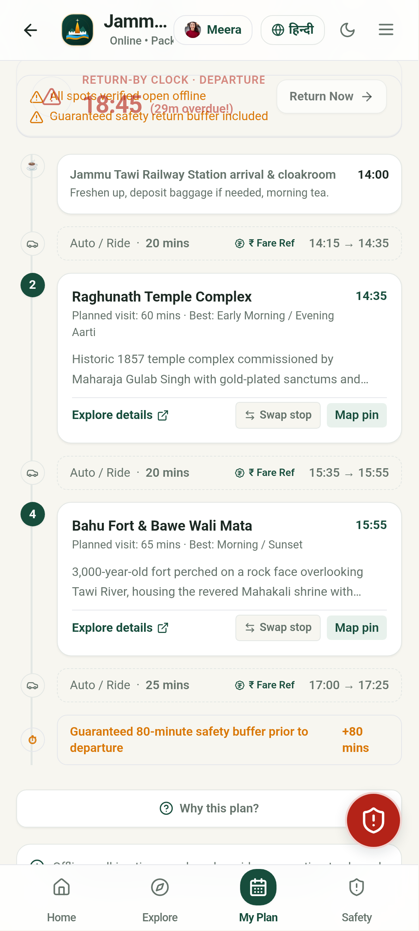
05 • SEAMLESS USER JOURNEY
From Station Arrival to Holy Darshan in 5 Frictionless Steps
Designed for immediate value without forced registration, heavy downloads, or steep learning curves.
STEP 1: 1. ARRIVAL AT STATION / AIRPORT
Yatri steps off train at Jammu Tawi (JAT) or IXJ Airport. Opens jammukhoj.in directly with 1 tap. Zero mandatory app-store download or login wall.
STEP 2: 2. 1-TAP ITINERARY GENERATION
Selects layover: '4-Hour Express' from station. App automatically reserves 45-min departure buffer and crafts a 2.5-hr curated temple circuit.
STEP 3: 3. TRANSPARENT LOCAL TRANSIT
Checks Matador Route #1 to Raghunath Bazaar. Boards with exact ₹15 fare; avoids cab touts quoting ₹400 for the same distance.
STEP 4: 4. CULTURAL DISCOVERY & PURE VEG FOOD
Offers prayers at Raghunath Mandir, tastes authentic Kaladi Kulcha with Jain/Pure Veg filter, and visits verified Basohli craft cooperative.
STEP 5: 5. SAFE ONWARD DEPARTURE
Returns to station with 50 minutes to spare. Boards onward Vande Bharat Express to Katra for holy darshan with complete peace of mind.
JammuKhoj • Smart Tourism & Pilgrim Companion • Live Demo: https://bucolic-buttercream-966135.netlify.app/

Slide 6
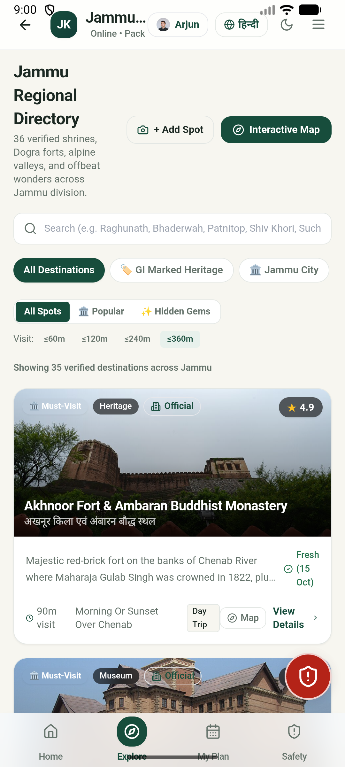
06 • COMPETITIVE DIFFERENTIATION
How JammuKhoj Outperforms Generic Travel Platforms
Direct comparison against Google Maps, MakeMyTrip, and generic travel blogs.
Dimension | Google Maps | MakeMyTrip / OTAs | JammuKhoj (Our App)
Offline Autonomy | Fails in mountain tunnels & valleys | 100% online only; unusable offline | 100% On-Device IndexedDB
Safe Buffer Planner | Ignores train layover deadlines | Rigid commercial packages only | 45m rail & 150m air locks
Transit Tariffs | No Matadors; no fare benchmarks | Commercial cabs at high markup | Matadors (₹10-25) + Taxi matrices
Senior & Pilgrim Care | No stair counts or walking load | Generic packages | Senior Ease Mode & step-free tags
Privacy & Data Safety | Ad-tracking & location profiling | Monetizes user contact data | Zero cookies, zero surveillance
JammuKhoj • Smart Tourism & Pilgrim Companion • Live Demo: https://bucolic-buttercream-966135.netlify.app/

Slide 7
07 • IMPACT & METRICS
Measurable Economic, Civic, and Social Outcomes
High-leverage socio-economic returns for pilgrims, local businesses, and municipal transit.
3x
Dwell Multiplier
Extending transit stay from <2h to 6-8h through safe itineraries.
₹150 Cr+
Economic Target
Direct injection into local Dogra food, crafts & certified transit.
₹1,200
Avg Family Savings
Preventing exploitative cab fares and spurious roadside craft purchases.
0
Missed Departures
100% adherence to conservative rail & flight safety buffers.
🏛️ Cultural & GI Heritage Renaissance
Empowers Basohli miniature painters, Pashmina weavers, and Bhaderwah Rajmash farmers with verified outlet discovery and fake-identification guides. Pilgrims purchase authentic GI certified heritage at fair benchmark prices directly supporting traditional craft families.
🛡️ Public Safety & Yatra Welfare
1-Tap WhatsApp GPS SOS dispatcher and offline dialers for ERSS 112, SMVDSB Shrine Helplines, and women's assistance. Real-time dynamic temple crowd meters and aarti timings prevent stampedes and reduce elder exhaustion during Navratri surges.
JammuKhoj • Smart Tourism & Pilgrim Companion • Live Demo: https://bucolic-buttercream-966135.netlify.app/

Slide 8
08 • EXECUTION ROADMAP
4-Stage Scalable Deployment Plan (2026 – 2027)
From proven progressive web app & Android build to institutional statewide rollout.
LIVE IN PRODUCTION
Q1-Q2 2027
Q3 2027
Q4 2027+
Phase 1: Foundation
✔ Live on jammukhoj.in domain
✔ 100% offline PWA & Android APK
✔ 36+ curated attractions & maps
✔ 44 automated unit & E2E tests passing
✔ 1-Tap buffer planner & transit matrix
Phase 2: Transit Node Pilot
• QR kiosks at Jammu Tawi & Katra concourses
• J&K Smart City e-bus live GPS sync
• Onboard 50+ verified local dhabas & GI shops
• Target: 50,000 monthly active yatris
Phase 3: Institutional Sync
• Official J&K Tourism Directorate endorsement
• SMVDSB Katra battery-car & RFID tie-in
• Northern Railway Yatri Niwas booking cross-links
• Target: 250,000 active pilgrim users
Phase 4: Ecosystem Scale
• Expansion to Bhaderwah, Kishtwar, Poonch & Rajouri
• Audio heritage guides in Dogri, Hindi & English
• Open-source blueprint for Varanasi & Tirupati
• Self-sustaining civic non-commission model
JammuKhoj • Smart Tourism & Pilgrim Companion • Live Demo: https://bucolic-buttercream-966135.netlify.app/

Slide 9
09 • TRUST & SUSTAINABILITY
Civic Integrity, Zero-Surveillance Privacy & Low Footprint
Built to protect user privacy and operate sustainably without predatory data monetization.
🔒 Zero-Surveillance Privacy
Google Play & Privacy Act Compliant
• 100% of user data, bookmarks, and custom plans remain strictly on-device in IndexedDB.
• Zero tracking cookies, zero third-party telemetry, zero location data monetization.
• Zero mandatory registration barrier: full functionality available to guests.
• 1-Tap permanent account & local storage wipe button directly in Settings.
🌱 Ultra-Low Resource Footprint
Engineered for Mountain Transit
• Lightweight 5.5 MB APK and <2 MB compressed web bundle.
• Runs smoothly on budget ₹6,000 Android phones without thermal throttling.
• Offline-first vector maps consume zero background cellular data.
• OLED-friendly dark mode and high-contrast WCAG 2.1 AA modes conserve traveler battery.
🤝 Sustainable Civic Model
Public Benefit, Non-Commission
• Non-commission directory preventing price inflation for travelers.
• Verified artisan and homestay listings supported by J&K Tourism development authorities.
• Open-source data structures contributing back to OpenStreetMap and civic archives.
• Scalable cloud architecture hosted efficiently with negligible monthly operational cost.
JammuKhoj • Smart Tourism & Pilgrim Companion • Live Demo: https://bucolic-buttercream-966135.netlify.app/

Slide 10
CLOSING PITCH • PILOT CALL TO ACTION
Partner with Us to Transform Jammu Tourism
Turn a hurried 2-hour transit rush into an enriching, safe cultural gateway for 10 million yatris.
1. Transit Signage Pilot
Permission for QR code info panels at Jammu Tawi (JAT) and SVDK Katra station concourses to give yatris instant offline guide access.
2. Tourism Dept Data Link
Official co-branding and verification link with Directorate of Tourism, Jammu (TRC) to keep fare tables and festival schedules authoritative.
3. Shrine Board Sync
Collaboration with SMVDSB Katra to integrate battery-car status, aarti timings, and emergency medical aid coordinates.
🌐 Live Demo: https://bucolic-buttercream-966135.netlify.app/ • 🌍 Domain: https://jammukhoj.in
Open Source • 100% Offline Progressive Web App & Android Ready • Contact: support@jammukhoj.in

