Slide 1

Digital Certificates
Public Key Deception
Digital Certificates
Certificate Authorities
Public Key Infrastructures (PKIs)
Notes:
‹#›

Slide 2
Public Key Deception
Impostor Claims to be a True Party
True party has a public and private key
Impostor also has a public and private key
Impostor sends impostor’s own public key to the verifier
Says, “This is the true party’s public key”
This is the critical step in the deception
Notes:
‹#›

Slide 3
Public Key Deception
If verifier accepts the impostor’s public key as the true party’s public key,
Impostor will be authenticated through any public key authentication method, because their private key will work
Impostor can also decrypt messages sent by the verifier if these messages are encrypted with the impostor’s public key
Notes:
‹#›

Slide 4
Public Key Deception
Moral:
Public key encryption for privacy, confidentiality, authentication, and message integrity only works if
The verifier gets the true party’s public key independently of the applicant,
From a trusted third party
Notes:
‹#›

Slide 5

Digital Certificates
Created by a Certificate Authority
Certificate authority is the trusted third party
Certificate
Authority
Digital
Certificate
Authenticated
Party
Notes:
‹#›

Slide 6
Certificate Authorities
Unfortunately, certificate authorities are not regulated
You must only use certificate authorities you trust
Company can be its own certificate authority for internal authentication among its hardware and software systems
Notes:
‹#›

Slide 7
Digital Certificates
Assert that a true party (named) has the public key contained in the digital certificate
Provides a name-public key pair
Therefore prevents public key deception
Fields and content are standardized by the ITU-T X.509 Standard
Notes:
‹#›

Slide 8
Digital Certificates
Each digital certificate has its own digital signature, signed (encrypted) by the private key of the certificate authority
Provides message integrity so that an impostor cannot change the name field in the digital certificate to its own
Notes:
‹#›

Slide 9
Digital Certificates
Certificate authorities may revoke digital certificates before the expiration date listed in the digital certificate
Revoked certificate ID numbers are placed in a certificate revocation list (CRL)
Verifier must check with the certificate authority to determine if a digital certificate is on the CRL
Without the CRL check, digital certificates do not support authentication
Notes:
‹#›

Slide 10
Digital Certificates
Recap
A digital signature gives the public key of a named party
This is needed for public key authentication, to prevent public key deception
However, a digital certificate alone does NOT provide authentication
Notes:
‹#›

Slide 11
Public Key Infrastructures (PKIs)
Private key creation and distribution
Digital certificate creation and distribution
Certificate Revocation List checking
Notes:
‹#›

Slide 12
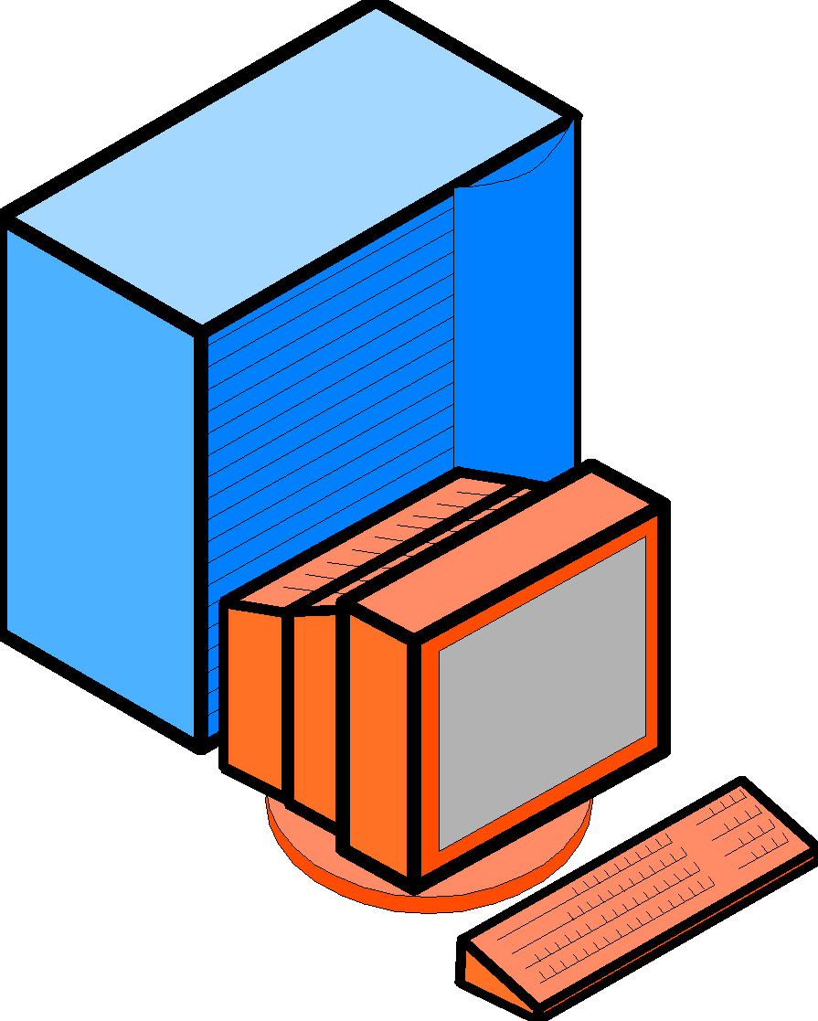
PKIs
To use public key methods, an organization must establish a comprehensive Public Key Infrastructure (PKI)
A PKI automates most aspects of using public key encryption and authentication
Uses a PKI Server
PKI
Server
Notes:
‹#›

Slide 13
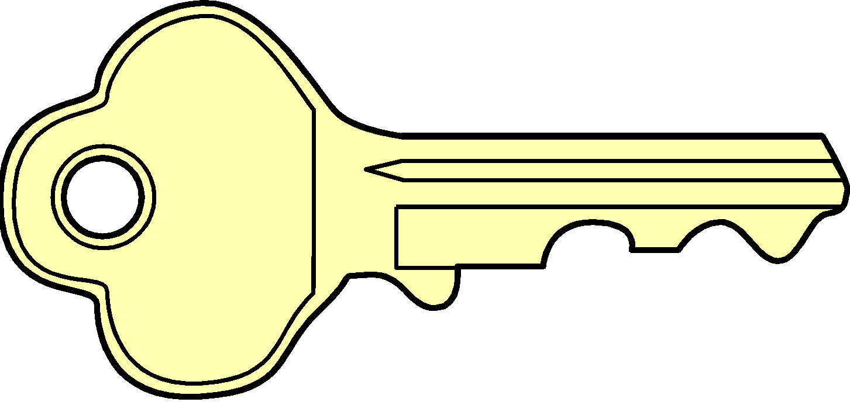

PKIs
PKI Server Creates Public Key-Private Key Pairs
Distributes private keys to applicants securely
Often, private keys are embedded in delivered software
Private Key
PKI
Server
Notes:
‹#›

Slide 14
PKIs
PKI Server Provides CRL Checks
Distributes digital certificates to verifiers
Checks certificate revocation list before sending digital certificates
Digital Certificate
PKI
Server
Notes:
‹#›

Slide 15
PKIs
CRL Checks
If applicant gives verifier a digital certificate,
The verifier must check the certificate revocation list
CRL
PKI
Server
OK?
OK or Revoked
Notes:
‹#›

Slide 16
Integrated Security System
When two parties communicate …
Their software usually handles the details
First, negotiate security methods
Then, authenticate one another
Then, exchange symmetric session key
Then can communicate securely using symmetric session key and message-by-message authentication
Notes:
‹#›

Slide 17
SSL Integrated Security System
SSL
Secure Sockets Layer
Developed by Netscape
TLS (now)
Netscape gave IETF control over SSL
IETF renamed it TLS (Transport Layer Security)
Usually still called SSL
Notes:
‹#›

Slide 18
Location of SSL
Below the Application Layer
IETF views it at the transport layer
Protects all application exchanges
Not limited to any single application
WWW transactions, e-mail, etc.
E-Mail
WWW
E-Mail
WWW
SSL
SSL
Notes:
‹#›

Slide 19
SSL Operation
Browser & Webserver Software Implement SSL
User can be unaware
Notes:
‹#›

Slide 20
SSL Operation
SSL ISS Process
Two sides negotiate security parameters
Webserver authenticates itself
Browser may authenticate itself but rarely does
Browser selects a symmetric session key, sends to webserver
Adds a digital signature and encrypts all messages with the symmetric key
Notes:
‹#›

Slide 21
Importance of SSL
Supported by Almost All Browsers
De facto standard for Internet application security
Problems
Relatively weak security
Does not involve security on merchant server
Does not validate credit card numbers
Viewed as an available but temporary approach to consumer security
Notes:
‹#›

Slide 22
Other ISSs
SSL is merely an example integrated security system
Many other ISSs exist
IPsec PPP and PPTP Etc.
Notes:
‹#›

Slide 23
Other ISSs
All ISSs have the same general steps
Negotiate security parameters
Authenticate the partners
Exchange a session key
Communicate with message-by-message privacy, authentication, and message integrity
Notes:
‹#›

