Slide 1
Complete Git & Github Course: For Dev, Qa And Et Al

Slide 2
Welcome Note…
Hi, I am Khaja. Thank you for enrolling into the “Complete Git & GitHub Course – for Dev, QA and et all” course. Git has become the leader in Version Control (which we are going to discuss what exactly in great detail) and Source Code Management.
Doesn’t matter what phase of the SDLC (Software Development Life Cycle), you belong to, there’s no way hiding from this awesome tool.
Once again, Welcome you to an awesome journey ahead.

Slide 3
Course Outline
Hi, let me walk you through the course outline.
In the first section, We will start with Git Overview, where you will learn about a few important concepts like What is version control, why do we need it etc., and deep dive into Git Architecture, and understand and break some of the myths of Git vs GitHub.
In the second section, you will learn the quick and dirty thing of installation and setup of Git environment.
In the third section, we will try to learn and understand a few core concepts of GitHub. Though we will be concentrating on GitHub, you can easily replace it with any other hosting services like BitBucket etc., whose underlying Version Control system is Git.

Slide 4
Course Outline
In the fourth section we will learn walk through some of the commonly used and very basic Git commands like Add, RM, Commit etc.,
In the fifth section we will deep dive into the more complex commands of Git.
In the sixth section, you will try to practice all we have learnt throughout the first five sections to replicate on an IDE like Eclipse or IntelliJ Idea.

Slide 5
Prerequisites
We assume that you are going to use Git to handle all levels of Java and other programming language based projects. For that it would be good enough if you have some basic understanding of software development life cycle. Well to confirm as long as you have a computer with Git installed on it, that pretty much is good enough to start our journey.

Slide 6
Version Control
Even before we start anything with Git, its very important to understand what is a Version Control system and why do we have to have a version control system?
Let’s try to understand it visually with a very basic day to day changing file. Let’s say you have a simple file name as abc_vx.0.txt (where x keeps changing with time). If you see the diagram shown on the screen, for every simple modification we do to the file, we give a new name to the file, by giving it a new version name to the file, so that the old file is not lost. Well, this is how we do version control of our day to day files. It’s quite easy isn’t it! Well, for starters you can say YES!, but imagine you have 100 or even 1000 revisions of this file. And all of a sudden you have decided to go back to a change that you made in the past for a certain text, image or some sort of data. The problem here is you may have to revisit more than one file to be able to find the exact file you require. This may sound easy but in practicality it’s quite a tedious process. Also, if you have lost the physical file of that version, there is no possible way to retrieve it back.
Let’s look another scenario, let’s say you have shared this file with your friend and both of you are working on the same file. He/ She will have their own versions of the file on their systems. When you decide to merge your changes with your friends, and somehow want to retrieve their old file, when they are away from their machines its impossible to get those changes.
I hope you get a hangout of what Version Control is by now. But managing it in a manual way is not anywhere close to a feasible solution. So, Version Control systems like Git comes to your rescue. Git is not the lone wolf in this space of the market. The following slide should give you a glimpse of various players in this market space.

Slide 7
Version Control
It is also important for us to discuss what different models of Version Control systems are available. We have 2 major types of Version Control Systems.
1. Centralized Version Control
2. Distributed Version Control

Slide 8
Version Control - Centralized Version Control
Centralized version control systems have come with idea that there’s only a single “central” copy of your project lets say on your server, and developers, designers or QA’s would update their changes to this particular central copy.
Well in this case, other’s involved with the project can easily see these change. They can also pull these changes, and the version control system/ tool will automatically update the contents of any or all files/ folders that were changed.
So, Programmers no longer have to keep many duplicate copies of files/ folders on their local hard drives manually, because the version control tool can talk to the central copy and retrieve any version they need on the fly.
Some of the most common centralized version control systems you may have heard of or used are CVS, Subversion (or SVN) and Perforce.
Some of the benefits of Centralized Version Control system are:
It is easy to understand.
You have more control over users and access (since it is served from one place).
More GUI & IDE clients (Subversion has been around longer).
Simple to get started.
Centralized Version Control Systems have some drawbacks:
Dependent on access to the server.
It can be slower because every command connects to the server.
Branching and merging tools are difficult to use.

Slide 9
Version Control – Distributed Version Control
Distributed Version Control systems do not necessarily rely on a central server to store all the versions of a project’s files. Instead, every programmer “clones” a copy of a repository so that they can have the full history of the project on their own hard drive. This copy (or “clone”) has all of the metadata of the original.
This could sound like duplication of the repository or files, though in reality its true to an extent it solves most of the problems of the Centralized Version Control system and is an excellent upgrade from Centralized Version Control system. As these days the disk space has become more and more cheaper, maintaining duplicate copies on ones systems should not be a huge task. Well you would be thinking then, why can’t I just have it manually, well, as we discussed earlier there are so many issues of maintaining these duplicate copies manually and things would be awfully wrong in organization projects. Most programming projects consist mostly of plain text files (and maybe a few images), and disk space is so cheap that
One common misconception about distributed version control systems is that there cannot be a central project repository. This is simply not true – there is nothing stopping you from saying “this copy of the project is the authoritative one.” This means that instead of a central repository being required by the tools you use, it is now optional and purely a social issue.
One huge advantage of Distributed Version Control system is, you are not completely dependent on the Server copy. At the start of the day, you can fetch the changes from the central repository/ server and start your work. You are completely free and on your own. Once you have a copy on your own, travel around the world or go to places where there’s no internet connection and work on your own (of course as long as you don’t need internet connection for your own project resources).
Some of the disadvantages of Distributed Version Control System are:
The distributed model is harder to understand.
The revisions are not incremental numbers, which make them harder to reference until you get a hang of it.

Slide 10
Version Control
abc_v1.0.txt
abc_v2.0.txt
abc_v3.0.txt
abc_v4.0.txt
abc_v5.0.txt
abc_v6.0.txt
abc_v7.0.txt
abc_v8.0.txt

Slide 11
Version Control
Source: https://en.wikipedia.org/wiki/Comparison_of_version_control_software
Software | Maintainer | Development status | Repository model | Concurrency model | License | Platforms supported | Cost
AccuRev SCM | Micro Focus International | Active | Client–server | Merge or lock | Proprietary | Most JavaPlatforms (Unix-like,Windows, OS X) | Non-free Quoted on an individual basis. $350 /seat
GNU Bazaar | Canonical Ltd. | Active | Distributed andClient–server | Merge | GNU GPL | Unix-like,Windows, OS X | Free
BitKeeper | BitMover Inc. | Active | Distributed | Merge | Apache | Unix-like,Windows, OS X | Free
ClearCase | IBM Rational | Active | Client–server | Merge or lock^{[nb 1]} | Proprietary | Linux,Windows,AIX, Solaris,HP UX,i5/OS,OS/390,z/OS, | Non-free $4600 per floating license (held automatically for 30-minutes minimum per user, can be surrendered manually)
Code Co-op | Reliable Software | Active | Distributed | Merge | Proprietary | Windows | Non-free $150 per seat
Codeville | Ross Cohen | official site offline; latest release July 13, 2007 | Distributed | precise codeville merge | BSD | Unix-like,Windows, OS X | Free
CVS | The CVS Team^{[1]} | maintained but new features not added | Client–server | Merge | GNU GPL | Unix-like,Windows, OS X

Slide 12
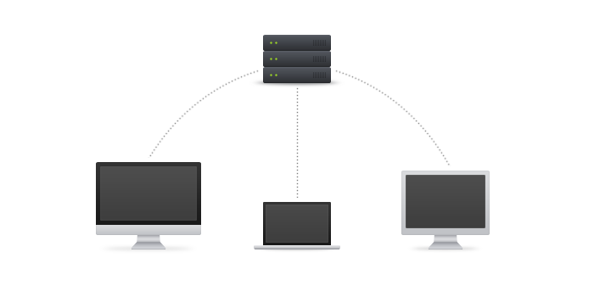
Version Control - Centralized Version Control
Source: http://guides.beanstalkapp.com/version-control/intro-to-version-control.html

Slide 13
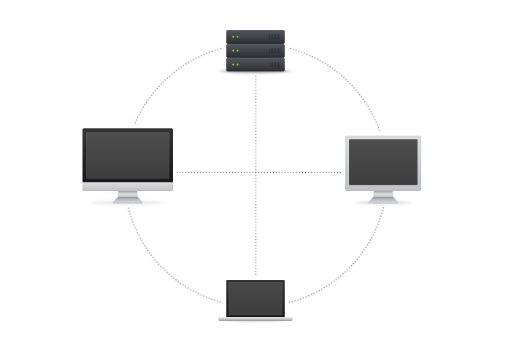
Version Control - Centralized Version Control
Source: http://guides.beanstalkapp.com/version-control/intro-to-version-control.html

Slide 14
Git – 2-tier Architecture
Below is a typical (of course simple) 2-tier architecture.
Repo
Working Copy
Fetch/ Checkout
Push/ Commit

Slide 15
Git – 3-tier Architecture
Git is a 3-tier architecture. Let me show in a pictorial representation of what am blabbering.
Repo
Staging Area
Working Copy
git commit abc.txt
Fetch/ Checkout
Push/ Commit
git add abc.txt

Slide 16
Git – 3-tier Architecture
Source: http://www.darwinbiler.com/understanding-the-3-tree-architecture-of-git/

Slide 17
Git vs GitHub
Git | GitHub
Git is a revision control system (a typical Distributed Version Control System), a tool to manage your source code history. | GitHub is a hosting service for Git repositories.
Typically, if you are coming from SVN world, Git replaces SVN | While GitHub replaces SourceForge
Git is a free and open source distributed version control system designed to handle everything from small to very large projects with speed and efficiency | GitHub is a web-based Git repository hosting service, which offers all of the distributed revision control and source code management (SCM) functionality of Git as well as adding its own features
You do not need GitHub to use Git | You need Git to use GitHub
Git is kind of local | GitHub is like a remote/ cloud.

Slide 18
Typical Daily Activities Of Folks Involved With Distributed Version Control
Source: http://www.tutorialspoint.com/git/git_life_cycle.htm

Slide 19
Typical Daily Activities Of Folks Involved With Distributed Version Control
Working Copy
Repository
Clone Operation
Edit, Modify,
Remove files
Modify the Working Copy
Update/ Fetch
Operation
Status and Diff
operations
Review Changes
Commit and Push
Operations
Push Operation
Commit Changes
Fix Changes
Amend and Push
Operations
Push Operation

