Slide 1

Defect State Diagram Version 2.1
The following diagram shows how a defect can change its state:
DV
Open
Assigned
Review
Fixed
Test Ready
Retest
Closed
Open
Closed
TL/FL
DV
DV
DV
DV
T
DV
T
DV
Reopen
T
Pending
DV
TL/FL
TL/FL
T: Tester, Test Lead / Functional Lead
TL/FL: Test Lead / Functional Lead
DV: Developer
DSD Version 2.1
*Developer has Tester and Test Manager permissions for defects opened by Development (Only)

Slide 2
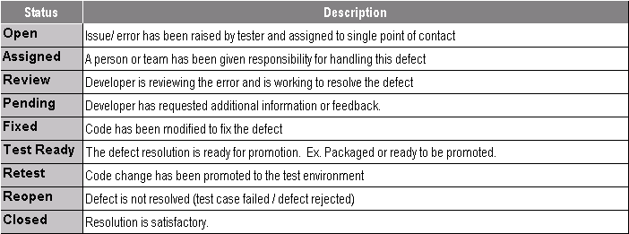
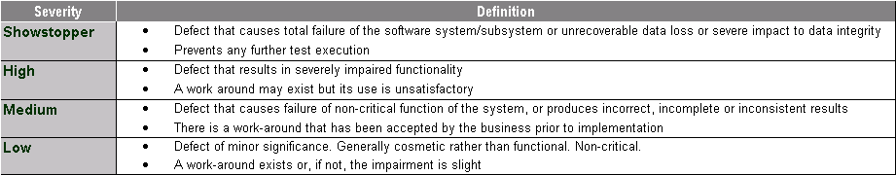
… Defect State Diagram Version 2.1
The following table describes the states of a defect:
The following table describes the severities of a defect:
*Note: Defect severity will be considered when assessing production readiness and drive exit and entrance criteria
DSD Version 2.1

Slide 3
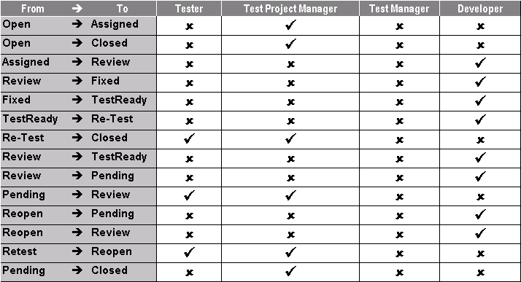
… Defect State Diagram Version 2.1
The following table describes the permissions on state transitions to different roles:
DSD Version 2.1

Slide 4
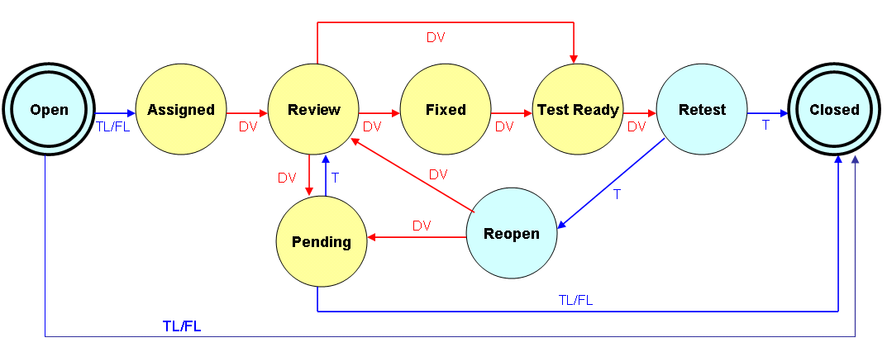

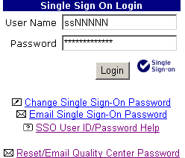


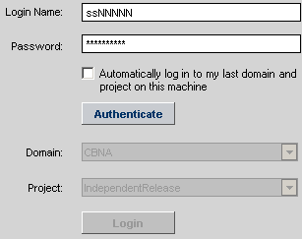

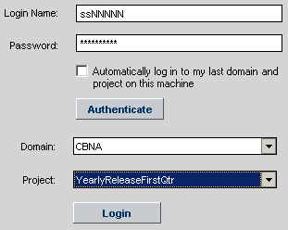
Defect Tracking Process: A Quick Reference
(1) Use the URL https://qc.nam.nsroot.net/QCLogin/
to login to Quality Center.
→ The SSO Login screen is displayed.
→ Type SOE ID and SSO password
→ Click on the Login button
(6) Mails may be sent from Quality Center. The e-mail IDs that reside at Quality Center database are used, (not using Outlook) Use the following icon for sending mails:
Spell check may be performed to the mail:
(7) The defect may marked for follow-up, use the following icon:
Defect State Diagram
→ The Quality Center Login screen is displayed
→ Type SOE ID and Quality Center password
→ Click on the Authenticate button
(8) The data shown on defect grid screen may be filtered as per the need. To do this click on:
(2) A defect may be closed in the following ways:
ReTest → Closed
Pending → Closed
Open → Closed
(9) While changing the states the writing the comments are mandatory.
(3) The following entities may be attached with each defect:
A file
A snapshot of the screen
An URL
Contents of clip board
(10) If the severity is critical, then blocker is a required field
→ Select the Domain (normally it is CBNA)
→ Select the Project (Example:YearlyReleaseFirstQtr)
→ Click on the Login button
→ You are logged into Quality Center
(11) The following charts are available in Quality Center for reporting purposes:
→Summary: Group by Status
→Progress:Group by Status
→Defect Age: Group by Status
→Trend: Group by Status
(4) The columns in defect grid screen may be customized by selecting or deselecting the columns icon. To do this click on:
(5) Use the URL to reset Quality Center password:
https://qcd.nam.nsroot.net/qcmacro/qcpasswordreset.htm
Note: CBNA_QC is a demo / sandbox project
DSD Version 2.1
URL for accessing Quality Center: http://qc.nam.nsroot.net/QCLogin/
Send questions / requests to the e-mail ID: *QC Support OR dl.QC.Support@imcnam.ssmb.com

