Slide 1

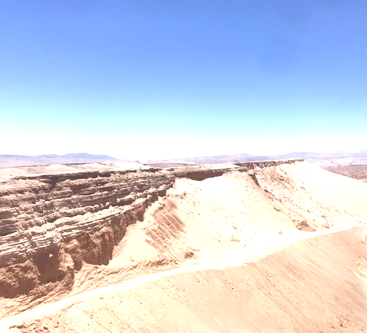

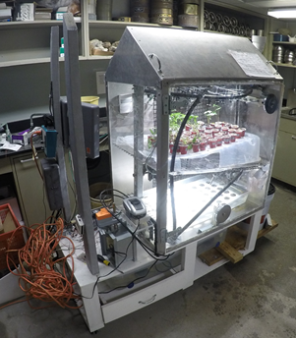
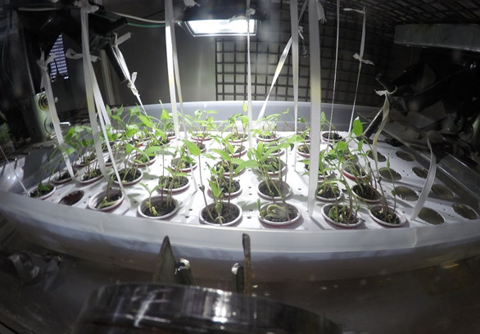
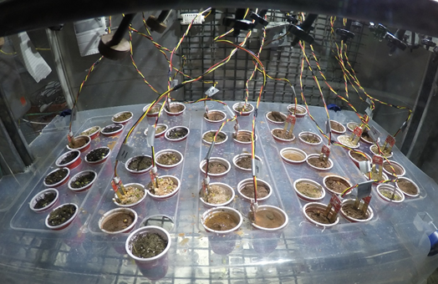


The Advancement of Mars Colonization Through Agricultural Development
Michael Bustamante, Andrew Cline, Julio Enriquez, Ignacio Hernandez,
Skylar Hoffert, Trung Le, Jordyn Stanek, Moises Nunez, Aaron Torres
Research Mentors: Dr. Martz & Dr. Morano
Abstract
This project will focus on developing a biomimicry inspired resource extraction system to successfully colonize Mars in the future. The objective will be to take pre-existing technology and techniques used in previous studies, and apply them to new environmental conditions to increase our survival outside the planet Earth. A theoretical system will be developed to simulate the vegetation growth environment of Earth. This will be done to sustain a civilization over an extended period of time on Mars (5-20 years). The resources targeted will include biofuels and food from the vegetation being grown, water from the Mars environment, and essential gases such as oxygen, carbon dioxide, nitrogen, and hydrogen. These resources will be utilized as fuels to power the multiple mechanical systems as well as life support for the inhabitants of Mars. This goal will be achieved by the designing of two deliverables: A theoretical growth environment for the settlement of Mars and a prototype to obtain tangible data of the vegetation growth environment of Earth. To successfully sustain vegetation survival on Mars, physical parameters including power management, durability, low mass, autonomy, and simplicity of both the prototype and theoretical designs must be studied. The experimental results of the prototype will be used to build a concrete plan of action and ensure accurate estimates to create the most successful theoretical design to colonize Mars.
Project overview
Prototype
Overview:
The prototype will gather tangible data to determine the most effective plant growth rates, Mars compositions, temperature, essential nutrient levels, and UV light absorption. This system will be automated in order to minimize human contact
Different soil compositions and a hydroponic system will be tested
It will be equipped with moisture sensors for two specimens of each soil kind and will have a temperature sensor to measure the environment
A photoelectronic sensor will be used to measure the light intensity being experience by the plants to see how the distance of the growth light will affect the growth patterns
Separate controllers will be used to manage the watering and light schedules.
All the data gathered will be input into excel to do a statistical analysis of the information
Limitations:
Fluctuation of light intensity of the prototype is not comparable to the Earth’s biological growth environment
Restricted growing season (limited amount of growth cycles)
Large size of research team
Wait time on prototype components
Component additions to original prototype
Accounting for changing variables in the prototype growth environment
Figure 1. Illustrates the growth environment of the prototype (a) along with the results of the hydroponic (b) and soil sample (c) experiments.
Table 2. Illustrates the different soil compositions tested in the prototype.
Preliminary Findings
Hydroponics has shown dramatic growth of all specimens
Desert and synthetic samples have shown poor growth patterns except for the soil samples
All moisture sensors and temperature sensors are operational and recording data
Amount of solar energy needed for effective growth still needs to be measured
Comparation between light intensity between hydroponic and soil growth environment still has to be done
Problems with the miracle grow samples and light Hight has been determined and will be fixed
Discussion
Determination of the effectiveness of the growth medium can be observed in Figure 1 (b and c) where the hydroponic environment shows the substantial growth of every single specimen, compared to the soil samples at the top which show most of the growth was done only by the regular soil samples. It can also be observed that the placement of the light is critical for effective growth, since the specimens furthest from the light source show less growth than those closest to the light source. This could be one of the key reasons why the soil samples seem to be growing exponentially less. Another possible issue that could have caused the lack of growth could have been the use of “miracle grow” which is not meant to be used in synthetic soil or dessert soil which can be observed in figure 1 c.
Future Work
The experimental data obtained by the prototype will be used to develop a theoretical Mars colonization model, that will sustain a population of individuals located in the Martian environment for an extended period of time (5-30 years). This period could be extended or shortened depending on the needs of the crew in Mars
Research on power sources, Mars environmental challenges, vegetation types and characteristics, communication and data management will be done to build a more concrete Mars colonization Model
Findings from this project will be presented to NASA Glenn Research Center where the viability of this project will be evaluated
References
Shultz, D. (2015). Curiosity Rover Finds Organic Molecules on Martian Surface. Eos, 96. doi:10.1029/2015eo037083
Francis, R., et al. (2017). AEGIS autonomous targeting for ChemCam on Mars Science Laboratory: Deployment and results of initial science team use. Science Robotics, 2 (7). doi:10.1126/scirobotics.aan4582
Hurowitz, J. A., et al. (2017). Redox stratification of an ancient lake in Gale crater, Mars. Science, 356 (6341). doi:10.1126/science.aah6849
Arvidson, R. E., et al. (2014). Ancient Aqueous Environments at Endeavour Crater, Mars. Science, 343 (6169). doi:10.1126/science.1248097
Meslin, P.Y, et al. (2013) Soil Diversity and Hydration as Observed by Chem Cam at Gale Crater, Mars. Science, 341, (6153). doi: 10.1126/science.1238670,
Acknowledgements
Dr. Martz & Dr. Morano, Department of Natural Sciences UHD
Dr. Tzouanas, Department of Science and Engineering Technology UHD
University Honors Program UHD
NASA Glenn Research Center
Houston Prep
The project will be divided into four disciplinary areas:
Chemistry
Geology
Computer Science
Electrical/software Engineering
The project will have two main deliverables:
Prototype (testing of hydroponic and soil environment)
Theoretical model of the growth environment
Project overview
1)Resources | 2) Extraction | 3) Refinement | 4) Storage
Oxygen Carbon dioxide Nitrogen Hydrogen Food Biofuels | Plant growth | Refinement of biofuels Recombination of essential gases to synthesize other valuable compounds | Gas tanks Fuel Tanks
Sun Chemical energy Nuclear Isotope Perchlorates Water | Thermal energy Chemical energy Martian soil | Distillation Purification of Martian soil | Nuclear Reactor Batteries Water reservoir Fuel tanks
(a) (b) (c)
Soil Types
Atacama Desert soil samples with no additives (San Pedro, Chile)
Atacama Desert soil samples with no additives (San Pedro, Chile)
Synthetic Soil with no additives (UHD lab; Houston, TX)
Synthetic Soil with nutrients (NPK; Miracle Grow)
Nutrient rich Potting Mix with no additives
Nutrient rich Potting Mix with nutrients (NPK; Miracle Grow)
Crushed Basaltic rock in nutrient rich hydroponics (Capulin, New Mexico)
Table 1. Illustrates the project overview which highlights the essential resources targeted along with the extraction, refinement, and storage for them.
Department of Natural Sciences
www.uhd.edu/academics/sciences/natural-sciences/
Notes:
1

