Slide 1




Slide 2


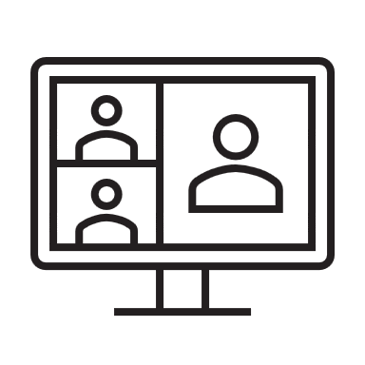



View the TodoList
Tab
Add a to-do item
extend
Update/Delete a to-do item
Tab
Meeting
Chat
Tab
Share with others
User
Meeting
Chat
Viewer
Get daily notifications
Bot

Slide 3

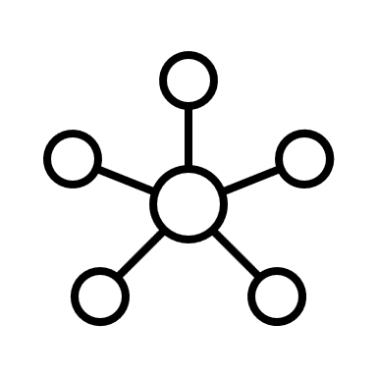

Front-end
Adaptive Card
Back-end
Database
Show user profile
Manage to-do items
MS Graph
Send notifications
SSO

Slide 4
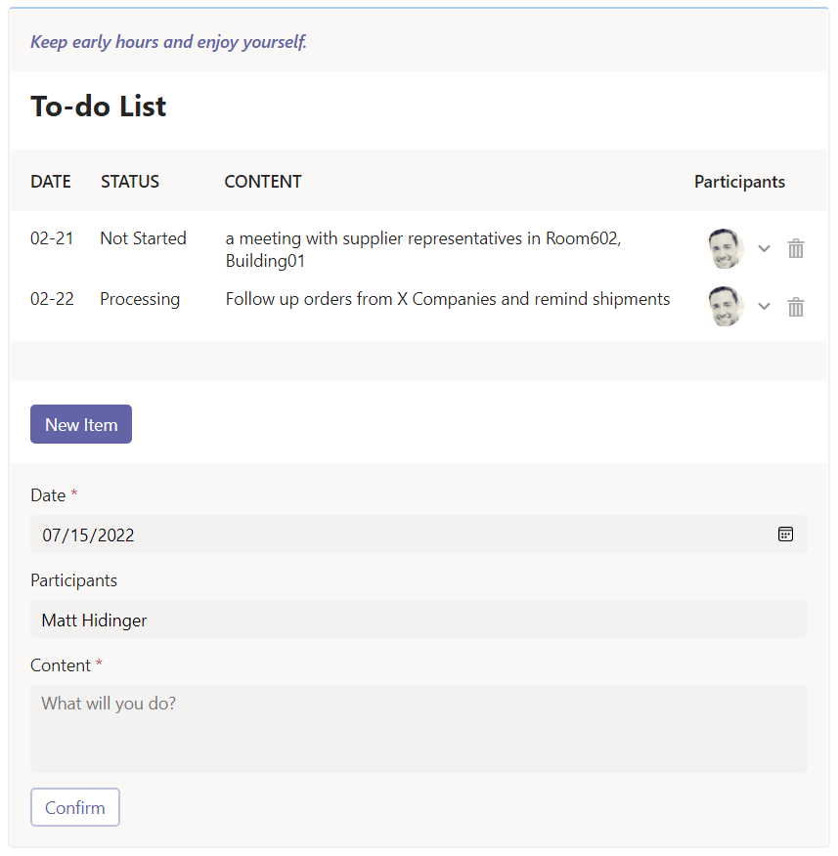
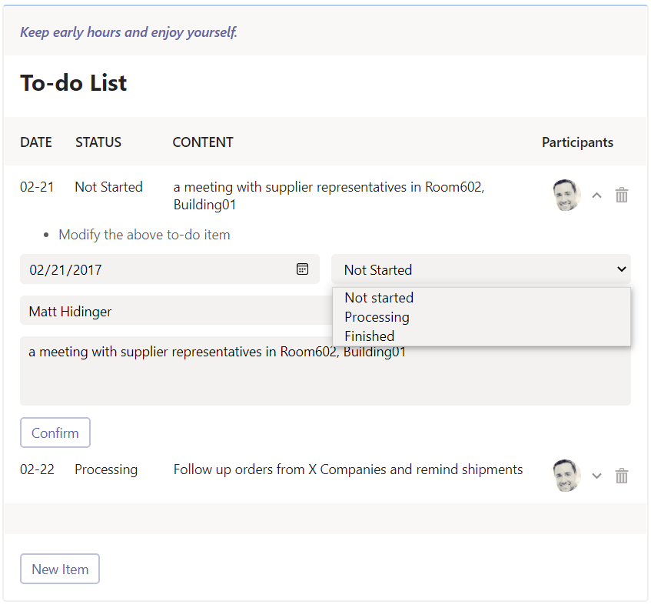
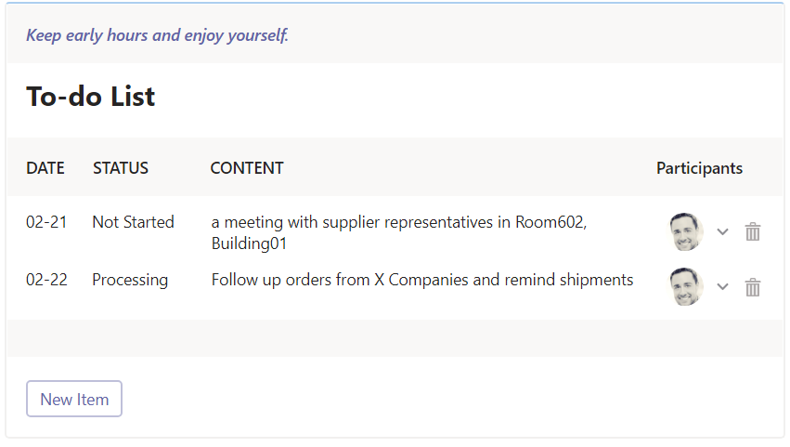
Scenario 1
3
2
1

Slide 5

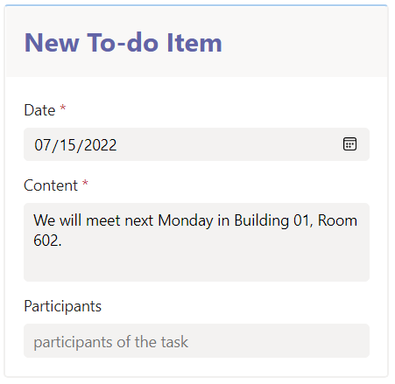

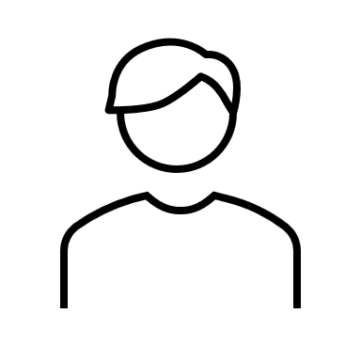
Scenario 2
1
… …
2
We will meet next Monday in Building 01, Room 602.
More actions >

Slide 6
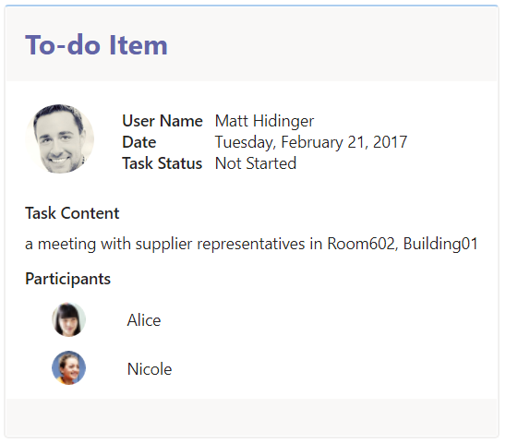
Scenario 3
1
2

Slide 7
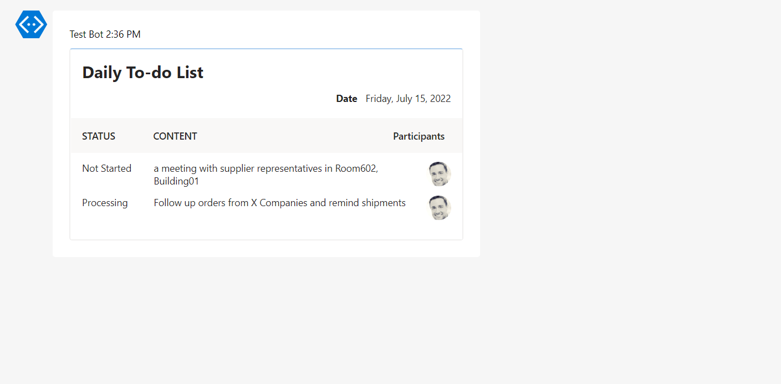
Scenario 4

