Slide 1
Predicting Taste Preference based on Nutritional Content
MOIRI GAMBONI ABHIJAI GARG

Slide 2
GAMBONI/GARG
WEBSITE
User enters:
Demographic information
Nutritional requirements
Food preferences (i.e. ingredients)
Daily nutritional requirements are calculated
Recipes for daily diet are found based on nutritional requirements
Can nutritional content successfully predict food preferences and provide better recipe suggestions?
2

Slide 3
GAMBONI/GARG
SURVEY
Sama Dining Hall menu for the past month.
Selecting 15 relatively popular dishes with recipes available online
Google Form for survey
Images + ingredients provided to give an idea of the food
5 star rating system
3

Slide 4
GAMBONI/GARG
INITIAL DATA PROCESSING
Processing the Food information
Parsing content from USDA (US Department of Agriculture) Food database
Matching recipe ingredients to database
Calculating total nutritional content per serve for each recipe
Processing the respondent replies
Person should have stayed in Abu Dhabi recently
Person should have replied to every food
4

Slide 5
GAMBONI/GARG
SURVEY RESULTS PROCESSING
For each nutrient across all recipes, normalize the nutrient values (between 0 and 1)
Get the average value of nutrients for liked foods and disliked foods for each person
3 stars is discarded, 0 or 5 star values are doubled (indicating strong like/dislike)
For each nutrient get average difference between liked average and disliked average.
Check significance of each nutrient's effect of preference:
separately label data with 'Like' or 'Dislike'
50,000 iterations shuffle test
5

Slide 6
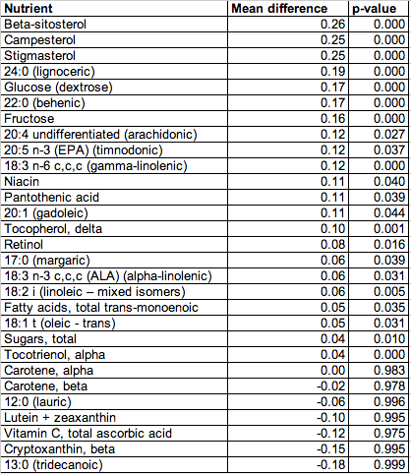
GAMBONI/GARG
RESULTS
6

Slide 7
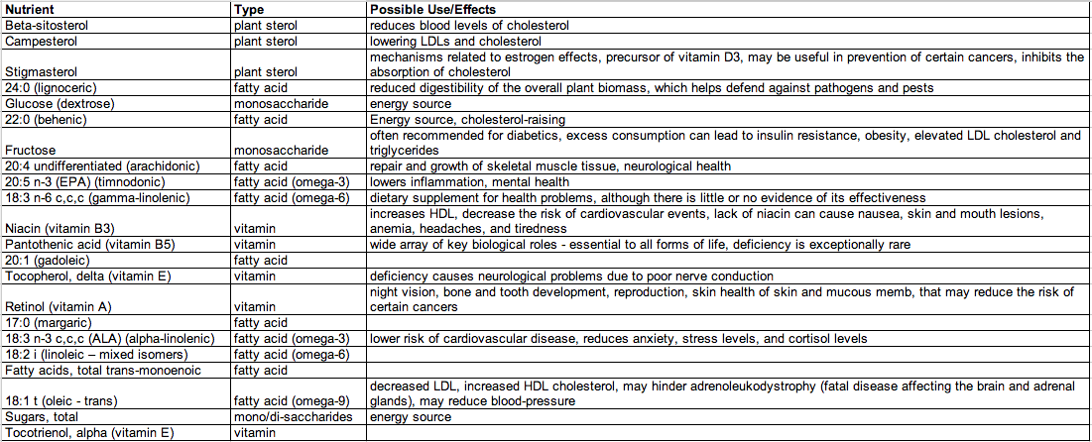
GAMBONI/GARG
ANALYSIS – LIKED FOOD INDICATORS - POSSIBLE HEALTH EFFECTS
7

Slide 8
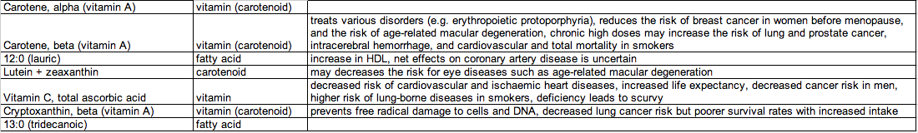
GAMBONI/GARG
ANALYSIS – DISLIKED FOOD INDICATORS - POSSIBLE HEALTH EFFECTS
8

Slide 9
GAMBONI/GARG
CONCLUSION
Proportions of nutrients in food can successfully predict preferences
Out of 145 nutrients, 22 are statistically significant indicators of liked food, 7 of disliked food.
Recipe selection based (partly) on nutritional content could improve the quality of service for the website.
Possible extension: create nutritional preference 'profiles' for individuals, which may give better indicators
9

