Slide 1



Hardening +
Debian +
CIS Benchmarks
Maceió 2023
Moisés Santos Farias
github.com/moisesmsf
moisesmsf@proton.me

Slide 2
Agenda
About me
Hardening
Debian
CIS Benchmarks
Questions?
Maceió 2023

Slide 3
About me
Privacy | Anonymity | SecOps | Monero
Piaçabuçu - AL
Ministério das Comunicações (MCom)
Maceió 2023

Slide 4
Hardening
Community-based | Battle-tested | Practical
Compliance & Auditing
NIST Cybersecurity Framework + Special Publication 800, 1800
CIS Critical Security Controls
ISO 27k
PCI-DSS
HIPAA
CyBok
Essential Eight
Gov.BR - PPSI
Maceió 2023
Hardening + Debian + CIS Benchmarks

Slide 5
Hardening
Examples
VMware Security Hardening Guides
Microsoft Security Baselines
Security Technical Implementation Guides (STIGs)
Security Content Automation Protocol (SCAP) | OpenSCAP | NIST NCP
OVAL
CIS Benchmarks
Maceió 2023
Hardening + Debian + CIS Benchmarks

Slide 6
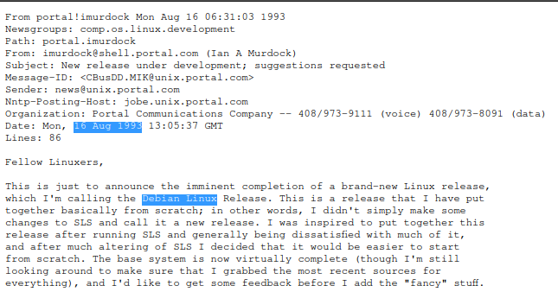
Debian
Maceió 2023

Slide 7
Debian
Is secure!?
Linux Hardening Guide, Checklist
Linux Security Hardening and Other Tweaks
Kernel Self Protection Project | linux-hardened
kconfig-hardened-check
Maceió 2023

Slide 8
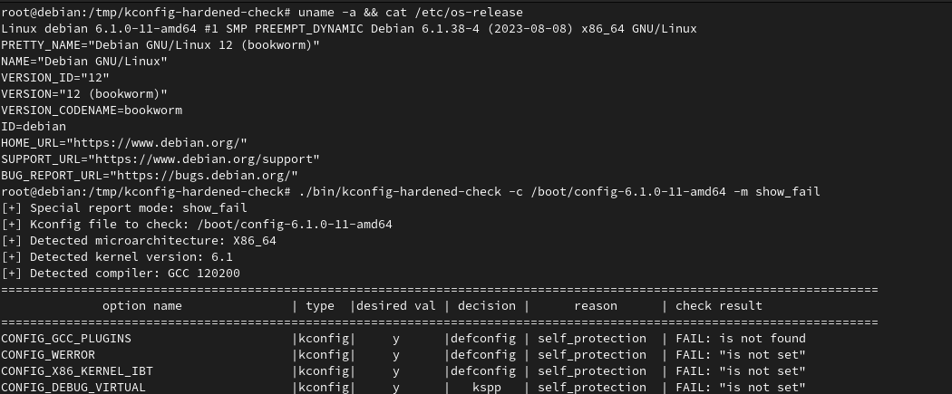
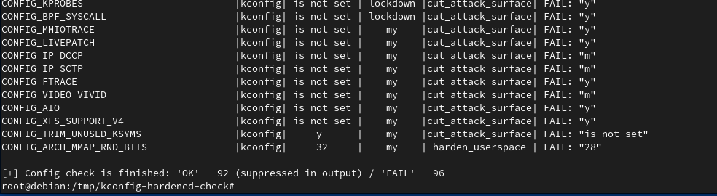
Maceió 2023
Hardening + Debian + CIS Benchmarks

Slide 9
Debian
Resources
Hardening (packages) | Security Management | Securing Debian Manual | Security Information (DSA), (OVAL) | Security Bug Tracker
debian-cis | harbian-audit | Debian Kicksecure
CIS Benchmarks Debian Linux
Maceió 2023

Slide 10
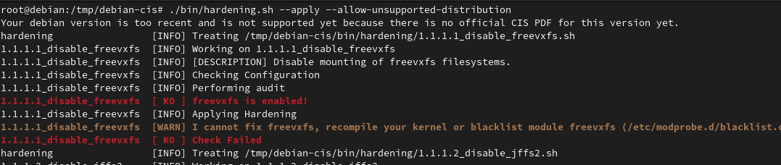
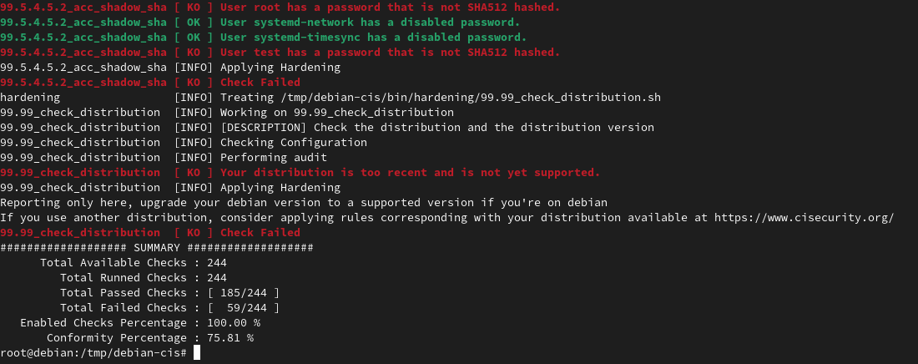
Maceió 2023
Hardening + Debian + CIS Benchmarks

Slide 11
CIS Benchmarks
CIS
CIS Critical Securty Controls
CIS Hardened Images
CIS RAM
CIS CAT
OVAL
CIS Workbench
CIS Advisories
...
Maceió 2023
Hardening + Debian + CIS Benchmarks

Slide 12
CIS Benchmarks
Structure
Audit
Recommendation
Default values
References
CIS Controls mapping
MITRE ATT&CK mapping
Additional information
Title
Assessment status (Automated, Manual)
Profile (Level 1, Level 2, Workstation, Server)
Description
Rationale
Impact
Maceió 2023
Hardening + Debian + CIS Benchmarks

Slide 13
CIS Benchmarks
Sections
Initial Setup
Services
Network Configuration
Logging and Auditing
Access, Authentication and Authorization
System Maintenance
Maceió 2023
Hardening + Debian + CIS Benchmarks

Slide 14
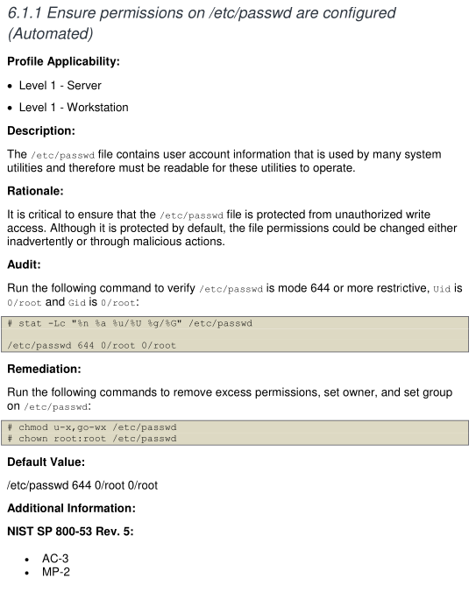
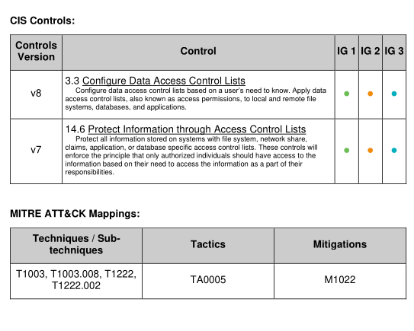
Maceió 2023
Hardening + Debian + CIS Benchmarks

Slide 15
CIS Benchmarks
Misc
+800 pages;
+250 secure configuration recommendations
Debian 11 ("bullseye") v1.0.0 published (2022/09)
Debian 12 ("bookworm") v1.0.0 draft
CIS Benchmarks for Debian 7 –> Debian 10
Maceió 2023
Hardening + Debian + CIS Benchmarks

Slide 16
CIS Benchmarks
Hardening + Debian + CIS Benchmarks (HDCB)
github.com/moisesmsf/hdcb
moisesmsf.github.io/hdcb
Maceió 2023
Hardening + Debian + CIS Benchmarks

Slide 17
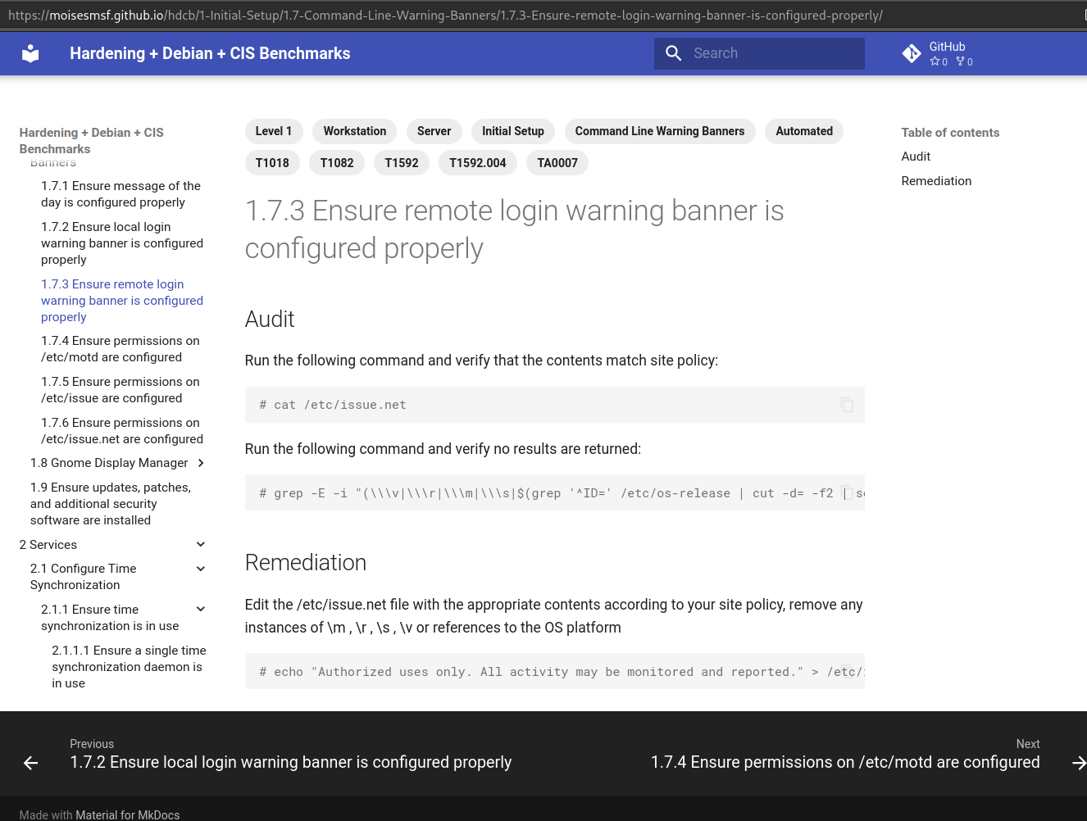
Maceió 2023
Hardening + Debian + CIS Benchmarks

Slide 18
Thank you!
Moisés Santos Farias
moisesmsf@proton.me
github.com/moisesmsf
Maceió 2023
Hardening + Debian + CIS Benchmarks

