Slide 1
IMAGE CLASSIFICATION WITH R
Marcel Socorro
Moises Vasquez

Slide 2
AGENDA
About the Data
The Process
Classification Models
Results

Slide 3
1.
ABOUT THE DATA
More than 200,000 images….

Slide 4
About the Data
3 different car images data sets, from Kaggle, Vehicle Make and Model Recognition Dataset ,and Visual Genome.
261,307 images
19.46 GBs

Slide 5
2.
The Process
Transforming Images To Numbers

Slide 6
OUR PROCESS
Load and Transform
Load the image, detect its edges, resize to a standard 50x50px, and extract the value of each color (RGB) for each pixel. Results in a 7,500 row data set.
Create Classification Models
Use the resulting data frame to train and test different classification models, like Naive Bayes, Random Forest, Support Vector Machines and Deep Learning.
Step 2
Step 4
Step 1
Step 3
Generate Pixel Coordinate Groups.
Group the Pixel coordinates in 10s, summarizing the average value per group. Resulting in 25 variables per color. A total of 75 Variables per Image
Compare and Contrast
Do Hypothesis Testing with the accuracies of the models to see which one is the best.

Slide 7
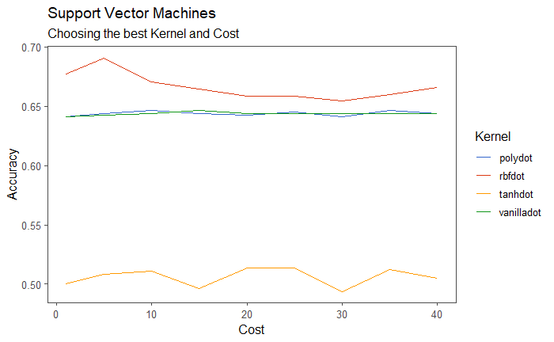
CLASSIFICATION MODELS
Naive Bayes
Random Forest
Deep Learning
Support Vector Machines
Using h2o and kernlab

Slide 8
RESULTS
 | Accuracy | Precision | Recall | AUC
Naive Bayes | .50 | 1 | 1 | .63
Random Forest | .52 | 1 | 1 | .71
Deep Learning | .45 | 1 | 1 | .70
Support Vector Machines | .52 | 1 | 1 | .67

Slide 9
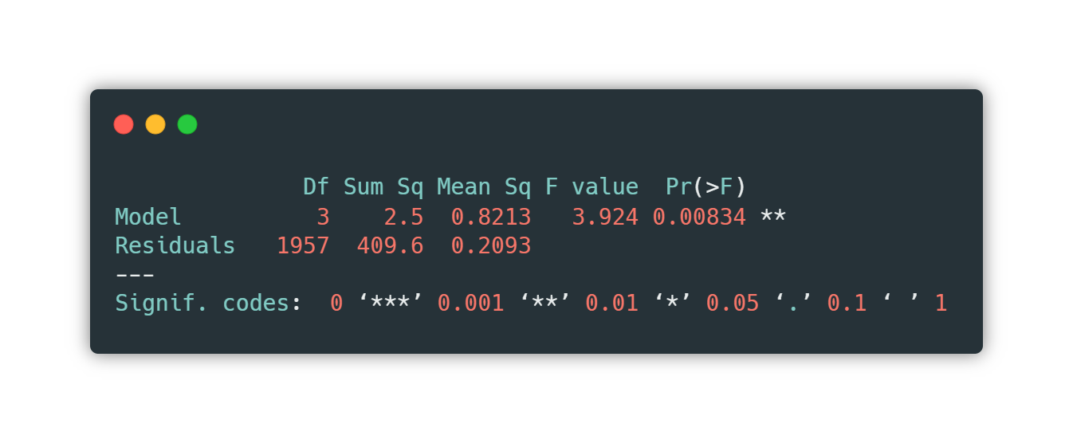
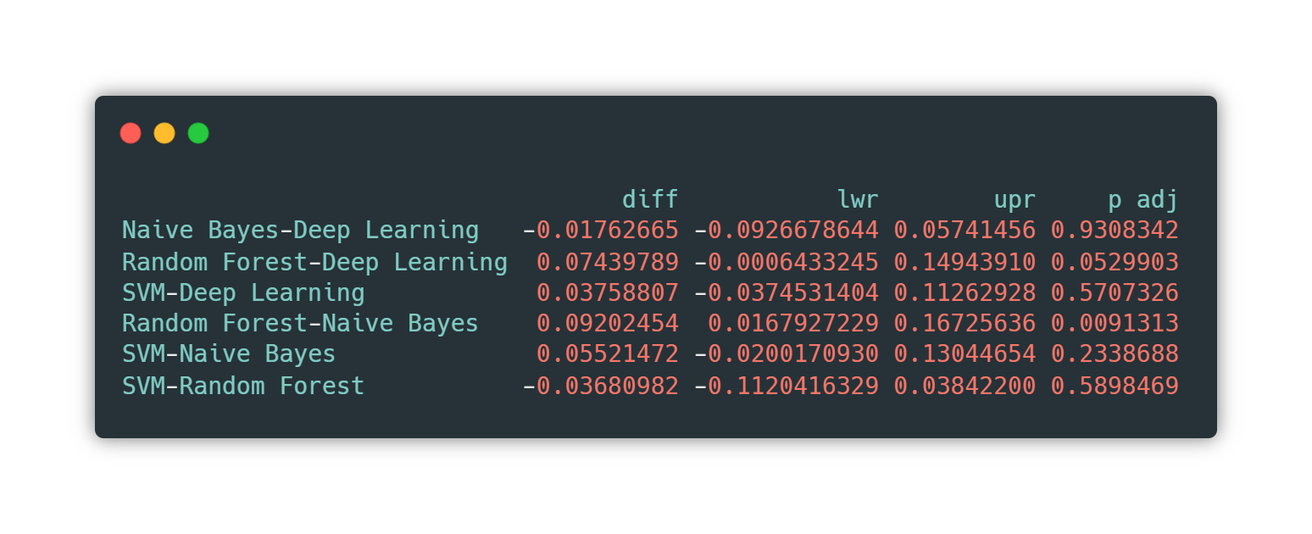
HYPOTHESIS TESTING
ANOVA
p-value is less than the significance level 0.05, we can conclude that there are significant differences between the accuracies of the models
Tukey HSD

Slide 10
THANKS!
Any questions?

