Slide 1
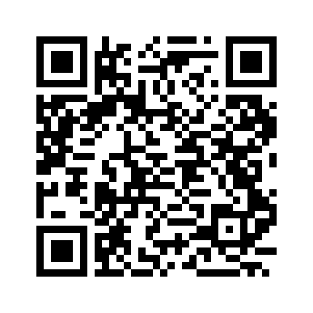
Moitrayan Chakravarty
1743704235773
03-04-2025

