Slide 1

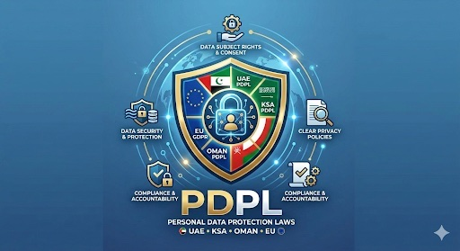
Jupiter Cyber Defence
Client Presentation Deck
From reactive checks to continuous cyber confidence
Clear risk visibility and prioritized remediation
Compliance mapping for GDPR, PDPL, and HIPAA
Audit-ready reporting for leadership and partners
Book your free security snapshot: jupitercyberdefence.com

Slide 2
Jupiter Cyber Defence
Why Clients Choose Jupiter
Common Security Pain Points
What Jupiter Delivers
Too many tools, unclear priorities
Limited visibility on external exposure
Compliance pressure without clear mapping
Reports that are too technical for leadership
One clear view of risk posture
Business-prioritized remediation roadmap
Regulatory mapping with gap visibility
Executive-ready audit evidence and reporting

Slide 3
Jupiter Cyber Defence
Core Services
Cyber Security Posture Assessment
External Attack Surface Assessment
Continuous Risk Monitoring
Cloud Security Readiness (AWS/Azure/GCP)
Identity & Access Security Review
Backup & Ransomware Readiness
Compliance Mapping (GDPR, PDPL, HIPAA)
Audit-Ready Documentation
Executive Security Reporting
Remediation Prioritization
Incident Readiness Review
Third-Party Risk Review

Slide 4


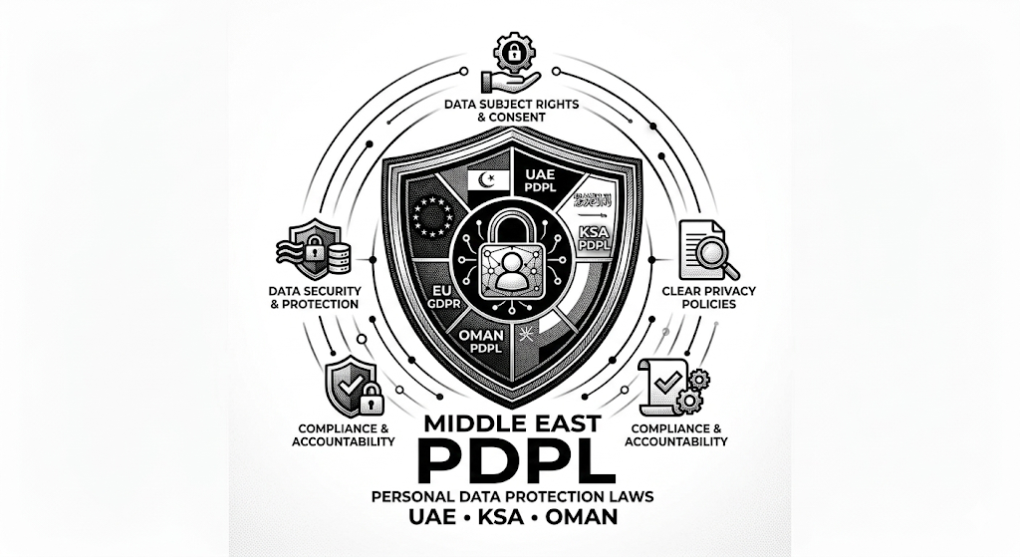
Jupiter Cyber Defence
Compliance and Evidence
Map controls against GDPR, PDPL, and HIPAA requirements with prioritized actions.
Audit-Ready Outputs
Executive-friendly reporting
Heatmaps and action ownership
Evidence pack for audits and partners
Control mapping and gap status
Priority remediation by impact and effort
Traceable ownership and progress view

Slide 5
Jupiter Cyber Defence
Package Pricing Matrix
Indicative package ranges by country
Package | Oman | UAE | KSA | EU
Package 1 | OMR 80–100 | AED 300–500 | SAR 300–500 | EUR 100–150
Package 2 | OMR 200–400 | AED 2,000–4,000 | SAR 2,000–5,000 | EUR 500–800
Package 3 | OMR 500–1,000 | AED 4,500–7,500 | SAR 6,000–12,000 | EUR 1,000–1,500
Packages can be tailored by asset volume, technical scope, and required reporting depth.

Slide 6
Jupiter Cyber Defence
How Engagement Works
1
Understand
2
Assess
3
Prioritize
Map domains, cloud, apps, and data flows.
Review posture, exposure, identity, and backups.
Deliver a 30–60 day remediation roadmap.
Business Outcomes
Industries
Faster remediation cycles
Stronger customer and partner trust
Clear weekly risk trend visibility
Healthcare
Logistics
SaaS
Professional Services
Education

Slide 7
Jupiter Cyber Defence
Book Your Free Security Snapshot
Turn security complexity into business clarity.
info@jupitercyberdefence.com | jupitercyberdefence.com

