Slide 1
Database
Key Concepts to Remember

Slide 2
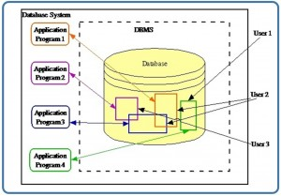
What is a Database
a shared collection of related data used to support
the activities of a particular organization

Slide 3
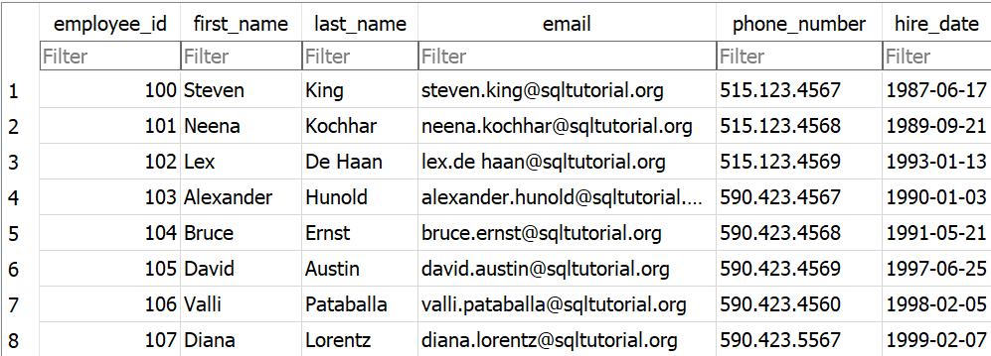
What is a Table
Employee Table
Rows
Column
a table is a collection of related data held in a table format
within a database. It consists of columns and rows.

Slide 4
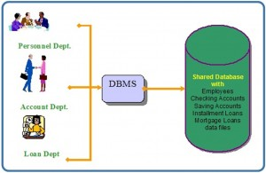
What is a DBMS
Database Management System (DBMS)
a collection of programs that enables users to create and maintain
databases and control all access to them

Slide 5
Types of Databases
How to Classify

Slide 6
Transactional
Analytical
Embedded
SQLite
DuckDB
Oracle
MySQL
Microsoft SQL Server
PostgreSQL
Snowflake
ClickHouse
Microsoft Analysis Services
Standalone

Slide 7
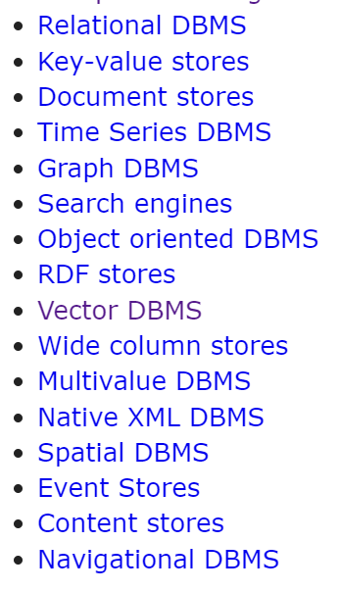
https://db-engines.com/en/ranking

Slide 8
Structured Query Language
A data language

Slide 9
Data Manipulation Language
Used to
SELECT data from table(s)
INSERT data into table
UPDATE existing data in table
DELETE existing data in table
SUMMARIZE data
EMPLOYEE TABLE
EMP_ID | NAME | SALARY | DEPARTMENT
1 | ALI KARIM | 80000 | IT
2 | JOHN SMITH | 120000 | IT
3 | FAISAL SALEEM | 100000 | FINANCE
4 | SALIMA KARIM | 90000 | HR

Slide 10
Data Manipulation Language
Fetch data from employee table
Update an employee salary
SELECT EMP_ID, NAME, SALARY FROM EMPLOYEE WHERE SALARY > 10000 ORDER BY NAME ASC;
UPDATE EMPLOYEE SET SALARY = 75000 WHERE EMP_ID = 2;
Add a new employee
Remove an employee record
INSERT INTO EMPLOYEE
(EMP_ID, NAME, SALARY, DEPARTMENT) VALUES (5, ‘SARA REHMAN’, 95000, ‘HR’);
DELETE FROM EMPLOYEE WHERE EMP_ID = 2;

Slide 11
Data Manipulation Language
Summarize by Department
Get Average Salary
SELECT DEPARTMENT, COUNT(EMP_ID), SUM(SALARY) FROM EMPLOYEE GROUP BY DEPARTMENT;
SELECT AVG(SALARY) FROM EMPLOYEE;

Slide 12
HAND-ON SESSION

Slide 13
Setup SQLite Browser (IDE)
Download from https://download.sqlitebrowser.org/DB.Browser.for.SQLite-3.12.2-win64.zip
Unzip downloaded file
Inside unzipped folder search for “DB Browser for SQLite.exe” file and double click it to run

Slide 14
Open Database in SQLite Browser (IDE)
On top left below Help, click “Open Database” button
Select the downloaded “employee.db” file or any other SQLite database file

