Slide 1
Indexation App Walkthrough
Economics Hub
Data & Analysis

Slide 2
Inflation Overview
Notes:
https://defcalc.apps.alpha.mojanalytics.xyz/

Slide 3
Glossary
Indices:
Retail Price Index (RPI): an outdated measure of general price inflation;
Consumer Price Index (CPI): the recommended measure of general price inflation;
Average Weekly Earnings (AWE): the recommended measure for wage inflation;
GDP Deflator: HMT produced index to measure real GDP and convert real costs into nominal costs.
Technical Terms:
Inflation: a general increase in the price level;
Nominal Values: any cost which includes the impacts of inflation;
Real Values: nominal costs which have been deflated to a given base year;
Deflating*: the method to convert nominal values into real values, to remove the impact of inflation;
Discounting: the method to convert real costs into net present costs;
Net Present Cost (NPC): any cost which has been deflated and discounted.
*NOT the same as deflation (i.e. negative inflation)

Slide 4
Background Information
MOJ Contracts:
Many MOJ contracts explicitly apply indexation as set out in their contractual terms;
These contracts apply a variety of inflation indices, with no consistency and a lack of a common transparent approach;
Selecting the appropriate inflation rates can help to reduce the risk pricing in contracts;
Some MOJ contracts implicitly apply inflation, which makes it difficult to control and estimate.
Inflation Impact:
The compounding nature of inflation has a significant impact on these contracts, and consequently overall MOJ expenditure;
Different indices are appropriate for different costs and products;
Different indices that are perceived to be similar can vary dramatically year-on-year;
Understanding indexation and where/when it is applied (especially in contracts) is crucial to accurately estimating expenditure and evaluating bids.
*as at FY 2020/21

Slide 5
Indexation: Recommendations
Standard Indices:
CPI: measures the price changes in a ‘typical basket of goods and services’ which people can be expected to purchase. CPIH extends this ‘basket’ to include housing costs as well.
AWE: measures price changes in employee wages and salaries.
BCIS: measures price changes in building and construction-related goods and services.
GDP Deflators: measures general inflation of the whole domestic economy – unlike other indices, this includes investment activities, government expenditure, and exports (but excludes imports).
RPI(X): not recommended. Since 2013, the ONS does not recognise it as a UK National Statistic.
Sometimes the use of subset indices is more appropriate – For example, CPI can be broken down into CPI - Food, or even further into CPI – Cake; and AWE can be broken down into AWE – Private Sector, or AWE – Retail Services. However, these breakdowns are not necessarily available as future forecasts, but are published as historic records by the Office for National Statistics (ONS).
For a detailed list of recommendations, please see the accompanying Indexation Guidance document.

Slide 6
Indexation Tool
Notes:
https://defcalc.apps.alpha.mojanalytics.xyz/

Slide 7
Indexation Tool: Overview
What Can It Do?
Provide up-to-date information on the latest official inflation (and other economic) forecasts;
Allow users to calculate and add their own indices locally;
Inflate financial costs from one time period to another;
Deflate financial costs from one time period to another, in line with HMT Green Book guidance;
Calculate Net Present Costs (NPC);
How Can It Help?
Provide an easy-to-access – and share – source of inflation statistics;
Help users understand and apply appropriate indices to different cost profiles;
Help users understand the impact of (different rates of) inflation on ongoing and future projects.
For more information, please see the in-app guidance

Slide 8
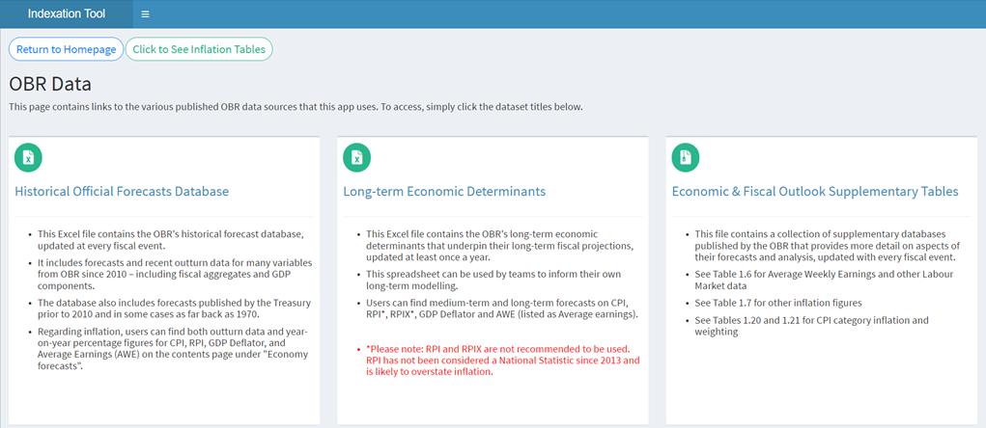
Indexation Tool: OBR Data
Use this page to access the same data that underlines the inflation forecast and calculator functions of this app.
Click the blue hyperlink titles to download the corresponding data in Excel.
This page also includes access to OBR data related to other economic and fiscal outputs.
For more information, please see the in-app guidance

Slide 9
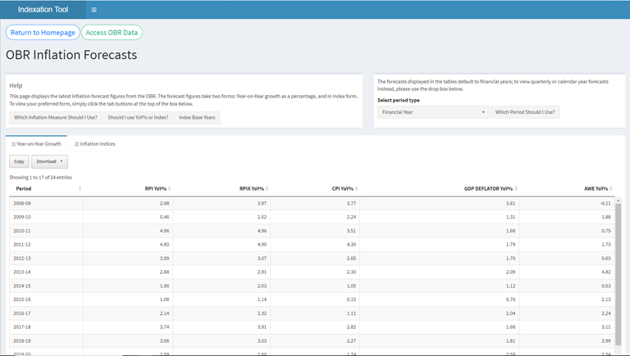
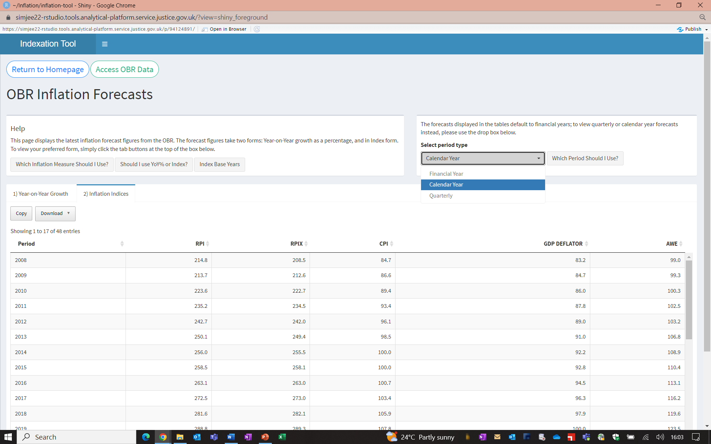
Indexation Tool: Inflation Forecasts
Use this page to access and download the most recent inflation forecasts across several different measures.
You can view data as either YoY% growth or in index form. You are also able to select what period type you wish to view the forecasts in (e.g. financial year, 2022-23)
Click Copy to copy the data in the desired format to clipboard. Click Download to save the data in either CSV or Excel.

Slide 10
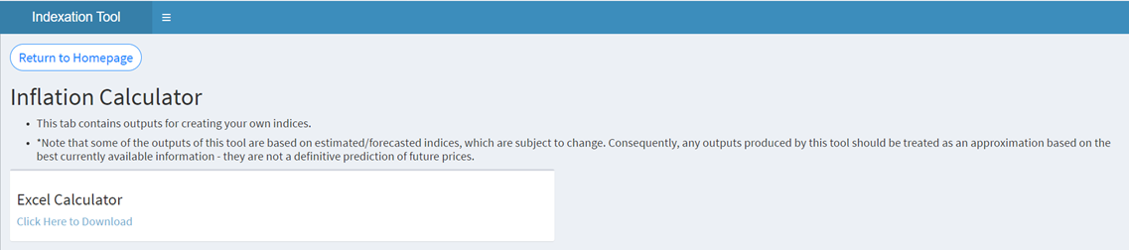
Indexation Tool: Inflation Calculator
Use this page to access a calculator tool that allows the user to create their own custom indices.
The calculator is built in Excel, making it an accessible tool that can be used offline by anyone.

Slide 11
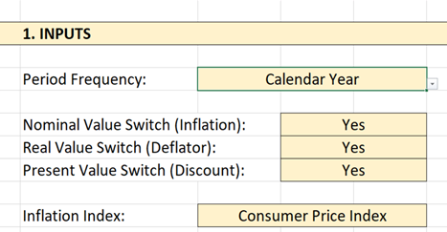
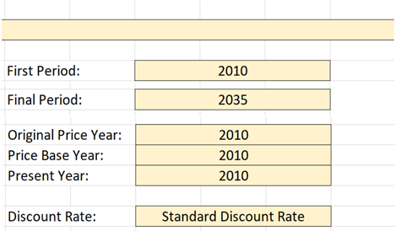
Indexation Tool: Inflation Calculator
A drop-down list of all time periods, limited to: Financial Year, Calendar Year, and Quarterly.
Selection between real-to-nominal, or vice versa. Note that real-to-nominal is for inflating, and nominal-to-real is for deflating. Understanding whether input data in/excludes inflation is crucial to correct use of the tool.
A drop down list of all available indices, including custom indices.
Required to identify the period range in which inflation is calculated and to generate the correct table dimensions. Note that changing the period may prevent valid calculations until the other Year inputs are updated (manifesting as #N/A in the output cells).
OPY refers to the period the Annual Price Period is currently based in. PBY refers to the period that the real price conversion needs to adjust to. PY refers to the period that the present price conversion needs to adjust to. These should not be set to a date outside of the First and Final Periods.
A drop-down list of available discount rates for converting to present-day prices. Standard Discount Rate selected as default.
For more information, please see the in-tool guidance

Slide 12
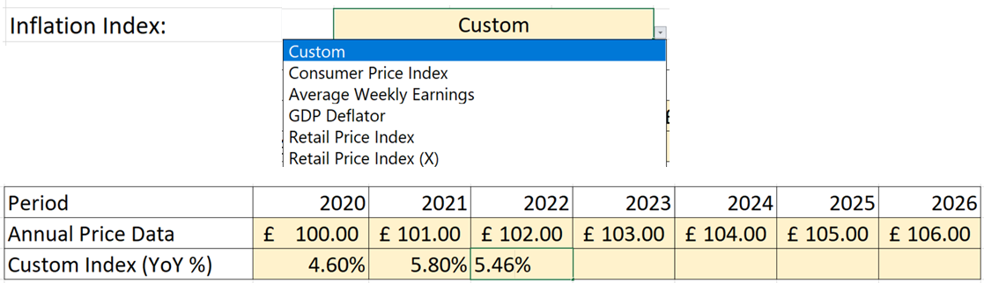
Indexation Tool: Inflation Calculator
If the Custom index is chosen by the user, alternative inflation rates can be provided in the Custom Index (YoY%) input row.
Required to produce any price conversions. Note that data must be input for each year individually, but may be left blank.
For more information, please see the in-tool guidance

Slide 13
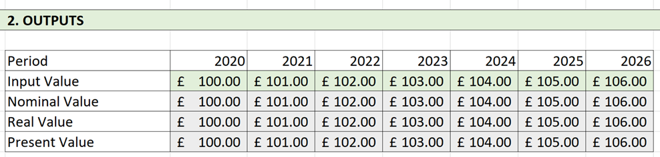
Indexation Tool: Inflation Calculator
Re-iterates the Annual Price Data that users provide in the INPUTS section.
Converts the Input Value into nominal prices (i.e. applies specific inflation rates), if required. If the Nominal Value switch is set to 'No', no change will occur.
Converts the Nominal Value into real prices (i.e. removes the effect of general inflation), if required.
Converts the Real Value into present prices (i.e. adjusts for time preferences), if required
For more information, please see the in-tool guidance

Slide 14
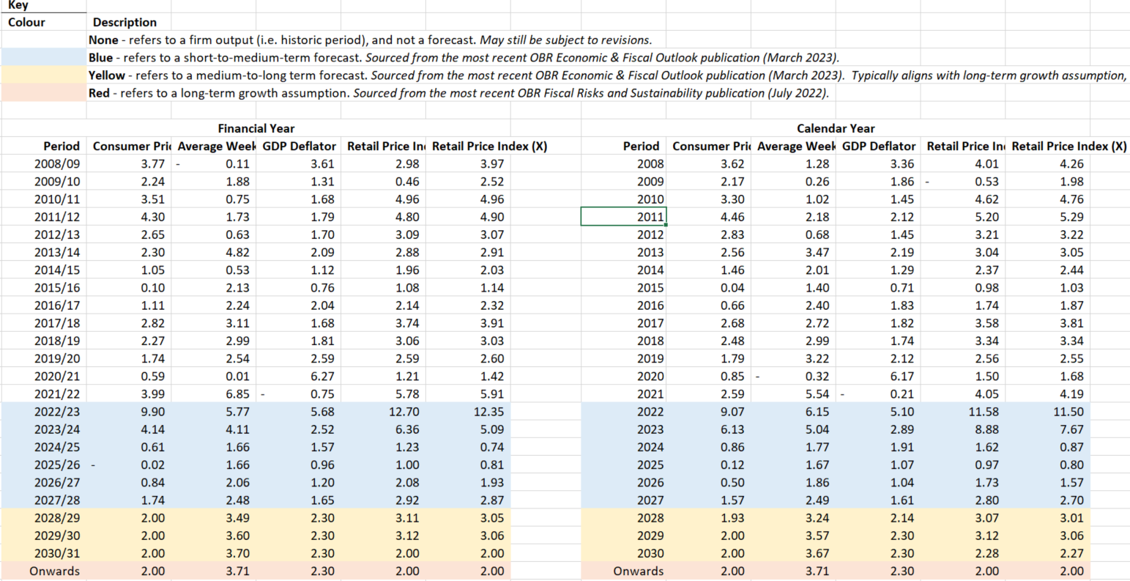
Indexation Tool: Indices Tab
The Indices tab includes reference data for inflationary figures across several measures and period types.
Data comes directly from OBR – Economic and Fiscal Outlook
Users can access for independent usage.

Slide 15
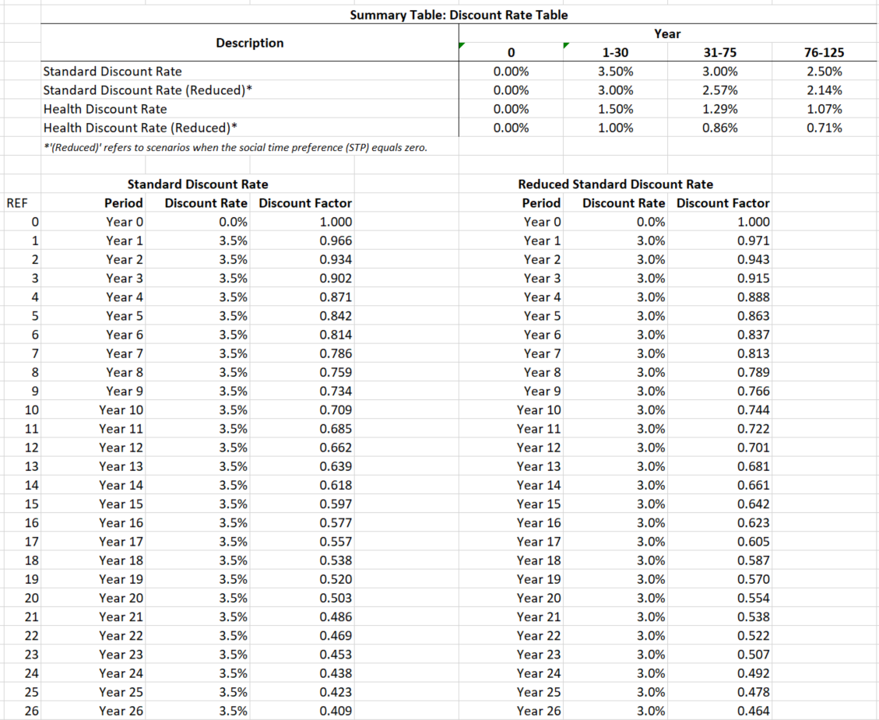
Indexation Tool: Discounting Tab
The Discounting tab contains the raw figures and formulae that underpin the discounting calculations of the outputs in the main tab.
Users can access this tab to use for independent usage or to better understand the process behind discounting.
Figures come from HM Treasury Greenhttps://www.gov.uk/government/collections/the-green-book-and-accompanying-guidance-and-documents#supplementary-guidance Book

Slide 16
Economics Hub
EconomicsHub@justice.gov.uk

