Slide 1
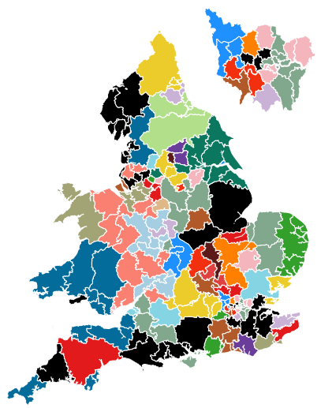
Supporting decision making in the Prison Estate Transformation Project with Linear Programming

Slide 2
Contents
Objectives of PETP (Prison Estate Transformation Program)
Our old approach to modelling PETP
What is Linear Programming
Basic example of a Linear Programme
Linear Progamming applied to PETP (the Scenario Assessment Tool)
Implementation overview
Run through of the system
Advantages and disadvantages of the tool/approach
Representing certain non linear constraints in Linear Programming

Slide 3
Our Client: Prison Estate Transformation Program (PETP)
Project Objectives
House prisoners in prisons suitable for their needs
Improve clarity of function for prisons
Most prisons were doing 3 functions (new/short term prisoners, long term prisoners, and prisoners about to be released)
Keep resettlement cohort as close to home as possible
So family ties could be more easily maintained
Keep reception cohort close to court
More efficient for court transfers

Slide 4
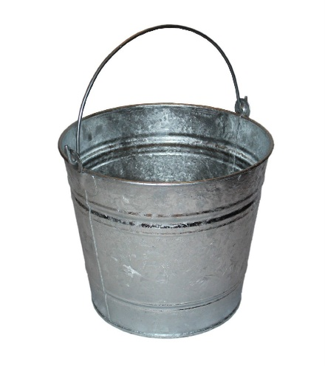
Our Old Approach
Stakeholders informed us of an estate/system
We modelled these rules using Excel/VBA
Long list of prisoners
For each type of function
Iterate through the list…
Allocate each prisoner to a suitable prison within the same CPA (or next best alternative)
Next function
Using outputs, assess how well the system fitted
…. including checking which prisoners were in the bucket

Slide 5
Our Old Approach
Disadvantages:
Long time to run a scenario (~90 mins)
Assumptions were always being changed, but modelling approach was not very flexible
Maintaining/amending/QAing the code in response to different assumptions/scenarios was time consuming and prone to errors
Was a reactive approach
Didn’t really offer insight or optimisation

Slide 6
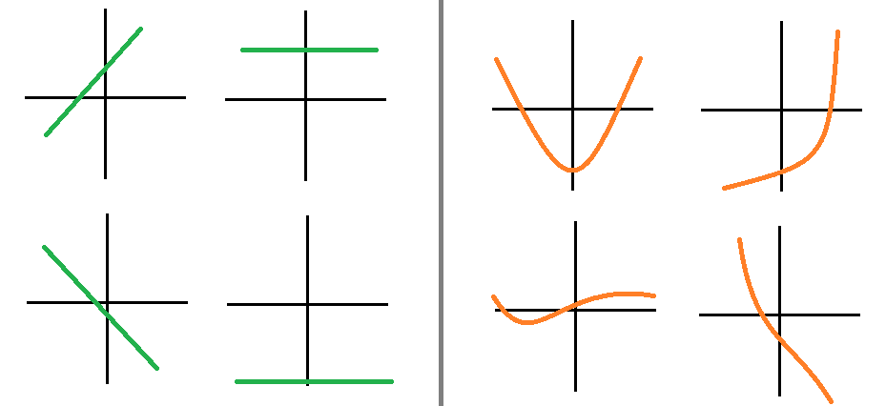
Linear Programming
A mathematical tool for maximizing or minimizing a quantity (usually profit or cost of production), subject to certain constraints.
Used where all the functions in the model are linear functions
Linear
Non Linear

Slide 7
An example LP (with 2 products/variables)
Maximising revenue from two products
Requirements for production of each product
Resources available
 | Product X | Product Y
Storage space (m²/unit) | 4 | 5
Raw material (kg/unit) | 5 | 3
Production rate (units/hour) | 60 | 30
Selling price (£/unit) | 13 | 11
 | Amount available
Storage space | 1500 m²
Raw material | 1575 kg
Production | 7 hours
Giving the following (all linear!) objective function and constraints
Objective Function | Maximise 13X + 11Y
Constraint 1 (storage) | 4X + 5Y <= 1500
Constraint 2 (raw material) | 5X + 3Y <= 1575
Constraint 3 (production) | X/60 + Y/30 <= 7

Slide 8
Example LP - Plotting the constraints
Anywhere to the upper right of any of the constraint lines is infeasible (i.e. not possible)
LP gives the solution:
To maximise revenue, 270 of product X and 75 of product Y should be produced
Gives revenue of 270 * 13 + 75 * 11 = £4335

Slide 9
Linear Programming applied to PETP
Split demand into ~300 demand locations in England and Wales
Each demand location split by ~6 functions
This demand could be allocated to ~120 prisons
Therefore the problem: what proportion of each demand location-function should be allocated to each prison, to minimise average drive time?
Therefore 300 * 6 * 120 = ~216,000 decision variables
So a graph with many many axes!
Include ability to implement minimum and maximum number of prisoners of function X could be held at prison Y

Slide 10
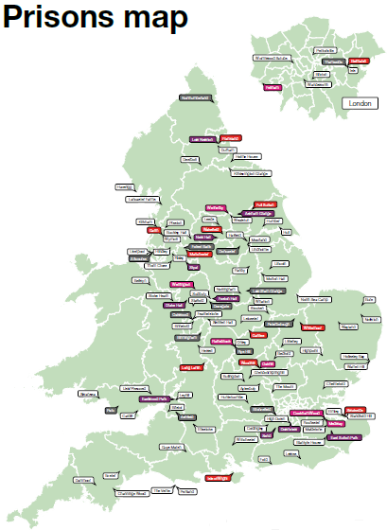
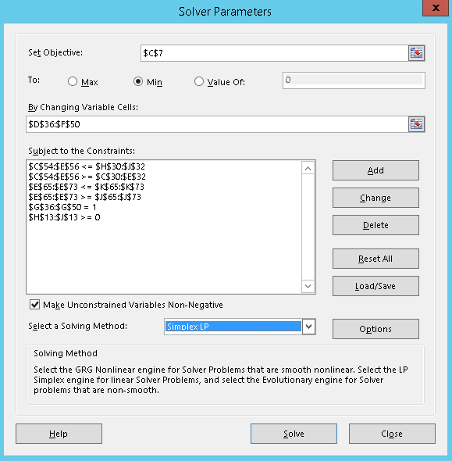
Implementation
Gathered drive time data
Between demand locations and prisons
Used Excel Solver
Is limited to 200 variables
Created a small example for checking model output

Slide 11

Implementation
Implemented in R using the Rglpk package
Rglpk_solve_LP(obj, mat, dir, rhs)
Where:
obj
a numeric vector representing the objective coefficients.
mat
a numeric vector or a (sparse) matrix of constraint coefficients.
dir
a character vector with the directions of the constraints. For a nonzero number of constraints each element must be one of "<", "<=", ">", ">=", or "==".
rhs
a numeric vector representing the right hand side of the constraints.

Slide 12
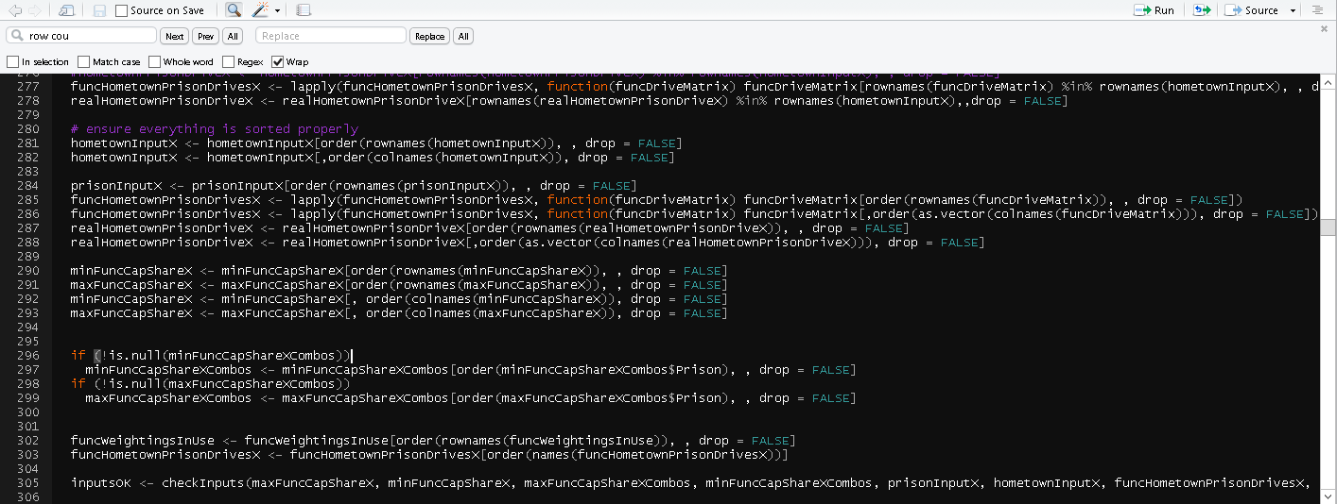
Implementation
Significant amount of pre-processing code (~600 lines) for
Checking and preparing inputs
Building the constraints matrix
…plus more for preparing the outputs
…and more for the interface

Slide 13
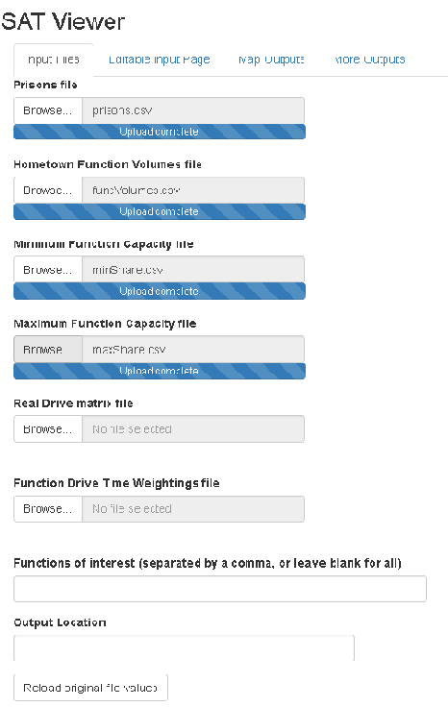
Screenshot of interface for loading scenarios and resulting map
Geographic coverage of prisons for a particular cohort (prisons are represented by colours)
And all the other outputs…

Slide 14
Advantages of the tool
Scenarios ran in minutes rather than hours
Code fixed – only inputs changed – quick turnaround
Live interaction with stakeholders, who could see immediately the effects of their assumptions and decisions
A better relationship with stakeholders
Progress! – enabled PETP to make decisions regarding prison functions (required for commissioning) and create an end state vision of prisons and their functions

Slide 15
Disadvantages of the tool
Constraints are very subjective but they may have significant effects on outcomes
It could be difficult to predict and explain the effects of changes
How relevant is the objective function? E.g. should minimising travel times be combined with cost?
LP gives “optimal” solution. Another non-optimal solution may actually be best from view of stakeholders

Slide 16
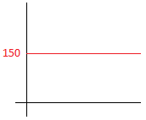
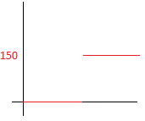
Further Exploring Linear Programming and uses
Implementing non-linear constraints within a Linear Programme.
E.g. Threshold constraint: Do not place a very small number of Vulnerable Offenders in a prison i.e. If any go in there, make sure there are at least 150 (i.e. 0 or >=150)
This is not the same thing as a simple linear minimum constraint, previously seen which would assume to always put 150 (i.e. >= 150)
Normal Minimum Constraint
Threshold Minimum Constraint

Slide 17
How to implement threshold T for VulnerablePrisoners at Prison P
Introduce “B” a binary variable (meaning its values can be either 0 or 1)
Introduce “N” a large number (greater than any possible values for any of the decision variables – in this case not that big at they are all between 0 and 1 as they are %s. Let’s say N = 100)
Create 2 additional constraints as follows:
N * B >= (% of Prison P’s Capacity used for VulnerablePrisoners)
(% of Prison P’s Capacity used for VulnerablePrisoners) >= T – N * (1 - B)
The first constraint means that when there are any VulnerablePrisoners in the prison, Binary variable B becomes 1
Then, because B has become 1, the second constraint means that the number of VulnerablePrisoners must be >= T (as –N * 0 = 0)
On the other hand, if no VulnerablePrisoners are held at the prison, B can be 0, and the 2nd constraint becomes meaningless (as right hand side becomes a negative number) also ensuring both constraints are satisfied

Slide 18
Another Use of Binary Variables
Counting and limiting prisons being used
Where best to build new prisons.
Say: option of 2 new prisons, at 10 possible locations. Which locations would be best for reducing travel time
BUT using Binary or Integer Variables will slow down your model!!! More complex/time consuming algorithm is required to find optimal point

