Slide 1
Inclusive Instant Payments System (IIPS) for Liberia
October 21, 2025

Slide 2
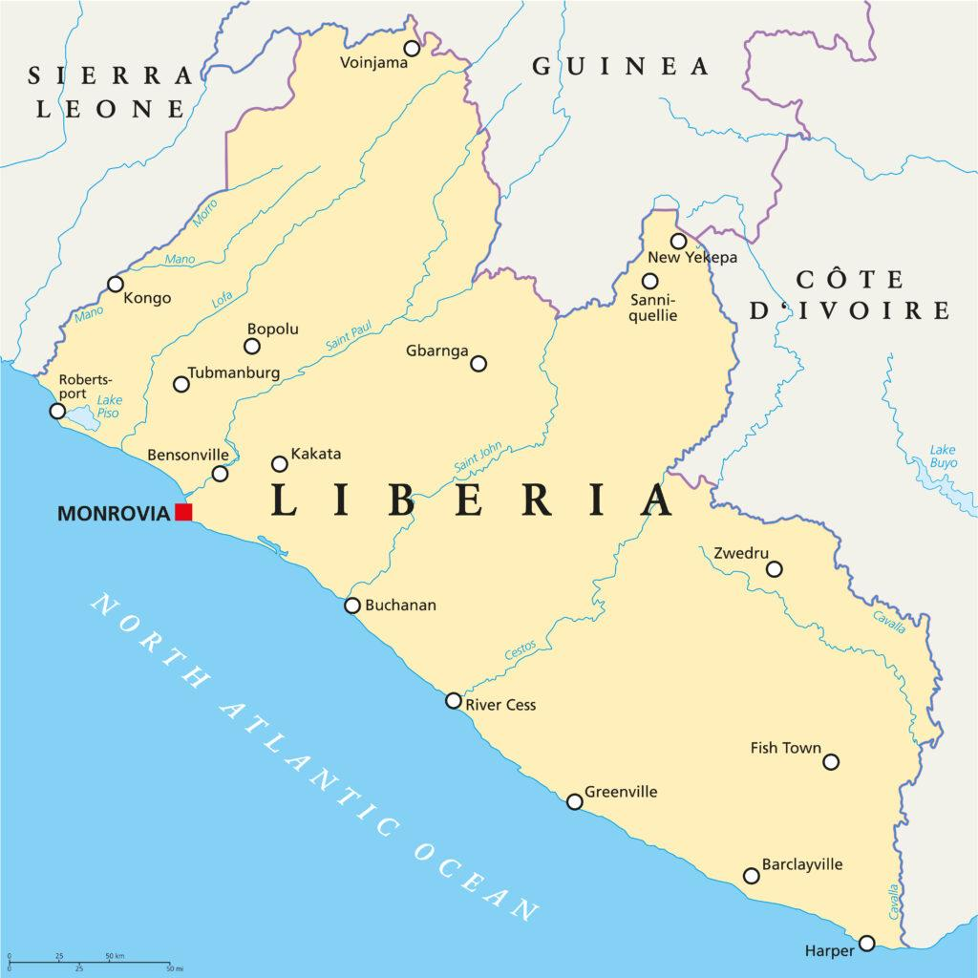
Payment Ecosystem in Liberia
Area: ~111,369 sq km
Population: 5.44 million (2023)
Payment Ecosystem:
9 commercial banks and several MFIs
11.5 million registered mobile money accounts; 4.3 million active users (2024)
Mobile money transactions in 2024: LRD 471B + USD 4.68B
First biometric ATM launched; digital services expanding

Slide 3
Pilot Objectives
Implement Mobile Money Interoperability – Enable seamless transactions across participating financial service providers.
Demonstrate P2P and G2P Use Cases on Mojaloop – Execute end-to-end P2P and G2P transactions.
Build Local Team Capacity – Equip the local stakeholders with hands-on experience and knowledge to plan and cost an Inclusive Instant Payments System (IIPS).
Prepare for National Scale – Test Mojaloop’s readiness as a fully scalable IIPS involving all digital financial service providers.

Slide 4
Governance Structure
Project Steering Committee
Project Management Team
Technology Workstream
Business Workstream
Regulatory
Workstream
Hub Operations Workstream
Charged with payment system's design, implementation, testing and go-live.
Responsible for exploring business requirements and strategies for implementation and market adoption.
Focused on laying the foundation for regulatory compliance and developing a scheme rulebook draft.
Responsible for managing onboarding processes, operational guidelines, and settlement procedures.

Slide 5
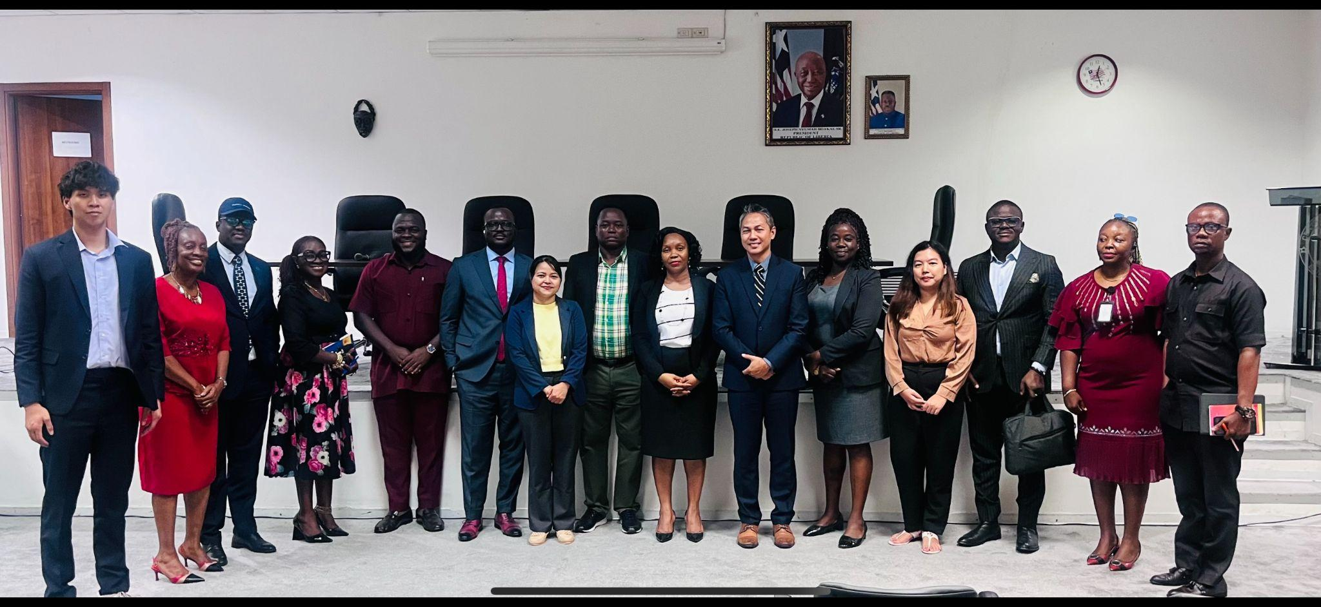
Governance Structure
Project Lead, Settlement Institution: Central Bank of Liberia (CBL)
Participating DFSPs:
Ministry of Finance and Development Planning (MFDP)
Orange Money Liberia (OML)
Lonestar Cell Mobile Money (MTN)
Project Coordinator: AfricaNenda Foundation
Market-level Engagement &
Capacity Building: Mojaloop Foundation
Technical Service Provider: ThitsaWorks

Slide 6
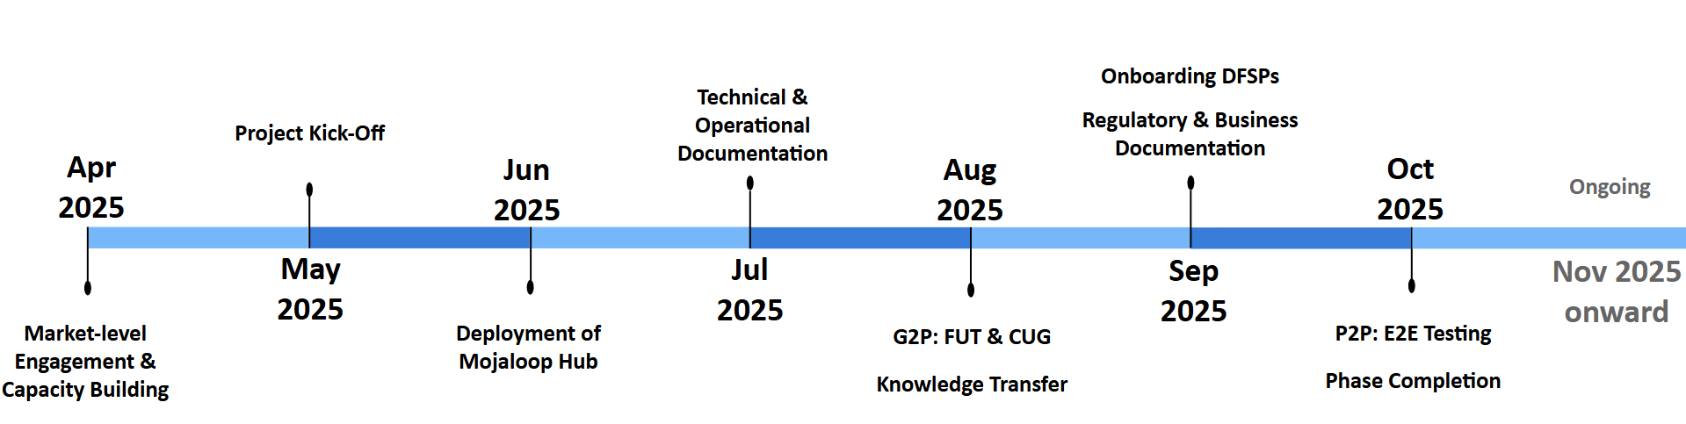
Key Activities & Timeline
We completed the first real-money transaction in 73 business days for the G2P use case and 111 business days for the P2P use case.

Slide 7
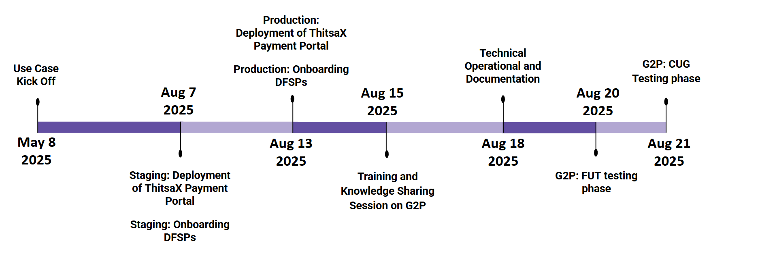
Government-to-Person (G2P)
The first real-money transaction from the Ministry of Finance and Development Planning (MFDP) to Orange Money was completed in 73 business days.

Slide 8
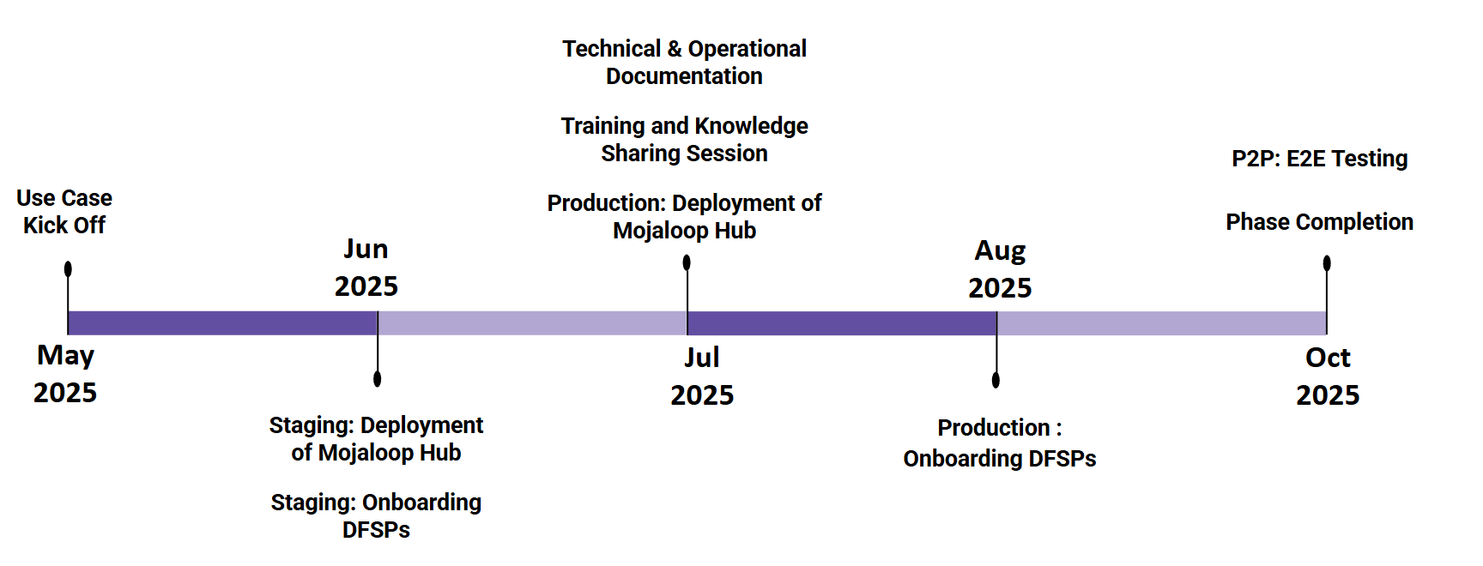
Person-to-Person (P2P)
The first real-money transaction between MTN Lone Star and Orange Money was completed in 111 business days.

Slide 9
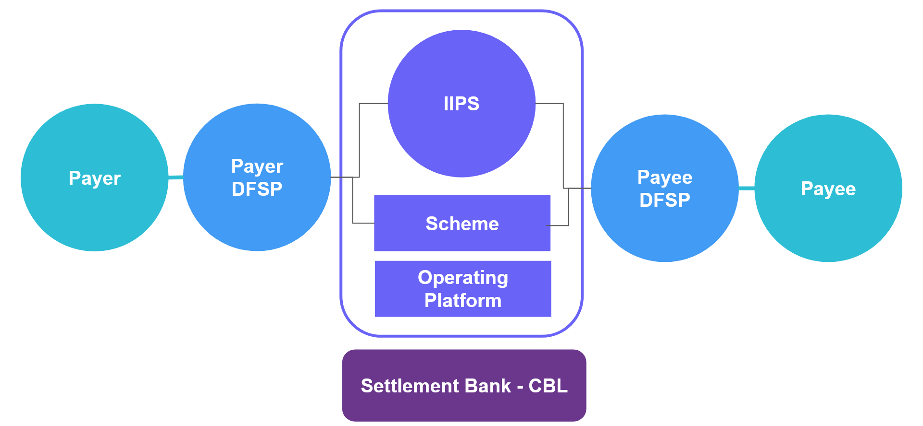
Technical Design: IIPS Overview

Slide 10
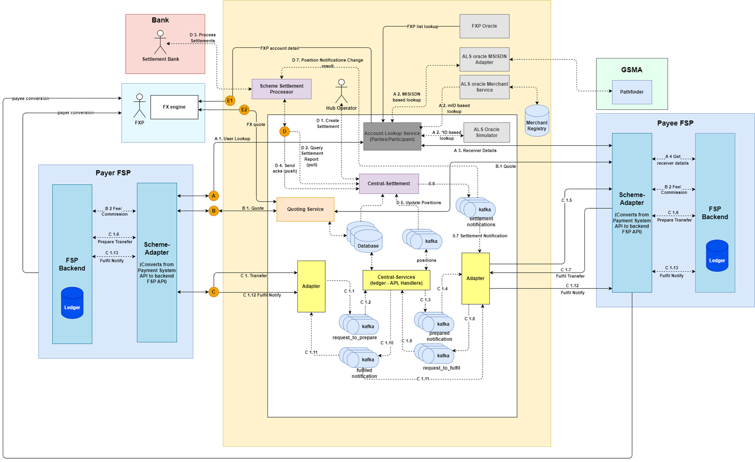
System Architecture Overview

Slide 11
Pilot Outcomes
Pilot Objective | Pilot Outcomes
Implement Mobile Money Interoperability | Mojaloop hub and related modules were deployed and three DFSPs were integrated into the Mojaloop hub.
Demonstrate P2P and G2P Use Cases on Mojaloop | FUT and CUG for G2P use case were successfully conducted between MFDP and Orange Money. End-to-end transactions for the P2P use case were demonstrated between end users of the two DFSPs.
Build Local Team Capacity | Comprehensive technical knowledge and hub operations processes were transferred to the local teams.
Prepare for National Scale | In addition to technical readiness, cost model template and initial version of the scheme rulebook were developed.

Slide 12
Key Success Factors
Local Leadership:
Role of the Central Bank of Liberia (CBL)
Role of the Ministry of Finance and Developing Planning (MFDP)
Role of Stakeholders (DFSPs)
Technical Assistance:
Role of AfricaNenda Foundation
Role of Mojaloop Foundation
Role of ThitsaWorks

Slide 13
Lessons Learned
Lessons Learned | Description
Importance of Design Thinking | Careful design—including cultural context, government payments, and mobile money—was key to adoption.
Time-to-Market as a Core Objective | Leveraging prior deployments and experiences helps accelerate rollout timelines.
Balancing Technical and Commercial Readiness | Both technical integration and commercial onboarding need sufficient time for realistic timelines.
Optimizing Timeline Efficiency | Accounting for onboarding and integration complexities upfront helps improve deployment speed and reduces unforeseen delays.
Documenting Pilot Knowledge | Maintaining clear records of pilot processes and risks ensures lessons are captured for smoother future phases.

Slide 14

Next Steps:
Advancing the National Rollout of Mojaloop as an IIPS
Engaging relevant stakeholders for the upcoming phase
Preparing for regulatory approval to proceed
Refining policies, operational guidelines, and legal frameworks
Scaling technical systems and infrastructure to support nationwide processing

Slide 15
Thank you

