Slide 1
Deploy Mojaloop locally using Core Test Harness (CTH)
Mojaloop Open-Source community event #27 Accra, Ghana
Sam Kummary, MLF

Slide 2
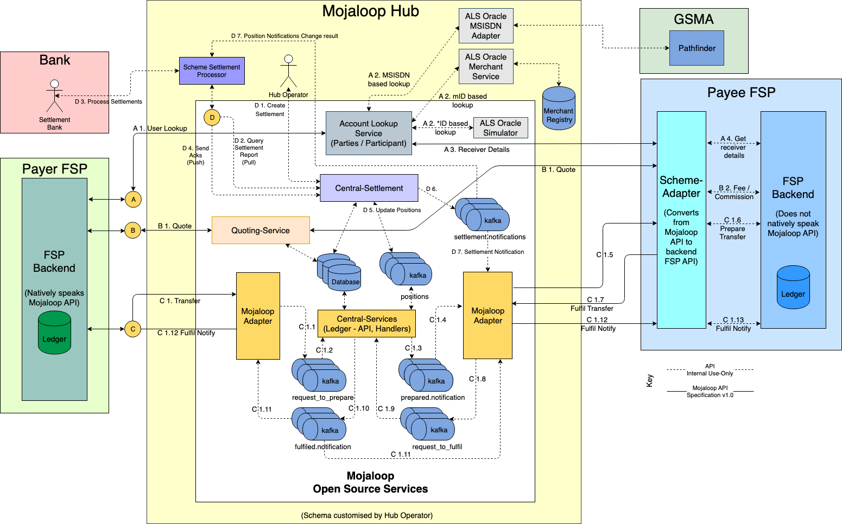

Slide 3
Agenda
Mojaloop Core-test-harness (CTH)
Overview – components
Run CTH locally – for dev, qa, demos and play!
Application and extensions: Developing using CTH

Slide 4
CTH: Prerequisites
Git
Docker
Docker-compose
Repo: https://github.com/mojaloop/ml-core-test-harness

Slide 5
CTH: Rebuild images if required
Images are default linux/amd64
Rebuild using scripts if necessary
Run CTH!

Slide 6
CTH: Extensions
Profiles for running: FX, Finance Portal, Monitoring
Demos
Usage in QA, development

Slide 7
Run CTH locally!
Questions, discussion

