Slide 1
ML: International Payments Addressing
PI-23 community event, Lusaka
October-November 2023. Paul Makin, Sam Kummary

Slide 2
Agenda
Overview of the (strategic) workstream
Compliance PoC with PASS update
PASS PoC by UNCDF

Slide 3
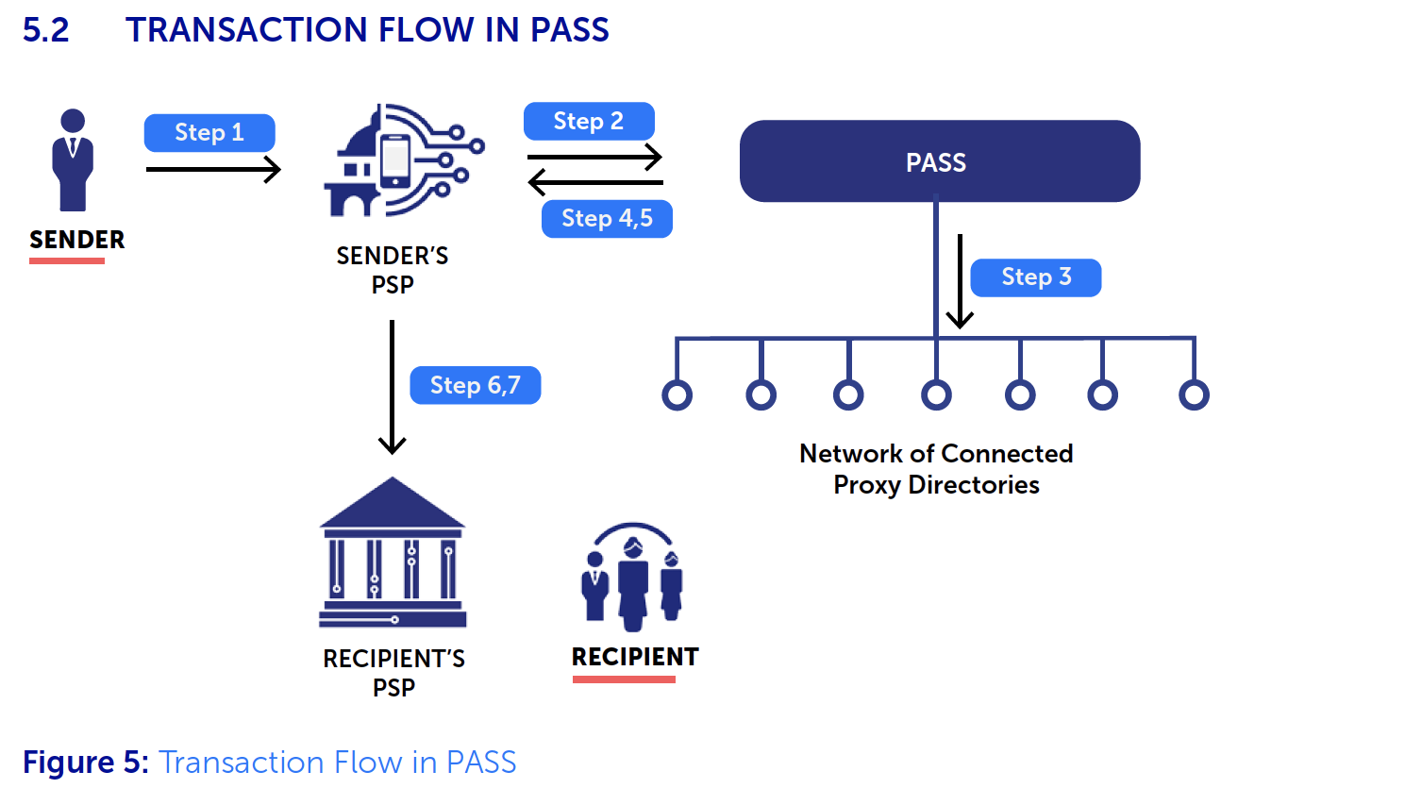
International Payments Addressing (IPA) PASS: Overview
Credit: Draft white paper by Arunjay K, UNCDF

Slide 4
PASS overview
Proxy Addressing System service, Directory of Proxy directories
Connects multiple local, regional and global proxy directories (vLEI) that store proxies (email, phone #s)
Payer initiates (PSP) with recipients info
Enable PSPs to choose optimal path
Maintain an audit log
Alias - tying to PII, payment credentials
Advantages (interoperable directory, enhanced UX, efficiency, assurance)
Key requirements (multiple proxy support, uniqueness, resolve duplication, Trust in PSPs, costs, audit trail, data exchange formats, System trust (secure, verifiable), vLEIs, Optimal route, recipient & PSP validity

Slide 5


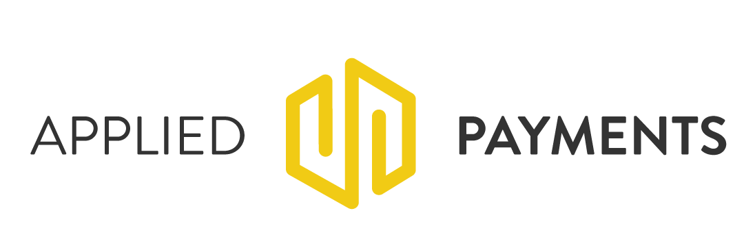

G20 Tech Sprint Tech update
In collaboration with:

Slide 6

Our solution
The solution proposes to provide a compliance history of checks performed on recipients receiving cross-border payments. The solution reduces the risk of paying a recipient related to money laundering, terrorist financing or potential sanctions evasion. Additionally, it helps process false positives and transactions faster.

Slide 7



How it works
1
Compliance checks are performed by a trusted compliance provider, who issues a compliance token for each check
2
The tokens are stored to form a compliance history for each recipient against their registered proxy
3
Compliance history (tokens) is shared with payment service providers

Slide 8



Overview: High-level Sequence Diagram
Testing Toolkit
(mocked for demo)
Payer FSP
IPS Switch
Discovery: Account lookup
Compliance check
Quoting / Agreement
Transfer
Payee FSP
Discovery
(PartyLookup)
Discovery
(Payee Info)
Agreement
(Quote) &
Authentication
Agreement
(Quote) &
Authentication
Ayesha
Core banking system / backend
Connector /
Adapter
Transfer
(Payment)
Transfer
(Payment)
Compliance
check
Compliance check provider (FRMS.IO)
Bhavik

Slide 9
Steps in the demo
User initiates lookup as the first step of a remittance / cross-border transfer
Payer user’s FSP requests Payment Switch for ID resolution, which may in turn involve resolution from other Schemes / payment systems
Payee ID matching performed based on outcome of address resolution (Proxy addressing system / other form of registries)
After match performed, user ID submitted to compliance-check service for validation
Compliance check returns: Checks performed, weighted score based on rules
User’s FSP makes the decision whether or not to continue with the transfer

Slide 10
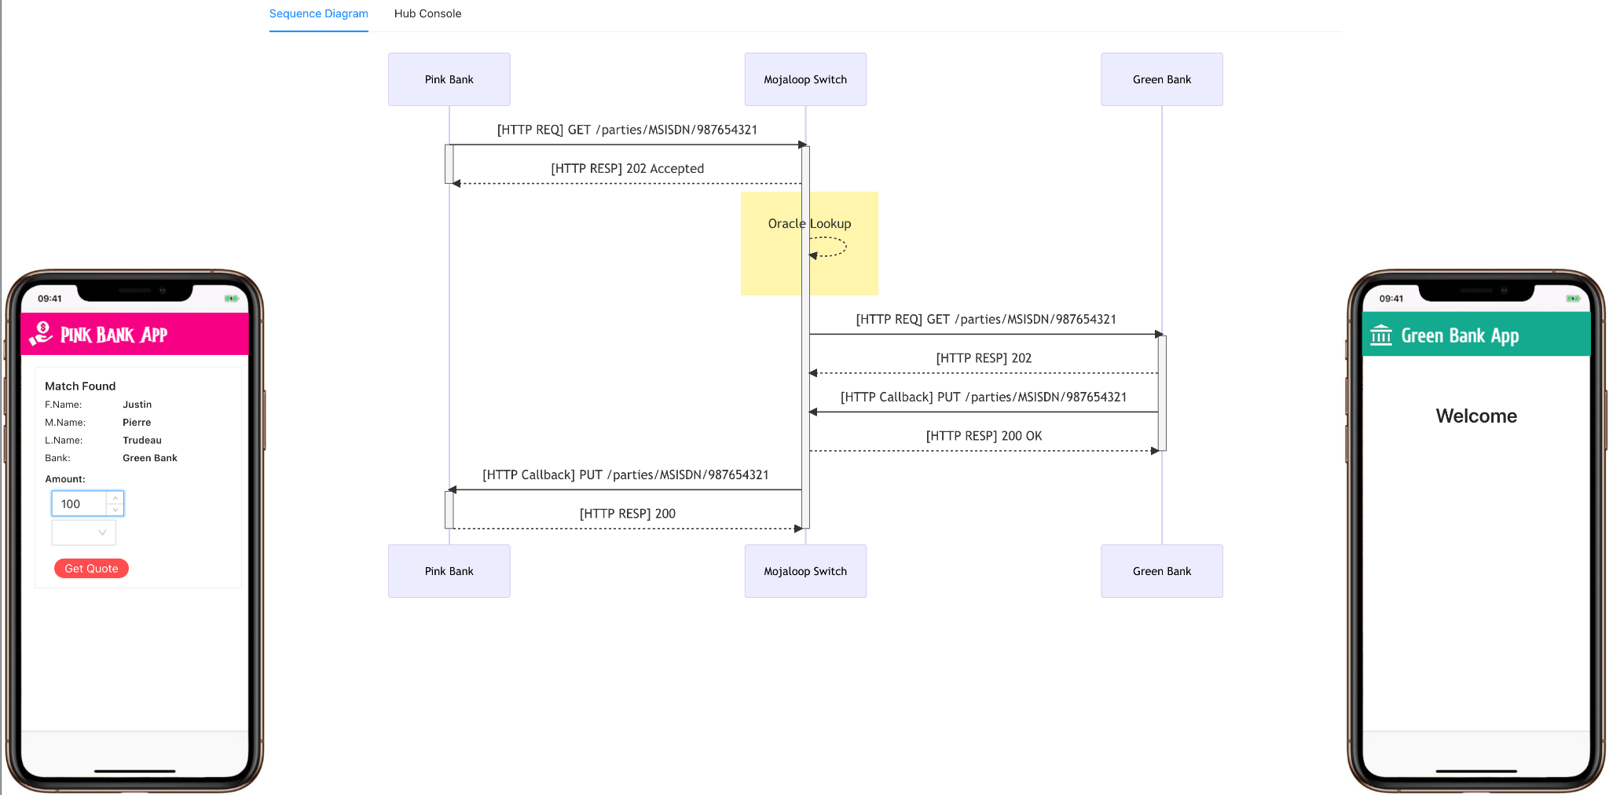
Lookup: user experience

Slide 11
PASS PoC participation
Phase-1 PoC
Yellow pepper platform chosen as PASS system
Participation requested by various entities such as switch platforms, directories

