Slide 1
Mojaloop - MOSIP - G2P
PI23 community event, Lusaka
October-November 2023 - Paul Baker, Paul Makin, Sam Kummary

Slide 2
PoC Goals
Understand capabilities of the adjacent platform(s) better: MOSIP, Mifos
Enable integration to provide guidance, template
Setup a foundation that can be built on for better quality deliverables
Enhance collaboration between DPGs

Slide 3
PI23 Status
Updates:
Finalize flows to show high level interactions and entities involved
Reviewing designs for integration - two proposals
Validate high level functions of MOSIP and Mifos to achieve desired integrations
Develop sequence diagrams that show integrating Mojaloop - MOSIP securely
Roadmap
Develop PoC for integration with live (test/demo) instances of Mojaloop, MOSIP running and
Demo!

Slide 4
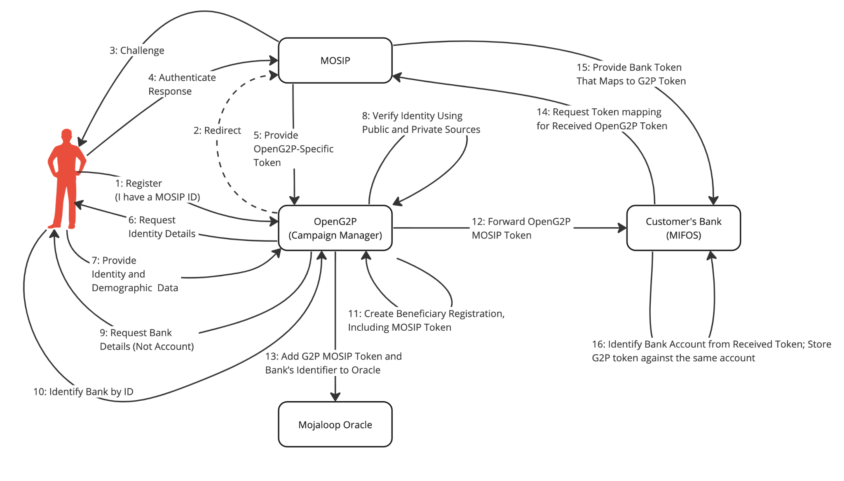
ML - MOSIP: Customer registers with OpenG2P (legacy)

Slide 5
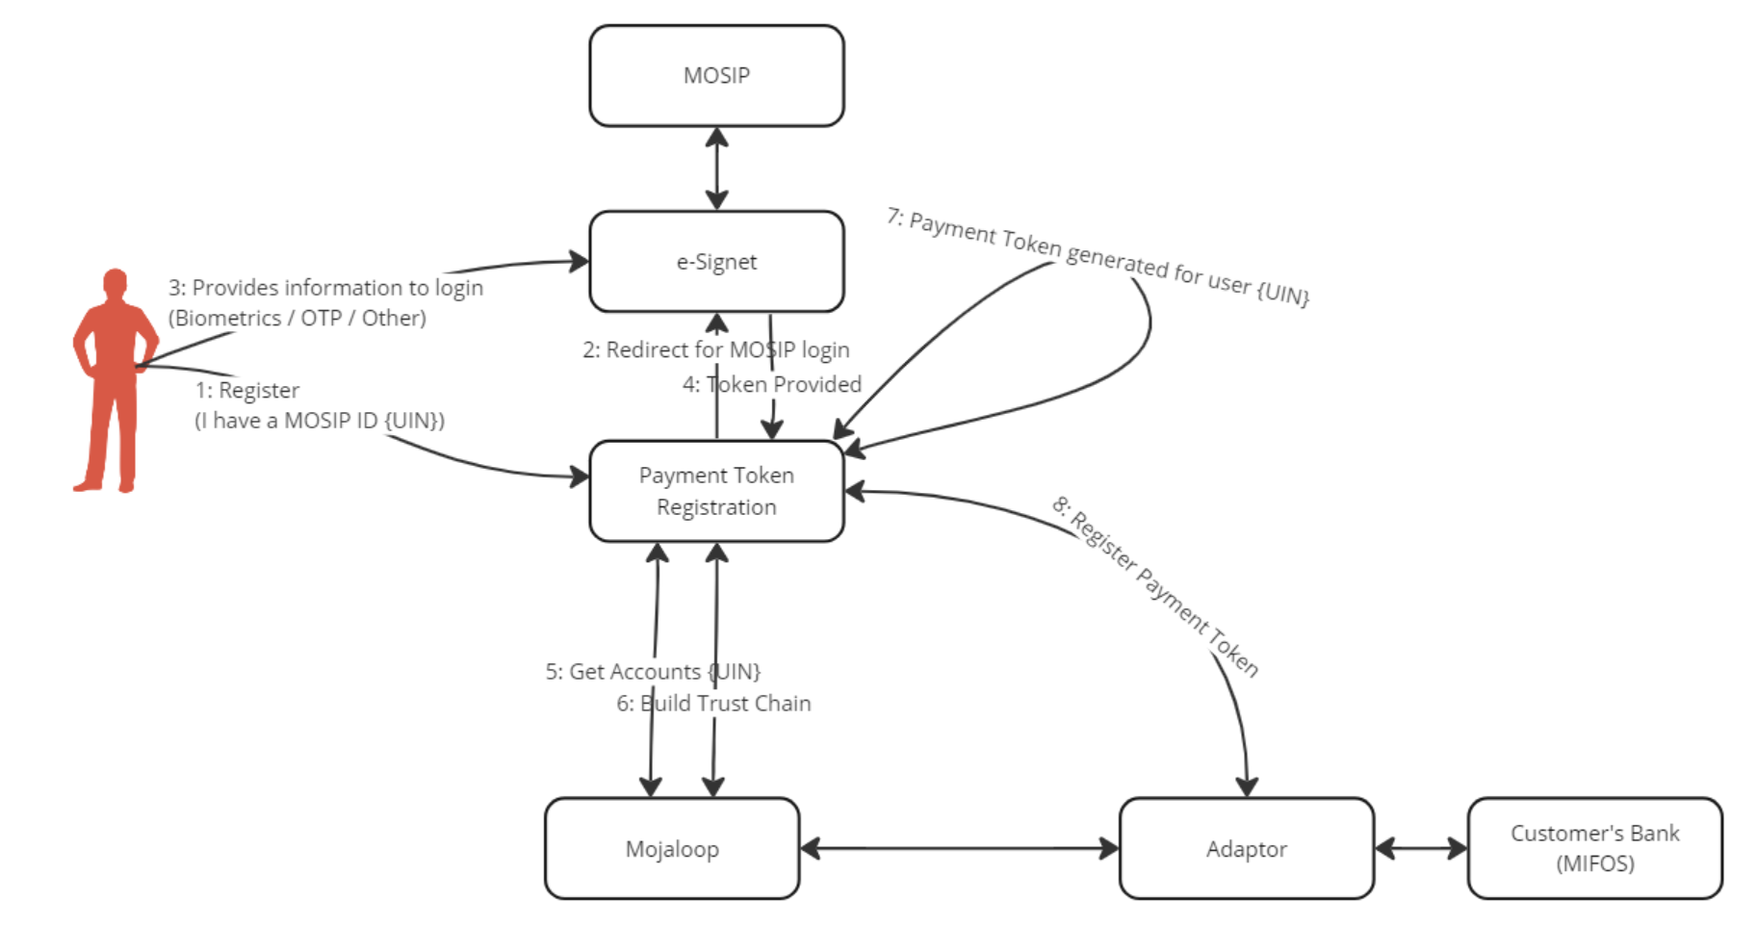
Mosip POC - 3p account linking pattern

Slide 6

G2P / Beneficiary Management – Use case
MOSIP
e-Signet
OAuth Login Redirect
2
Beneficiary Management System
Payment Token Registration
1
OAuth Login Redirect
OAuth Login Redirect
3
Mifos
6
Return token in JWT
5
Register Token
4
Choose account
→ Approves
mojaloop

