Slide 1
Projet Keystone
ISO 20022 Analytics
BIS Innovation Hub

Slide 2
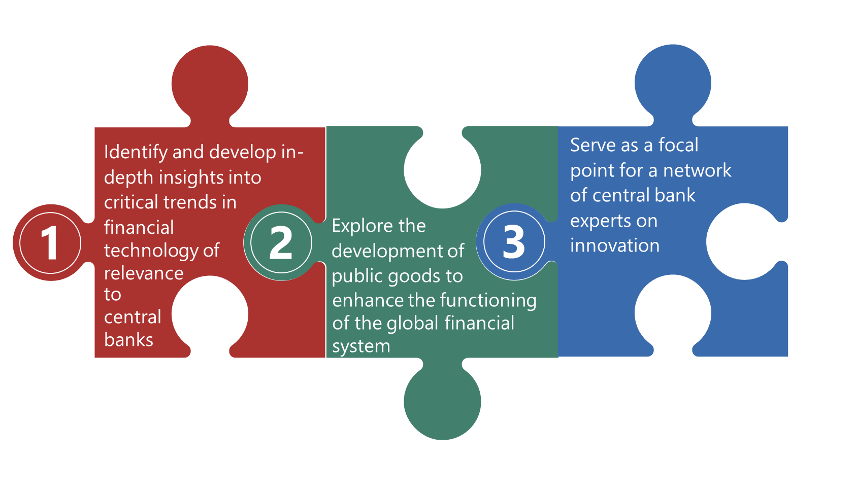
Fondée en 2019, la BISIH a pour mandat d'encourager la collaboration internationale sur les technologies financières innovantes au sein de la communauté des banques centrales.

Slide 3
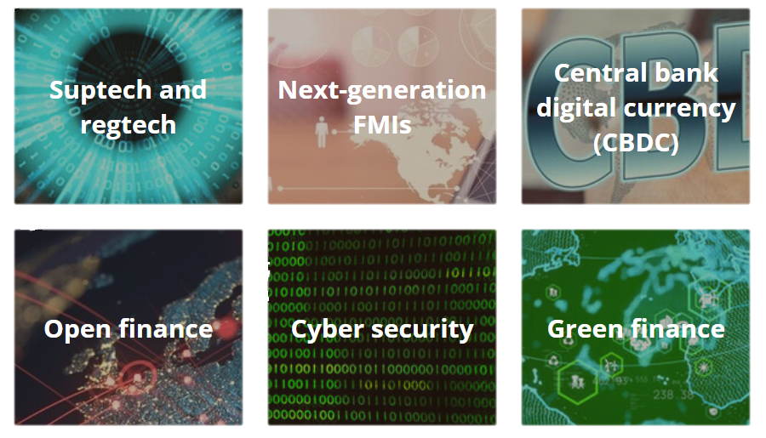
BISIH - Domaines d'action

Slide 4



The Current Environment
ISO 20022 is a new global payments messaging standard.
It is gradually being implemented by Real Time Gross Settlement (RTGS) system operators around the world.
These standards prescribe precise financial messaging requirements and enable granular descriptions of the data elements contained within payment messages.

Slide 5
Problem Statement
ISO 20022 Format
ISO 20022 data is formatted in an XML “tree structure”. While XML provides strong formatting capabilities, it can be difficult to parse and use in traditional analytic engines
Data Analytics
Existing data analysis tools will need to be modified to process ISO 20022 data
ISO 20022’s enhanced data fields provide new opportunities for expanded data analysis
A Community Issue
Given ISO 20022’s global adoption, there will be mass duplication of efforts to parse and analyse ISO data

Slide 6



Project Keystone - Goals
Develop a modular code base that extracts the complex data contained in ISO 20022 messages, storing it in a structured way for wide-ranging analysis by central banks.
Develop several analysis modules to provide key insights into ISO messaging data flowing through RTGS systems
Open source the extraction and analysis modules, and foster a community to continue to develop analysis for general or specific use cases identified in the central banking community

Slide 7







Project Keystone – How does it work?
Analysis Modules
Extract, Transform, Load (ETL)
Messaging Standards
Macroeconomic Conditions
Extraction
Transformation
Normalization
Storage
Liquidity monitoring

Slide 8
Project Keystone – How does it work?
Extract, Transform, Load (ETL)
Extraction
Keystone leverages industry standard data import features to ingest data from RTGS systems
Transformation
Keystone flattens ISO 20022’s XML data structure to allow for easier ingestion into data platforms
Normalization
Once flattened, this data is normalized into a relational database format for storage and rapid querying
Storage
Keystone provides an industry standard interface into database systems

Slide 9
Project Keystone – How does it work?
Liquidity monitoring
Macroeconomic Conditions
Messaging Standards
Near real time monitoring of bank positions
Similar reporting for cross jurisdiction data
Understanding of network typologies and risks
Analysis of purpose codes for leading economic indicators
Focus on housing and card spending use cases
Scoring of community use of ISO enriched data fields
Scoring of community compliance with CPMI harmonization requirements

Slide 10
Upcoming Tech Sprint
June 2025
Launching a tech sprint to enable Central Banks to use the outputs of the project.
Areas of Focus:
1. New Analytics Modules
2. The use of standardized data for collaboration
3. What policy insights may be unlocked by near real time monitoring

