Slide 1
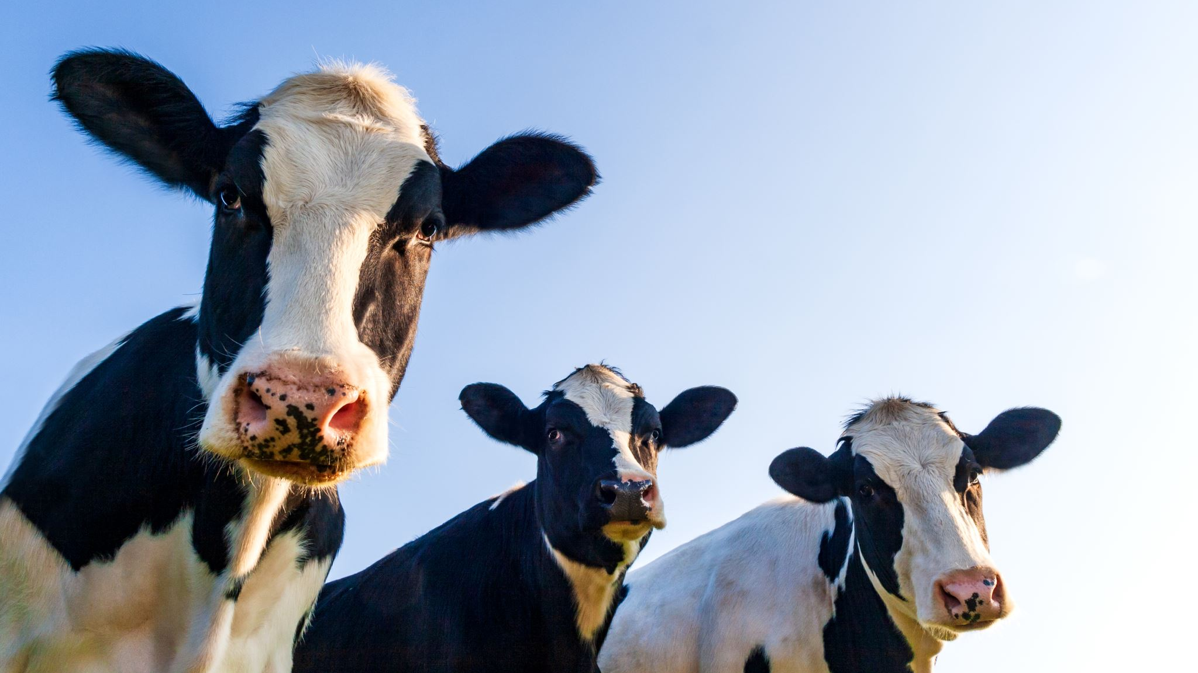
Rumen gut microbiome analysis in cows with Mastitis
Jayden William Kgobe
29 April 2026
BIOMI4300

Slide 2
Table of Contents
01. Background
02. Scientific Question
03. Methods
04. Analysis
05. Conclusion

Slide 3

01. Background

Slide 4
Mastitis is an inflammatory response of the udder tissue in the mammary gland
Contagious
Transmission from cow-to-cow during milking
Common Pathogens:
Saphylococcus aureus
Streptococcus agalactiae
Mycoplama bovis
Corynebacterium
Environmental
Opportunistic pathogens in the bedding/housing of livestock
Common Pathogens
E.coli,
Klebsiella spp
Enterobacter spp
Pseudomonas

Slide 5
Bovine mastitis can be classified into 2 classes based on the degree of inflammation
Subclinical
No visible signs of infection
Decrease in milk production
Increase in somatic cell count
Clinical
Red and swollen udders
Fever
Milk appears to have flakes/clots
Notes:
Clinical: the most evident type of mastitis

Slide 6
70% in losses for dairy farmers
11% to 18% of the gross margin per cow per year

Slide 7

02. Scientific Question

Slide 8
Gut microbiota have emerged as a crucial factor in regulating the physiological functions of the host and the progression of diseases
Notes:
Because mastitis is caused by bacteria, one can ask themselves
SCFAsderived from the gut microbiota help maintain anaerobic conditions in the intestine, regulate the mucosal and systemic of pathways that in the metabolic adaptation of the brain’s innate immune system.

Slide 9
Gut microbiota play an important role in regulating progression of disease state
Scientific Question
Does rumen microbiota community change based on the disease state of Mastitis in dairy cattle?
Null Hypothesis
There is no significant difference in the ruminal microbiome of cattle with varying degrees of Mastitis (alpha or beta diversity)
Alternative Hypothesis
Cattle with Clinical Mastitis would have a lowered alpha and beta diversity
Notes:
Studies have indicated that the gut microbiota are critically involved in regulating inflammation in extraintestinal tissues

Slide 10

03. Methods

Slide 11
Data used for analysis was from 60 Holstien Cows in China (Wang et al, 2021)
Cohort Definition
20 Healthy Cows (SCC < 100,000 cells/ml)
20 Subclinical Mastitis (600,000 < SCC < 1,000,000 cells/mL)
20 Clinical Mastitis (SCC > 3000,000 cells/mL)
16S Sequencing Strategy
V3-V4 amplified using 338F/806R
Illumina Paired-End Sequencing (2 x 300)
ASVs assigned with DADA2
Scaled Sequencing Depth of 8,500 reads across 60 samples
Notes:
0 Holstein cows were selected and divided into 3 groups: 20 cows with healthy udder (H group) (SCC < 100,000 cells/mL; no clinical symptoms in udders; CMT results were negative); 20 cows with SM (SM group) (600,000 < SCC < 1,000,000 cells/mL; no obvious clinical symptoms of mastitis in the udder; CMT results were weakly positive); and 20 cows with CM (CM group) (SCC > 3000,000 cells/mL, with obvious signs of inflammation in udders, including udder swelling, redness and milk clots, etc., as well as positive or strongly positive CMT results)

Slide 12
Lack of properly labelled metadata significantly impacted the quality of analysis
SRA metadata file from the NCBI BioProject: PR669201 lacked crucial information about the disease state of the cows
However, there was a column titled “Sample.name” which grouped 60 cows as either (J, Y or L)
Based on this discovery, analysis was done gingerly to try and establish whether these groups corresponded to Mastitis disease state or something else

Slide 13

04. Analysis

Slide 14
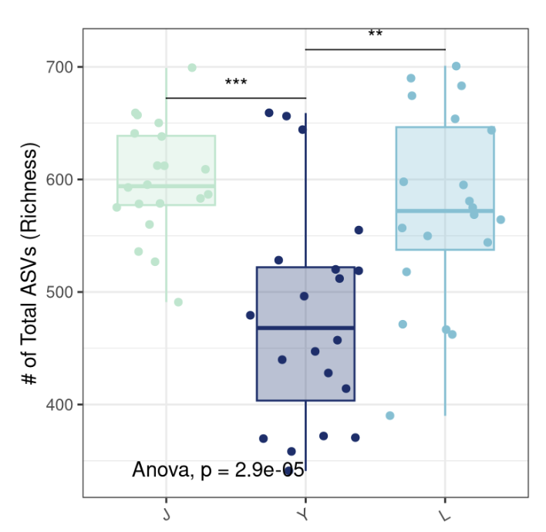
Observed richness across the 3 groups differed
Group Y had a substantially lowered observed richness than groups J and L, which were more similar to one another.
The largest group-level differences are being driven by the presence or absence of less abundant taxa, rather than by major shifts in the dominant members of the community.

Slide 15
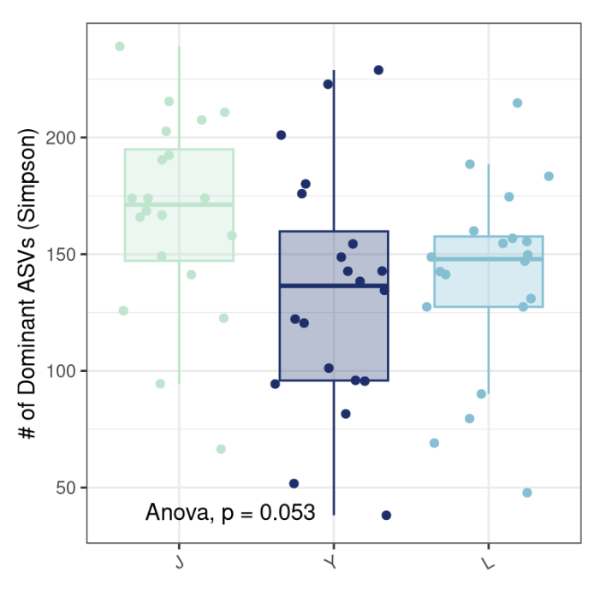
Dominant taxa do not influence the structure of the community
The dominant organisms in the communities are comparatively more stable across groups than
Notes:
Simpson diversity emphasizes dominant taxa,

Slide 16
Rare Taxa appear to be more important than the dominant taxa
Notes:
In terms of alpha diversity

Slide 17
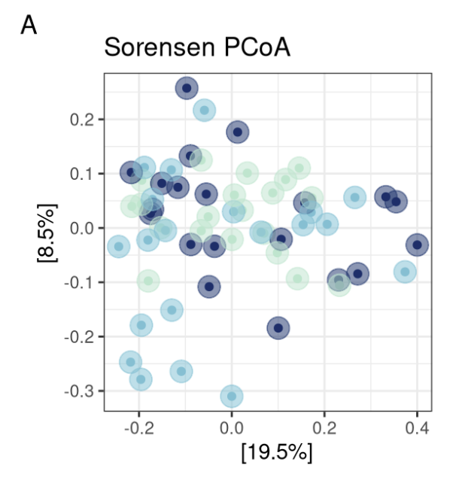
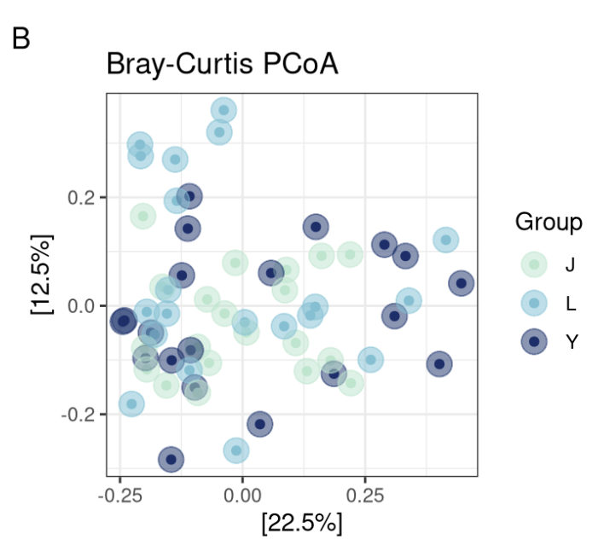
Ordination results showed a strong overlap among groups J, Y and L
Notes:
Red flag
No sharply distinct microbial states

Slide 18
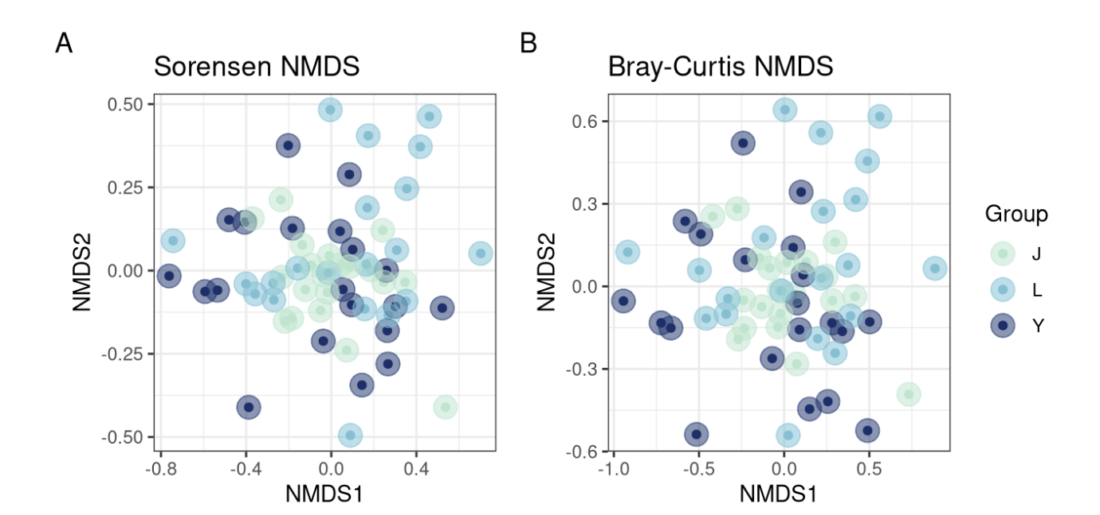
Even Non-metric Multi-dimensional scaling indicate that the three sample groups do not form strongly separated microbial community clusters.

Slide 19

Average community composition is not significantly different

Slide 20
Sample groups (J, Y and L) only explain 4.3% of variation
Bray-Curtis PERMANOVA:
R-squared value = 0.043
p-value = 0.127
No statistically significant differences in overall rumen microbial community composition among groups J, L, and Y
3 groups do not possess strongly distinct average microbial communities.

Slide 21
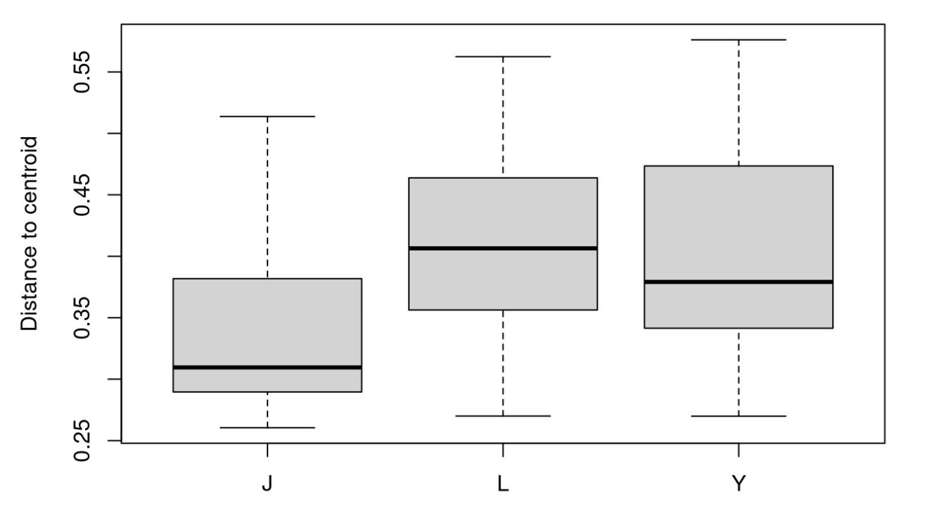
Groups L and Y significantly dispersed than Group J
Notes:
Betadisper testing

Slide 22
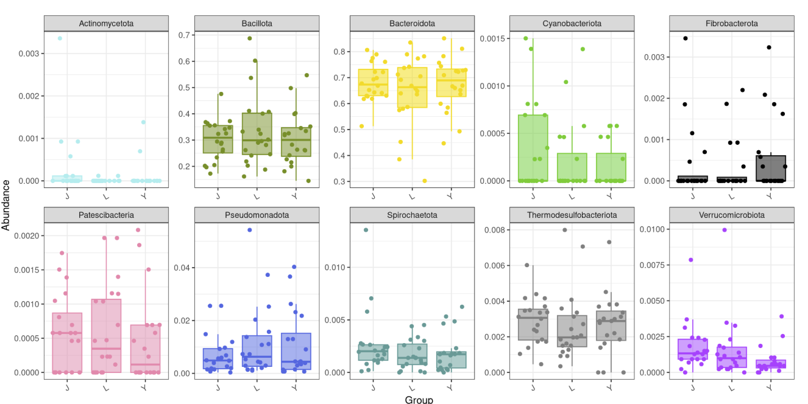
Overall composition of phyla is consistent across all groups

Slide 23
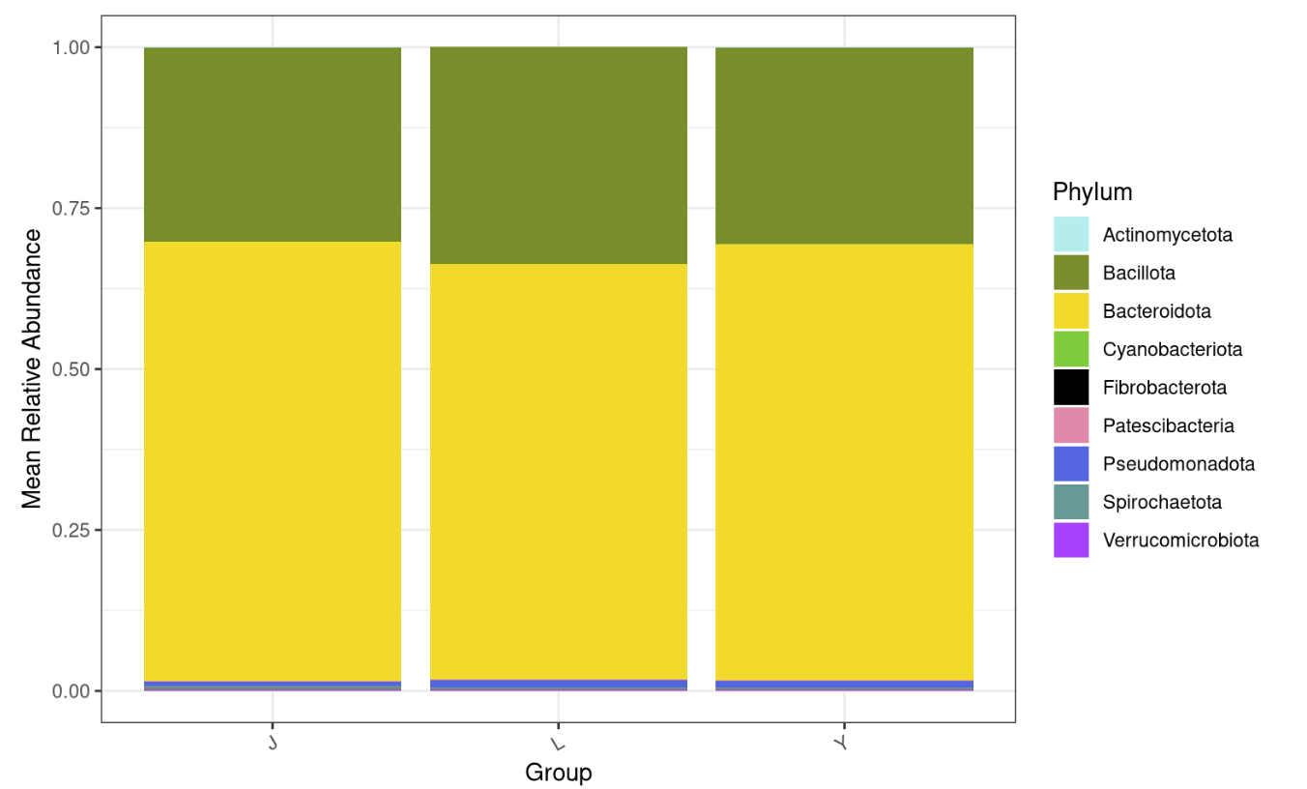
Bacteriodota make up the majority of phyla in all samples
Notes:
Makes sense

Slide 24
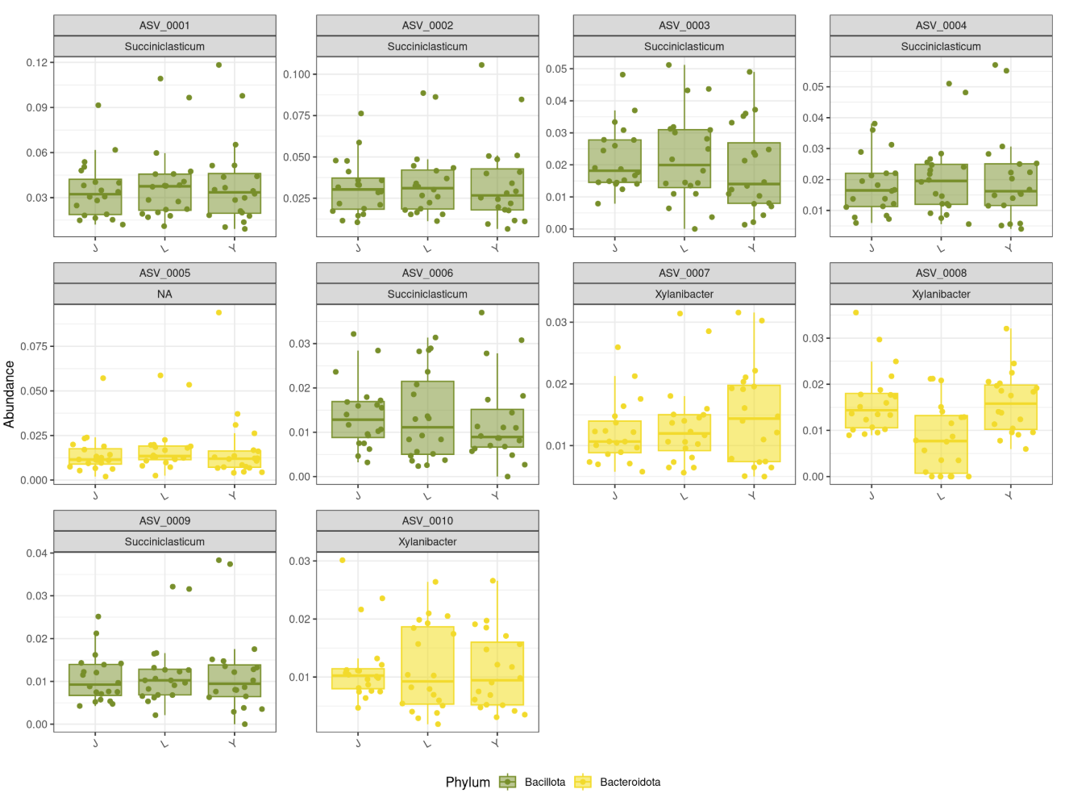
Succiniclasticum is associated with rumen microbiome

Slide 25

05. Conclusion

Slide 26
Core microbiome likely shared across all 3 groups
Groups J/L/Y do not have radically different average communities.
But they differ in richness and ecological stability.
Heterogeneity may be the key biological signal.
Notes:
But could be a possibility of not knowing my metadata

Slide 27

Questions?

Slide 28
Citations
Cheng, W. N., & Han, S. G. (2020). Bovine mastitis: Risk factors, therapeutic strategies, and alternative treatments — A review. Asian-Australasian Journal of Animal Sciences, 33(11), 1699–1713. https://doi.org/10.5713/ajas.20.0156
Wang, Y., Nan, X., Zhao, Y., Jiang, L., Wang, M., Wang, H., Zhang, F., Xue, F., Hua, D., Liu, J., Yao, J., & Xiong, B. (2021). Rumen microbiome structure and metabolites activity in dairy cows with clinical and subclinical mastitis. Journal of Animal Science and Biotechnology, 12(1), 36. https://doi.org/10.1186/s40104-020-00543-1
Zhu, S., Bian, S., Lu, J., Wang, Y., Iqbal, M., Kiani, F. A., Dong, H., Zhang, X., Yuan, Z., Liu, F., & Li, A. (2026). Pathogenesis of Bovine Mastitis and Influence of the Gut Microbiota: A Review. Journal of Agricultural and Food Chemistry, 74(5), 4222–4234. https://doi.org/10.1021/acs.jafc.5c13667

