Slide 1
Title: Assessing Aircraft Risk for Business Expansion Subtitle: Using Data to Guide Safe Aircraft Purchases
Presenter: Edwin George Date: 09/09/2024

Slide 2
Business Problem
Overview:
Our company is venturing into aviation to diversify.
We need to identify low-risk aircraft for both commercial and private operations.
Objective:
Provide actionable insights to guide safe aircraft investment and minimize risk.

Slide 3
Business Understanding
Approach:
I applied CRISP-DM methodology for a structured analysis.
My Key Focus Areas:
Risk assessment of various aircraft models.
Predicting accident likelihood based on historical data.
Evaluating how environmental and operational factors impact risk.

Slide 4
Objectives
Identify aircraft makes with the lowest risk.
Determine which models are more prone to accidents.
Analyse the effect of environmental conditions on accident rates.
Assess the feasibility of investing in amateur-built aircraft.
Examine how the purpose of the flight impacts risk levels.

Slide 5
Data Overview
Dataset:
Source: Kaggle - Aviation Accident Database Synopses
Key Attributes:
Aircraft make and model
Incident and accident records
Weather conditions at the time of incidents
Severity of injuries
This dataset provides comprehensive accident records and environmental conditions, allowing for detailed risk analysis of aircraft models.

Slide 6
Data Cleaning & Preparation
Steps:
Addressed missing values in key columns such as Make and Model.
Standardized entries to ensure consistency (e.g., converting "Unk" to "UNK").
Feature Engineering:
Simplified aircraft make entries (e.g., "CESSNA 172" to "CESSNA").
Ensured consistent reporting of injury severity for accurate analysis.
The Data cleaning and preparation ensure that our analysis is based on accurate and uniform information.

Slide 7
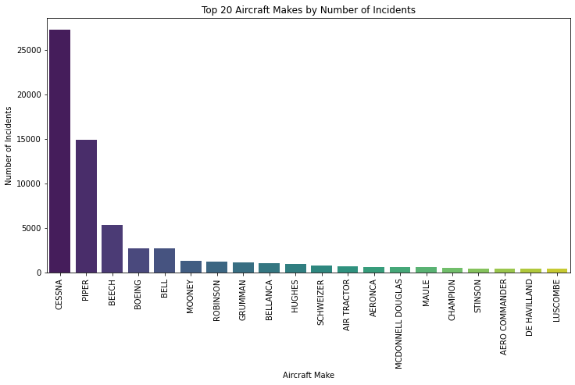
Key Visualizations
Accident Frequency by Make and Model:
Bar chart visualizing the number of accidents per aircraft make and model.
Helps identify which aircraft are involved in the most incidents.
This visualization highlights high-risk aircraft based on accident frequency, giving guide toward safer investment choices.

Slide 8
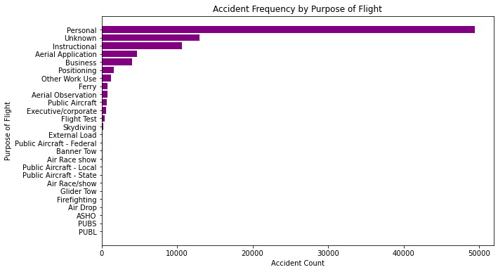
Accident Frequency by Purpose of Flight
Analysis:
Bar chart showing accident rates based on flight purpose (e.g., commercial, private).
Reveals higher accident frequencies associated with private flights.
Understanding accident rates by flight purpose helps us evaluate the risk associated with different types of operations.

Slide 9
Findings
Low-Risk Criteria:
Aircraft with fewer accidents and lower injury severity.
Consistent performance across different environments and flight phases.
Environmental Factors:
Adverse weather conditions correlate with higher accident rates.
Geographical challenges increase risk.
Flight Purpose:
Private flights generally showed higher risk compared to commercial flights.
Cargo and training flights exhibit varying risk levels based on operational nature.

Slide 10
Recommendations
Avoid aircraft models with high accident frequencies and severe incidents.
Consider environmental factors like weather patterns when planning operations.
Tailor aircraft selection to the intended flight purpose to mitigate risks.
Invest in aircraft with robust safety records and proven reliability.

