Slide 1
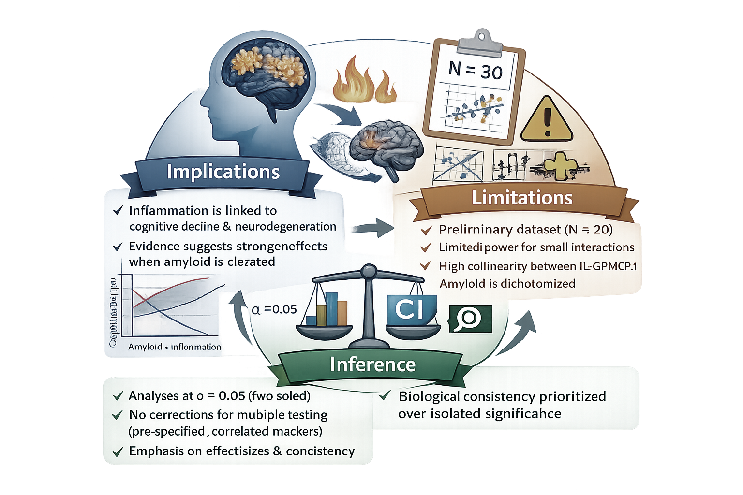
Peripheral Inflammation, Amyloid Pathology, and Cognitive Decline
BIOS 6624 Presentation
Mojde Mir

Slide 2
Aim 1: Analysis Approach
Research Question: Do peripheral inflammatory markers predict one-year decline in episodic memory and cortical thickness?
Hypothesis: Higher baseline levels and increase in inflammatory markers → greater decline in outcome
Predictors
Primary: IL-6, TNF-α, MCP-1, Eotaxin-1
Additional markers → exploratory analyses
Methods
Linear regression of change scores
Each marker modeled separately (reduce collinearity)
Covariates:
Age, sex (primary)
Additional covariates (sensitivity analyses)
Interpretation Strategy
Focus on:
consistency of direction
magnitude of effects
Not just individual p-values

Slide 3
Aim 2: Analysis Approach
Research Question: Does peripheral inflammation modify (moderate) the relationship between amyloid burden and cognitive and neurodegenerative decline?
Hypothesis: higher inflammation is associated with greater cognitive and neurodegenerative decline, and that this association is stronger at higher levels of amyloid burden
Amyloid Modeling
Primary: Continuous SUVR
Secondary: Amyloid-positive (SUVR ≥ 1.10)
Methods
Linear regression models
Amyloid
Inflammation
Amyloid × Inflammation interaction
Interaction = difference in associations across amyloid levels
Interpretation
Significant interaction → examine:
predicted values
simple slopes
Covariates
Same as Aim 1 (age, sex, sensitivity analyses)

Slide 4
Summary of Preliminary Data
Preliminary Findings
Data Overview
Sample size: N = 30 (preliminary dataset)
Outcomes:
Memory change (CVLT_CNG3)
Cortical thickness change (CORT_CNG3)
Predictors:
IL-6, MCP-1 (inflammatory markers)
Data Characteristics
Outcomes: approximately symmetric
Relationships: approximately linear
Key Findings
Memory: modest associations (r = -0.26 to -0.32)
Cortex: stronger associations (r = -0.60 to -0.69)
IL-6 & MCP-1 highly correlated (r = 0.93) → collinearity

Slide 5
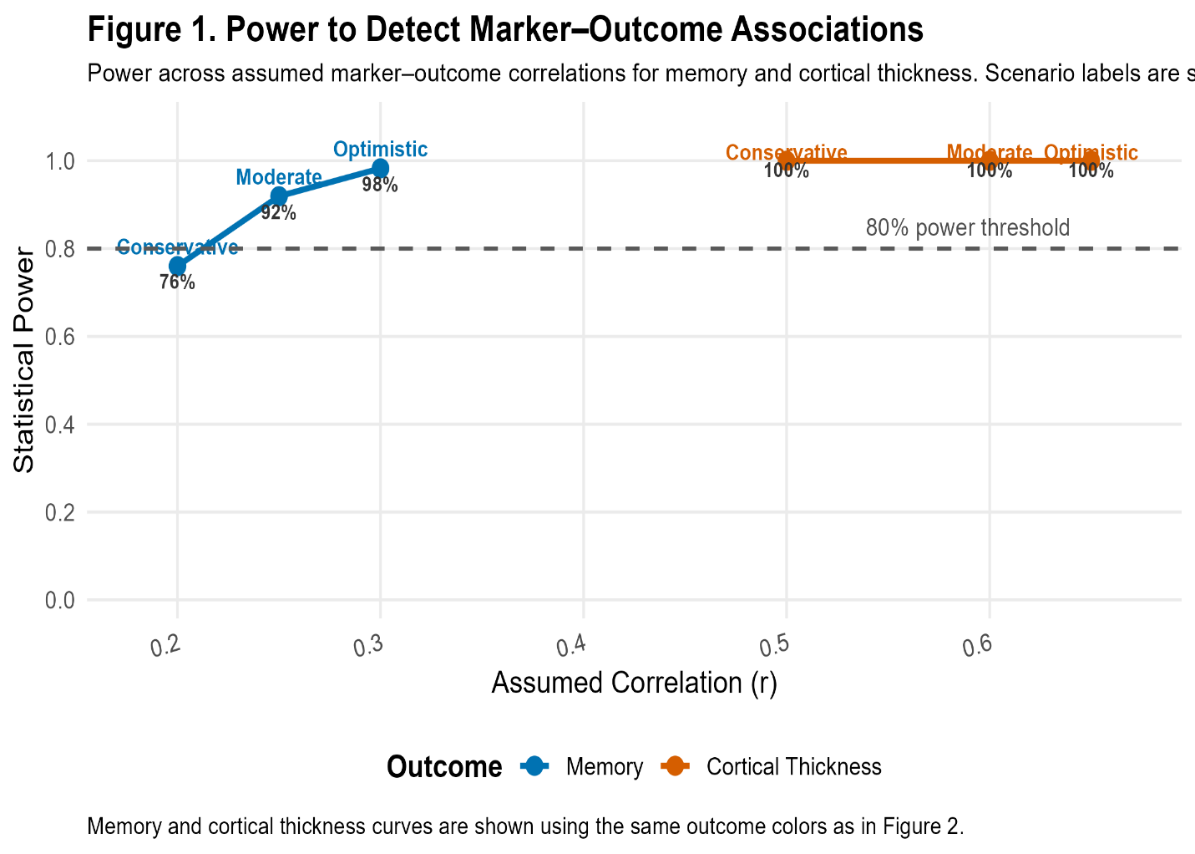
Aim 1: Power Analysis
Method: corr1.samp
Assumptions:
N = 175, α = 0.05
Memory: r = 0.20–0.30
Cortex: r = 0.50–0.65
Results
Memory: Power = 0.76–0.98
Cortex: Power ≈ 1.00
Adequate power for moderate effects
Higher power for cortical thickness

Slide 6
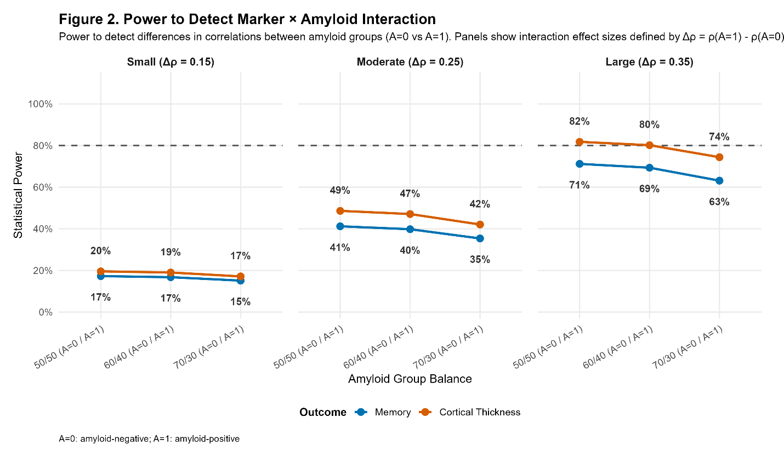
Aim 2: Power Analysis
Method
corr.2samp
Interaction : difference in correlations between amyloid groups
Amyloid: SUVR ≥ 1.10 vs < 1.10
Assumptions:
Baseline: -0.10 (memory), -0.25 (cortex)
Δρ: 0.15, 0.25, 0.35
Group balance: 50/50 to 70/30
Results
Memory: Power = 0.17–0.63
Cortex: Power = 0.19–0.82
Power ↑ with effect size & balance
Moderate–large effects detectable
Limited power for small interactions

Slide 7
Implications and Limitation
Implications
Inflammation is linked to cognitive decline and neurodegeneration
Stronger effects for cortical thickness
Evidence supports interaction: greater impact when amyloid is elevated
Limitations
Limited power for small interaction effects
Preliminary data (N = 30)
High collinearity among markers
Amyloid dichotomization simplifies continuous biology
Inference Strategy
Analyses at α = 0.05 (two-sided)
No multiple-testing correction (pre-specified, correlated markers)
Focus on:
effect sizes & confidence intervals
consistency across markers and outcomes

