Slide 1
HANDS-ON TEACHING DEMO
Decision Tree Classification
with Python
Credit dataset • Step-by-step code • Google Colab
Dr. Jiahui Mo
Information Technology & Business Analytics

Slide 2
OVERVIEW
What will we do?
1
Load
Read the Credit CSV into a pandas DataFrame
2
Prepare
Separate the target, encode categories, and split the data
3
Train
Fit a readable entropy-based decision tree
4
Evaluate
Compare accuracy, baseline, and confusion matrix
5
Interpret
Read the tree, rules, and feature importance
Hands-on Decision Tree Analysis with Python
2

Slide 3
STEP 1 · FRAME THE PROBLEM
Business problem and data
Goal
Column | Role | Meaning
OBS# | ID | Exclude from model
DURATION, AGE, Amount | Numeric inputs | Measured quantities
CHK_ACCT, JOB, ... | Category inputs | Codes; one-hot encode
CREDIT | Target | Recorded class 0 or 1
Predict the recorded CREDIT class from an applicant profile as a bank decision-support example.
Supervised learning: the known CREDIT label teaches the model.
Do not translate 0/1 into Good/Bad until a matching data dictionary verifies the mapping.
Hands-on Decision Tree Analysis with Python
3

Slide 4
STEP 2 · SET UP PYTHON
Import the libraries
1 import io
2 from pathlib import Path
3 import matplotlib.pyplot as plt
4 import pandas as pd
5 from sklearn.compose import ColumnTransformer
6 from sklearn.metrics import (...)
7 from sklearn.model_selection import train_test_split
8 from sklearn.pipeline import Pipeline
9 from sklearn.preprocessing import OneHotEncoder
10 from sklearn.tree import DecisionTreeClassifier, plot_tree
1–2 Support uploaded files and local paths.
3 Creates charts.
4 Loads and summarizes tabular data.
5, 8–9 Build a reusable preprocessing-and-model workflow.
6 Imports evaluation tools.
7 Creates training and testing samples.
10 Imports the tree model and plot.
Hands-on Decision Tree Analysis with Python
4

Slide 5
STEP 3 · LOAD DATA
Choose how to load the CSV
1 raw_url = "https://raw.githubusercontent.com/.../Credit.csv"
2 UPLOAD_FILE = False
1 Stores the direct GitHub address of the CSV.
2 False loads from GitHub. Change to True to upload a file in Colab.
A local fallback lets the notebook also run beside Credit.csv.
Hands-on Decision Tree Analysis with Python
5

Slide 6
STEP 3 · LOAD DATA
Load from GitHub or upload a file
1 if UPLOAD_FILE:
2 from google.colab import files
3 uploaded = files.upload()
4 df = pd.read_csv(io.BytesIO(...))
5 else:
6 df = pd.read_csv(raw_url)
7 print(f"Dataset shape: {df.shape}")
8 df.head()
1–4 When True, Colab displays a Choose Files button and reads the uploaded bytes.
5–6 Otherwise, pandas reads the GitHub CSV.
7 Confirms 59 rows × 10 columns.
8 Displays the first five records.
Hands-on Decision Tree Analysis with Python
6

Slide 7
STEP 3 · LOAD DATA
Check the loaded data
OBS# | CHK_ACCT | DURATION | AGE | Amount | JOB | ... | CREDIT
1 | 0 | 6 | 67 | 10,034 | 2 | ... | 1
2 | 1 | 48 | 22 | 10,543 | 2 | ... | 0
3 | 3 | 12 | 49 | 2,032 | 1 | ... | 1
4 | 0 | 42 | 45 | 30,456 | 2 | ... | 1
5 | 0 | 24 | 53 | 26,455 | 2 | ... | 0
Dataset shape: 59 rows × 10 columns
Hands-on Decision Tree Analysis with Python
7

Slide 8
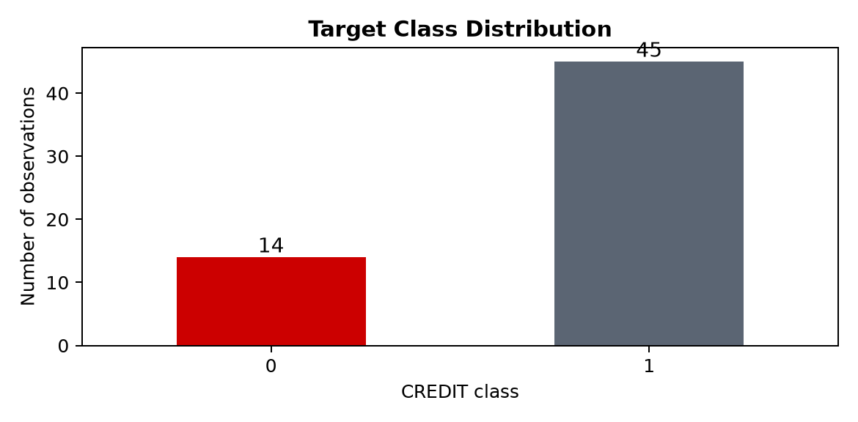
STEP 4 · INSPECT
Check data quality and class balance
What do we learn?
• No missing values are present.
• Class 1 has 45 rows; class 0 has 14.
• A majority-only rule is 76.3% accurate.
• Accuracy alone may hide poor minority-class performance.
Always compare the model with a baseline.
Hands-on Decision Tree Analysis with Python
8

Slide 9
STEP 5 · PREPARE DATA
Select predictors and target
1 id_column = "OBS#"
2 target_column = "CREDIT"
3 feature_columns = [
4 c for c in df.columns
5 if c not in [id_column, target_column]
6 ]
7 X = df[feature_columns]
8 y = df[target_column]
1 Identifies the row ID, which is not a useful applicant characteristic.
2 Identifies the outcome to predict.
3–6 Keeps all remaining columns as predictors.
7 Creates the feature table X.
8 Creates the target vector y.
Hands-on Decision Tree Analysis with Python
9

Slide 10
STEP 5 · PREPARE DATA
One-hot encode category codes
1 preprocessor = ColumnTransformer([
2 ("category", OneHotEncoder(
3 handle_unknown="ignore"), categorical_columns),
4 ("number", "passthrough", numeric_columns)
5 ])
1 Creates one coordinated transformation.
2–3 Makes a separate 0/1 indicator for each category. Unknown future codes will not crash prediction.
4 Leaves DURATION, AGE, and Amount numeric.
Decision trees do not need feature scaling.
Hands-on Decision Tree Analysis with Python
10

Slide 11
STEP 6 · SPLIT THE DATA
Create an 80/20 train-test split
1 X_train, X_test, y_train, y_test = train_test_split(
2 X, y,
3 test_size=0.20,
4 random_state=42,
5 stratify=y
6 )
1–2 Separates predictors and labels together.
3 Reserves 20% for final testing.
4 Makes the same split reproducible.
5 Preserves class proportions as closely as possible.
Result: 47 training rows and 12 testing rows.
Hands-on Decision Tree Analysis with Python
11

Slide 12
STEP 7 · TRAIN THE TREE
Fit a readable entropy-based tree
1 model = Pipeline([
2 ("preprocess", preprocessor),
3 ("tree", DecisionTreeClassifier(
4 criterion="entropy",
5 max_depth=3,
6 random_state=42
7 ))
8 ])
9 model.fit(X_train, y_train)
1–2 Applies identical preprocessing during training and prediction.
3 Creates the classifier.
4 Chooses splits using entropy reduction.
5 Limits depth for readability and reduces overfitting.
6 Makes tie-breaking reproducible.
9 Learns the tree from the training rows.
Hands-on Decision Tree Analysis with Python
12

Slide 13
STEP 7 · TRAIN THE TREE
How does a decision tree choose a split?
01
Try candidate questions
02
Measure class mixture
Example: DURATION ≤ 21?
Entropy is lower when a node is purer.
03
Choose the best reduction
04
Repeat on each branch
Prefer the split with the largest information gain.
Stop at max_depth = 3 in this demo.
Entropy is a split criterion—not a measure of business fairness or real-world value.
Hands-on Decision Tree Analysis with Python
13

Slide 14
STEP 8 · EVALUATE
Predict the holdout rows and calculate metrics
1 y_pred = model.predict(X_test)
2 accuracy_score(y_test, y_pred)
3 balanced_accuracy_score(y_test, y_pred)
4 classification_report(y_test, y_pred)
1 Applies preprocessing and the fitted tree to unseen test rows.
2 Calculates the overall correct share.
3 Averages recall across the two classes.
4 Reports precision, recall, and F1 for each class.
Use several views; no single metric tells the whole story.
Hands-on Decision Tree Analysis with Python
14

Slide 15
STEP 8 · EVALUATE
Holdout results
Test accuracy
Balanced accuracy
Majority baseline
0.667
0.444
0.766
The tree's 66.7% accuracy is below the 76.6% training baseline. Balanced accuracy is also low. The correct conclusion is not ‘success’—it is that this tiny sample does not support a reliable model.
A negative result is still a valuable modeling result when it prevents false confidence.
Hands-on Decision Tree Analysis with Python
15

Slide 16
STEP 8 · EVALUATE
Draw the confusion matrix
1 ConfusionMatrixDisplay.from_predictions(
2 y_test, y_pred,
3 labels=[0, 1],
4 cmap="Reds",
5 colorbar=False
6 )
7 plt.show()
1–2 Compares actual and predicted classes.
3 Fixes a clear class order.
4–5 Controls the chart appearance.
6–7 Completes and displays the chart.
Rows are actual classes; columns are predicted classes.
Hands-on Decision Tree Analysis with Python
16

Slide 17
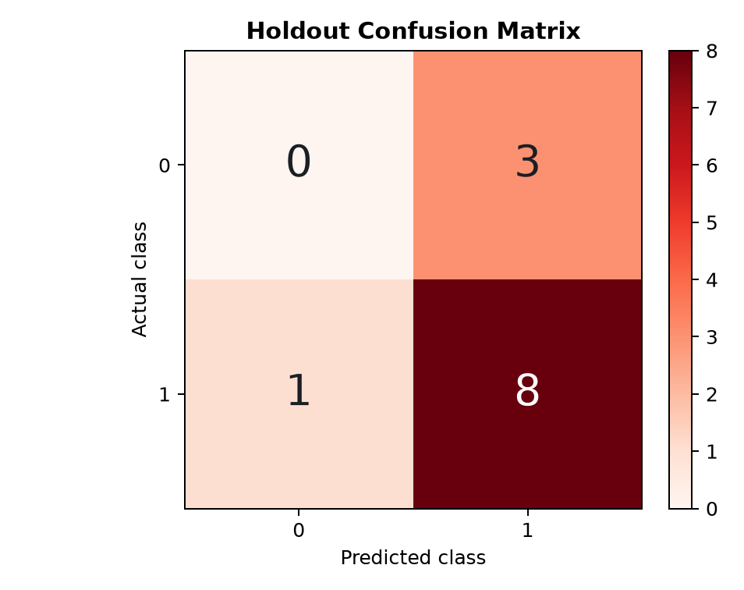
STEP 8 · EVALUATE
Where did the model make errors?
Interpretation
• 8 class-1 rows are correctly identified.
• 1 class-1 row is predicted as class 0.
• All 3 class-0 rows are missed.
• Overall accuracy hides that class-0 recall is 0%.
Business error costs require the verified class mapping.
Hands-on Decision Tree Analysis with Python
17

Slide 18
STEP 9 · INTERPRET
Visualize the fitted tree
1 tree_model = model.named_steps["tree"]
2 feature_names = model.named_steps["preprocess"]
3 .get_feature_names_out()
4 plot_tree(tree_model,
5 feature_names=feature_names,
6 class_names=["0", "1"],
7 filled=True, rounded=True
8 )
1 Extracts the fitted classifier from the pipeline.
2–3 Gets the names created by one-hot encoding.
4–8 Draws the nodes, questions, class counts, and predicted class.
Follow left when the condition is true and right when it is false.
Hands-on Decision Tree Analysis with Python
18

Slide 19
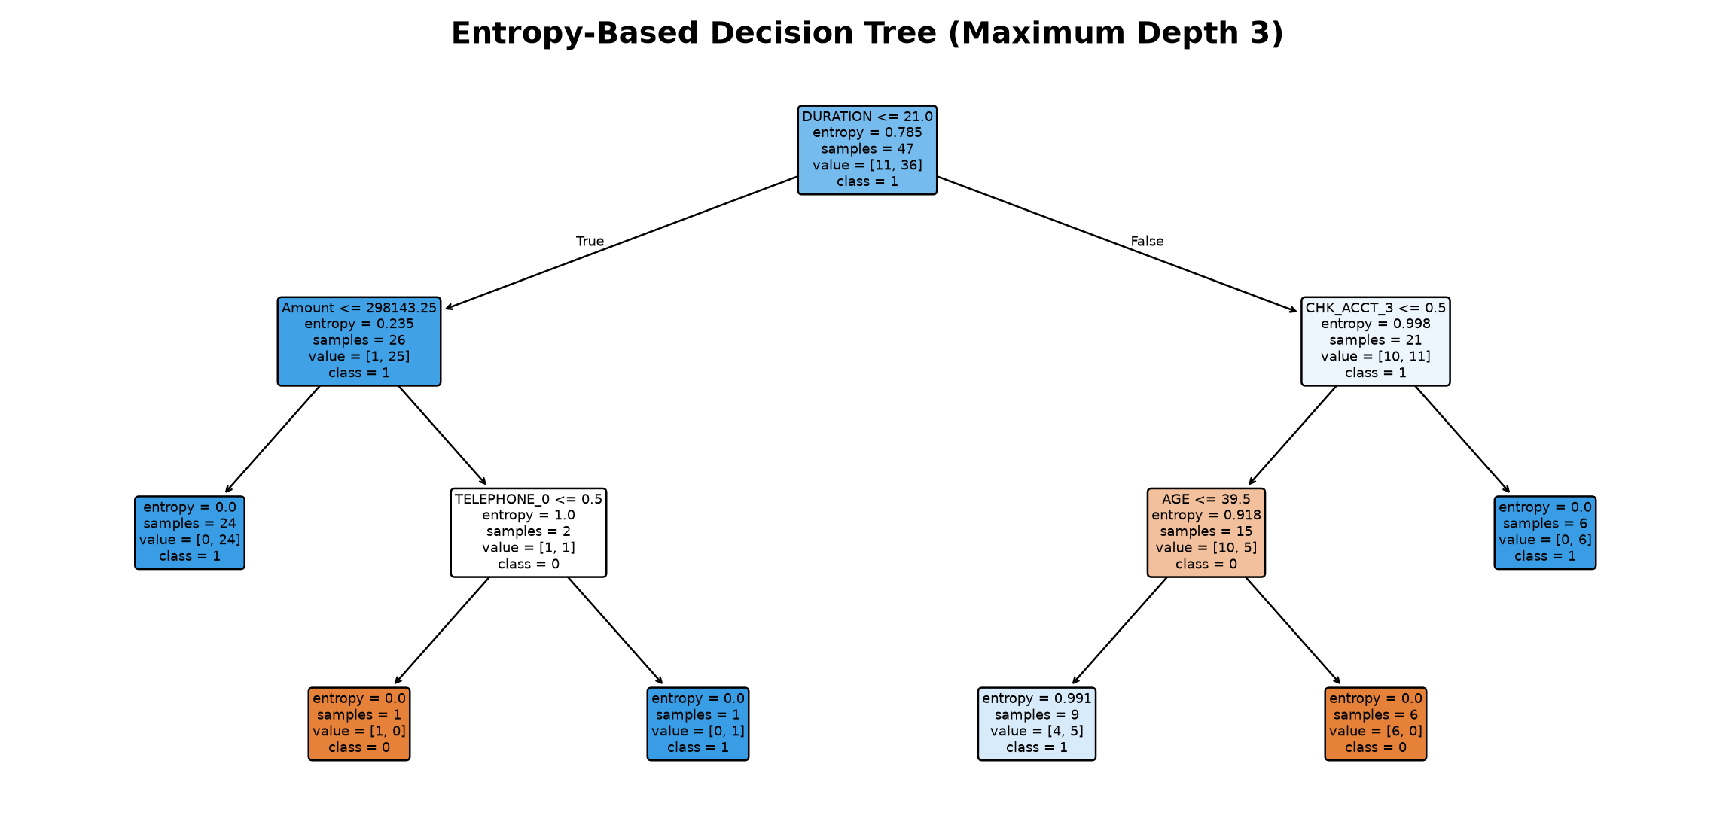
STEP 9 · INTERPRET
Read the fitted decision tree
Hands-on Decision Tree Analysis with Python
19

Slide 20
STEP 9 · INTERPRET
What does each node tell us?
Condition
The question used to route a row left or right.
Entropy
The node's class mixture; 0 means completely pure.
Samples
How many training rows reached the node.
Value
Counts of class 0 and class 1 at the node.
Class
The prediction made at that node or leaf.
A readable rule can still be unstable, inaccurate, or inappropriate for deployment.
Hands-on Decision Tree Analysis with Python
20

Slide 21
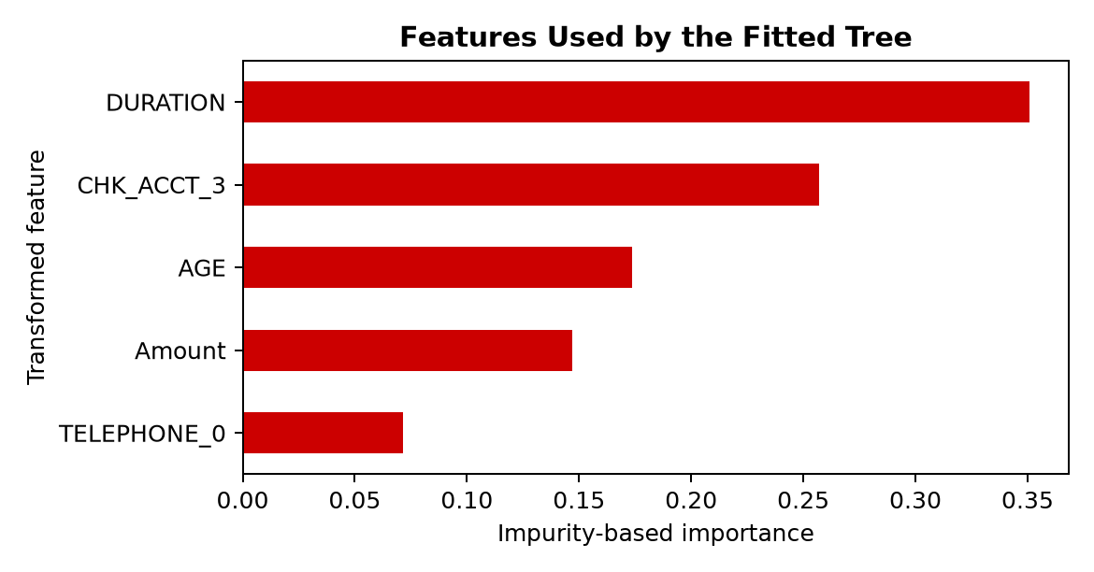
STEP 10 · INTERPRET
Which features did this tree use?
Use importance carefully
• Importance sums impurity reduction in this tree.
• Unused features receive zero importance.
• Correlated inputs can share or shift importance.
• Importance does not prove causality or fairness.
Hands-on Decision Tree Analysis with Python
21

Slide 22
STEP 11 · EXPERIMENT
Can class weighting change the errors?
Why try it?
DecisionTreeClassifier(
criterion="entropy",
max_depth=3,
class_weight="balanced",
random_state=42
)
• Class 0 is much less frequent than class 1.
• Balanced weights make minority-class mistakes matter more during training.
• The tradeoff may shift—not disappear.
• Choose using business costs and stronger validation, not one tiny test split.
Experimentation is for learning; it does not turn this dataset into a deployable lending model.
Hands-on Decision Tree Analysis with Python
22

Slide 23
STEP 12 · DISCUSS
What should we conclude?
Small sample
59 rows and only 12 test cases make results unstable.
Imbalance
The majority class dominates ordinary accuracy.
Unknown labels
The CSV does not verify which value means Good or Bad.
Code mismatch
Legacy category descriptions do not match the CSV coding.
High-impact use
Real lending requires fairness, compliance, monitoring, and far stronger validation.
Hands-on Decision Tree Analysis with Python
23

Slide 24
GENERAL PROCESS
A repeatable classification workflow
01
Frame the outcome
04
Train and explain
Define the target, decisions, and error costs.
Control complexity; inspect rules and assumptions.
02
Audit the data
05
Evaluate honestly
Check meaning, quality, leakage, and class balance.
Use baselines, class-aware metrics, and stronger validation.
03
Prepare and split
Fit preprocessing only through a reproducible pipeline.
A classification model is valuable only when its predictions support a valid, responsible decision.

Slide 25
TEACHING HANDOFF
Run the demo in Google Colab
• Open the notebook using the Colab link below.
• Keep UPLOAD_FILE = False to read from GitHub, or change it to True to upload Credit.csv.
• Select Runtime → Run all.
• Use File → Save a copy in Drive before editing or sharing with students.
OPEN THE COLAB NOTEBOOK
https://colab.research.google.com/github/mojiahui777/ba_course/blob/main/decision_tree_credit_risk_demo.ipynb
Teaching tip: pause before each output and ask students to predict what they expect to see.
Hands-on Decision Tree Analysis with Python
25

