Slide 1
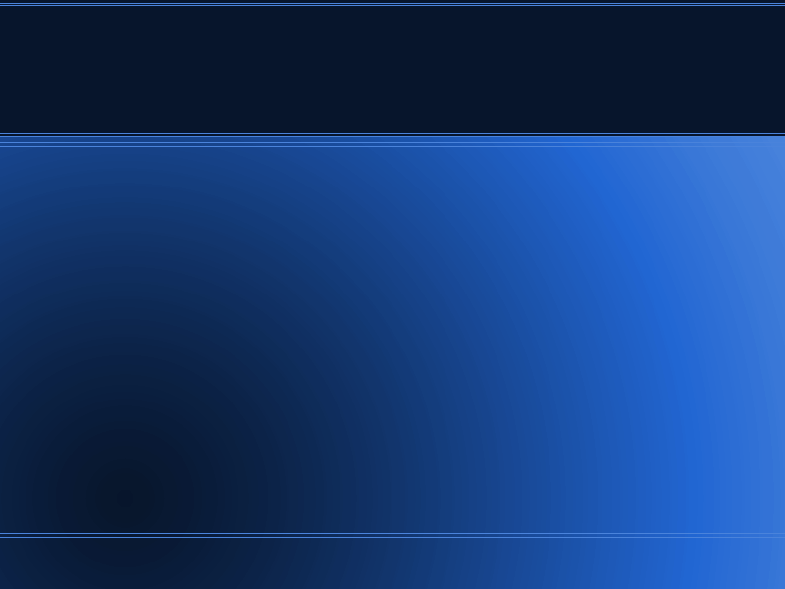
A Simple List

Slide 2
An Overview
Just a simple list.

Slide 3
Project Goal
Take it anywhere.

Slide 4
Client Side
User
Sign-in / Sign-out
Lists

Slide 5
Backend
Users
Lists

Slide 6
Challenges
New concepts
Unfamiliarity

Slide 7
Good Points
Minimal functionality
Rspec Testing

Slide 8
Weak Points
Weak planning
Known bugs

Slide 9
In 3 weeks...
Fix known bugs
Change look
Add more to lists

