Slide 1

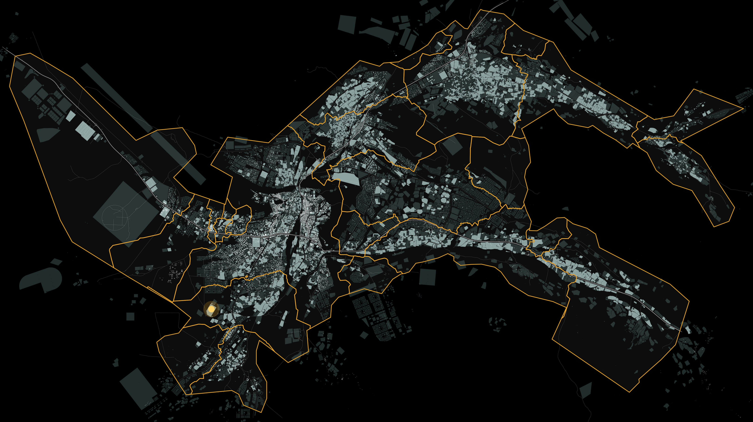








IBRI NEW STP, SEWER & TE NETWORKS
Design Basis Report
Settlement boundaries, population, flows and loads
PROJECT
Consultancy Services for Design and Supervision for STP, Sewer & TE Networks Systems in Ibri
TENDER NO.
MEETING
REPORT
T / 2719110 / 2025
16th September 2026
Revision 0
CONSULTANT · JOINT VENTURE
Boundaries
Population
Growth
Network
Plant
Decisions
Notes:
One hour. The purpose: the seven decisions on the answer sheet at the end. Everything else is the reason for each.

Slide 2








Why this meeting: the foundation before the design
OVERVIEW
The concept design will be one document. Its options for the network and the STP rest on the numbers in the Design Basis Report.
If a number changes after the options are drawn, the options are drawn again.
So the foundation comes first: where the settlements are, how many people, how much the land can hold, and the sewage every element must carry.
Only what the guideline does not settle is put to Nama Water Services for approval. The guideline's own values are adopted and reported.
7
decisions to take
8
values adopted, for information
7
data requests
The hour, in six steps
Boundaries
Population
Growth
Network
Plant
Decisions
Decision 1: the 25 settlements
Decisions 2 and 3: people, plots, the rates
Decisions 4, 5 and 6: overflow, horizon, the series
Decision 7: the flow of every element
STP flows and loads; treated effluent
the data requests; the answer sheet
Overview
Boundaries
Population
Growth
Network
Plant
Decisions
2
Notes:
Frame the hour: seven yes/no decisions. Say that the report is the record; today is for the decisions.

Slide 3
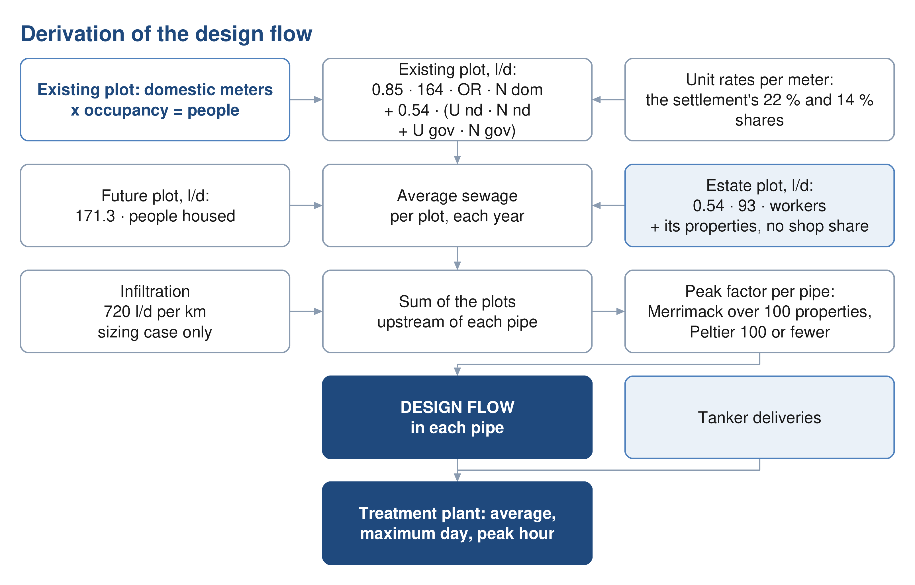
From the meter to the STP: the chain of the numbers
OVERVIEW
• Every domestic electricity meter is a property; the settlement's occupancy makes it people.
• Water per person from the guideline; shops and government as shares; the return to the sewer per stream.
• The plot carries an average flow for 2024, 2030, 2055 and the year the land is full.
• The pipe adds the peak and the infiltration. The STP adds the margin.
• Today: 119,893 people, 20,852 m³/d. Saturation 2070: 349,029 people, 60,099 m³/d.
Overview
Boundaries
Population
Growth
Network
Plant
Decisions
3
Notes:
Report Sections 3 to 7. Keep it to one minute: the point is that every later number comes from this chain.

Slide 4
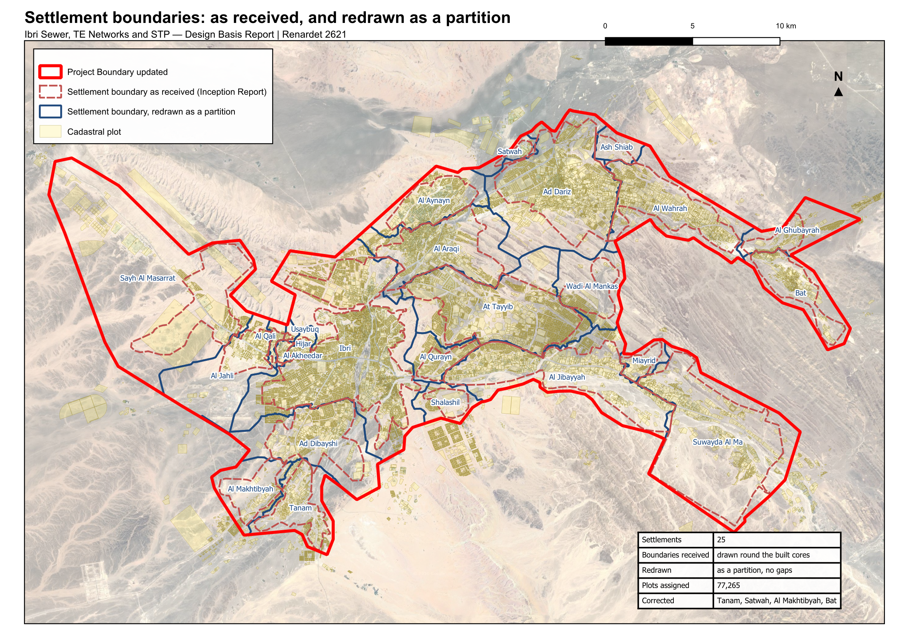
Decision 1 · The settlement boundaries
BOUNDARIES
• Received: 26 polygons for 25 settlements, drawn round the built cores, not touching.
• Four miss part of their plots: Tanam, Satwah, Al Makhtibyah, Bat.
• Redrawn: every plot in one settlement, no gaps. Names, series and plots as received.
• Every rule of the basis is applied per settlement; this is why it matters.
Decision 1. Approve the twenty-five settlement boundaries redrawn so that every plot lies in one settlement and there are no gaps between them.
Overview
Boundaries
Population
Growth
Network
Plant
Decisions
4
Notes:
Section 2. Red dashed = received, blue = redrawn. The ask: approve the redrawn boundaries.

Slide 5
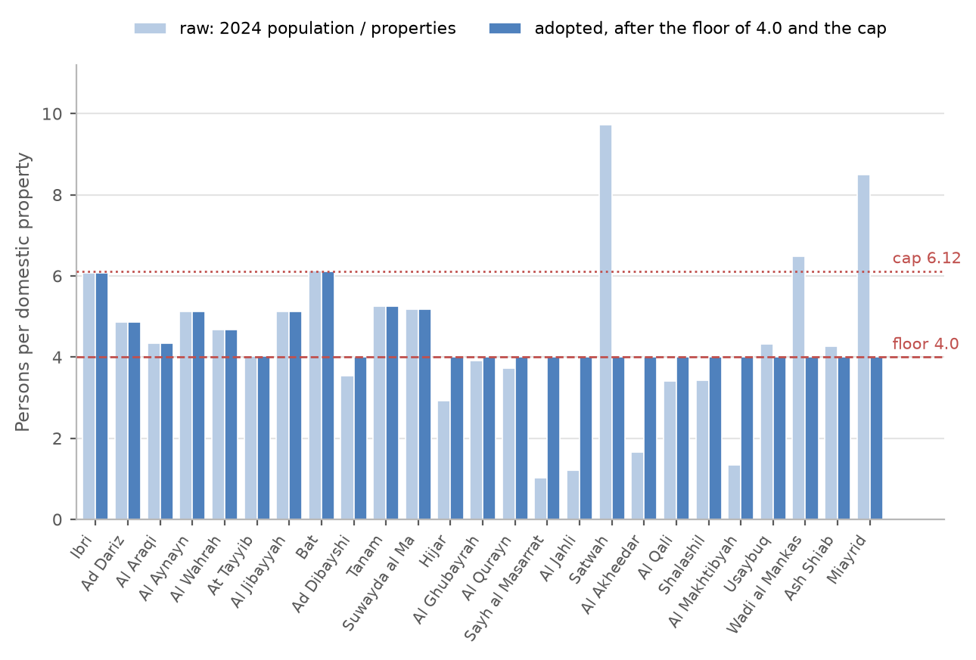
Decision 2 · Persons per property, by settlement
POPULATION
• Occupancy = 2024 population ÷ properties counted. Ibri 6.07; area-wide 5.16.
• Floor 4.0: institutional housing (police, college) drags some settlements to 1 to 4; those properties discharge all the same.
• Cap 6.12, the highest among settlements of 2,000 or more.
• Under 1,000 people: 4.0, one property per plot, home share 0.9 (13 settlements).
• Result: 119,893 people in 2024 against 116,452 in the census series.
Decision 2. Approve the persons per property calculated for each settlement, with the floor of 4.0, the cap of 6.12 and the rule for settlements under a thousand people.
Overview
Boundaries
Population
Growth
Network
Plant
Decisions
5
Notes:
Section 3.2, Table 4 has all 25. Housing units are not published at settlement level; counted properties replace them.

Slide 6
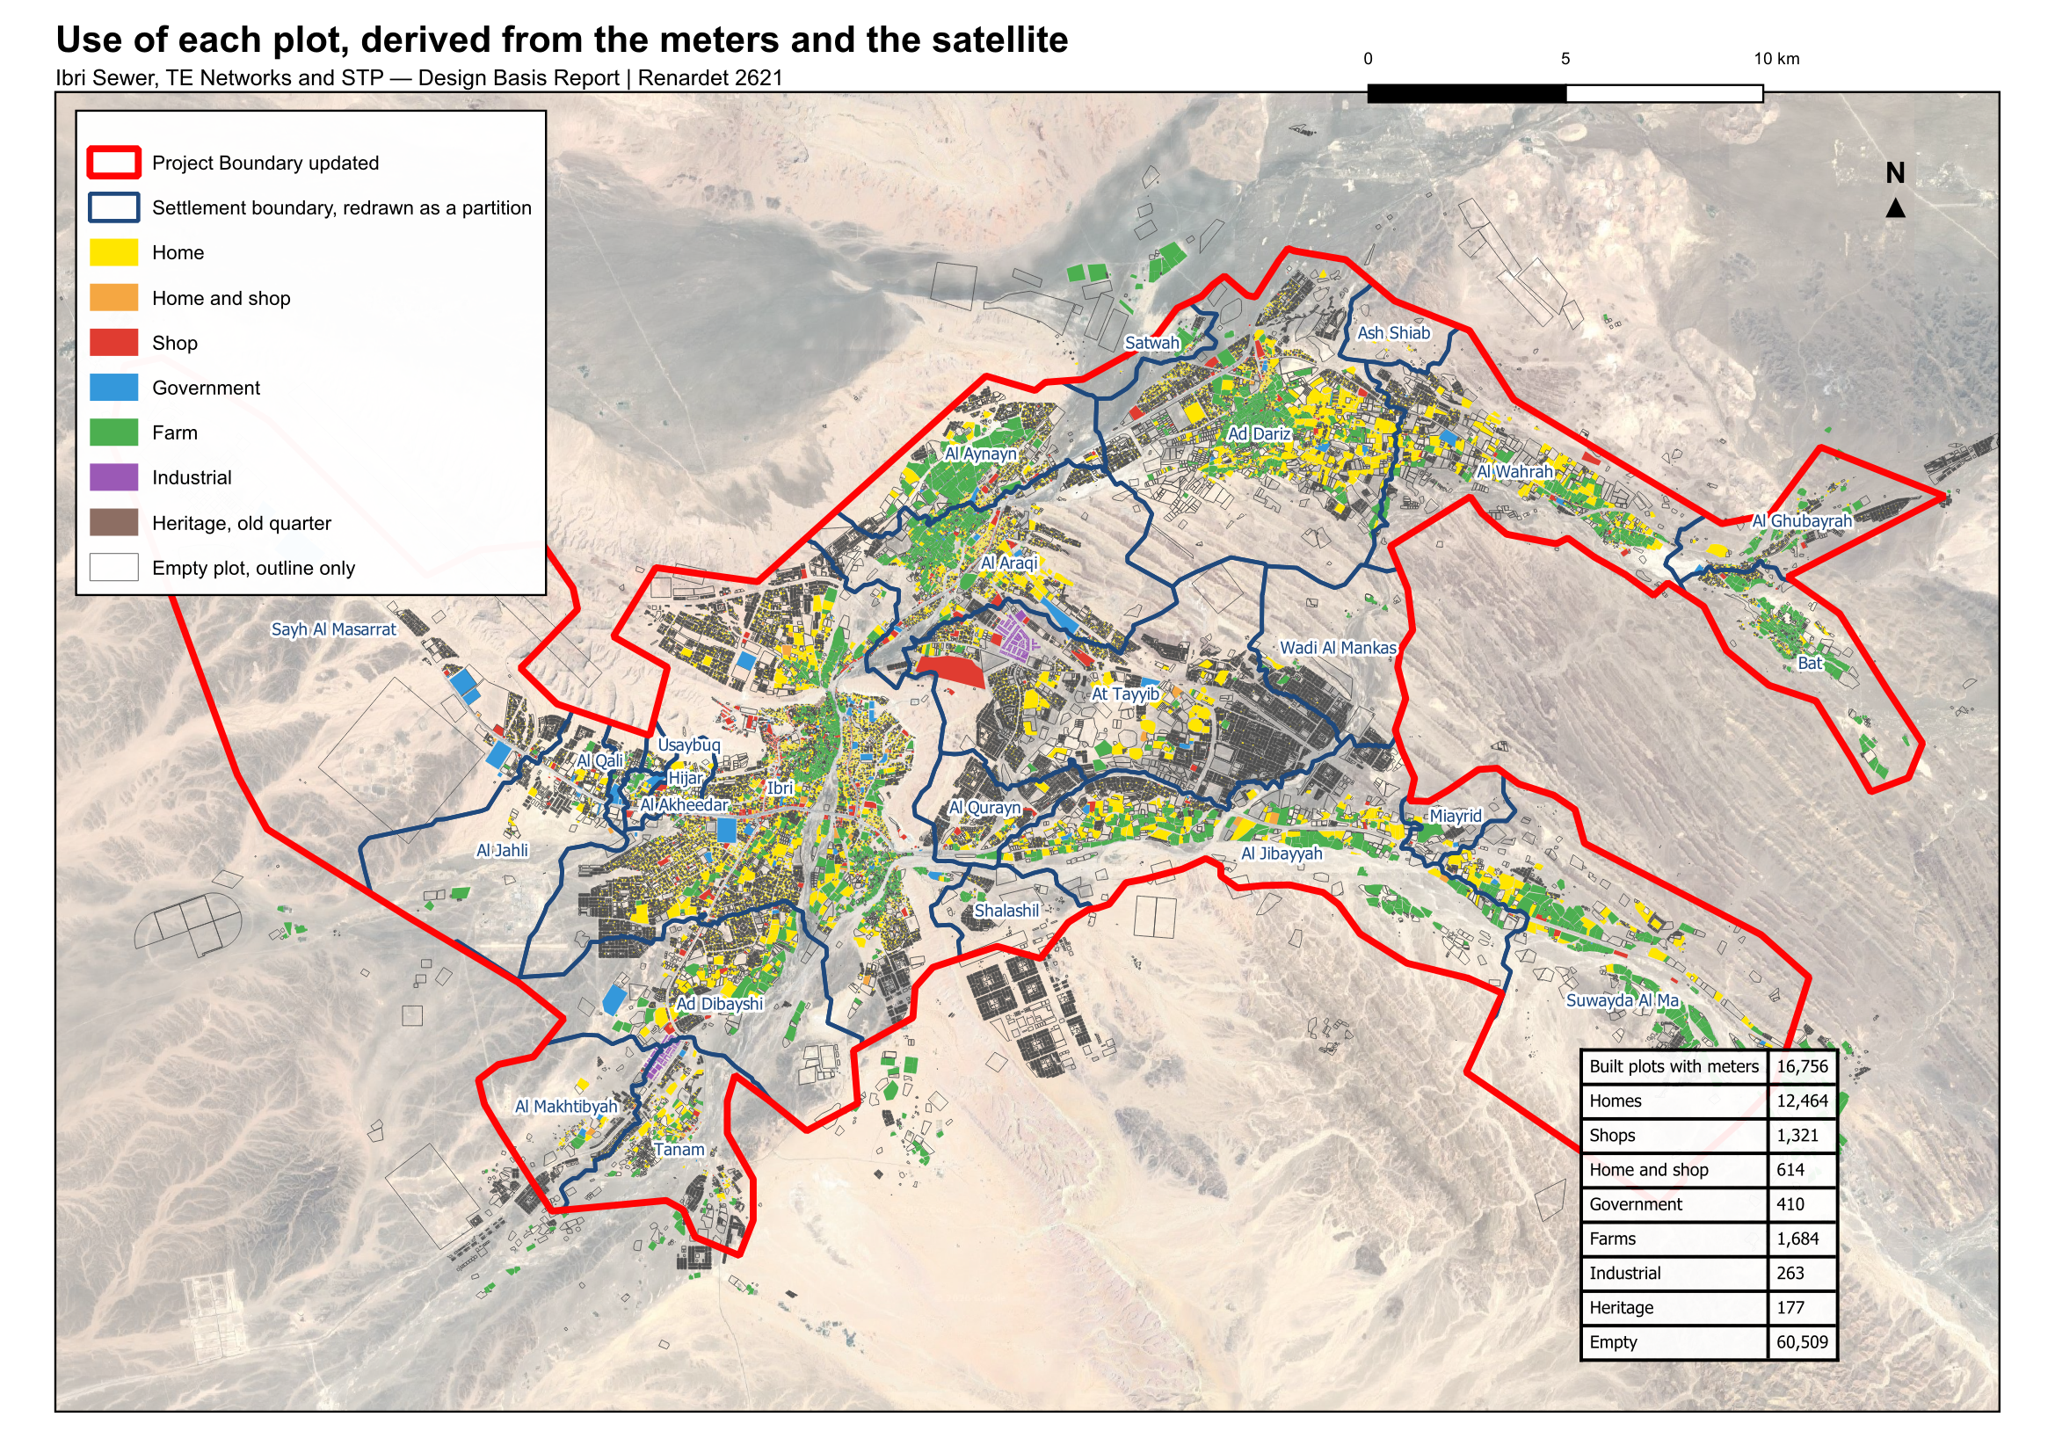
Decision 3 · The use of each plot
POPULATION
• The cadastre's own land-use field disagrees with the meters on 24 % of the metered plots and has no government class.
• The use is determined from what is on the plot: estate, heritage, farm meter, planted (satellite), then the meters by proportion.
• 12,464 homes, 1,321 shops, 410 government, 1,684 farms; 60,509 empty.
• It decides where the shop and government water sits, not how much.
Decision 3. Approve the use determined for each plot from the meters and the satellite image, in place of the cadastre's own land-use field, as the basis for placing the loads.
Overview
Boundaries
Population
Growth
Network
Plant
Decisions
6
Notes:
Section 4. The 126 meters with no plot within 15 m are left out (about 140 people); the map is in the report.

Slide 7
The rates adopted from the guideline (for information)
POPULATION
Value | Adopted | Source
Domestic water use | 164 l per person per day | PAM-GUD-201 Table 11, Adh Dhahirah
Shops and offices | 22 % of domestic, placed on the shop meters | Table 11, the distributed ratio
Government | 14 % of domestic, placed on the government meters | Table 11; unit rates need quantities not held
Return to the sewer | 85 % domestic and tanker; 54 % the rest | Table 19
A person in a new home | 171.3 l of sewage a day | 164 × 0.85 + 36 × 0.54 + 23 × 0.54
Industrial estates (special) | 4,500 + 1,800 workers at 93 l/d | an assumption until the estates' records
Farm meters | no sewage | irrigation pumps; the house is metered separately
Tanker water, private wells | not in any flow | no records held: requested
Overview
Boundaries
Population
Growth
Network
Plant
Decisions
7
Notes:
Section 5. These are informed, not asked. If NWS wants to change 164 or the ratios, it is their call; the numbers move accordingly.

Slide 8
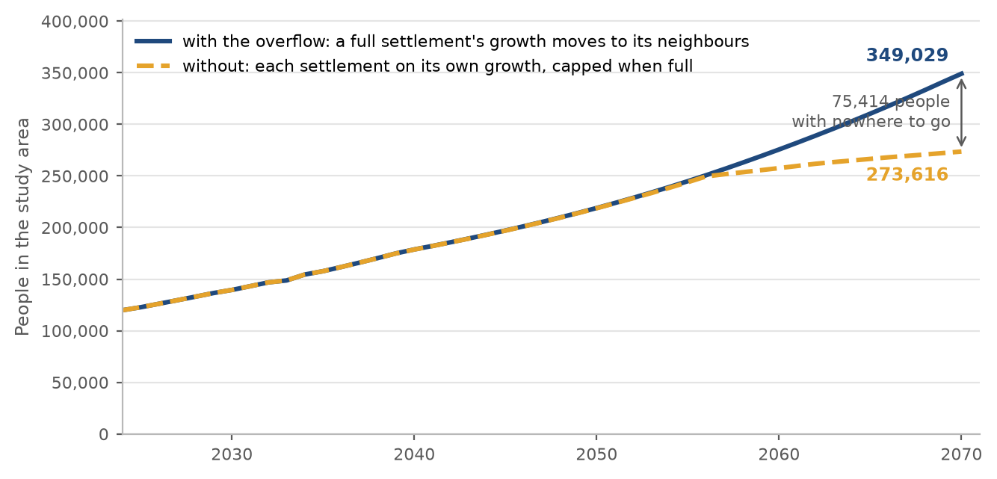
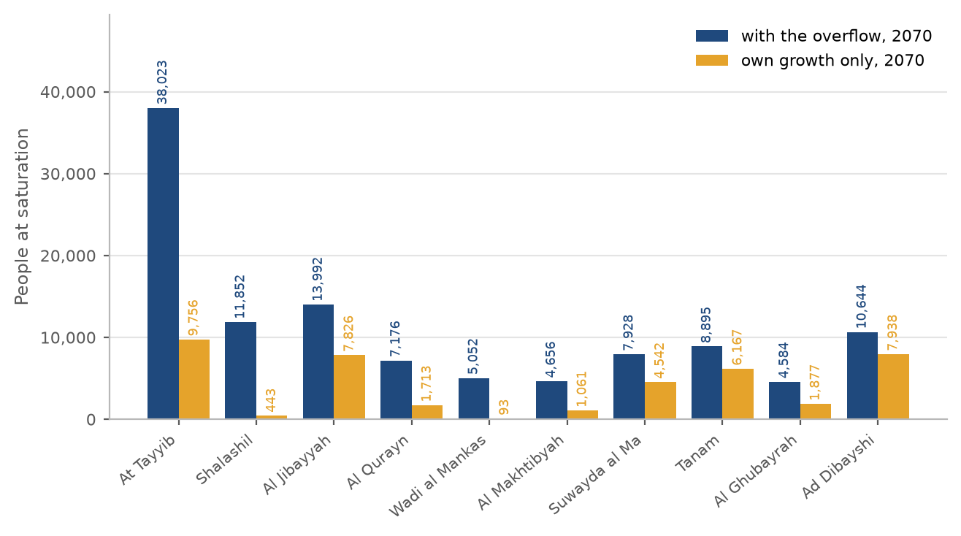
Decision 4 · When a settlement is full: the overflow
GROWTH
• A settlement grows at the series' rate until its empty plots are built.
• With the overflow its further growth moves to its neighbours: every settlement fills by 2070, 349,029 people.
• Without it, 7 settlements never fill before 2100, the area holds 273,616 in 2070, and 75,414 people of the series have nowhere to go.
• Ibri's overflow: Al Araqi 70 %, Al Qurayn 20 %, Shalashil 10 %, then Ad Dariz, then the nearest with room.
• A sewer sized on own growth in those settlements is sized for land that never fills.
Decision 4. Approve the overflow: when a settlement's land is full, its further growth moves to its neighbours. Without it 75,000 people of the series have nowhere to go by 2070.
Overview
Boundaries
Population
Growth
Network
Plant
Decisions
8
Notes:
Section 6.3, Table 9 by settlement, the map of the routes in the report. The largest single decision.

Slide 9
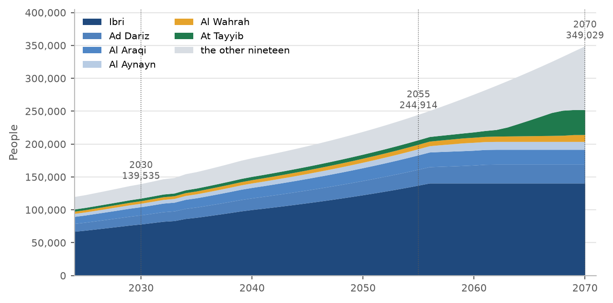
Decision 5 · The design horizon: 2055, or the year the land is full
GROWTH
 | 2055 = 2030 + 25 years | 2070 = the land is full
People | 244,914 | 349,029
Average sewage flow, m³/d | 42,266 | 60,099
STP average with the margin, m³/d | 46,492 | 66,109
STP peak hour with the margin, m³/d | 78,322 | 106,724
What it means for the network | cheaper; full while the plots around it are still being built | laid once; runs at low flow for longer
• The Terms of Reference name both: completion plus 25 years, and the saturation of the area.
• Saturation is 42 % more flow than 2055. The STP is staged on the series either way.
Decision 5. Decide the design horizon: 2055, the opening year 2030 plus 25 years, with 244,914 people and 42,266 cubic metres a day; or 2070, the year the land is full, with 349,029 people and 60,099 cubic metres a day.
Overview
Boundaries
Population
Growth
Network
Plant
Decisions
9
Notes:
Section 6.4. No recommendation in the report: the two horizons and what each implies. Get the year.

Slide 10
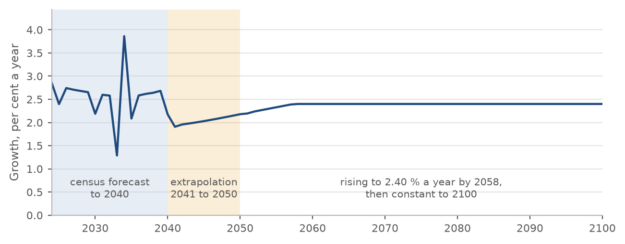
Decision 6 · The growth beyond 2050
GROWTH
• To 2040: the official forecast for the wilayat. 2041 to 2050: its extension in the Inception Report. Both are the client's own.
• From 2051 the series rises from 2.2 % a year to 2.40 by 2058 and holds it to 2100, the horizon NWS instructed.
• The guideline allows ten years of extension beyond a forecast; this goes further.
• Only the rate is used. The series' 2100 total is not a target: the land fills first.
Decision 6. Approve the extension of the population series beyond 2050: the rise to 2.40 per cent a year by 2058 and that rate held to 2100. The series to 2050 is the client's own.
Overview
Boundaries
Population
Growth
Network
Plant
Decisions
10
Notes:
Section 6.2. The rate after 2058 drives when the last settlements fill, not how many people the land holds.

Slide 11
The flow each element is designed for
NETWORK
Element | Sized on | Checked on | Adds
Plot | its average flow, each year | — | nothing: no peak, no infiltration
Pipe | saturation flow of the plots upstream, peaked, + infiltration | 2030 flow × 61 % connected, peaked, no infiltration: self-cleansing | Merrimack > 100 properties, Peltier ≤ 100; 720 l/d per km
Pumping station | peak of its catchment + infiltration, at saturation | rising main 0.75 to 2.5 m/s (1.0 start-stop) | 12 m of cover is the limit at this stage
Trunk sewers | sum of the settlements upstream, peaked | — | same rules as the pipe
STP | average annual flow × 1.10 (biology, with the load) | peak hourly flow × 1.10 (pass-through structures) | infiltration of the network; tankers when recorded; maximum day from records
Overview
Boundaries
Population
Growth
Network
Plant
Decisions
11
Notes:
Section 7. All of it is the guideline's, adopted; the one departure is the next slide.

Slide 12
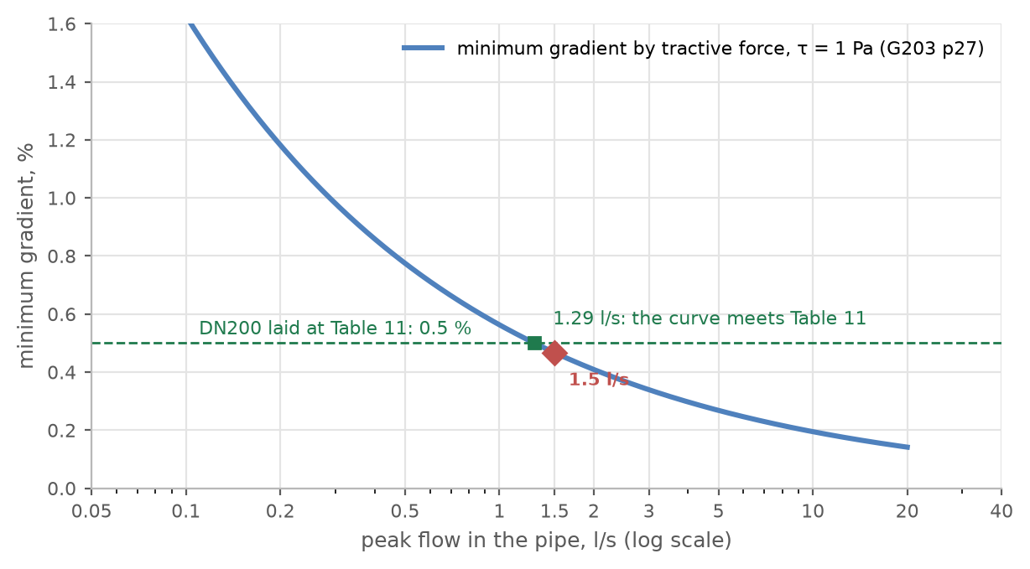
Decision 7 · Gradients and self-cleansing at the concept stage
NETWORK
• Every pipe laid at the guideline's Table 11 minimum gradient, rounded up to 0.05 % steps (our rounding, for round figures on the drawings).
• The guideline also asks for the tractive-force test and the steeper of the two. The tension it needs is not given; 1 pascal is used.
• At this stage the test only lists the pipes that need early washing; it steepens nothing.
• A pipe under 1.5 l/s is checked as if it carried 1.5: the curve asks 0.47 %, so a 200 mm pipe at Table 11 always passes.
• This is a departure from PAM-GUD-203 §4.2.2.1, stated for approval.
Decision 7. Approve the concept-stage rule: pipes laid at the Table 11 minimum gradient rounded up to steps of 0.05 per cent; the tractive-force test at 1 pascal used only to list the pipes needing early washing, with a pipe carrying less than 1.5 l/s checked as if it carried 1.5. The guideline asks for the steeper of the two gradients; this is a departure.
Overview
Boundaries
Population
Growth
Network
Plant
Decisions
12
Notes:
Section 7.3 and Appendix A2. The test area gave 70 % of the length needing early washing, all 200 mm under 1.3 l/s.

Slide 13
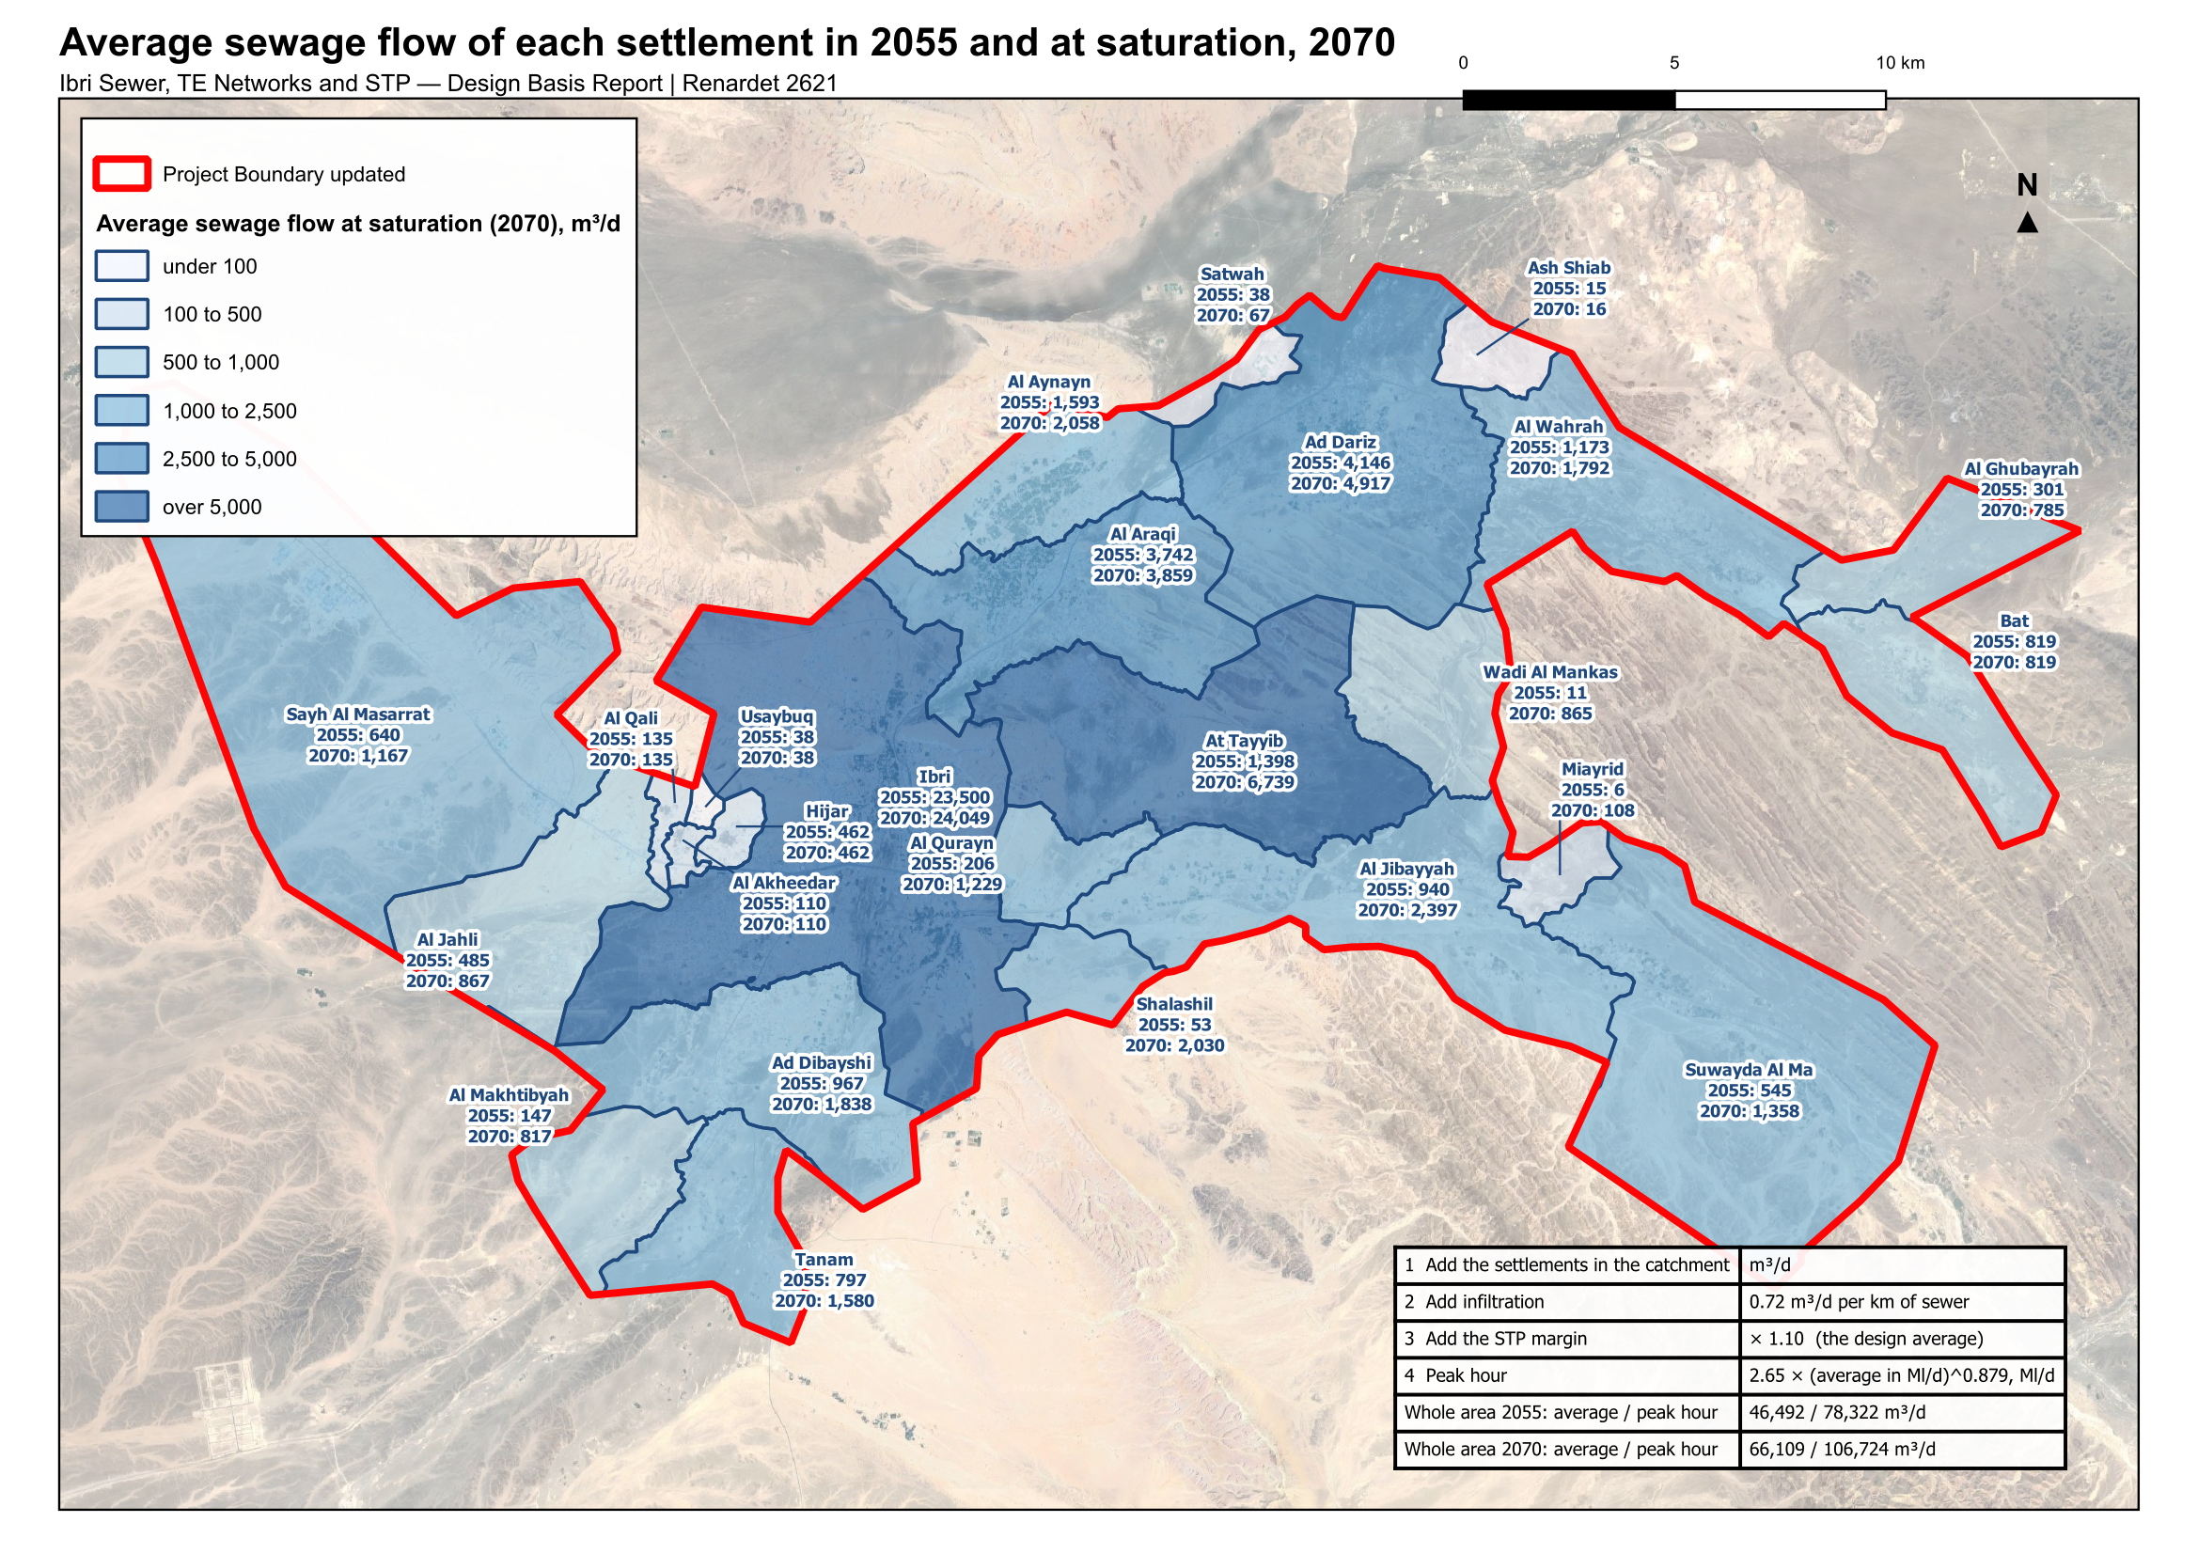
STP flows by year, and any catchment's flow read off the map
PLANT
 | 2030 | 2055 | 2070
People | 139,535 | 244,914 | 349,029
Average from the plots | 24,216 | 42,266 | 60,099
Average annual flow, +10 % | 26,638 | 46,492 | 66,109
Peak hourly flow, +10 % | 48,003 | 78,322 | 106,724
• One STP for the whole area, before infiltration and tankers.
• Infiltration to add: 0.79 m³/d per km of sewer, with the margin.
• The four steps on the map give any grouping of settlements its own STP flow by hand.
• Maximum day flow: from the existing STP's records, requested.
Overview
Boundaries
Population
Growth
Network
Plant
Decisions
13
Notes:
Section 7.5. If NWS asks about two plants: the map and the four steps answer it on the spot.

Slide 14
The STP load and the treated effluent (for information)
PLANT
Load at the STP | 2030 | 2055 | 2070
BOD, kg/d (60 g per person per day) | 8,372 | 14,695 | 20,942
Suspended solids, kg/d (80 g per person per day) | 11,163 | 19,593 | 27,922
BOD as a concentration, mg/l (guideline range 350 to 400) | 346 | 348 | 348
• No laboratory data for Ibri's sewage is held: the guideline's minimum per person is used until the existing STP's results arrive.
• Sewage by tanker is far stronger (350 to 1,050 mg/l BOD) and is provided for separately once its records arrive.
• Two industrial estates, workshops on the commercial tariff: no wet industry found, no separate line foreseen.
Treated effluent, m³/d | 2030 | 2055 | 2070
STP inflow, design average | 26,638 | 46,492 | 66,109
Produced, 95 % | 25,306 | 44,168 | 62,803
Delivered, less 10 % in the network | 22,776 | 39,751 | 56,523
Overview
Boundaries
Population
Growth
Network
Plant
Decisions
14
Notes:
Sections 7.6 to 7.8. Adopted, not asked.

Slide 15
Seven data requests: each replaces an assumption with a record
DECISIONS
Item | What is asked for | Why
Tanker water and sewage tankers | Filling-station volumes by area and sewage tanker deliveries to the STP, with their source | Water supplied by tanker is not in any flow. It can only raise the loads.
Private wells | Any record of private abstraction inside the study area | The guideline requires it to be assessed. Not held.
Existing STP records | Daily inflow and the laboratory results for the Ibri STP, three years | Sets the maximum day flow and checks the per-person loads.
Industrial estates | Workforce and water use of the Al Tayyeb and Tanam estates | Replaces the assumed 4,500 and 1,800 workers.
Army camp | Occupancy and drainage arrangement of the camp west of the town | 296 hectares with no meter in the dataset.
Ibri View | The development plan of the resort at As Sulayf | Two square kilometres announced; no load carried until the plan is issued.
Non-domestic quantities | Pupils, beds, employees and floor areas by plot, where held | Would allow the unit rates of the guideline in place of the ratios.
Overview
Boundaries
Population
Growth
Network
Plant
Decisions
15
Notes:
Section 9. None stops the concept design.

Slide 16
The answer sheet: seven decisions
DECISIONS
 | Decision | The ask | Answer
1 | Settlement boundaries | Approve the twenty-five settlement boundaries redrawn so that every plot lies in one settlement and there are no gaps between them. | ☐ Yes ☐ No
2 | Persons per property | Approve the persons per property calculated for each settlement, with the floor of 4.0, the cap of 6.12 and the rule for settlements under a thousand people. | ☐ Yes ☐ No
3 | Use of each plot | Approve the use determined for each plot from the meters and the satellite image, in place of the cadastre's own land-use field, as the basis for placing the loads. | ☐ Yes ☐ No
4 | The overflow | Approve the overflow: when a settlement's land is full, its further growth moves to its neighbours. Without it 75,000 people of the series have nowhere to go by 2070. | ☐ Yes ☐ No
5 | The design horizon | Decide the design horizon: 2055, the opening year 2030 plus 25 years, with 244,914 people and 42,266 cubic metres a day; or 2070, the year the land is full, with 349,029 people and 60,099 cubic metres a day. | ☐ Yes ☐ No
6 | The growth beyond 2050 | Approve the extension of the population series beyond 2050: the rise to 2.40 per cent a year by 2058 and that rate held to 2100. The series to 2050 is the client's own. | ☐ Yes ☐ No
7 | Gradients and self-cleansing at the concept stage | Approve the concept-stage rule: pipes laid at the Table 11 minimum gradient rounded up to steps of 0.05 per cent; the tractive-force test at 1 pascal used only to list the pipes needing early washing, with a pipe carrying less than 1.5 l/s checked as if it carried 1.5. The guideline asks for the steeper of the two gradients; this is a departure. | ☐ Yes ☐ No
Overview
Boundaries
Population
Growth
Network
Plant
Decisions
16
Notes:
Section 10 A. Read each line; take the answer; note who answered.

Slide 17
Thank you
CONSULTANT · JOINT VENTURE

