Slide 1
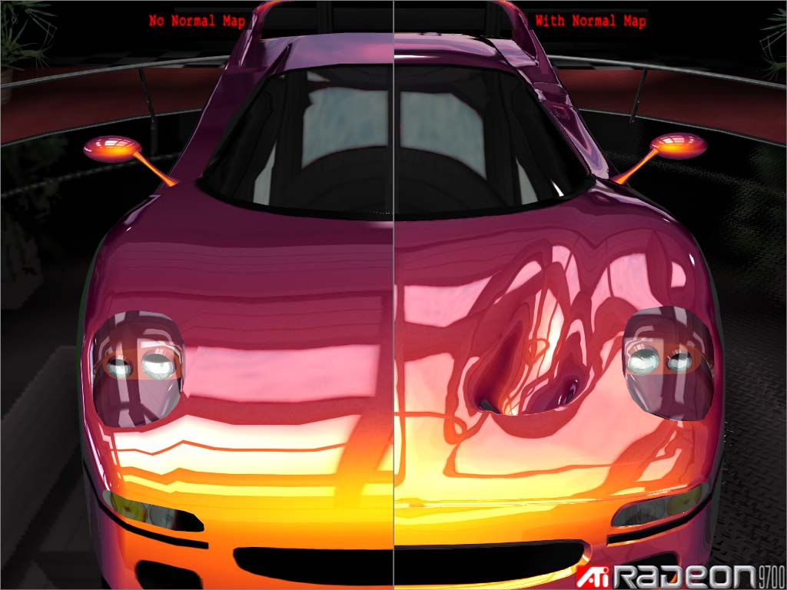
Normal Mapper Tool
Developed by Dave Gosselin, ATI

Slide 2
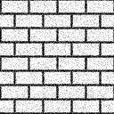
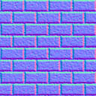
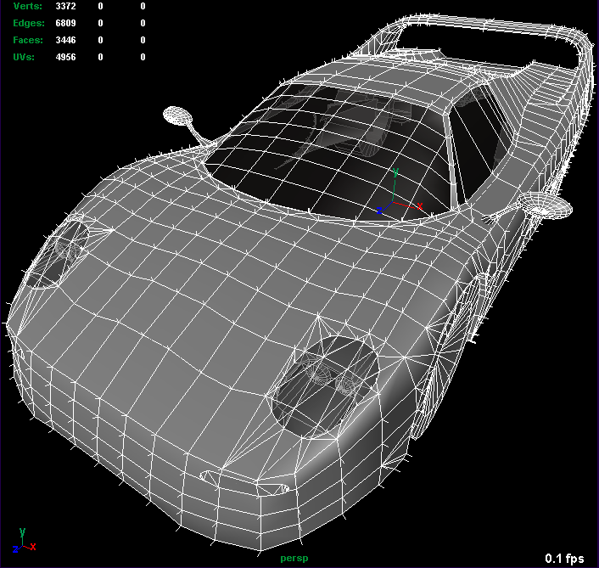
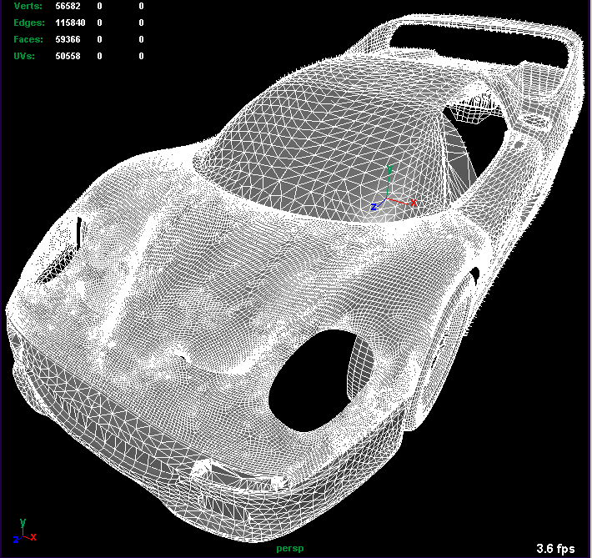
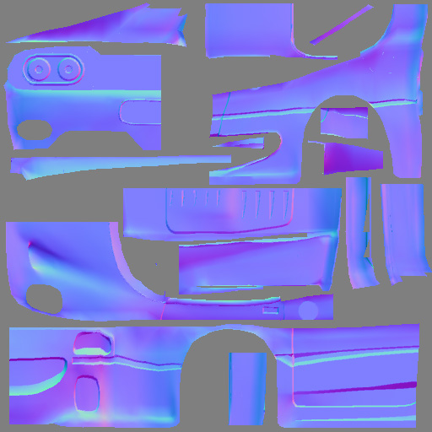
Normal Maps
Commonly created from a height map:
Using low and high resolution models is becoming widely adopted:
&

Slide 3
ATI’s Normal Mapper Tool
Command line interface that generates a bump map from a high and low resolution model (and a height map for fine details)
High resolution model requires vertices and normals
Low resolution model requires vertices, normals, and one set of texture coordinates
The output normal map is applied to the low resolution model at runtime

Slide 4
Ray Casting
For each texel mapped onto the low resolution model, a ray is cast out from the low resolution model and intersected with the high resolution model (Multiple rays if super sampling)
Rays
Low Resolution Model
High Resolution Model

Slide 5
Ray Casting (Continued)
If multiple polygons on the high resolution model are intersected, the one closest to the origin of the ray is chosen.
Negative intersections are valid:

Slide 6
Beam Optimization
As a preprocess, to minimize the number of intersection tests for each ray, a list of polygons on the high resolution model is generated for each polygon on the low resolution model.
A 3-sided beam consisting of 6 planes is used. Each side of the beam is represented by 2 planes. If the plane test passes for either of the 2 planes, the test for that side of the beam passes.
Plane A
Plane B
Side #1

Slide 7

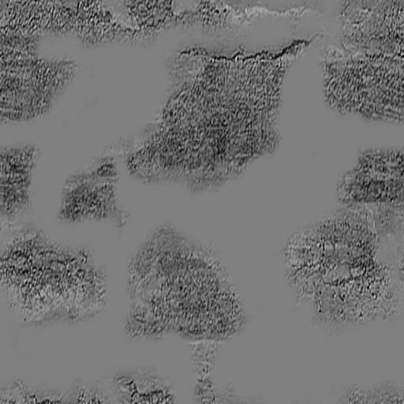
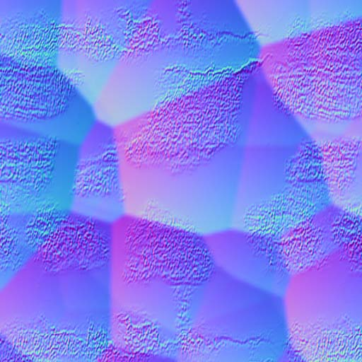
Combining With A Height Map
A height map can be combined with the ray cast normal map to provide micro detail to the normal map
Scars on skin, imperfections in rock, bumps in bricks, etc.
Normal Map
Height Map
Final Map
&

Slide 8
Authoring Normals For Low Resolution Model
Artists must make sure that rays cast based on the normals from the low resolution model, can accurately represent the high resolution model.
BAD: High Res Detail Missed!
GOOD
High Resolution Model
High Resolution Model
Vertex Normals
Low Resolution Model
Vertex Normals
Low Resolution Model

Slide 9
Spacing Texture Coordinates
Space must be left between surfaces so there is room for a dilation filter (similar to fur)
Bilinear fetches and mip map generation requires this

Slide 10
Tangent Space
Tangent space in the normal map computations must match the tangent space of the run-time model
If normal map is generated in world space, tangent space isn’t needed, unless model is skinned

Slide 11
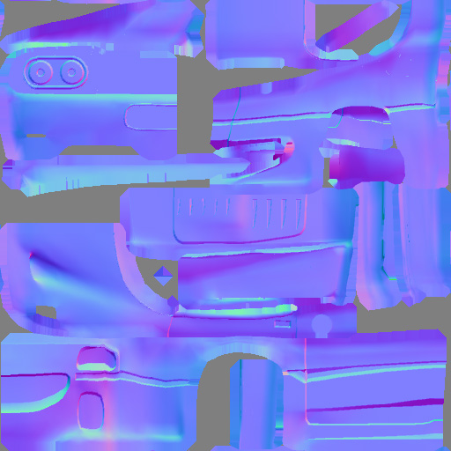
Normal Map Dilation Filter For Bilinear Fetches
A 4-tap filter is used to grow the normals to neighboring pixels. This is necessary for generating mip maps and bilinear fetches.
Before Filter
After Filter
Dilation Filter

