Slide 1
10 highest h-index (within dataset only) plus some article authors. First author position only.
Clearly shows specialists compared to generalists/surveyors.

Slide 2
12 most cited articles (within Scopus only)
Individual articles are quite specialised. Reflects the broad range of focus in the journal, but also that integration between them should not be taken for granted.

Slide 3
Topics by geographic region. Need to remove other and unknown.
Regions can be combined to reduce number of categories. North America, Europe and UK likely a reflection of their respective volumes.

Slide 4
Topics by 5 year period.
Only some minor changes, may not be significant. Emergence of GE after 2000. Decrease in leadership and change, until COVID and re-emergence of career schock research?

Slide 5
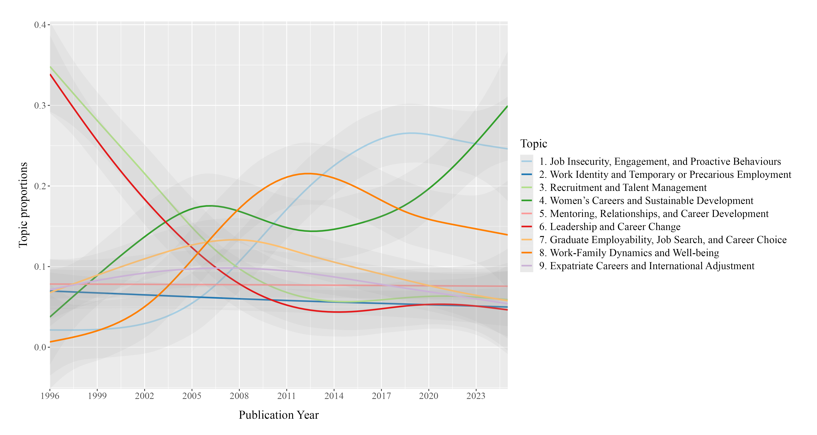
Topics by year, continuous. Skewed visualisation, over-emphasises early data.
Initial focus on management dropped off. Rise of GE 2000-2012. Rise of focus on identity in precarious and temp work and in gender and sustainable careers.

