Slide 1
EXECUTIVE SUMMARY
OBJECTIVE: To identify reasons for decline in customer base using historical dataset.
ANALYSIS: Conducted exploratory data analysis by segmenting customers on the basis of class and travel type
MODEL: Developed a machine learning model to predict customer satisfaction and the parameters it is influenced by
RESULTS: Discussed various key drivers impacting customer satisfaction

Slide 2



MINDBENDERS
View in Power BI
Last data refresh:
9/21/2020 11:32:19 PM India Standard Time
Downloaded at:
9/21/2020 11:34:04 PM India Standard Time

Slide 3















INSIGHTS
75%
60%
Flight Distance
40%
50%
20%
25%
0%
Disloyal 18.3%
50.7%
1-1000
1001-2000
2001-3000
3001-4000
4001-5000
0%
49.3%
Business Personal
Satisfied 43.5%
Business 47.9%
Dissatisfied 56.6%
Eco 44.9%
Loyal 81.7%
Eco Plus 7.3%

Slide 4
MISSING DATA POINTS
#missing data points in the dataset < 5% of the total data
CATEGORICAL DATA
Data Scale: Ordinal
Treatment: Mode Value
NUMERICAL DATA
Data Scale: Ratio
Treatment: Replaced Missing values with Corresponding ‘Departure Delay in Minutes’ values
#missing points
Inflight Wi-Fi service
4
Departure/Arrival time convenient
4
#missing points
Ease of Online booking
3
Gate location
8
393
Food and drink
5
Arrival Delay in Minutes
Online boarding
6
Seat comfort
1
Inflight entertainment
4
Reason:
For ‘Arrival Delay in Minutes’, Mode=0min, Median=0min, Mean=15min. For flights with departure delay in hours (say, 8hrs), it is inaccurate to say that they may have arrival delay of 0min or 15min.
On-board service
3
Leg room service
2
Baggage handling
2
Check-in service
3
Inflight service
1
Cleanliness
2

Slide 5
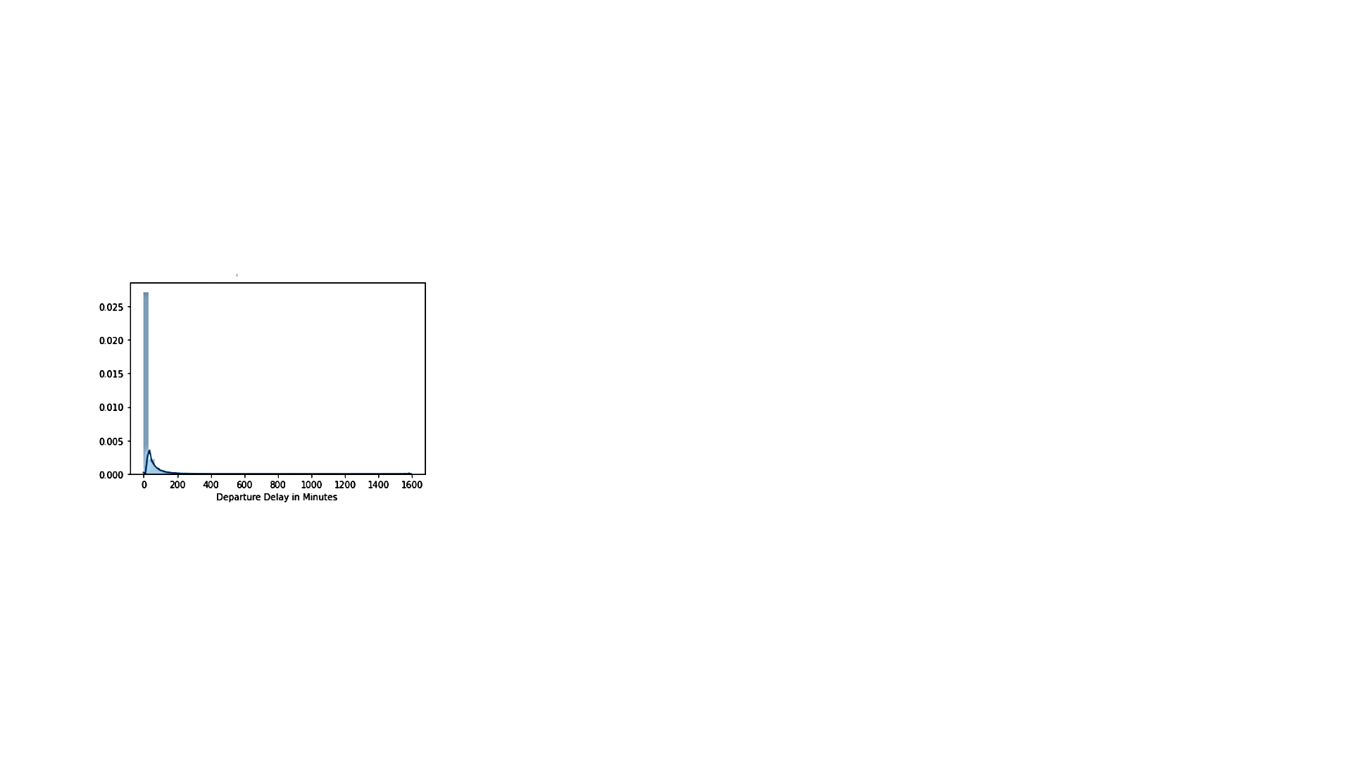
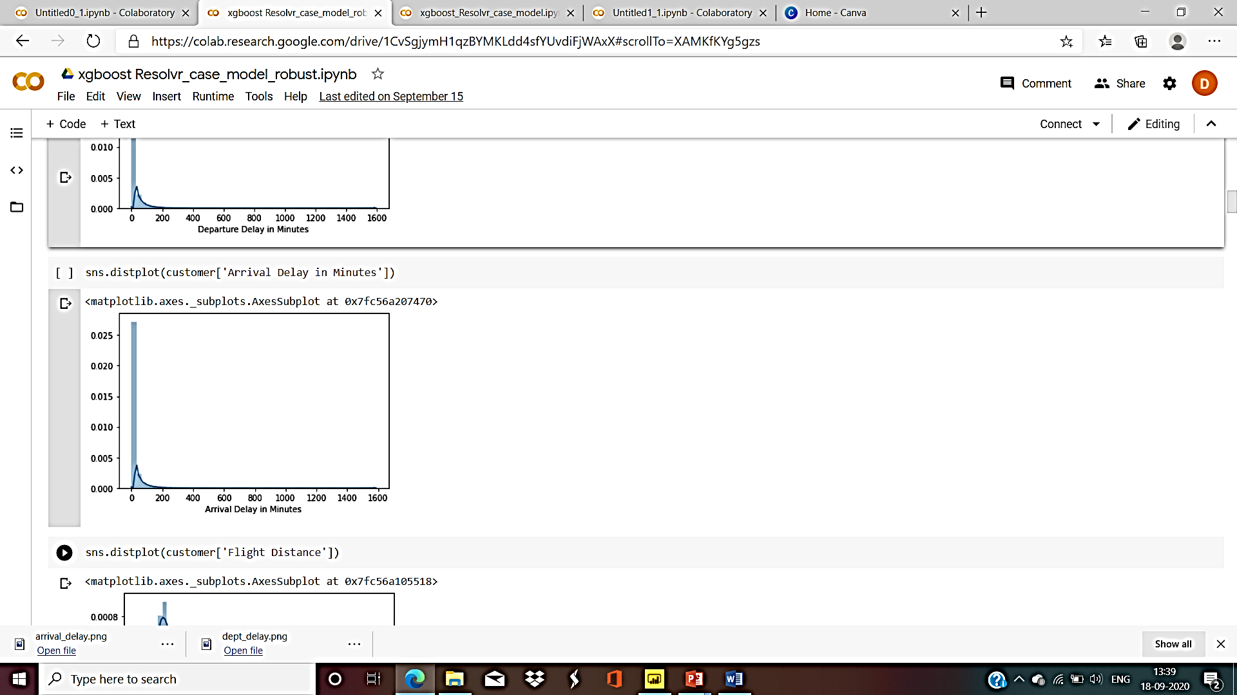
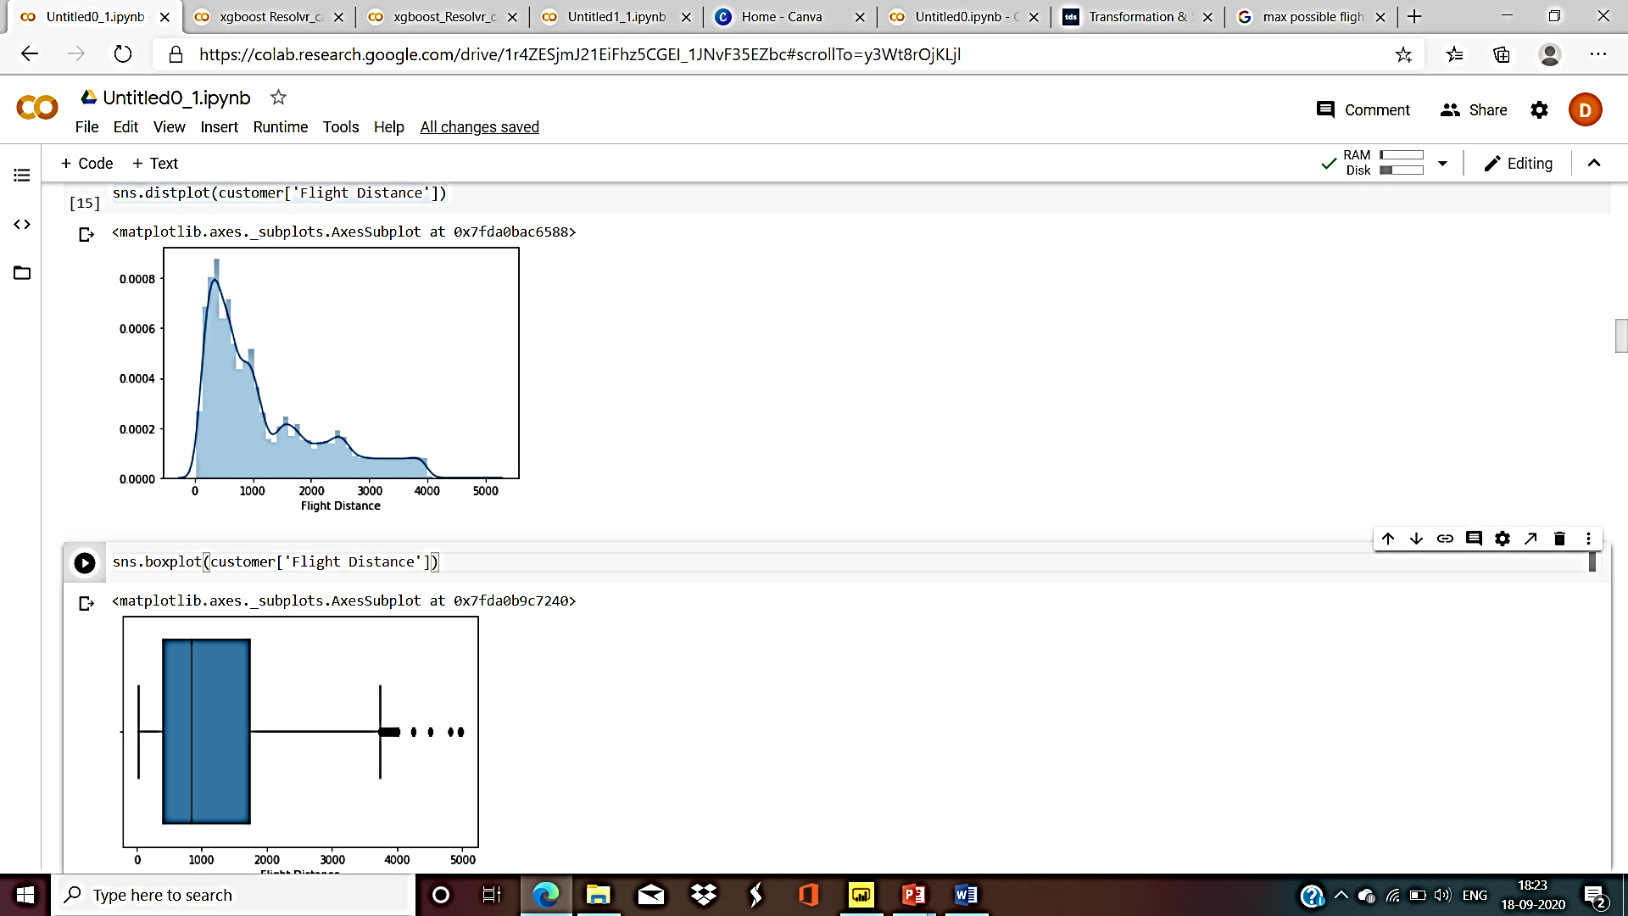
OUTLIERS & SCALING
Treatment: Log transformation via log() available in Python’s Numpy library
High positive skew in ‘Departure Delay in Minutes’ & ‘Arrival Delay in Minutes’ suggests the presence of outliers.
Outliers account for approx. 2% of total data.
Applied log transformation after adding 1 to the values in these columns as most of the values were 0.
Reason: In practical scenario, the extreme cases of flight delay shown by outliers are possible. So, outliers may provide useful information. Therefore, instead of dropping them, we reduced the range of these features.
Slight positive skew is present in ‘Flight Distance’.
Here, skew does not necessarily suggests the presence of outliers because the maximum distance recorded for flight distance in this dataset is approx. 5000km which is not an exceptional case.
Reason: To reduce variation in this feature.

Slide 6
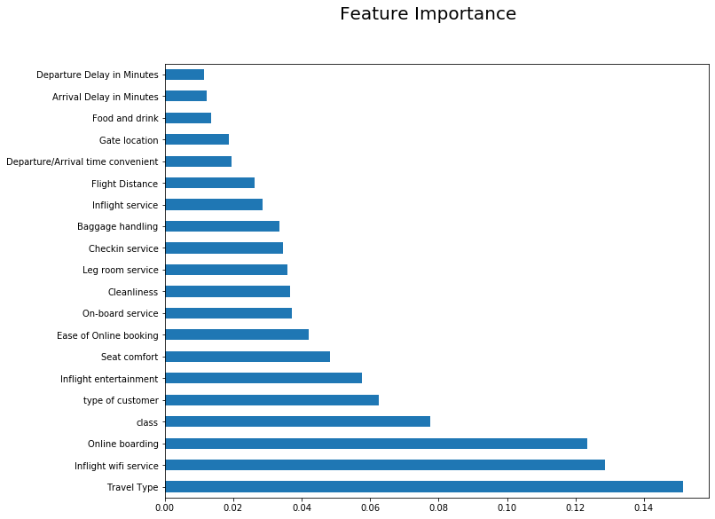
Model & Validation Technique
After preprocessing, divided the whole dataset in train and test set, using train_test_split.
Used XGBoost Algorithm, a tree-based ensemble Machine Learning algorithm that uses a gradient boosting framework, for training the model.
For validation of the model K-fold Cross Validation technique was used which divided the training set into 5 folds and reserved one of them for validation set.
The Model was trained on training folds for different parameters and evaluated on Validation fold. This process was repeated 5 times and each time different fold was used for validation.
Optimized the hyperparameters with the help of GridSearchCV that minimized the average training error.
Finally tested the model on the Test data.
Accuracy Score of the model was 96.4%
Original Set
Test Set
Training Set
Validation Fold
Training Fold

Slide 7
Class : Eco
Overall
Dissatisfied
Total #customers in Eco class = 58309
Total % of dissatisfied customers = 81.23%
Majority dissatisfied
Personal Traveler
Total #personal type travelers in Eco class = 33005
Total #business type traveler in Eco class = 25304
Majority Personal Type traveler
Business Traveler
Personal traveler
Out of total #personal type travelers in Eco class,
%dissatisfied customers=89.8%
Majority Personal Type travelers dissatisfied
Common Problems:
Inflight WiFi service
Ease of online booking
Gate location
Online boarding
Inflight Entertainment
Leg room service
Cleanliness
Traveler type specific problems:
Business type traveler -
Departure/Arrival time convenient
Seat Comfort
On-board services
Baggage Handling
Checkin service
Business traveler
Out of total #business type travelers in Eco class,
%dissatisfied customers=70.05%
Majority Business Type travelers dissatisfied

Slide 8
Class : Eco Plus
Overall
Dissatisfied
Total #customers in Eco Plus class = 9411
Total % of dissatisfied customers = 75.36%
Majority dissatisfied
Personal Traveler
Total #personal type travelers in Eco Plus class = 4509
Total #business type traveler in Eco Plus class = 4902
Approx. 50-50 ratio of traveler type
Business Traveler
Personal traveler
Out of total #personal type travelers in Eco Plus class,
%dissatisfied customers=91.26%
Majority Personal Type travelers dissatisfied
Common Problems:
Inflight WiFi service
Ease of online booking
Gate location
Food & drink
Online boarding
Inflight Entertainment
Leg room service
Cleanliness
Traveler type specific problems apart from common problems:
Business type traveler -
Departure/Arrival time convenient
Seat Comfort
On-board services
Baggage Handling
Checkin service
Business traveler
Out of total #business type travelers in Eco Plus class,
%dissatisfied customers=60.73%
Majority Business Type travelers dissatisfied

Slide 9
Class : Business
Overall
Dissatisfied
Total #customers in Business class = 62160
Total % of dissatisfied customers = 30.56%
Majority satisfied
Personal Traveler
Total #personal type travelers in Business class = 2673
Total #business type traveler in Business class = 59487
Majority Business Type traveler
Business Traveler
Personal traveler
Out of total #personal type travelers in Business class,
%dissatisfied customers=88.3%
Majority Personal Type travelers dissatisfied
Common Problems:
Inflight WiFi service
Ease of online booking
Gate location
Cleanliness
Traveler type specific problems apart from common problems:
Business type traveler -
Departure/Arrival time convenient
Dissatisfied Business type travelers (28%) have given less ratings to most of the services
Business traveler
Personal type traveler:
Food and drink
Inflight entertainment
On-board services
Leg room service
Out of total #business type travelers in Business class,
%dissatisfied customers=28%
Majority Business Type travelers satisfied

Slide 10
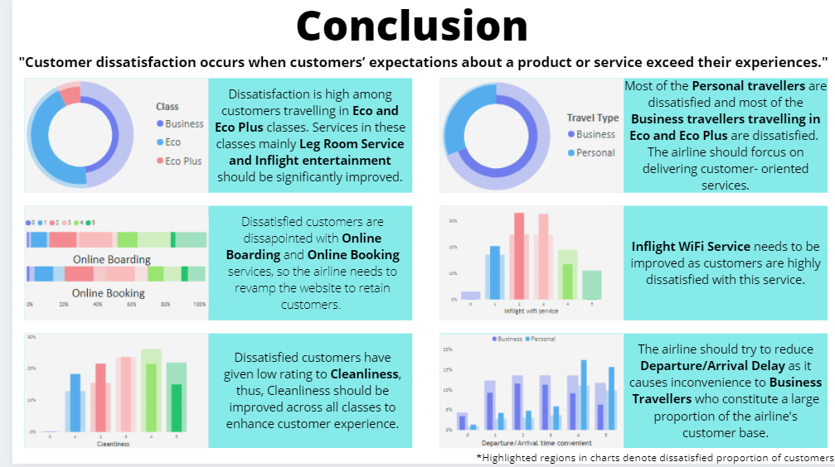

Slide 11
MIND BENDERS
DEBI PAUL
AISHWARYA NASA
HANSRAJ COLLEGE
HANSRAJ COLLEGE
190257610
19025761002
8.8 CGPA (SEM 1)
8.4 CGPA (SEM 1)
NITIN SEN
ANUBHAV NAIN
HANSRAJ COLLEGE
HANSRAJ COLLEGE
19025761015
19025761003
7.8 (SEM 1)
6 CGPA (SEM 1)

