Slide 1
Internet of Things(IoTs)
Mojtaba Aajami

Slide 2
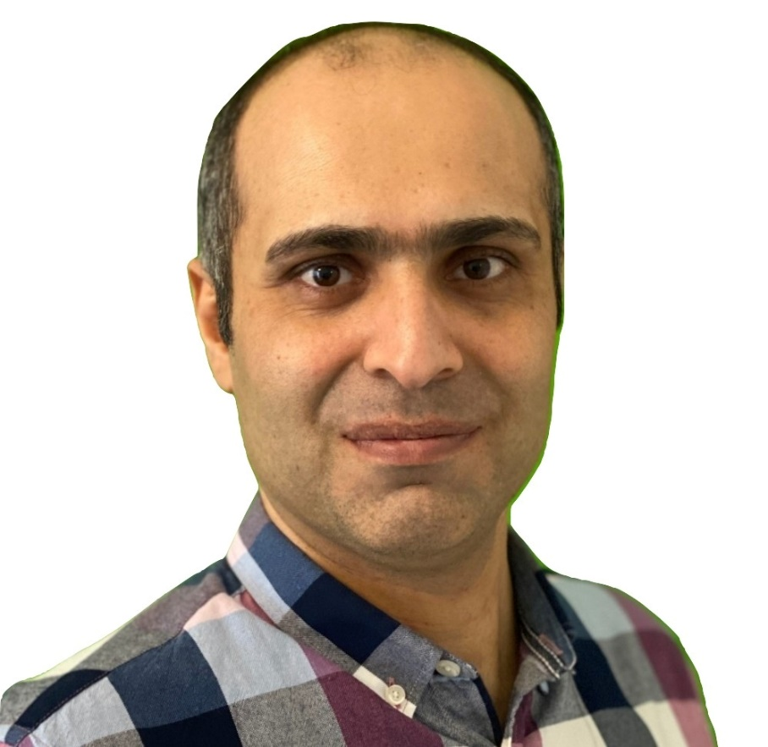
Who am I?
Mojtaba Aajami
Assistant Prof. of Computer Eng.
PhD in Computer Eng.
From Yonsei Univ.

Slide 3
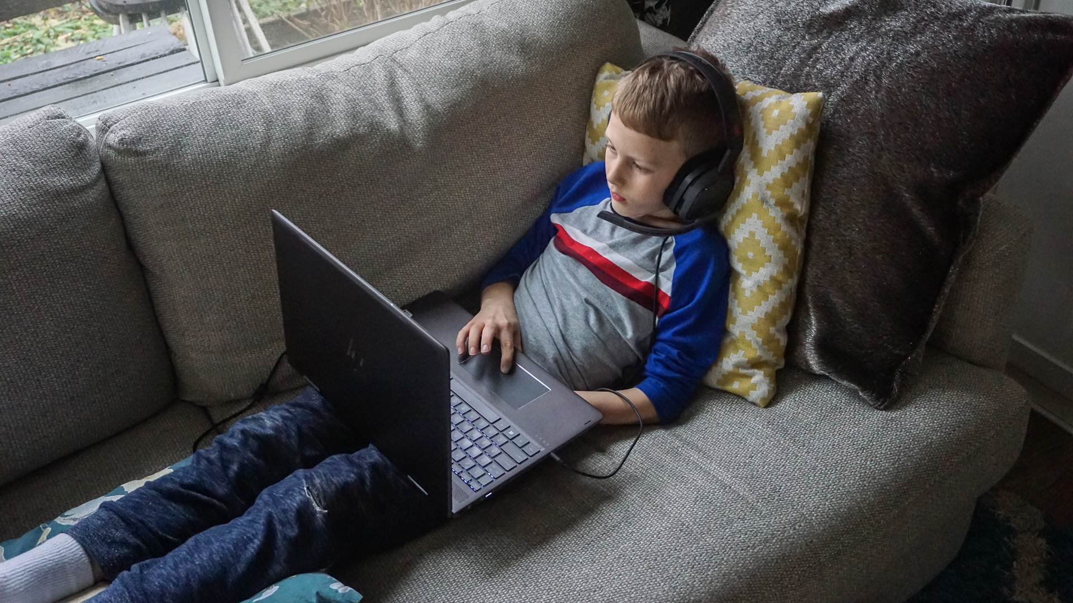
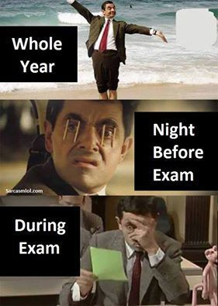

Grading
Term Project: 25 %
Graduate ➔ Paper review
Undergraduate ➔ Arduino Programming
At most 3 people
Final Exam: 40%
Attendance: 10%
Home works: 25%

Slide 4


Rules
Under no circumstances call me or send me message on messengers!
Each home work’s due date is the next week.
Send me your home works to aajami732@gmail.com

Slide 5

Reference Books

