Slide 1
Multimedia Systems
Media Representation: Audio

Slide 2
What is Sound?
Sound is a wave phenomenon, involving molecules of air being compressed and expanded under the action of some physical device.
A speaker (or other sound generators) vibrates back and forth and produces a longitudinal pressure wave that is perceived as sound.
Since sound is a pressure wave, it takes on continuous values, as opposed to digitized ones.
If we wish to use a digital version of sound waves, we must form digitized representations of audio information.

Slide 3
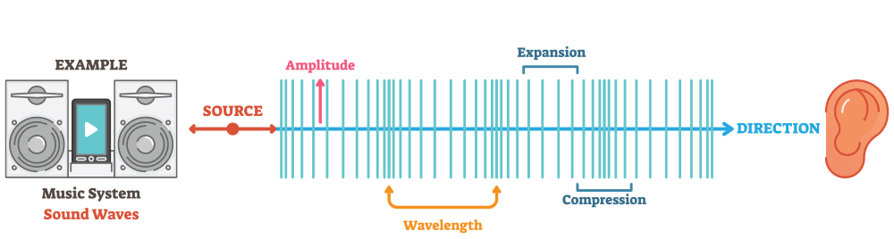
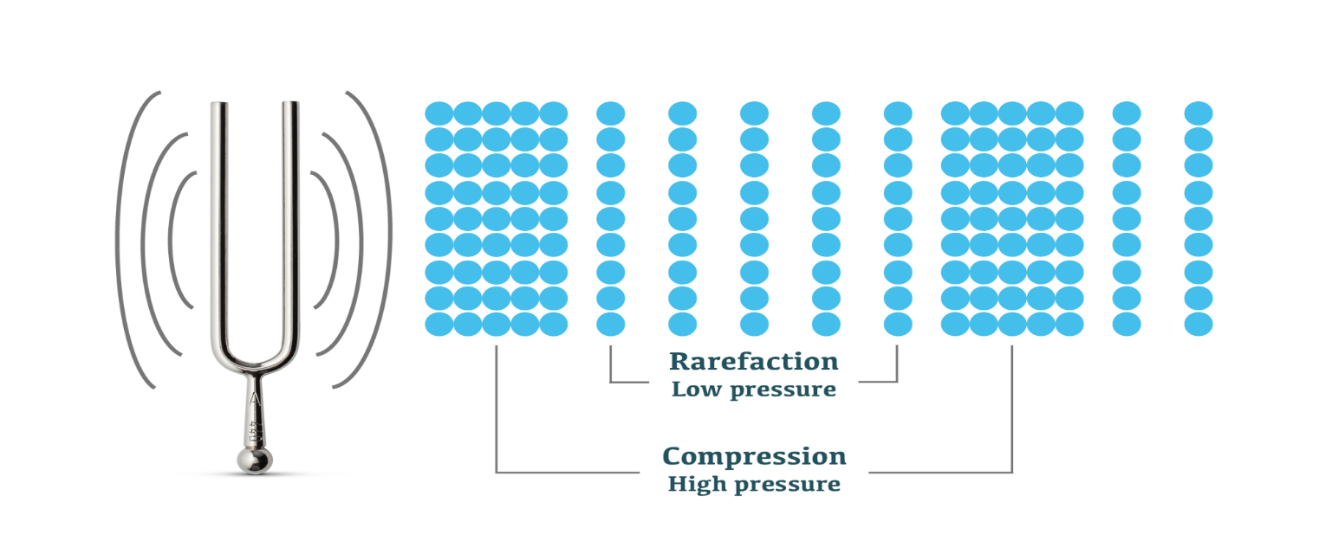
What is Sound?

Slide 4
Physical World is often Analog

Slide 5
Digitization
1-dimensional nature of sound: amplitude (sound pressure/level) depends on a 1D variable, the time.
Digitization: conversion to a stream of numbers, and preferably these numbers should be integers for efficiency.

Slide 6
Digitization
Digitization must be in both time and amplitude.
Sampling: measuring the quantity we are interested in, usually at evenly-spaced intervals.
First kind of sampling, using measurements only at evenly spaced time intervals, is simply called sampling.
The rate is called the sampling frequency.
For audio, typically from 8 kHz (8,000 samples per second) to 48 kHz.
Sampling in the amplitude or voltage dimension is called quantization.

Slide 7
Sampling and Quantization

Slide 8
Parameters in Digitizing
To decide how to digitize audio data we need to answer the following questions:
What is the sampling rate?
How finely is the data to be quantized, and is quantization uniform?
How is audio data formatted? (file format)

Slide 9
Sampling Rate
Signals can be decomposed into a sum of sinusoids.

Slide 10
Sampling Rate
If the sampling rate just equals the actual frequency
A false signal (constant ) is detected
If we sample at 1.5 times the actual frequency
An incorrect (alias) frequency that is lower than the correct one
The wavelength is double that of the actual signal

Slide 11
Sampling Rate
For correct sampling, we must use a sampling rate equal to at least twice the maximum frequency content in the signal. This rate is called the Nyquist rate.
The relationship among the Sampling Frequency, True Frequency, and Alias Frequency is as follows:

Slide 12
Sampling Rate
Nyquist frequency: half of the Sampling rate.
It is impossible to recover frequencies higher than Nyquist frequency in any event.
Most systems have an antialiasing filter
It restricts the frequency content in the input to the sampler to a range at or below Nyquist frequency.

Slide 13
Nyquist Theorem
Band-limited Signal:
There is a lower limit f1 and an upper limit f2 of frequency components in the signal.
The sampling rate of a band-limited signal should be at least 2(f2 − f1).

Slide 14
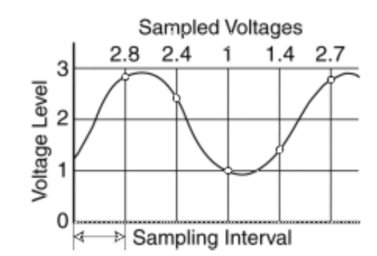
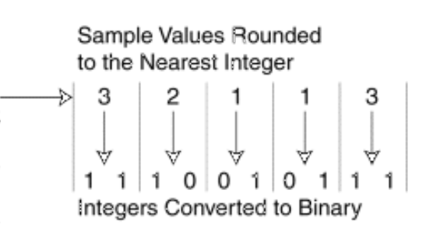
Quantization (Pulse Code Modulation)
At every time interval, the sound is converted to a digital equivalent.
Using 2 bits the following sound can be digitized

Slide 15
More on Quantization
Quantization is lossy.
Roundoff errors => quantization noise/error

Slide 16
Quantization Noise
Quantization noise: the difference between the actual value of the analog signal, for the particular sampling time, and the nearest quantization interval value.
At most, this error can be as much as half of the interval.
The quality of the quantization is characterized by the Signal to Quantization Noise Ratio (SQNR)
A special case of SNR (Signal to Noise Ratio)

Slide 17
Signal to Noise Ratio (SNR)
Signal to Noise Ratio (SNR): the ratio of the power of the correct signal and the noise
A common measure of the quality of the signal
The ratio can be huge and often non-linear
SNR is usually measured in log scale: decibels (dB), where 1 dB is 1/10 Bel.
The SNR value, in units of dB, is defined in terms of base-10 logarithms of squared voltages, as follows:

Slide 18
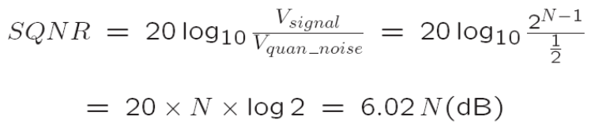
Signal-to-Quantization Noise Ratio (SQNR)
For a quantization accuracy of N bits per sample, the peak SQNR can be simply expressed:
6.02N is the worst case.
We map the maximum signal to 2^{N−1} − 1 (≃ 2^{N−1}) and the
most negative signal to −2^{N−1}.

Slide 19
Signal-to-Quantization Noise Ratio (SQNR)
Dynamic range
The ratio of maximum to minimum absolute values of the signal: Vmax / Vmin
The max abs. value Vmax gets mapped to 2^{N-1} − 1.
The min abs. value V_{min} gets mapped to 1.
V_{min} is the smallest positive voltage that is not masked by noise.
The most negative signal, −V_{max}, is mapped to −2^{N−1}.

Slide 20
Linear and Non-linear Quantization
Linear format: samples are typically stored as uniformly quantized values.
Non-uniform quantization: set up more finely-spaced levels where humans hear with the most acuity.
Weber’s Law stated formally says that equally perceived differences have values proportional to absolute levels:

Slide 21
Linear and Non-linear Quantization
Inserting a constant of proportionality k, we have a differential equation that states:
with response r and stimulus s.
Integrating, we arrive at a solution
with the constant of integration C
Stated differently, the solution is

Slide 22
Non-linear Quantization
Nonlinear quantization works by first transforming an analog signal from the raw s space into the theoretical r space, and then uniformly quantizing the resulting values.
Such a law for audio is called μ-law encoding, (or u-law). A very similar rule, called A-law, is used in telephony in Europe.
The equations for these very similar encodings are as follows:

Slide 23
Non-linear Quantization

Slide 24
Non-linear Quantization

Slide 25
Non-linear Quantization

Slide 26
Bit allocation
In μ-law, we would like to put the available bits where the most perceptual acuity (sensitivity to small changes) is.
Savings in bits can be gained by transmitting a smaller bit-depth for the signal.
μ-law often starts with a bit-depth of 16 bits, but transmits using 8 bits.
And then expands back to 16 bits at the receiver.

Slide 27
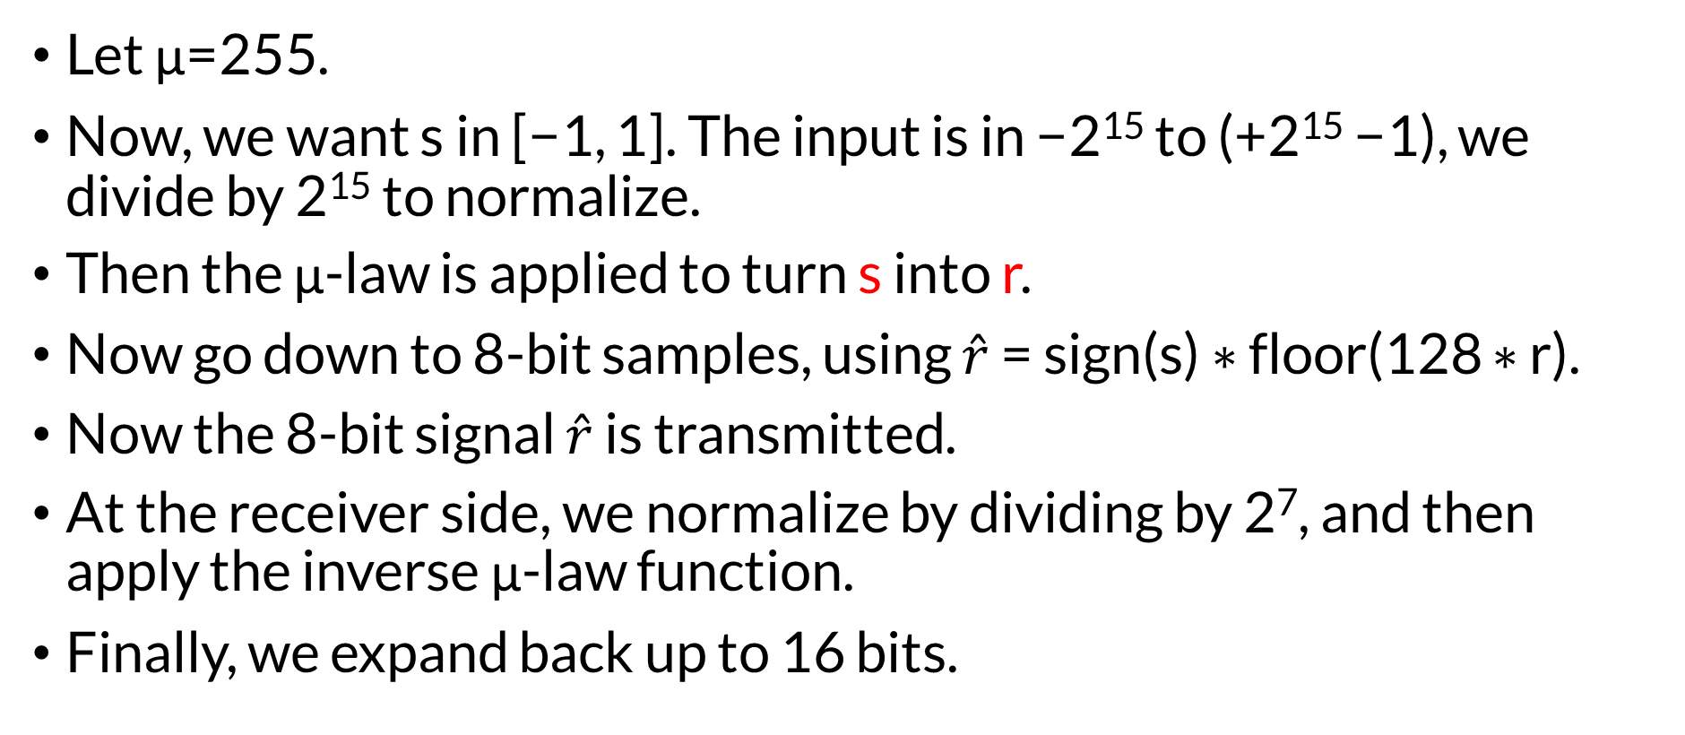
Bit allocation: Example
Let μ=255.
Now, we want s in [−1, 1]. The input is in −2¹⁵ to (+2¹⁵ −1), we divide by 2¹⁵ to normalize.
Then the μ-law is applied to turn s into r.
Now go down to 8-bit samples, using $\hat{r}$ = sign(s) ∗ floor(128 ∗ r).
Now the 8-bit signal $\hat{r}$ is transmitted.
At the receiver side, we normalize by dividing by 2⁷, and then apply the inverse μ-law function.
Finally, we expand back up to 16 bits.

Slide 28
Bit allocation: Example

Slide 29
MIDI: Musical Instrument Digital Interface
MIDI forms a protocol adopted by the electronic music industry that enables computers, synthesizers, keyboards, and other musical devices to communicate with each other.
MIDI is a scripting language — it codes “events” that stand for the production of sounds. E.g., a MIDI event might include values for the pitch of a single note, its duration, and its volume.

Slide 30
MIDI
The MIDI standard is supported by most synthesizers, so sounds created on one synthesizer can be played and manipulated on another synthesizer and sound reasonably close.
Computers must have a special MIDI interface, but this is incorporated into most sound cards.
The sound card must also have both D/A and A/D converters.

Slide 31
MIDI Concepts
MIDI channels are used to separate messages.
There are 16 channels numbered from 0 to 15. The channel forms the last 4 bits (the least significant bits) of the message.
Usually, a channel is associated with a particular instrument: e.g., channel 1 is the piano, channel 10 is the drums, etc.
Nevertheless, one can switch instruments midstream, if desired and associate another instrument with any channel.

Slide 32
MIDI Concepts
System messages
Several other types of messages, e.g. a general message for all instruments indicating a change in tuning or timing.
The way a synthetic musical instrument responds to a MIDI message is usually by simply ignoring any play sound message that is not for its channel.

Slide 33
MIDI Terminology
Synthesizer:
was, and still can be, a stand-alone sound generator that can vary the pitch, loudness, and tone color.
inexpensive synthesizers are also included on PC sound cards
Sequencer:
started off as a special hardware device for storing and editing a sequence of musical events, in the form of MIDI data.
Now it is more often a software music editor on the computer.
MIDI Keyboard:
produces no sound, instead generating sequences of MIDI instructions, called MIDI messages

Slide 34
MIDI Terminology
Timbre: The instrument that is trying to be emulated, e.g. a piano as opposed to a violin: it is the quality of the sound.
Voice: every different timbre and pitch that the tone module can produce at the same time. Synthesizers can have many (typically 16, 32, 64, 256, etc.) voices. Each voice works independently and simultaneously to produce sounds of different timbre and pitch.
Polyphony: the number of voices that can be produced at the same time

Slide 35
MIDI Specifics
Q: How different timbres are produced digitally?
A: Different timbres are produced digitally by using a patch — the set of control settings that define a particular timbre. Patches are often organized into databases, called banks.

Slide 36
General MIDI
In General MIDI, channel 10 is reserved for percussion instruments, and there are 128 patches associated with standard instruments.
For most instruments, a typical message might be a Note On message (meaning, e.g., a key press and release), consisting of what channel, what pitch, and what “velocity” (i.e., volume).
For percussion instruments, however, the pitch data means which kind of drum.
A Note On message consists of “status” byte — which channel, what pitch — followed by two data bytes. It is followed by a Note Off message, which also has a pitch (which note to turn off) and a velocity (often set to zero).

