Slide 1
Wireless Networks
Physical Layer II

Slide 2
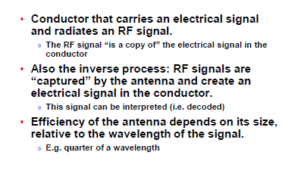
What is an Antenna?

Slide 3
Types of Antennas

Slide 4
Antenna Types: Dipoles

Slide 5
Multi-element Antennas

Slide 6
Directional Antenna Properties

Slide 7
Examples 2.4 GHz

Slide 8
Summary

Slide 9
Propagation Modes

Slide 10
Impact of Obstacles

Slide 11
Refraction

Slide 12
Fresnel Zones

Slide 13
Fresnel Zones

Slide 14
Sketch of Calculation: Difference in Path Length

Slide 15
Sketch of Calculation Fresnel Radius

Slide 16
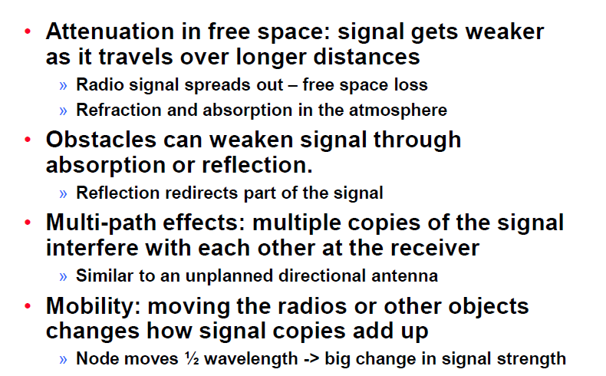
Propagation Degrades RF Signals

Slide 17
Free Space Loss

Slide 18
Log Distance Path Loss Model

