Slide 1
Kuberise
Based on GitOps Principles and Platform engineering
Mojtaba Imani

Slide 2
Problems to solve
Self service platform products
Container Deployment System
Deployment pipelines
Environment-specific configuration parameters
Changing parameters during run time
Secure parameters

Slide 3
Assumptions
Kubernetes as the container management platform
2 Kubernetes cluster dta: test and acceptance, prd: production
There are isolated namespaces per environment per team

Slide 4
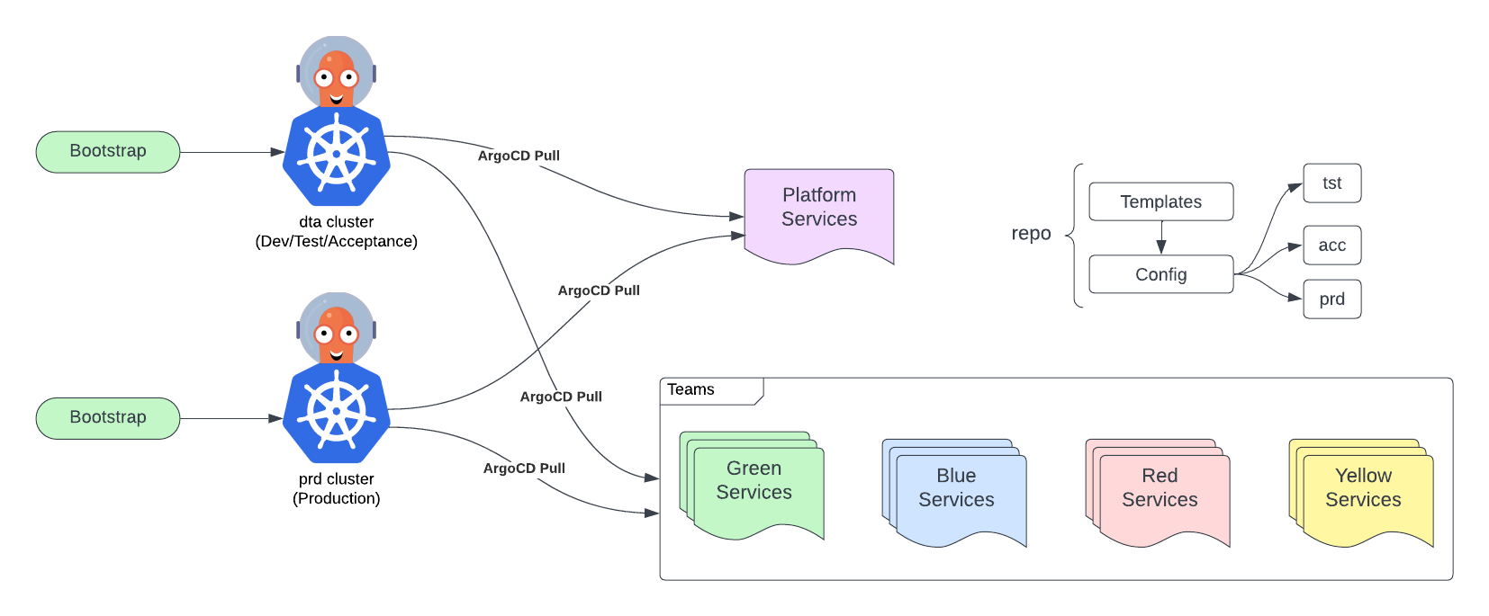

Slide 5
Solution
GitOps principle
Platform Engineering Method
ArgoCD in Pull Mode
Services in Helm or Kustomize format or simple group of yaml files
Separation of templates and configuration
Merge into main will deploy to test environment
Deployment to acceptance and production is based on tags

Slide 6
Platform Services Repository
Self-service tools
Core platform services (Grafana, Prometheus, Sealed-Secrets, Loki)
Configurations and Templates are separated.
ArgoCD using the app-of-the-apps pattern.
Real-time changes to configuration are deployed by ArgoCD.
Version-tagged platform tools for independent updates.
Namespaces for teams and access

Slide 7
Team Services Repositories
Each team can have one or multiple repositories
They can only view and deploy to the namespaces provided by the platform team. (e.g., blue-tst, blue-acc, blue-prd, etc.)
Teams can use platform tools or develop their own
Templates and configurations are separated
They use ArgoCD app-of-the-apps pattern
Applications can be enabled/disabled in app of apps value file.

Slide 8
Secrets Management
Secrets are stored in Kubernetes Secrets and their sealed one in git repo
Using sealed-secrets
Kubeseal the secret
Add encrypted secret to the repo
ArgoCD deploys sealed secret to the cluster
Sealed-Secret operator will generate the secret inside each cluster
Secrets inside kubernetes are protected using RBAC
Secrets can be different for each environment
Adding the encrypted secrets to the repository keeps track of history and changes responsibility

Slide 9
Live Demo
Code (platform/teams)
Live dta,prd clusters (K9s)
ArgoCD Dashboard
Grafana Dashboard

Slide 10
Talking about competitors and where is the place for my product

Slide 11
Next Step
Monitoring
Dashboards
Alerting
Security
Hashicorp Vault
Access and roles
SSL (Cert-Manager)
Automation
CI Automation
Articles and readme (how to run)
Identify target audience (competitors and position in the market)
Finding the first client
(remove: backstage, Postgresql, )

