Slide 1
What factors contribute to educational success?
Group 56- Alyssa Benjamin, Monisha Kapadia, Anh Nguyen, Yi Chen Wu

Slide 2
INTRODUCTION
1
Summary of our Motivation & Data

Slide 3
MOTIVATION
PROBLEM:
As current students, we understand the determination to strive for the best GPA and grades. 75% of high school students report that they ALWAYS or OFTEN worry about not getting good grades.
WHAT WE THINK:
However, there are numerous factors that can affect the end determination of our grades, some in our control and some out of it.
In our project, we plan to explore this idea of whether we have full control over the grades we receive and how we can possibly predict our grades based on a series of factors.
Notes:
As students, the pressure to achieve, particularly for grades, is immense. In fact, over 75% of high school students in a survey reported they always or often worry about not getting good grades. That stress often follows students into pursuits of higher education, especially when worrying about GPA and possible job prospects. The usual advice received is to study hard and to pay attention. However, studies have shown that those at historical disadvantages, whether in terms of race, class or gender, struggle with achieving at higher grades from simply their circumstances. With this conflicting information, our team aims to evaluate, based on a sample representative of college students reporting on a variety of personal, educational, and familial factors, which factors bear an influence on our grades with machine learning and visualization tools.

Slide 4
DATASET DESCRIPTION
A representative sample of 145 students in 2019 in the Faculty of Engineering and Faculty of Educational Sciences at the Near East University in Cyprus.
Students were given a questionnaire that consists a total of 30 questions in 3 categories: Personal Questions, Family Questions, and Educational Preferences.
Each student also has a final grade from 0 - 7 (with 0 being an F, 7 being an A+)

Slide 5
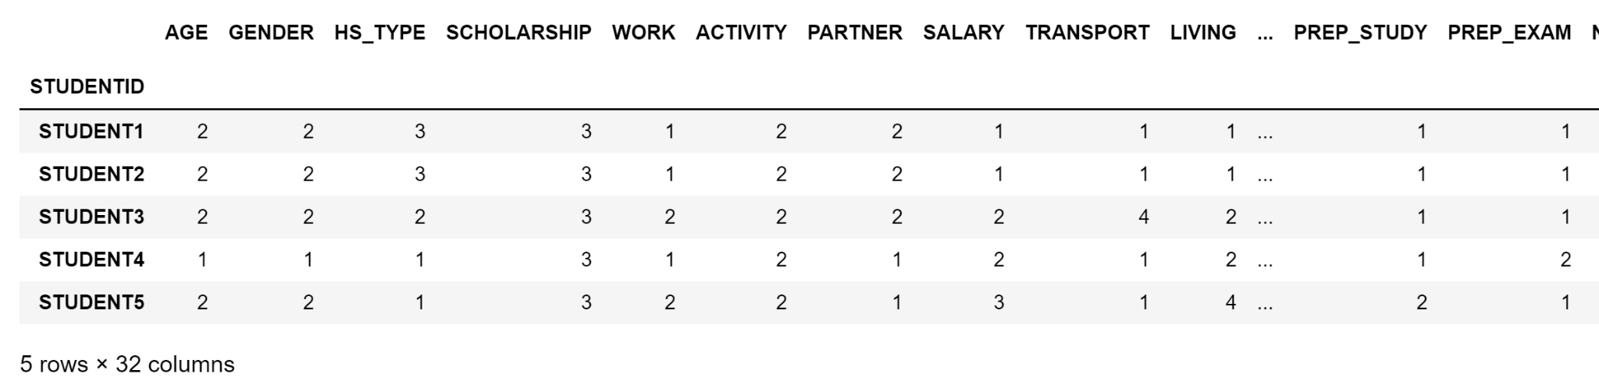
DATASET
Notes:
Explain that 1, 2,3 etc. correlate to a certain response i.e. in the gender column, 1 refers to male and 2 refers to female (?)

Slide 6
DATA APPROACH
To better prepare our data, we grouped the columns into 3 main groups to determine if one group was a better predictor of academic success (grades) or not (for the ML applications).
EDUCATIONAL
PERSONAL
FAMILIAL
Notes:
3 Categories
EDUCATIONAL
High school type, preparation study, preparation exam, takes notes, listens, likes to discuss, likes flipped classroom, cumulative gpa, expected gpa, weekly study hours, reading frequency, attendance to seminars, attendance to classes, preparation to midterm exams
PERSONAL
Age, gender, scholarship, work, activity, partner, salary, transport, living, sex, regular artistic/sports activity, total salary, transportation to university, accommodation type
FAMILIAL
Mother’s education ,father’s education, number of brothers/sisters, parental status (married/divorced), mother’s occupation, father’s occupation

Slide 7
DATA ANALYSIS
2
Exploring our Data & its Features

Slide 8
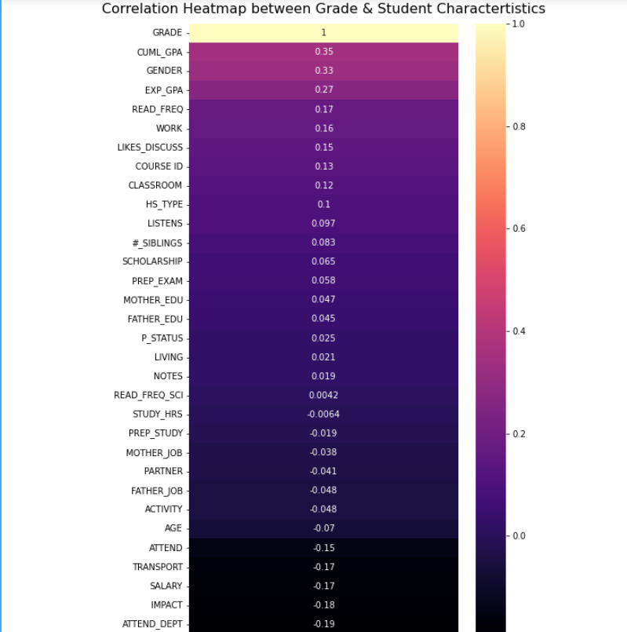
This heatmap is good indicator of the correlation is between all the detailed characteristic given for each student in the dataset to the grade they received at the end.
Visually, some characteristics of particular importance would be gender, cumulative gpa, expected gpa, and reading frequency (in general) as they show the strongest correlation.
Some characteristics close probably hold very little importance such as whether the student takes notes, how many hours they study, or their mother's occupation.
Notes:
don’ t hate me but could we potentially use like blank white slides or a more simple theme
Ill make a new presentation and copy everything is that fine

Slide 9
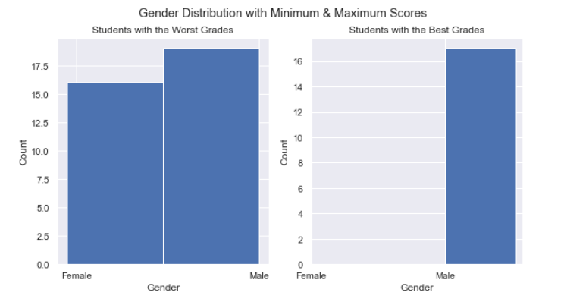
Histograms of Important Characteristics
Notes:
Based on the subplot above, in this sample, male students were the only ones to achieve high grades and also shared most of the distibution for the worst grades. Solely from a data perspective, being male could have played in a role in whether the student had the ability to get a higher grade.

Slide 10
ML APPLICATIONS & VISUALIZATIONS
3
Applying our ML Methods of Choice

Slide 11
MACHINE LEARNING METHODS
k-NN Classifier
Random Forest Regressor
Is the colour of the clear sky and the deep sea. It is located between violet and green on the optical spectrum.

Slide 12
Method - Machine Learning: Knn Classifier
Knn classifier
One classifier for all variables, one for each respective factor group (educational, familial, personal)
Confusion matrix visualizes what the algorithm predicts a student’s grade to be (grades 0 -7)
Random decision classifier/tree
Love the tree
Notes:
The best suited ML option for the ordinal and non-continuous data at our disposal we determined was the k-NN classifier. Particularly, we were interested in a method that would be supervised so there would be output predictions based on the patterns discerned from data, which is the basis of our project goal. The k-NN classifier will be split up into three different segmentations of the data, and then with one overall classifier with all input functions. The three segmentations will be based on the category of questions the data focuses on: familial, personal, or educational matters which we had mentioned before.
Pitfalls: a classifier when calculating accuracy and interpreting the effectiveness of the predictions does not take into account the difference in grades. For instance, the classifier would consider mistakenly classifying a student who was in the highest rank of grades (7) as someone who received the next rank of grades (6) the same gravity of mistake as classifying that same person as someone who received the lowest rank of grades (1). This will make the accuracy of the classifier appear better than something like a regressor.

Slide 13
Method - Machine Learning: Random Decision Classifier/Tree
Random decision classifier/tree
Love the tree
Notes:
The best suited ML option for the ordinal and non-continuous data at our disposal we determined was the k-NN classifier. Particularly, we were interested in a method that would be supervised so there would be output predictions based on the patterns discerned from data, which is the basis of our project goal. The k-NN classifier will be split up into three different segmentations of the data, and then with one overall classifier with all input functions. The three segmentations will be based on the category of questions the data focuses on: familial, personal, or educational matters which we had mentioned before.
Pitfalls: a classifier when calculating accuracy and interpreting the effectiveness of the predictions does not take into account the difference in grades. For instance, the classifier would consider mistakenly classifying a student who was in the highest rank of grades (7) as someone who received the next rank of grades (6) the same gravity of mistake as classifying that same person as someone who received the lowest rank of grades (1). This will make the accuracy of the classifier appear better than something like a regressor.

Slide 14
CONFUSION MATRIX
The matrix shows how well our model can perform

Slide 15
RESULTS

Slide 16
TAKEAWAYS & CONCLUSIONS
4
Interpreting our Results in our Data’s Context

Slide 17
TAKEAWAYS

Slide 18
THANKS!
Any questions?
You can find me at
@username / user@mail.me

Slide 19
SlidesCarnival icons are editable shapes.
This means that you can:
Resize them without losing quality.
Change fill color and opacity.
Change line color, width and style.
Isn’t that nice? :)
Examples:

