Slide 1

Machine Learning and Email Classification
Mahmut Ozge Karakaya

Slide 2
Agenda
Linear Regression
Neural Networks
Convolutional Neural Networks and Reinforcement Learning (Deep Learning)
Email Classification
Notes:
Éénduidige opmaak van slides

Slide 3
Linear Regression
 | Living Area (x1) | Build Year (x2) | Fireplaces (x3) | Price (y)
House 1 | 158 | 1961 | 0 | 181500
House 2 | 117 | 1958 | 1 | 223500
House 3 | 165 | 1998 | 1 | ?
θ1 * 158 + θ2 * 1961 + θ3 * 0 + b = 181500
θ1 * 117 + θ2 * 1958 + θ3 * 1 + b = 223500
θ1 * 165 + θ2 * 1998 + θ3 * 1 + b = ?
θ = weights (w)
b = bias
We want to learn θ and b
Notes:
Éénduidige opmaak van slides

Slide 4
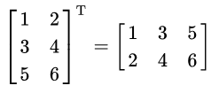
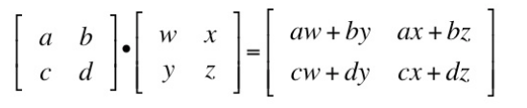
Matrix Operations
Transpose matrix
  It switches the row and column indices of the matrix A by producing another matrix denoted by A^{T}
Dot product
  Dot product of N X M matrix and M X K matrix is another matrix with size N X K where N, M, and K are the dimensions.
Notes:
Éénduidige opmaak van slides

Slide 5
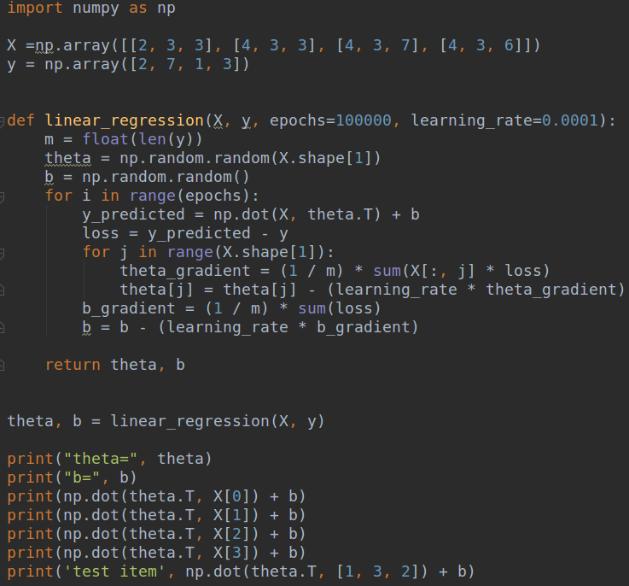
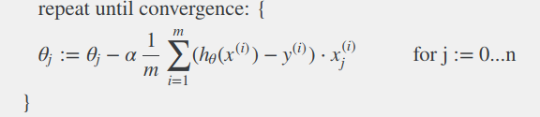
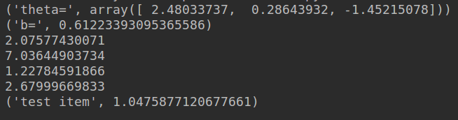
Linear Regression (SGD)
h_{θ} = dot(x, θ^{T}) + b
Can ML learn random data?
What if y = [Apartment, Not Apartment] ?
→ Apply sigmoid to h_{θ} and change loss function.
What if y = [Apartment, Farm House, Castle] ?
→ Apply one-vs-all classification
Does this algorithm work for house price prediction?
Notes:
Éénduidige opmaak van slides

Slide 6
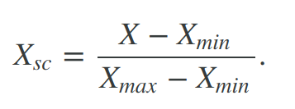
ML Preprocessing
Min-max scaling
One-hot Encoding
  Clay = {0, 0, 1}
  Metal = {0, 1, 0}
  Wood = {1, 0, 0}
Roof Material (x4)
Clay
Metal
Wood
 | is_wood (x5) | is_metal (x6) | is_clay (x7)
House 1 | 0 | 0 | 1
House 2 | 0 | 1 | 0
House 3 | 1 | 0 | 0
In feature engineering, we create new features. New features may improve the results.
  log(living area) → difference between 75-80 may be more important than the difference between 140-145
  T-shirt size living area
  Square(any x)
  Distance to city center (if you have coordinates)
Notes:
Éénduidige opmaak van slides

Slide 7

Neural Networks
NN has 3 type of layers.
They are building blocks of Deep Learning algorithms, and they can be used by their own.
Nodes are connected to each other with some weights, and we want to learn the all weight values.
We first predict y values (feed forward), and then we update the weights using the error (backpropagation)
If all nodes in a layer are connected to all nodes in previous layer, the layer is called fully connected (dense layer)
The output is a single node if the problem is a regression problem.
Number of nodes in output layer equal to number of classes, if the problem is a classification problem. (one-vs-all is also possible but costly)
X1
X2
Y
X3
Notes:
Éénduidige opmaak van slides

Slide 8
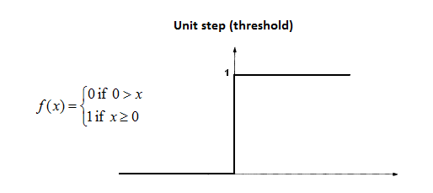
Perceptron
Perceptons are building blocks of neural networks
Input values or One input layer
Weights and Bias
Net sum (dot product)
Activation Function
Output
1
w0
Activation Function
w0 +
w1 * x1 +
w2 * x2 +
w3 * x3
x1
w1
w2
x2
w3
x3
Notes:
Éénduidige opmaak van slides

Slide 9
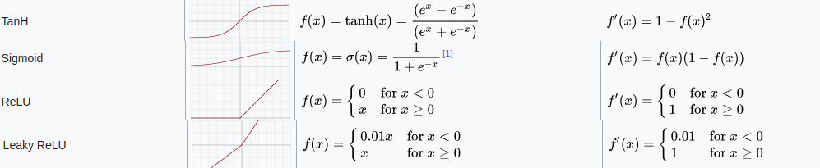
More Activation Functions
Activation functions are always nonlinear. NNs are nonlinear because of the activation functions.
Linear AF doesn’t work with NN.
Sigmoid functions and their combinations usually work better for classification techniques.
ReLU is a widely used activation function and yields beter results compared to Sigmoid and Tanh.
Leaky ReLU is a solution for a dead neuron problem.
Notes:
Éénduidige opmaak van slides

Slide 10
Neural Networks – Feed forward
x1
W 0,1
AF(w1 * x1 +
w2 * x2)
= ho
W1,0
y_predicted
= ho* W1,0
W 0, 2
x2
ho = hidden output
AF = activation function
In feed forward process we calculate y values.
If we had more hidden nodes, we’d get the dot product to calculate y
Notes:
Éénduidige opmaak van slides

Slide 11
Neural Networks – Back propagation
x1
W 0,1
AF(w1 * x1 +
w2 * x2)
= ho
W1,0
y_predicted
= ho* W1,0
W 0, 2
x2
In back propagation, we update the weights (W)
error = y - y_predicted
W1, 0 = W1, 0 + learning_rate * ( error * ho )
W0, 1 = W0,1 + learning_rate * ( error * W1,0 * AF`(w1 * x1 + w2 * x2) * x1)
W0, 2 = W0,2 + learning_rate * ( error * W1,0 * AF`(w1 * x1 + w2 * x2) * x2)
Notes:
Éénduidige opmaak van slides

Slide 12
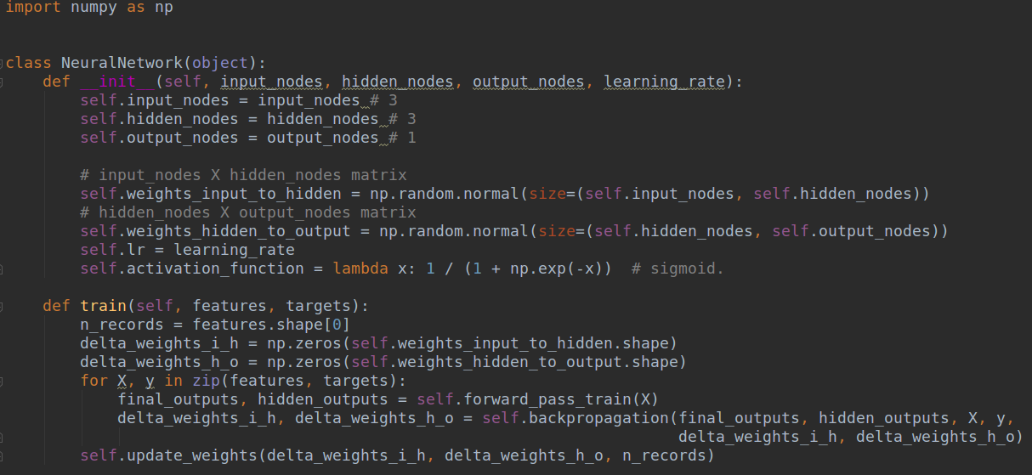
Neural Network - Implementation
Notes:
Éénduidige opmaak van slides

Slide 13
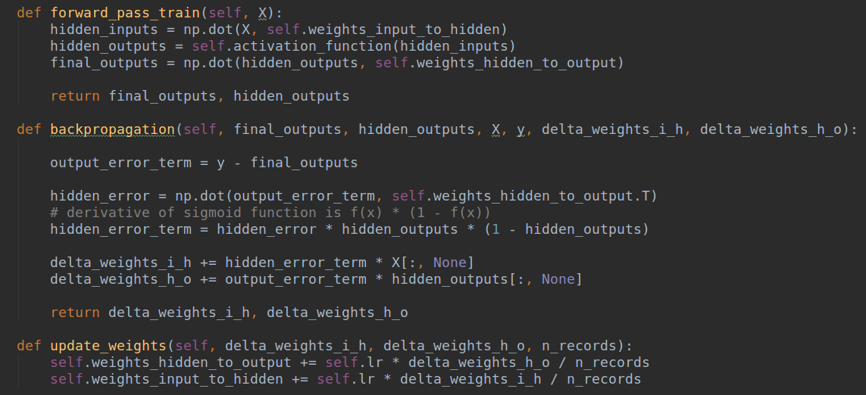
Neural Network - Implementation
Notes:
Éénduidige opmaak van slides

Slide 14
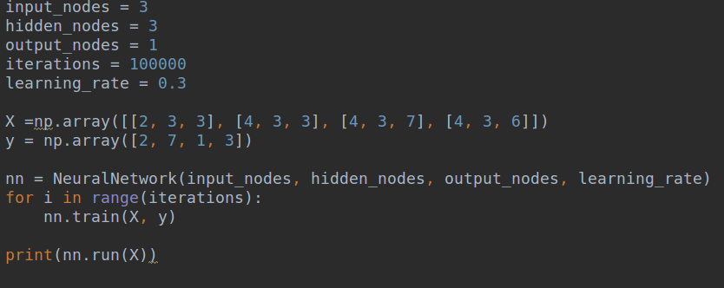
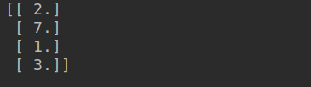
Neural Network - Implementation
LR, NN implementation will be available at;
https://github.com/mokarakaya/machine-learning-presentation
Notes:
Éénduidige opmaak van slides

Slide 15
Playground Tensorflow
Circular Data (Relatively Simple)
  One layer one neuron is linear
  One layer two neurons is non-linear but not enough
  One layer 3 neurons will learn
  Does the model work with linear activation function?
Spiral Data (Relatively Complex)
  One layer 3 neurons is not enough
  8 X 8 X 4 model will learn (L2 = 0.001)
  Nodes in the first hidden layer are always linear?
  Nonlinear feature combinations
  Nodes in the first hidden layer are always linear?
Try the statements above at https://playground.tensorflow.org
Notes:
Éénduidige opmaak van slides

Slide 16
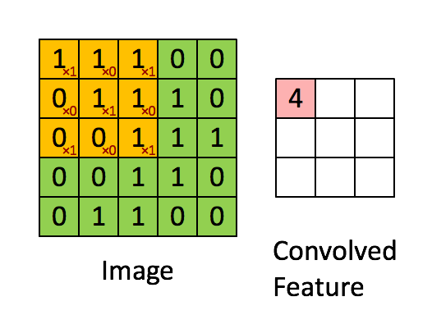
Convolutional Neural Networks (CNN)
  7 as an image:
  0 1 1 1 1 1
  0 0 0 0 0 1
0 0 0 0 1 0
0 0 0 1 0 0
0 0 1 0 0 0
Filter:
Convolutional Layer:
-1 | -1 | 1
-1 | 1 | -1
1 | -1 | -1
0 | 0 | 0
0 | 0 | 3
0 | 3 | 0
Calculation for CL(0, 0):
ReLU (SUM (-1 * 0 + -1 * 1 + 1 * 1 +
-1 * 0 + 1 * 0 + -1 * 0 +
1 * 0 + -1 * 0 + -1 * 0))
= 0
Notes:
Éénduidige opmaak van slides

Slide 17
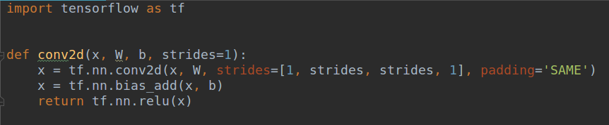
Convolutional Neural Networks (CNN)
Strides = height and weight of the convolution window (Generally square)
The window will shift 1 in all directions.
Padding SAME will extend the image with zeros if the window exceeds the image.
In transfer learning, a model developed for a task that was reused as the starting point for a model on a second task
First task may be predicting dog breeds and the second task may be predicting car models.
Since first layers of NN consist of simple equations and they keep simple information (lines, edges, etc), reusing these layers in other task yields better results.
Transfer learning is not limited to visual data.
Notes:
Éénduidige opmaak van slides

Slide 18
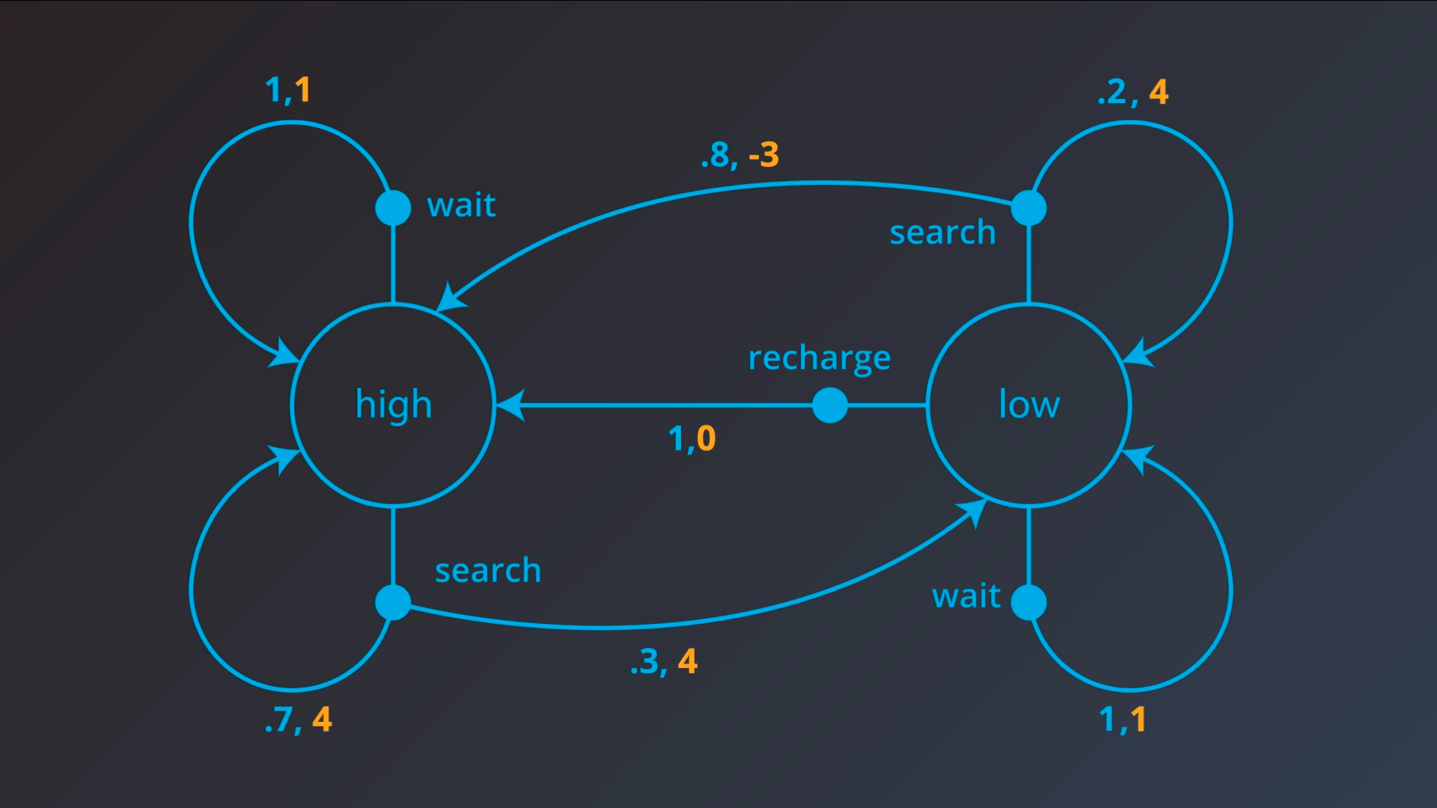
Reinforcement learning (RL) - Markov Decision Process (MDP)
The goal of the agent is to maximize expected cumulative reward.
RL algorithms depends on MDP
S = {high, low}
A = {wait, search, recharge}
R = labeled with yellow
Notes:
Éénduidige opmaak van slides

Slide 19
TF-IDF
 | Text in email (x1) | Class (y)
Email 1 | Hello, sepa payment | 1
Email 2 | Hello, international payment | 2
Email 3 | Hello, sepa tax | 3
Email 4 | Hello, international tax | ?
tf(t,d) = 1 if t occurs in d and 0 otherwise
idf(t, D) = log( N / | {d ∈ D : t ∈ d} |)
tf-idf(t, d, D) = tf(t, d) * idf(t, D)
D = all documents
N = size of D
d = a specific document
t = term
Notes:
Éénduidige opmaak van slides

Slide 20
TF-IDF
 | Hello (x1) | Sepa (x2) | Payment (x3) | International (x4) | Tax (x5) | Class (y)
Email 1 | 1 * log(3/3) = 0.0 | 1 * log(3/2) = 0.1 | 1 * log(3/2) = 0.1 | 0 * log(3/1) = 0.0 | 0 * log(3/1) = 0.0 | C 1
Email 2 | 1 * log(3/3) = 0.0 | 0 * log(3/2) = 0.0 | 1 * log(3/2) = 0.1 | 1 * log(3/1) = 0.4 | 0 * log(3/1) = 0.0 | C 2
Email 3 | 1 * log(3/3) = 0.0 | 1 * log(3/2) = 0.1 | 0 * log(3/2) = 0.0 | 0 * log(3/1) = 0.0 | 1 * log(3/1) = 0.4 | C 3
Email 1 = Hello, sepa payment
Email 2 = Hello, international payment
Email 3 = Hello, sepa tax
N-gram(1, 1) = 10848
N-gram(1, 6) = 254062
log(1) = 0
log(3/2) = 0.17
log(3) = 0.4
Notes:
Éénduidige opmaak van slides

