Slide 1
Predicting Wine Quality
from Physicochemical Properties
A Comparative Study of Supervised Learning Methods
Mengjia Shang · ID: 7338151449
EE559/CSCI 559 — Spring 2026 · Prof. Anand A. Joshi · USC
Notes:
Welcome everyone. I'm Mengjia Shang and today I'll present my EE559 project: predicting wine quality from physicochemical measurements. I'll walk through the dataset, my feature engineering decisions, three supervised learning models, and a rigorous comparison including bootstrap confidence intervals, McNemar's significance tests, and a multi-seed robustness study.

Slide 2
Why Automate Wine Quality Assessment?
THE PROBLEM
6,497
Traditional certification relies on expert sensory panels
Process is expensive, slow, and highly subjective
Scores vary between panels — reproducibility is limited
Physicochemical testing already happens during production
Goal: predict expert ratings from measurable chemistry
Practical impact: low-cost, objective quality gate for producers
Wine Samples
11
Physicochemical
Features
0
Missing Values
Notes:
Wine quality is traditionally assessed by certified tasters — but this is expensive and inconsistent. Physicochemical properties like alcohol content, acidity, and sulfur dioxide are already measured in the lab. If we can train a model on these measurements, we get a reproducible, instant quality estimate at no extra cost.

Slide 3
Problem Formulation
TASK DEFINITION
CLASS DISTRIBUTION
Type: Binary Classification
Input: 11 physicochemical
measurements
Target: High Quality (≥6)
vs Low Quality (<6)
Threshold: Score of 6 = industry
pass/fail convention
63.3%
36.7%
High Quality
(score ≥ 6)
Low Quality
(score < 6)
Mild imbalance — class_weight='balanced'
tuned for LR & SVM
Notes:
This is binary classification. Given 11 physicochemical inputs, we predict whether a wine will score 6 or above. The class distribution is mildly imbalanced at 63 to 37 — which is why I tuned class_weight equals balanced for the linear and kernel models alongside the regularization parameter.

Slide 4
Dataset, EDA & VIF Multicollinearity Check
r = +0.44
r = −0.27
VIF=15.3
Alcohol
(top positive predictor)
Volatile Acidity
(top negative)
Density
(multicollinear ⚠️)
1,599
4,898
0
Red wine samples
White wine samples
Missing values
VIF FINDINGS & FOLLOW-UP
3 features have VIF > 10: volatile_acidity (39.4), acidity_ratio (37.2), density (15.3)
Density-drop experiment: RF AUC = 0.9041 (with) vs 0.9040 (without) — no meaningful change
Confirms density adds essentially zero independent information to tree-based models
Notes:
Beyond standard EDA, I computed Variance Inflation Factors. Three features cross the conventional warning threshold of 10 — volatile acidity at 39, the engineered acidity_ratio at 37, and density at 15. To act on this insight, I ran a follow-up experiment: training Random Forest with and without density. The AUC difference is essentially zero, confirming density adds no independent information for tree models.

Slide 5
Preprocessing & Feature Engineering
Step | Action | Rationale
Outlier handling | Winsorize chlorides & residual sugar at 1st / 99th percentile | Reduce extreme-value influence
Wine type indicator | Encode red = 0, white = 1 | Red & white have different chemistry
SO₂ ratio | free SO₂ / (total SO₂ + ε) | Effective preservation fraction
Acidity ratio | volatile acidity / (fixed acidity + ε) | Relative spoilage-acidity contribution
Standardization | Zero mean, unit variance | Required for LR & SVM; skipped for RF
Final feature matrix: 14 features (11 original + 3 engineered) Scaler fit on training set only — no data leakage
Notes:
Five preprocessing steps. Outlier winsorization, wine-type indicator, SO2 ratio, acidity ratio, and standardization. All statistics computed on the training fold only — no leakage.

Slide 6
Experimental Protocol — Rigor & Reproducibility
TRAIN
VALIDATION
TEST (HOLDOUT)
4,547
975
975
Model fitting,
GridSearchCV
Threshold tuning,
model selection
Reported once
per model
TUNING & EVALUATION PROTOCOL
Hyperparameter search: 5-fold stratified CV inside training set, scoring=ROC-AUC
class_weight ∈ {None, 'balanced'} tuned for all 3 models (not just RF)
Test metrics include: ROC-AUC + PR-AUC, Brier score, 95% bootstrap CI, McNemar's test
Multi-seed robustness: 5 seeds × full retraining → mean ± std
Notes:
The protocol has four pillars. First, stratified 70-15-15 split. Second, hyperparameter tuning happens entirely inside cross-validation on the training set. Third — and this is upgraded from my midway report — class_weight balanced is tuned for all three models, not just Random Forest. Fourth, I report not just point estimates but bootstrap confidence intervals, McNemar significance tests, and multi-seed robustness.

Slide 7
Model 1 — Logistic Regression with L2
HOW IT WORKS
RESULTS
Linear classifier — fits a weighted sum of features ŷ = σ(wᵀx + b)
L2 penalty: ½C⁻¹ ‖w‖₂² added to cross-entropy
Grid search: C × class_weight
Best: C = 0.1, class_weight = balanced
Balanced weights compensate for 63/37 imbalance
Best C
0.1
class_weight
balanced
CV AUC
0.7999
Test AUC
0.8161
Test PR-AUC
0.8922
Why appropriate: Interpretable linear baseline. Coefficient magnitudes directly quantify each feature's influence on quality. Establishes the upper bound of linear separability.
Notes:
Logistic Regression is the interpretable linear baseline. The balanced class weight is the key tuning choice — without it, low-quality recall would be only 0.56. With balanced weighting, recall climbs to 0.74, more than compensating for the modest accuracy decrease.

Slide 8
Model 2 — Support Vector Machine (RBF Kernel)
HOW IT WORKS
RESULTS
RBF kernel: k(x, x') = exp(−γ‖x − x'‖²)
Maps inputs into high-dim space implicitly
Finds maximum-margin hyperplane in kernel space
Grid: C × γ × class_weight
Best: C = 1, γ = 0.1, class_weight = balanced
CV AUC jumps from 0.822 (no cw) to 0.828 with balanced cw
Best C
1
Best γ
0.1
class_weight
balanced
CV AUC
0.8276
Test AUC
0.8503
Why appropriate: Captures non-linear chemical interactions implicitly. With balanced weighting, achieves the best low-quality recall (0.796) of any model — most defective bottles caught.
Notes:
The RBF SVM also benefits from balanced class weighting. With balanced weights, the SVM achieves the best minority-class recall of any model — 0.796 — meaning it catches the most defective bottles. This becomes important when we discuss the practical interpretation later.

Slide 9
Model 3 — Random Forest Ensemble
HOW IT WORKS
RESULTS
300 decision trees on bootstrap samples Random feature subset at each split → decorrelated trees
Aggregates by majority vote
Grid: n × depth × class_weight
Best: n=300, depth=None, cw=None
Bootstrap sampling already handles imbalance — no balanced cw needed
Best n
300
Best depth
None
class_weight
None
CV AUC
0.8814
Test AUC
0.9041
Notable: RF was the only model where class_weight = None won — bootstrap sampling provides implicit balancing. RF achieves highest AUC, best Brier score (0.124), and highest low-class precision.
Notes:
An interesting finding: RF was the only model where class_weight equals None won the grid search. This is because bootstrap sampling provides implicit balancing — each tree sees a re-sampled training set. RF achieves the highest overall AUC and, surprisingly, the best probability calibration as measured by the Brier score.

Slide 10
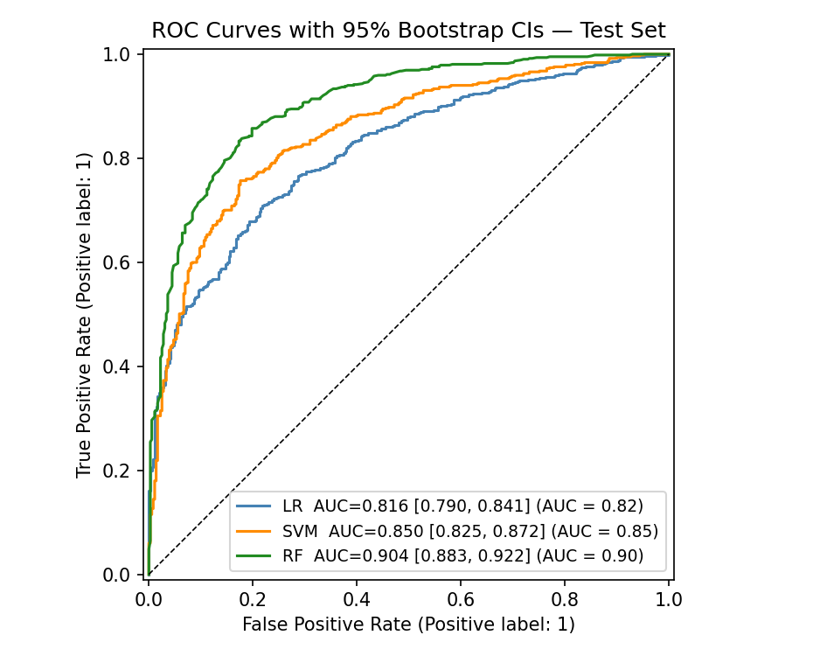
Test Set Results — ROC + 95% Bootstrap CIs
TEST METRICS (RF ★)
Accuracy
0.829
Macro F1
0.811
ROC-AUC
0.904
95% CI
[0.883, 0.922]
PR-AUC
0.938
Brier (↓)
0.124
All three AUC CIs are non-overlapping → ranking is statistically robust on this test set
Notes:
These are the final test set ROC curves with their 95 percent bootstrap confidence intervals. The Random Forest curve dominates throughout the operating range. Random Forest achieves test ROC-AUC of 0.904 with confidence interval 0.883 to 0.922, PR-AUC of 0.938, and the lowest Brier score at 0.124. Critically, none of the AUC confidence intervals overlap between any two models, so the ranking is statistically robust.

Slide 11
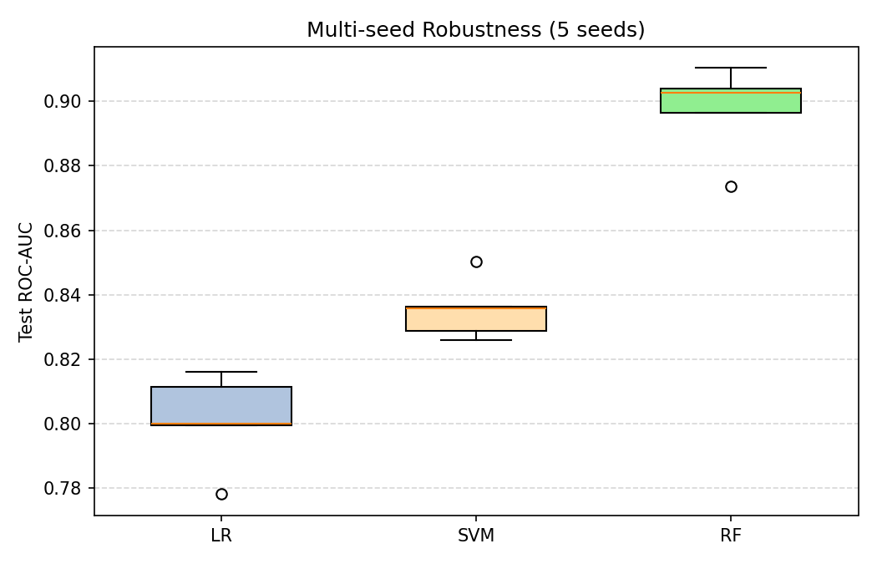
Statistical Significance & Multi-seed Robustness
MCNEMAR'S TEST
MULTI-SEED BOXPLOT (5 SEEDS)
Comparison | χ² | p-value
LR vs SVM | 11.84 | 5.8 × 10⁻⁴
LR vs RF | 41.54 | 1.2 × 10⁻¹⁰
SVM vs RF | 19.38 | 1.1 × 10⁻⁵
All p-values < 0.001
Pairwise differences are highly significant
Boxes are disjoint → ranking is robust across splits
Notes:
Two independent statistical analyses confirm the ranking is real. On the left, McNemar's test on test-set predictions gives p-values below 0.001 for all three pairwise comparisons. On the right, the multi-seed boxplot shows test ROC-AUC across 5 different stratified splits — and the boxes are clearly disjoint between every pair of models. The ranking is not seed-dependent.

Slide 12
Per-Class — Operational Cost Trade-off
Model | Low Prec. | Low Recall | Low F1 | High F1
Logistic Reg. | 0.614 | 0.743 | 0.673 | 0.777
SVM (RBF) ★ | 0.663 | 0.796 | 0.723 | 0.812
Random Forest ★ | 0.801 | 0.710 | 0.753 | 0.869
WHEN TO PICK SVM
WHEN TO PICK RANDOM FOREST
Highest low-quality recall (0.796)
Misses only 20% of defective bottles
Best when: FN cost (shipping defective wine) >> FP cost
Highest low-quality precision (0.801)
80% of low-quality alarms are real
Best when: FP cost (re-testing good wine) >> FN cost
Notes:
This is one of the most interesting findings of the project. SVM with balanced class weights achieves the highest minority-class recall — it catches the most defective bottles. Random Forest achieves the highest minority-class precision — its alarms are most reliable. The right model depends on the cost ratio between shipping a defective bottle and re-testing a good one. This is a much richer story than just picking the model with the highest AUC.

Slide 13
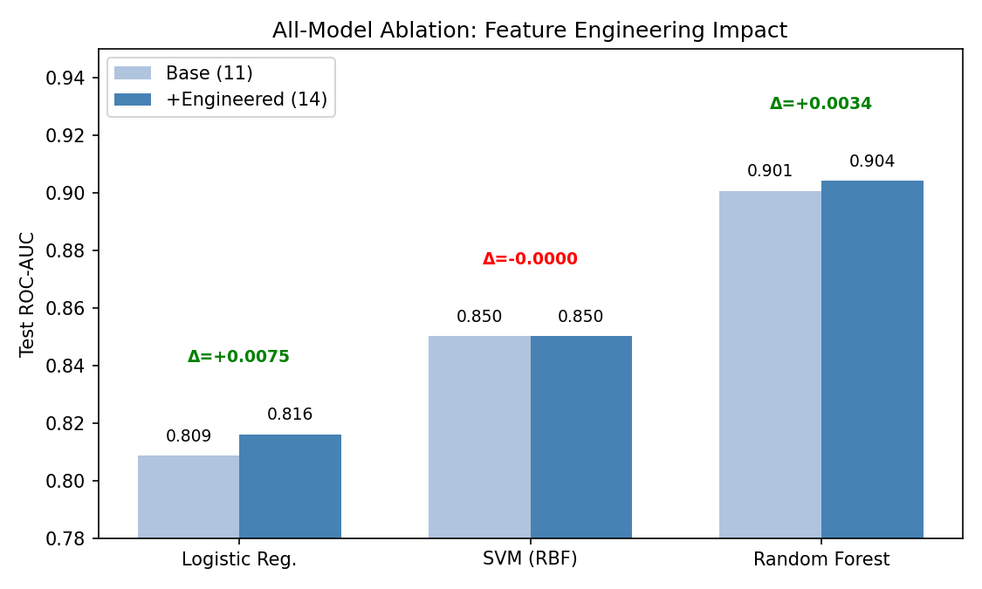
All-Model Ablation — Who Benefits from Engineering?
PATTERN
LR
ΔAUC = +0.0075
largest gain
SVM
ΔAUC ≈ 0
RBF absorbs info
RF
ΔAUC = +0.0034
trees rediscover
KEY INSIGHT: benefit of feature engineering scales inversely with model capacity — exactly the predicted hierarchy
Notes:
This is the single most important methodological insight of the project. The ablation bar chart shows test ROC-AUC for each model trained on the 11 base features alone versus all 14 features. Logistic Regression gets the largest benefit — delta-AUC of plus 0.008 — because the linear boundary cannot discover the ratio relationships on its own. SVM gets essentially zero because the RBF kernel implicitly captures the same information. Random Forest gets a small boost because deep trees can already rediscover most ratio relationships from raw inputs. The pattern is exactly the predicted hierarchy: feature engineering matters more for lower-capacity models.

Slide 14
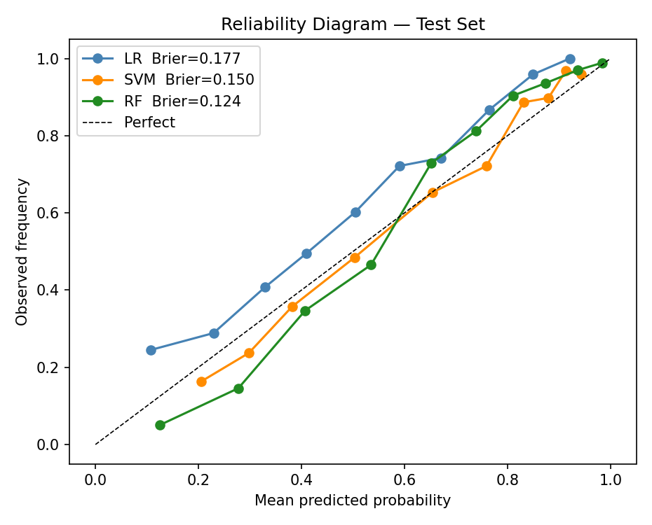
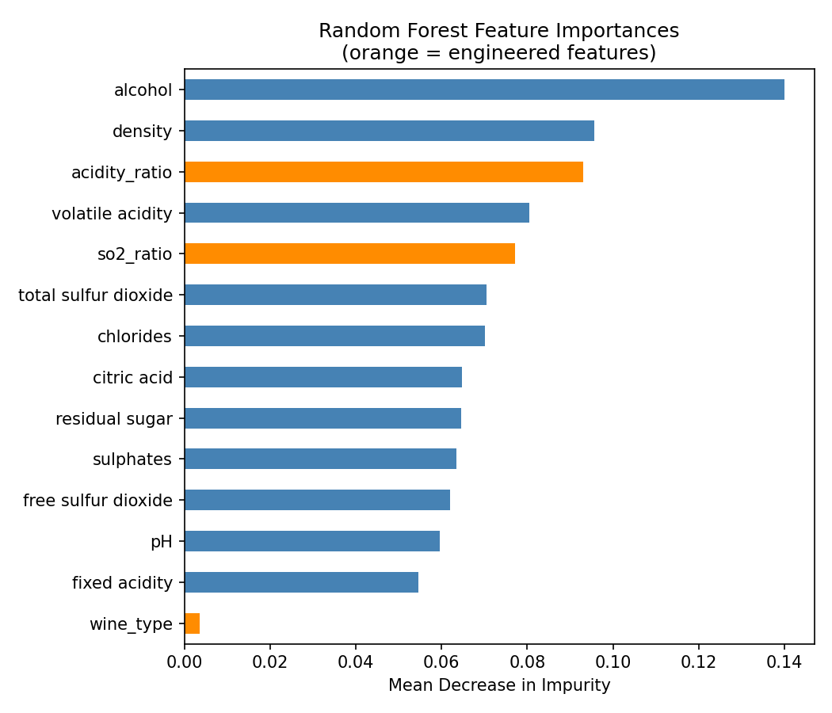
Calibration & Feature Importance
RELIABILITY DIAGRAM (BRIER ↓)
RF FEATURE IMPORTANCE
RF has lowest Brier (0.124) — best calibrated | Alcohol dominates importance (matches EDA r = +0.44)
Notes:
Two important secondary results, both shown as actual figures from the pipeline. On the left, the reliability diagram. The diagonal represents perfect calibration. Random Forest tracks the diagonal most closely — Brier 0.124. Logistic Regression systematically over-predicts in the low-probability bins because balanced class weighting pushes probabilities toward 0.5. On the right, Random Forest feature importances. Alcohol dominates as predicted by the EDA correlation of plus 0.44. The engineered acidity_ratio and so2_ratio features rank in the top-5, confirming their domain-motivated construction was useful.

Slide 15
Discussion & Conclusion
Random Forest wins on overall AUC (0.904), F1, and calibration (Brier 0.124)
SVM with balanced class weights wins on low-quality recall (0.796) — best for production quality gates
All three pairwise differences are statistically significant (McNemar p < 0.001)
Ranking is robust across 5 random seeds (non-overlapping ±2σ intervals)
Engineered features benefit linear models most (LR ΔAUC = +0.008, RF ΔAUC = +0.003)
Density confirmed redundant via VIF + ablation — could be dropped in deployment
Limitations: binarization loses ordinal info; no producer/vintage covariates
Future: MLP, SHAP attribution, ordinal regression, cost-sensitive learning with elicited FN/FP costs
Thank you! Questions welcome.
Mengjia Shang · 7338151449 · EE559 Spring 2026 · Prof. Anand A. Joshi
Notes:
To summarize: Random Forest wins on overall metrics including AUC, F1, and calibration. But SVM with balanced class weights actually wins on minority-class recall — the most operationally important metric for a production quality gate. All pairwise differences are statistically significant under McNemar's test, and the ranking is robust across five random seeds. The all-model ablation confirms engineered features help linear models most. Density is confirmed redundant by both VIF and ablation. Thank you, I'm happy to take questions.

