Slide 1
Constant voltage control is an important charging mechanism This is a required feature to extend the lifetime of the battery and preventing overcharging and even explosions or fire hazards (especially mandatory for Li-ion).
We took the approach of calculating error value of the required voltage and then applying it to an integrating circuit (Possibly entire PID system) and feed that to PWM generating circuit to adjust the supply voltage.

Slide 2
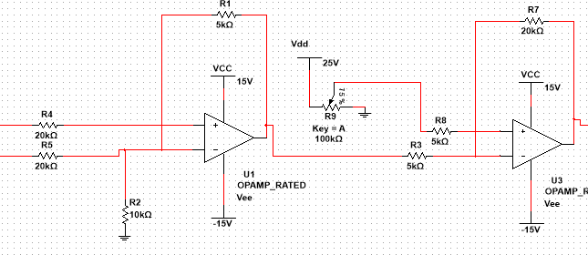

Battery voltage is read through differential amplifier $Vout=\frac{R1}{R4}\left(V_{4}−V_{5}\right)$=>$Vout=\frac{1}{4}(V_{4}−V_{5})$ Then output is compared with the 6.25V

Slide 3

Here $Vout2=\frac{R7}{R8}\left(V_{o1}−6.25\right)$ => $Vout2=4\left(V_{o1}−6.25\right)$
If Vout2 is positive, then the supply voltage must be reduced. Or if its negative supply voltage must be increased.

Slide 4
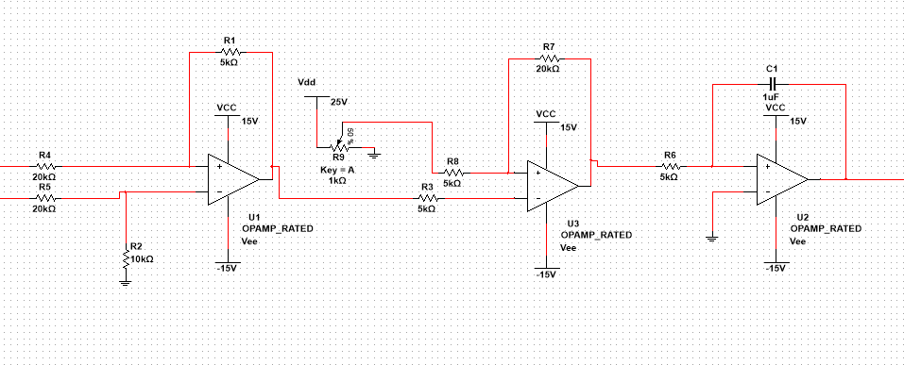

Next slide
But the current voltage must be updated with the change in supply voltage (PWM generating circuit won't recognize the current voltage). This can be implemented with integrating circuit.
$Vout3=\frac{−1}{R6∗C1}\int_{0}^{t}{V_{02} d}$t ;accumulation of error values

Slide 5
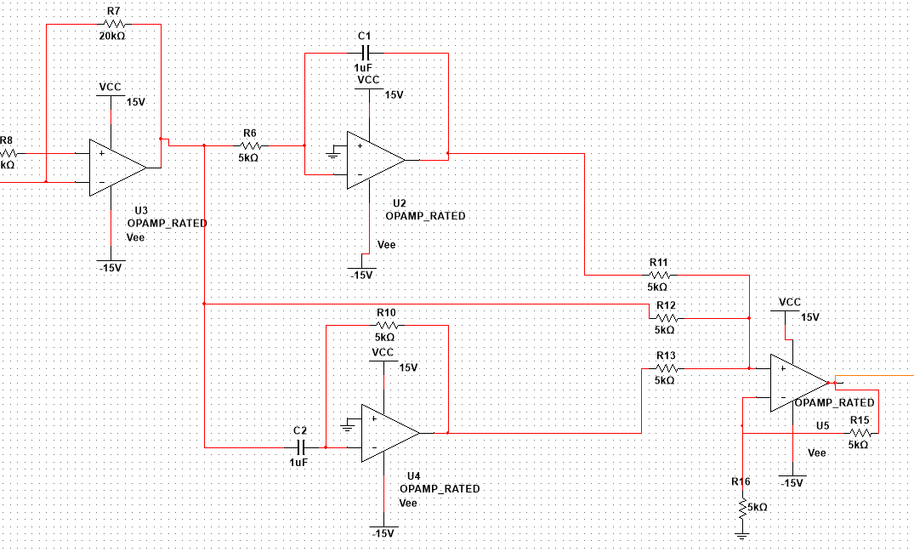
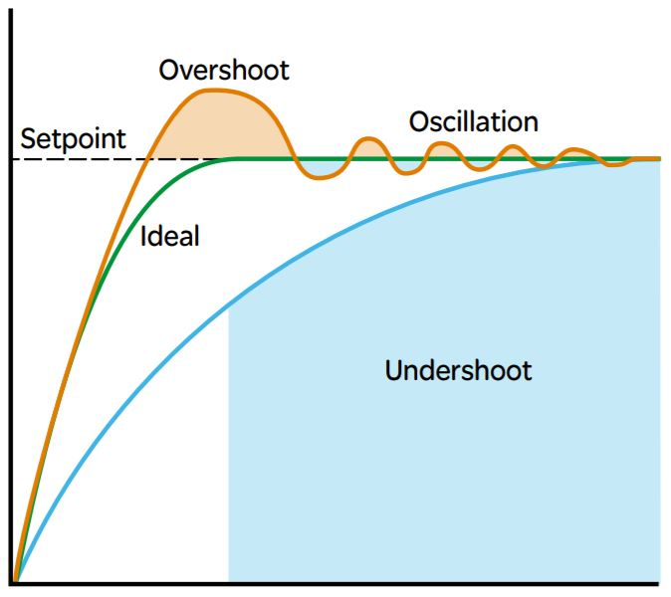
We are Considering to use a PID system instead of just integrator, so that we we could reduce the oscillation ,overshooting and achieve result faster.
By using voltage dividers through surge resistors, we can use the basic opamp TL084 due to its low noise, voltage drift and high +-20V supply voltages

