Slide 1



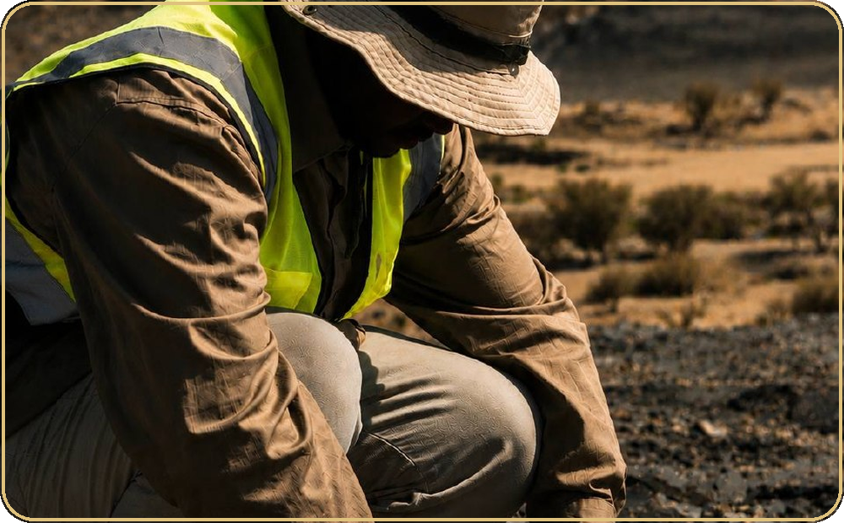
GMCO • SUMMER TRAINING PROGRAM
Summer Training
Program
Mohammed Khubrani & Mohammed Baaqil
King Abdulaziz University • College of Mining
Mineral Resources and Rocks
A hands-on geological exploration program focused on field mapping, core logging, and trenching — supported by ArcGIS Pro and Fusion.
GMCO • SUMMER TRAINING 2026
01

Slide 2
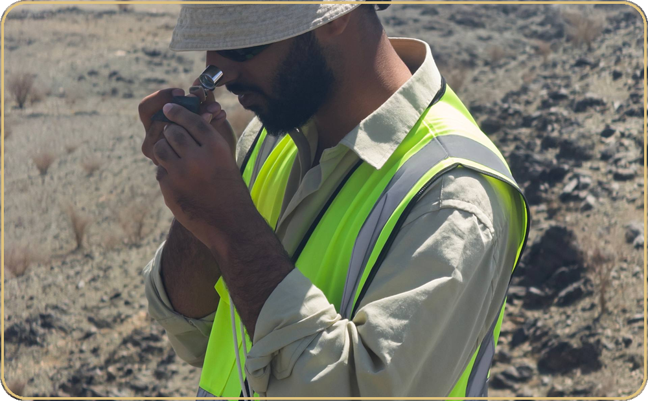
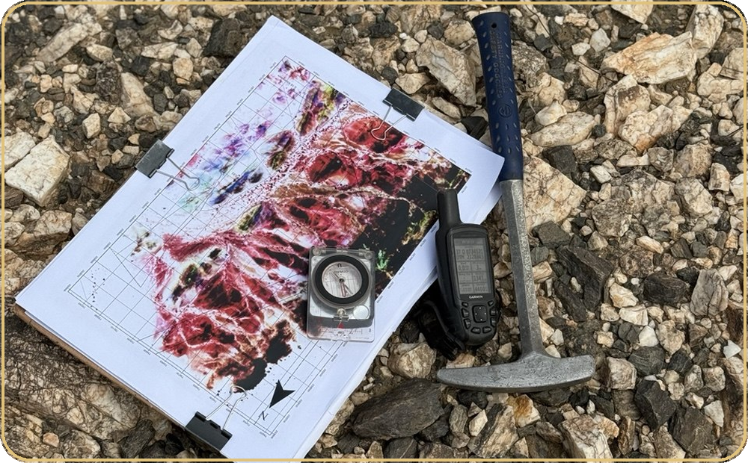
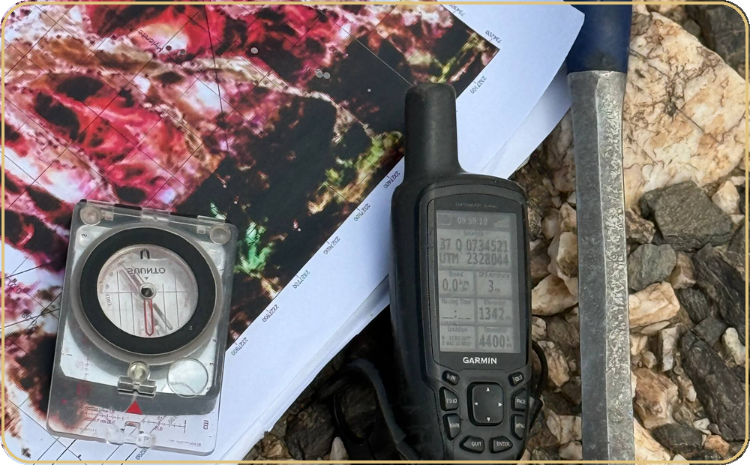
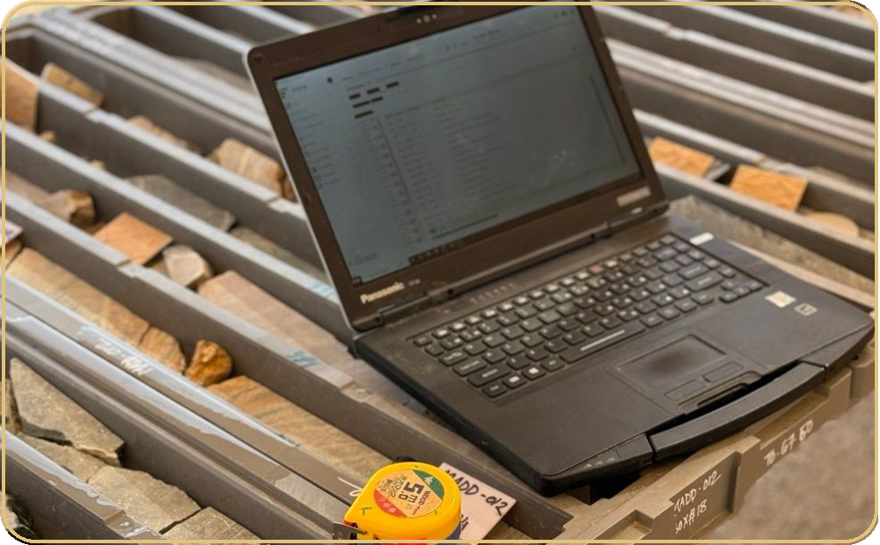
Training Projects & Team
Working alongside GMCO geologists and technical staff, the training followed a structured workflow from field data collection to digital interpretation.
01
02
03
04
Field Team
Data Collection
Mapping & Logging
Digital Processing
Work with geologists
and technical staff
Record observations,
measurements & notes
Map sites, log cores,
and trench
Use ArcGIS Pro & Fusion
for interpretation
Each stage built on the last — from initial field observations through to processed digital deliverables.
GMCO • SUMMER TRAINING 2026
02

Slide 3
Geological Setting & Mineralization Styles
Overview of the project area, geological setting, and associated mineralization styles.
Geological framework
Orogenic Gold
Structurally controlled gold mineralization associated with deformation zones, faults, and shear structures.
1 Project location
2 Major lithological units
3 Structures
VMS
Volcanic-hosted hydrothermal mineralization characterized by sulfide-rich zones and associated alteration.
Lithology Structure Alteration Mineralization
GMCO • SUMMER TRAINING 2026
03

Slide 4
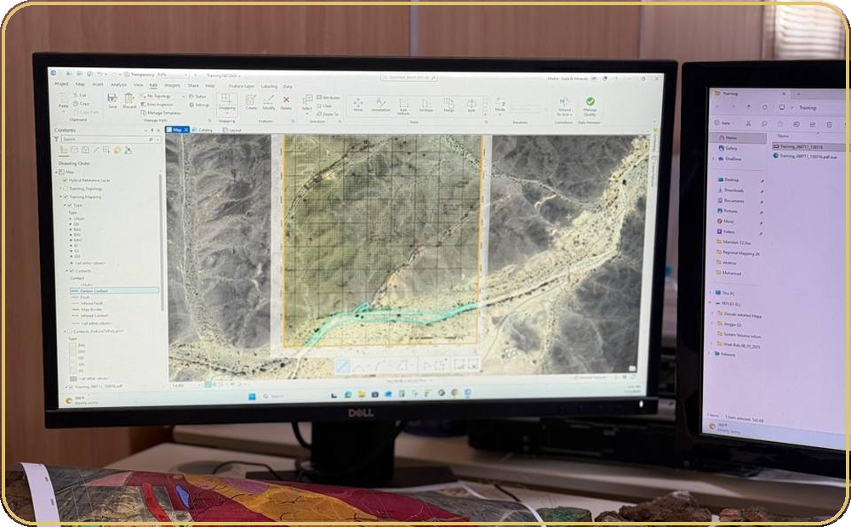
Geological Mapping
Field mapping developed core skills in lithology identification, structural observation, and geological interpretation — all digitized using ArcGIS Pro.
Field Observation
Lithology, contacts, and structural features
Data Collection
GPS coordinates and field documentation
Interpretation
Geological analysis and unit boundaries
ArcGIS Pro
Digitizing and compiling the geological map
GMCO • SUMMER TRAINING 2026
04

Slide 5
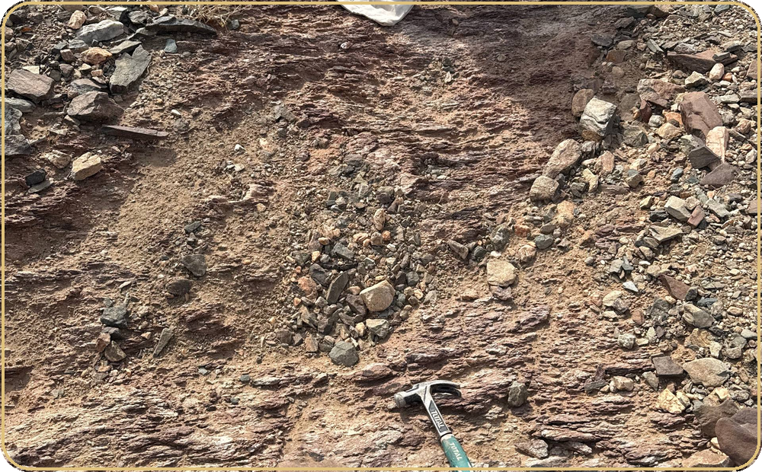
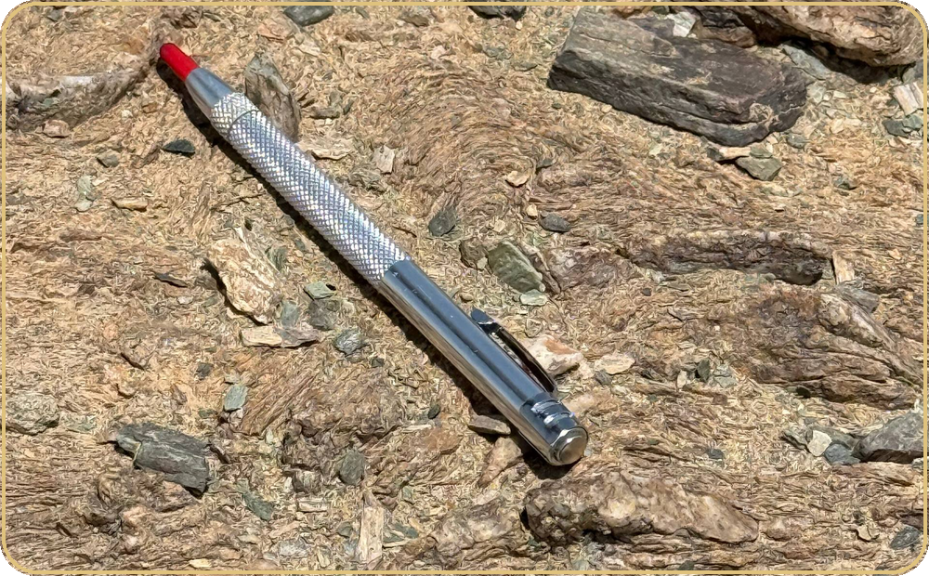
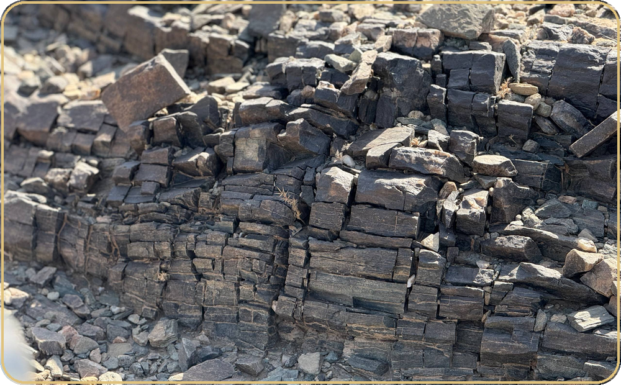
Geological Mapping | Field Work
Field tools and activities used to observe, measure, document, and interpret geology in the field.
Field tools
Compass • hand lens • sampling
Field activities
Structural measurements • rock observations
Documentation
Samples • notes • mapped observations
GMCO • SUMMER TRAINING 2026
05

Slide 6
Core Logging
Hands-on experience inspecting and logging drill cores — documenting lithology, texture, alteration, mineralization, veins, fractures, and core recovery using Fusion for digital data management.
Core Inspection
Alteration & Mineralization
Lithology, texture, and rock description
Quartz veins, fractures, and structural features
Geotechnical
Fusion Platform
PHYSICAL CORE → LOGGING → DIGITAL DATA
Core recovery, RQD, fractures, and rock mass condition
Digital logging and data integration workflow
Systematic observation and consistent documentation connect the physical core to an organized digital record.
GMCO • SUMMER TRAINING 2026
06

Slide 7
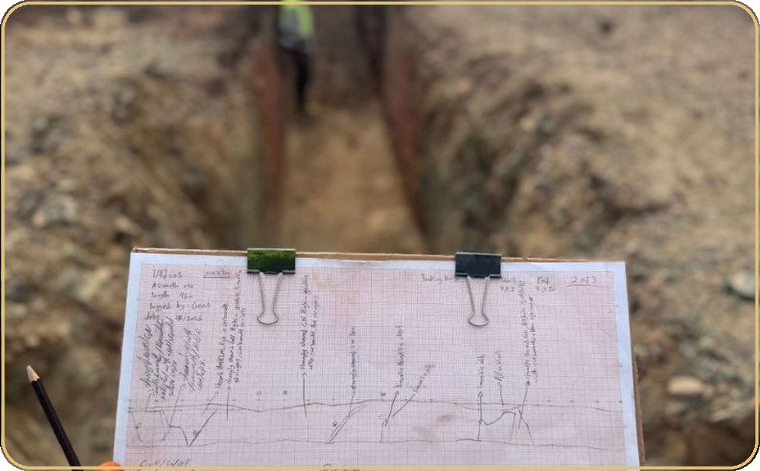
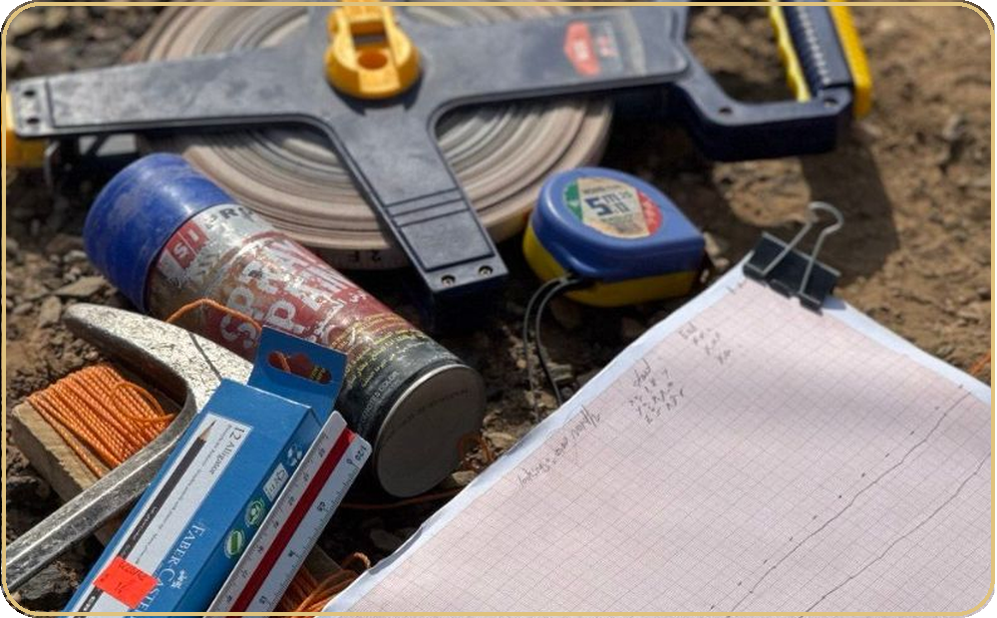
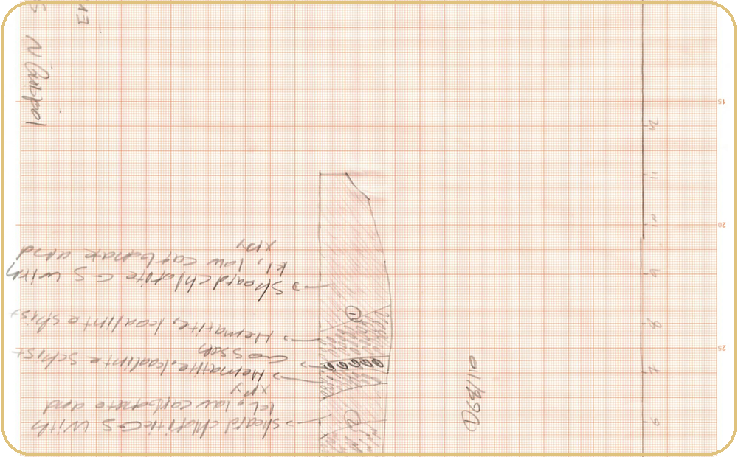
Trenching
Trench mapping provided direct exposure to subsurface geology — identifying lithological units, alteration zones, mineralization, and structural features across exposed sections.
01
02
03
Trench Exposure
Mapping & Documentation
Interpretation
Site inspection and geological observation of exposed sections
Documentation of lithological contacts, alteration zones, mineralization, and structural features
Interpretation of geological relationships and mineralization patterns
GMCO • SUMMER TRAINING 2026
07

Slide 8
Trenching | Documentation
From exposed geology to systematic field documentation and interpretation.
Mapping & Documentation
Document lithological contacts, alteration zones, mineralization observations, and structural features along exposed sections.
Interpretation
Use field observations to build a clearer understanding of geological relationships and the patterns visible across the trench.
01 OBSERVE 02 DOCUMENT 03 INTERPRET
GMCO • SUMMER TRAINING 2026
08

Slide 9
Field Environment & Camp Life
"Adapting to a new place and experiencing a different side of field life."
Getting used to the Environment
Camp Life
Personnel & Team Structure
Adapting to the desert, the camp, the weather, and the daily field routine.
A comfortable and well-equipped camp with the essential facilities, great food, and a pleasant environment.
Building professional relationships, collaborating effectively, and sharing knowledge and experience.
We genuinely enjoyed the place, the people, the work, and even the simple moments in between.
GMCO • SUMMER TRAINING 2026
09

Slide 10
Conclusion
"This training experience allowed me to connect academic geological knowledge with real-world exploration practices."
Field Skills
Digital Tools
Mapping, core logging, and trenching
ArcGIS Pro and Fusion proficiency
Interpretation
Teamwork
Geological observation and analysis
Professional collaboration and communication
Special thanks to GMCO and all supervisors, geologists, and team members for their guidance and support throughout this program.
GMCO • SUMMER TRAINING 2026
10

Slide 11
Thank You
THANK YOU
Thank you to GMCO, our supervisors, geologists, and the entire training team.
Mohammed Khubrani & Mohammed Baaqil
King Abdulaziz University • College of Mining
SCAN FOR MORE
[ QR CODE / LINK ]
From academic knowledge to practical geological experience.
GMCO • SUMMER TRAINING 2026
11

