Slide 1
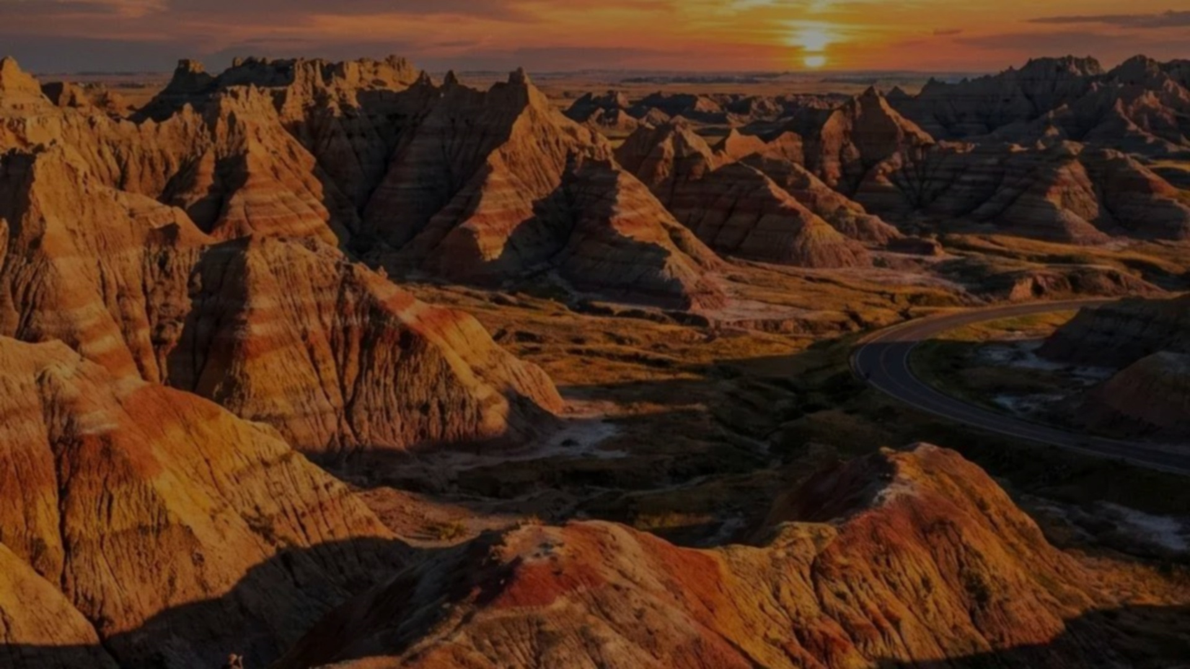
GMCO · SUMMER TRAINING PROGRAM
Summer Training Program
Mohammed Khubrani & Mohammed Baaqil · King Abdulaziz University · College of Mining · Mineral Resources and Rocks
A hands-on geological exploration program at GMCO, focused on field mapping, core logging, and trenching — supported by ArcGIS Pro and Fusion for digital geological workflows.

Slide 2

Training Projects & Team
Working alongside GMCO geologists and technical staff, the program followed a structured workflow from field data collection through to digital interpretation.
Field Team
Mapping & Logging
Work with geologists and technicians
Map sites, log cores, and trench
Data Collection
Digital Processing
Record field observations and notes
Interpret data in ArcGIS Pro and Fusion
Each stage built on the last — from initial field observations through to processed digital deliverables.
Field Collaboration
Data Collection
Digital Workflows
Worked alongside experienced geologists on active exploration projects
Systematic field observations, measurements, and documentation
ArcGIS Pro and Fusion for geological data processing and interpretation
Notes:
Decorative background treatment: add subtle verdigris-inspired geometric accents such as thin arcs, faint circles, and light diagonal lines behind the content. Keep the elements low-contrast and non-intrusive so the diagram and text remain clearly readable.

Slide 3




Geological Mapping
Field mapping developed core skills in lithology identification, structural observation, and geological interpretation — all digitized using ArcGIS Pro.
Field Observation
Lithology, contacts, and structural features
Data Collection
GPS coordinates and field documentation
Interpretation
Geological analysis and unit boundaries
ArcGIS Pro
Digitizing and compiling the geological map

Slide 4
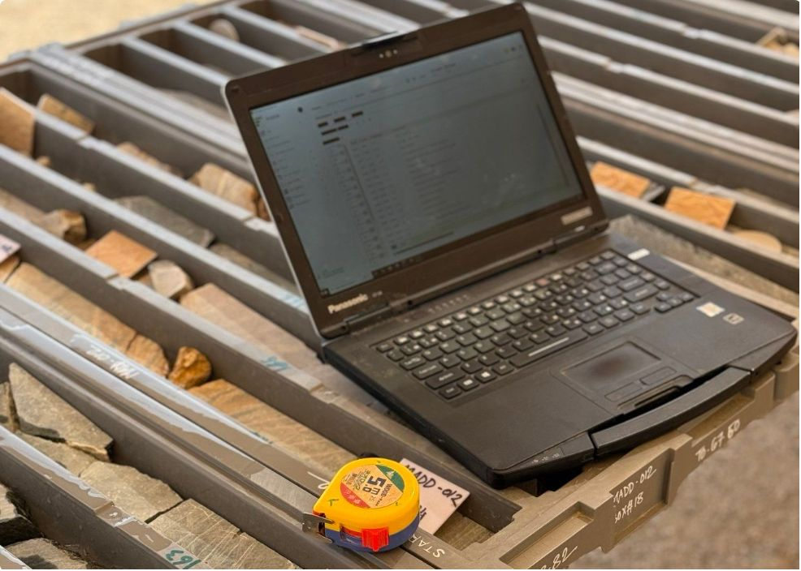

Core Logging
Hands-on experience inspecting and logging drill cores — documenting lithology, texture, alteration, mineralization, quartz veins, fractures, and core recovery using Fusion for digital data management.
Core Inspection
Alteration & Mineralization
Core Recovery
Fusion Platform
Recovery observations and geological documentation
Lithology, texture, and rock description
Quartz veins, fractures, and structural features
Digital logging and data integration workflow

Slide 5
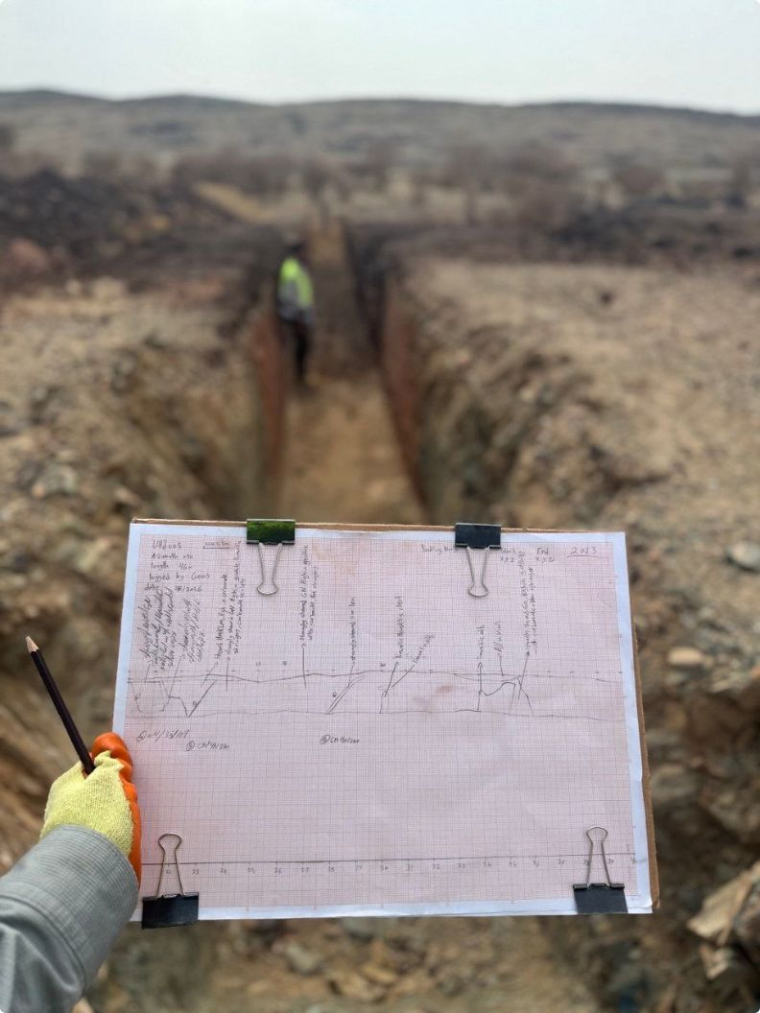
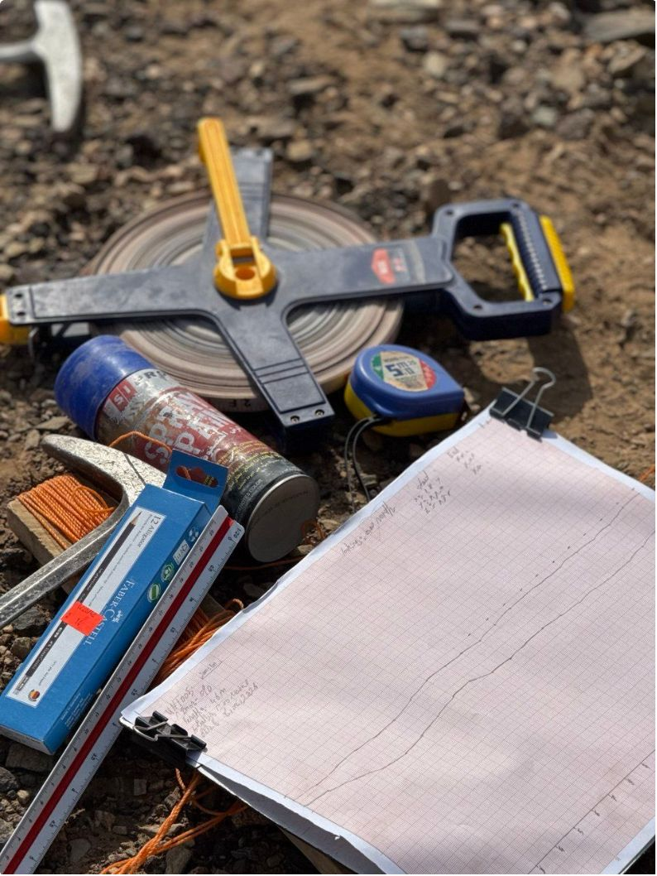
Trenching
Trench mapping provided direct exposure to subsurface geology — identifying lithological units, alteration zones, mineralization, and structural features across exposed sections.
01
02
03
Trench Exposure
Mapping & Documentation
Interpretation
Site inspection and geological observation
Lithological contacts, alteration zones, and structural features
Analysis of exposed geology and mineralization patterns

Slide 6
Conclusion & Thank You
"This training experience allowed me to connect academic geological knowledge with real-world exploration practices."
Field Skills
Digital Tools
Mapping, core logging, and trenching
ArcGIS Pro and Fusion proficiency
Interpretation
Teamwork
Geological observation and analysis
Professional collaboration and communication
Special thanks to GMCO and all supervisors, geologists, and team members for their guidance and support throughout this program.
MOHAMMED KHUBRANI · KING ABDULAZIZ UNIVERSITY

