Slide 1
Photosuperhero
Multimedia communication
Name: mokhlaroyim Tuychiboeva
ID: u1610148
Group: 16-3

Slide 2
“Marvel comics”
Motivation
Many people find app as a source of entertainment
Among app users, there are some fans of Marvel Comics, who would like to see themselves in the image of superhero
There is no exact app to fit people’s face in the superhero costumes in few clicks
To realize the wishes of thousands of fans, the idea of "PhotoSuperhero” has arrived

Slide 3
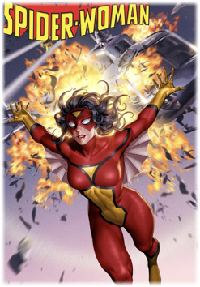
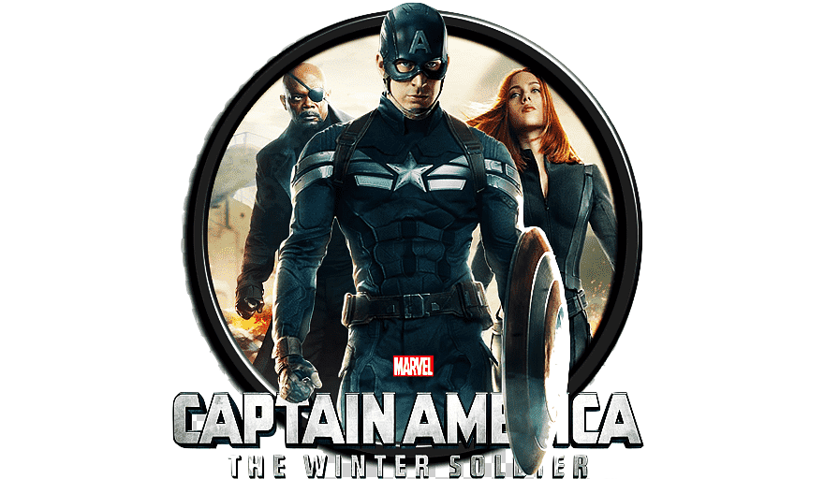
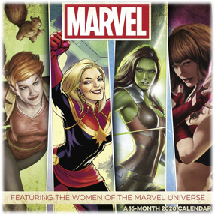
Be superhero
Design idea
Make program easy to use
Use simple UI and UX
Less human interaction
Make one snapshot, which ->
Turns your face into Superhero’s face

Slide 4
Flow Chart
Run app
Choose image
No
1
Yes
2
Close app
No
Turn on camera
3
4
Yes
Yes
Press “Space”
press
“esc”
GET OUTPUT
Yes
Yes
3

Slide 5
Problems I face
Detecting faces of main characters in cartoonish images in my case was difficult
Even if faces were recognized, they really did not fit correctly to the right position
Therefore, more photorealistic pictures (.png format) are used as a background image
Chasing the contour of face in order to fit the exact fitness

Slide 6
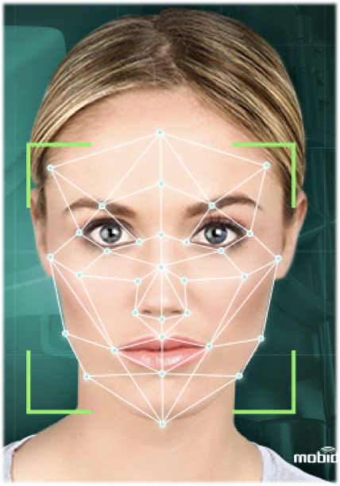
Advantages
Entertains users
It will be free of access
Easy to make photo and to get desired output
Work with face recognition

Slide 7
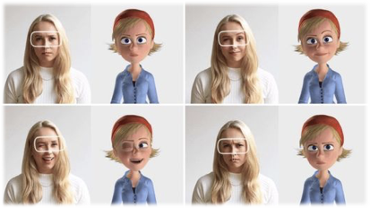
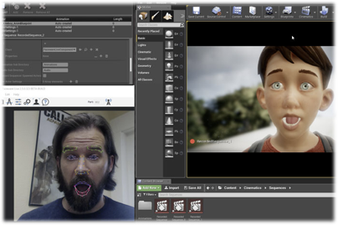
disadvantages
No animation (static images)
No Real Time Visualization
Not ideal face cut (contour detection)

Slide 8
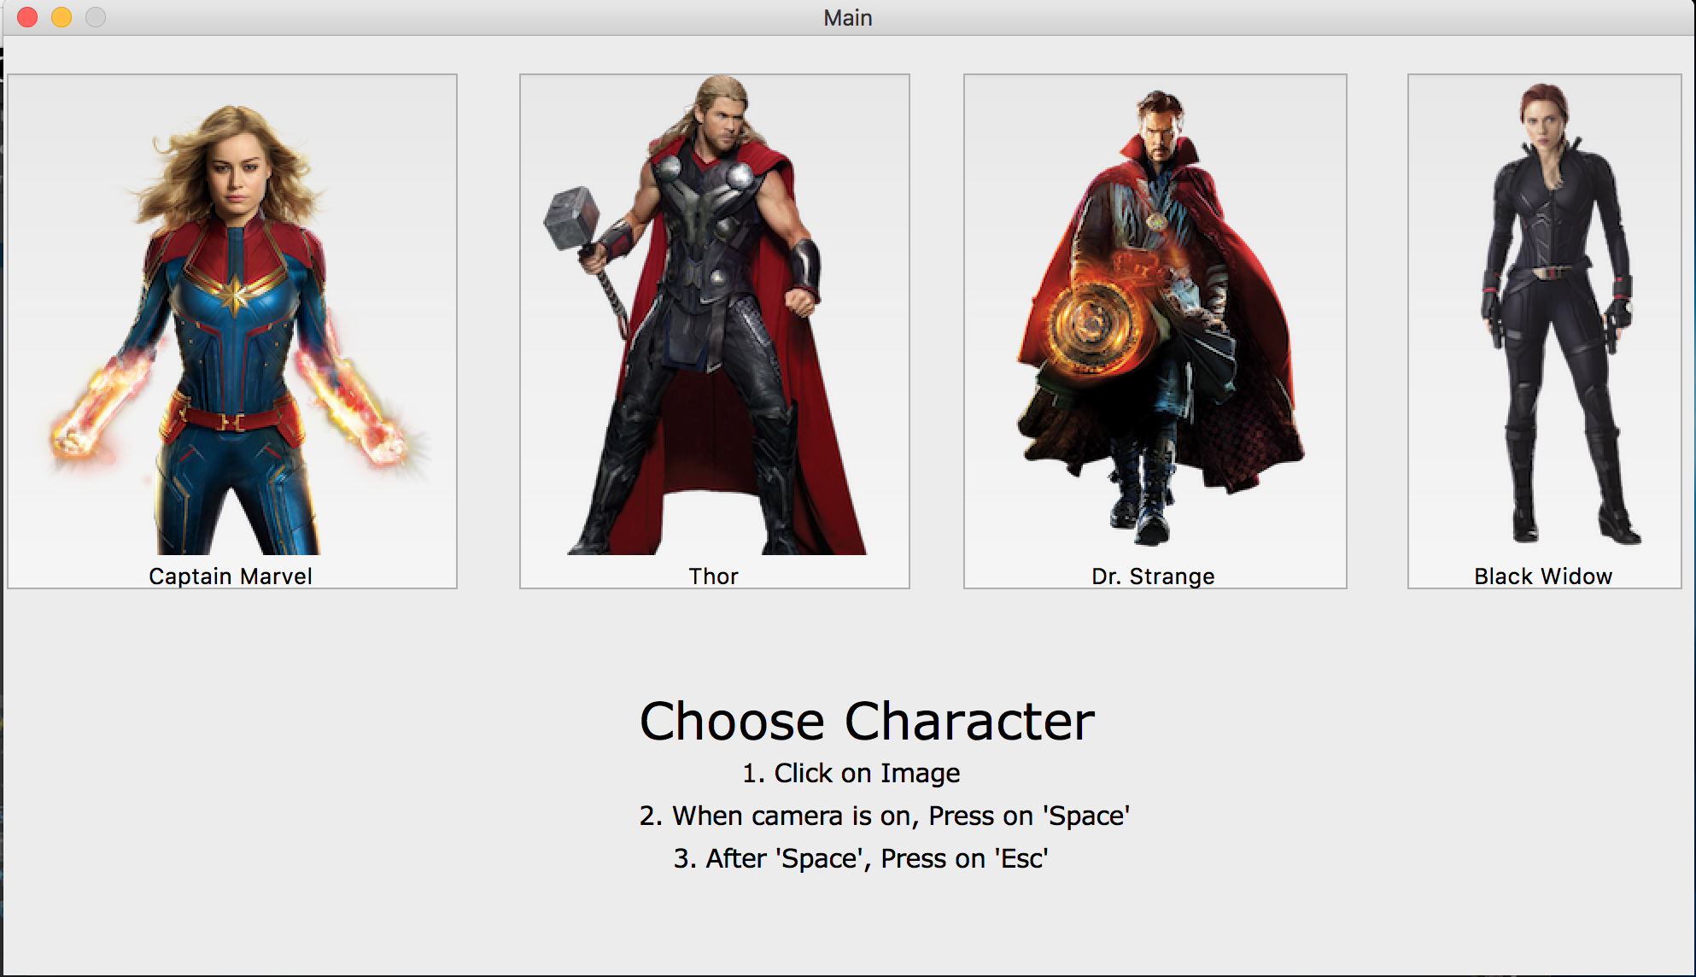
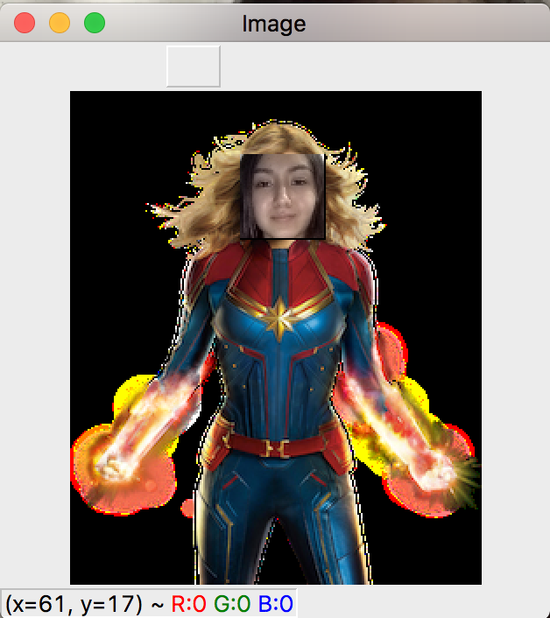
Current realization
Output result

Slide 9
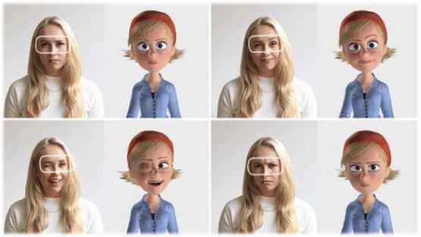
Future improvements
Add features such as Real Time Image Processing
Apply Artificial Intelligence for better implementation of program
Fix all disadvantages
Add variety of choices
with background for
user preference

Slide 10
Goal
never stop working on your dreams
Mokhlaroyim Tuychiboeva

