Slide 1
SUPMTI Rabat AI Capstone 2025-2026 Topic 15
Built with
Network Traffic
Python 3.12
Streamlit
scikit-learn
Anomaly Detection
Plotly
SQLite
Unsupervised K-Means Clustering NSL-KDD Dataset
pytest
AUTHOR
SUPERVISOR
YEAR
Said Louham
Pr. Soufiane HAMIDA
2025 / 2026
125,973
6 steps
44 tests
training records
automated pipeline
all passing

Slide 2
What was built
An end-to-end unsupervised ML pipeline
detecting network intrusions without labeled training data
Deployed as a browser application — anyone can run it in one click.
NSL-KDD Dataset
K-Means Clustering
125,973 training records across 5 attack categories. Zero missing values. Pre-split train/test sets with no data leakage.
Configurable k (2-20). Pre-trained k=5 model loads in one click. Anomaly cluster auto-identified by attack density.
6-Step Automated Pipeline
Production-Quality Code
Upload -> EDA -> Preprocess -> Detect -> Evaluate -> Export. Every step is interactive, cached, and runs in the browser.
44 automated unit tests across 4 pytest modules. CSV, PDF, and SQLite export. Auto-migration on schema changes.

Slide 3
01
The Challenge
Why automated anomaly detection matters
01
Volume
Networks generate thousands of connections per second. A single 1Gbps link can produce over 60,000 flows per minute — manual inspection is physically impossible.
02
Variety
Attacks differ fundamentally in behavior. DoS floods bandwidth. Probes scan for open ports quietly. R2L and U2R exploit service vulnerabilities through legitimate channels. No single rule catches all four.
03
No Labels
In production, traffic arrives without pre-labeled categories. Supervised classifiers require labeled attack samples at training time — a requirement that cannot always be met in new environments.
Solution — K-Means unsupervised clustering groups traffic by behavior. No labels required at training time. The cluster with the highest attack density is automatically flagged.
1 / 15

Slide 4
02
NSL-KDD Dataset
Improved KDD Cup 1999 — standard academic benchmark for intrusion detection research
125,973
22,544
41
23
Training records
Test records
Features/record
Attack classes
KDDTrain+.txt
KDDTest+.txt
per connection
in training set
Attack Categories
Dataset Properties
DoS
neptune, smurf, back, pod, teardrop
No missing values in either file
Probe
ipsweep, nmap, portsweep, satan
Pre-split train / test — zero data leakage
R2L
warezclient, imap, spy, ftp_write
3 categorical + 38 numeric features
U2R
buffer_overflow, rootkit, perl
Labels removed before training
Normal
approx. 55% of training records
Labels used only after clustering to evaluate quality
2 / 15

Slide 5
03
System Architecture
How the modules connect — from raw file to export
Streamlit Application — src/app/app.py
Interface
6 render functions Session state management Custom CSS Sidebar settings panel
loader.py
eda_analysis.py
preprocessor.py
kmeans_model.py
metrics.py
File loading Schema validation
5 Plotly chart functions
OHE + Scaler 43 -> 122 features
Train, predict Anomaly mask
Silhouette, DB ARI, P, R, F1
Logic
data/raw/
models/
database.py
PDF / CSV
KDDTrain+.txt KDDTest+.txt
kmeans_model.pkl preprocessor.pkl
SQLite history auto-migration
fpdf2 report Download button
Storage
3 / 15

Slide 6
04
6-Step Pipeline
End-to-end workflow — every step is automated and interactive
01
02
03
04
05
06
Upload & Validate
Explore
Preprocess
Detect
Evaluate
Export
CSV, Excel, or NSL-KDD .txt Auto schema check | Row/null/duplicate count
4 Plotly chart tabs: Labels, Categoricals, Numerics, Correlation All charts update when new data is uploaded
OneHotEncoder + StandardScaler via ColumnTransformer 43 raw columns --> 122 processed features
K-Means with configurable k (2-20) via sidebar slider Pre-trained k=5 model loads in one click
Silhouette Score | Davies-Bouldin | ARI | Precision | Recall | F1 PCA 2D scatter + cluster bar chart + error breakdown
Download CSV with cluster + is_anomaly columns Auto-generated PDF report | SQLite history database
>
>
>
>
>
4 / 15

Slide 7
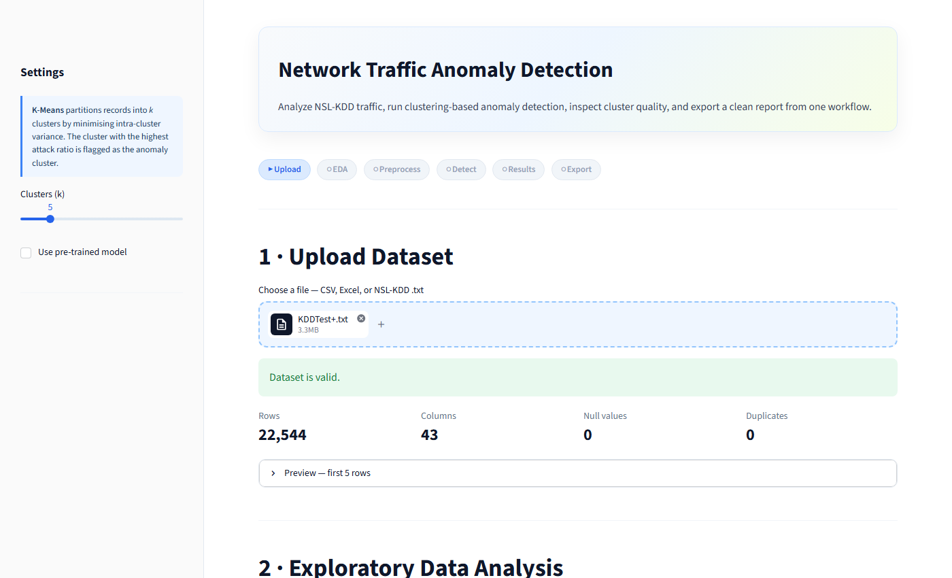
Step 1 — Upload & Validation
Drag-and-drop a file and the app validates schema, counts rows, nulls, and duplicates automatically
6-step progress indicator
File badge with size
Automatic schema validation
22,544 rows loaded
0 null values
43 columns detected
5 / 15

Slide 8
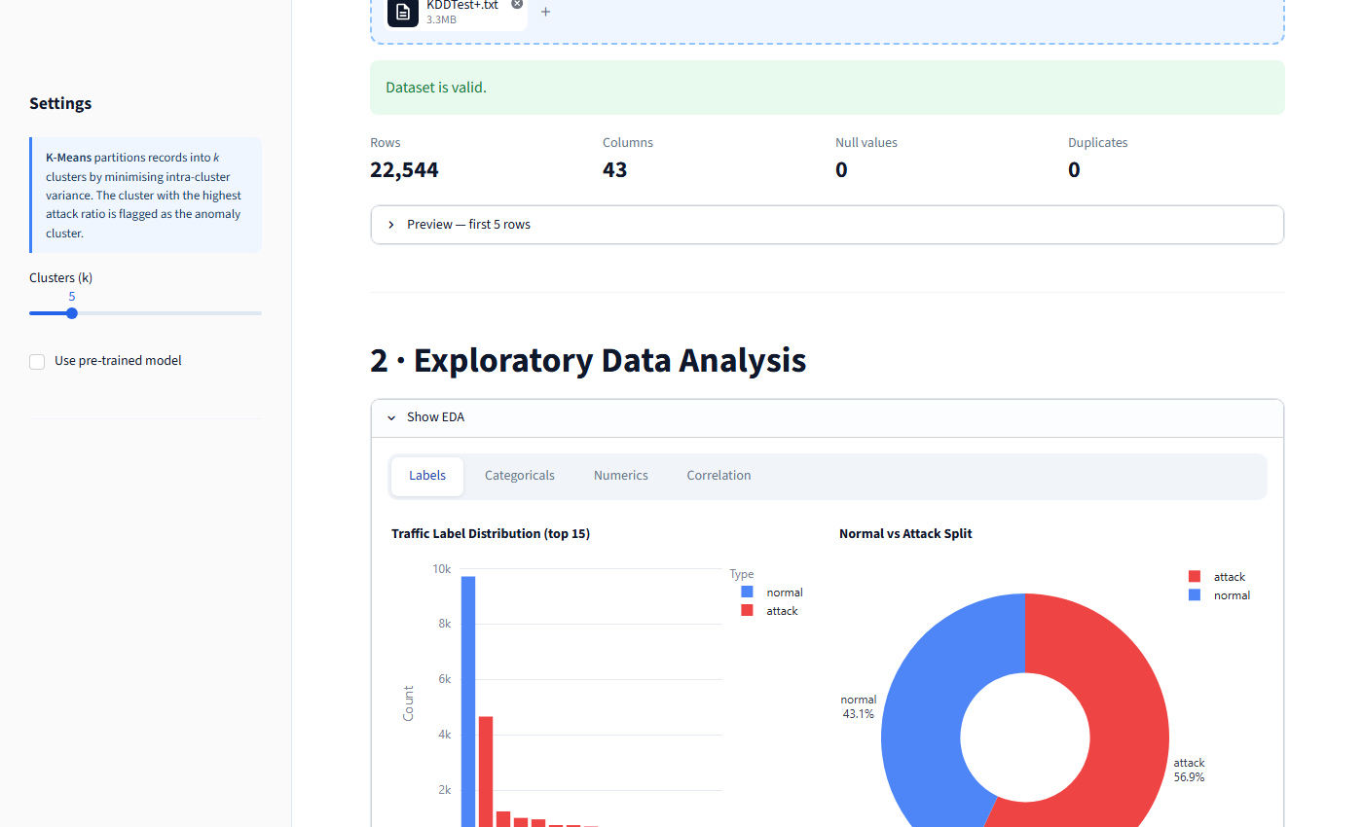
Step 2 — Exploratory Data Analysis
4 interactive Plotly tabs — Labels, Categoricals, Numerics, Correlation — rendered on upload
4 chart tabs
Normal vs Attack donut
Traffic label distribution
56.9% of records are attacks
6 / 15

Slide 9
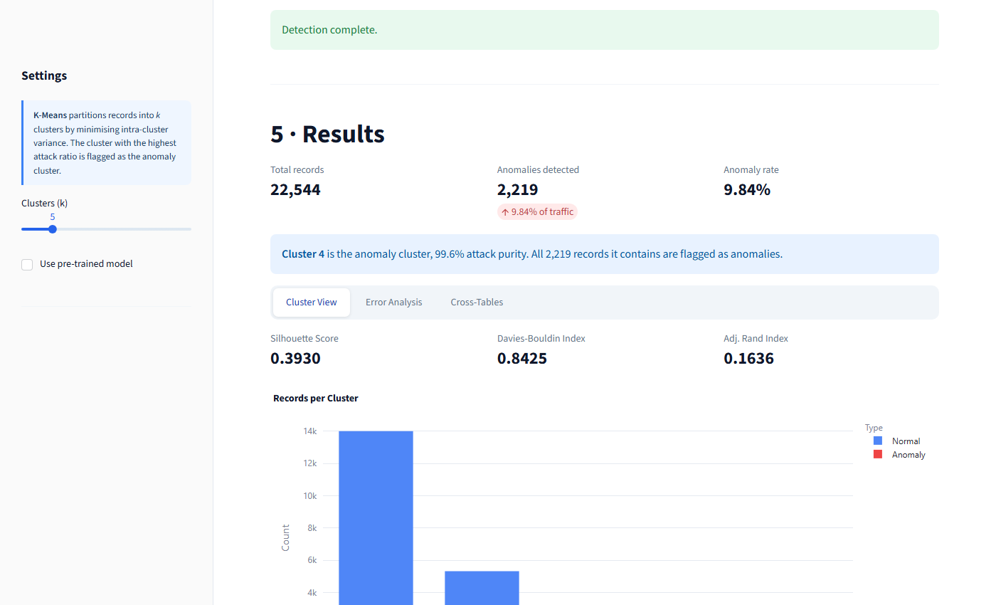
Step 5 — Detection Results
Cluster 4 auto-flagged as anomaly cluster (99.6% attack purity) | Silhouette Score 0.3930 | 2,219 anomalies
2,219 anomalies detected
9.84% anomaly rate
Auto-identified anomaly cluster
Silhouette Score
Davies-Bouldin Index
Records per cluster bar chart
7 / 15

Slide 10
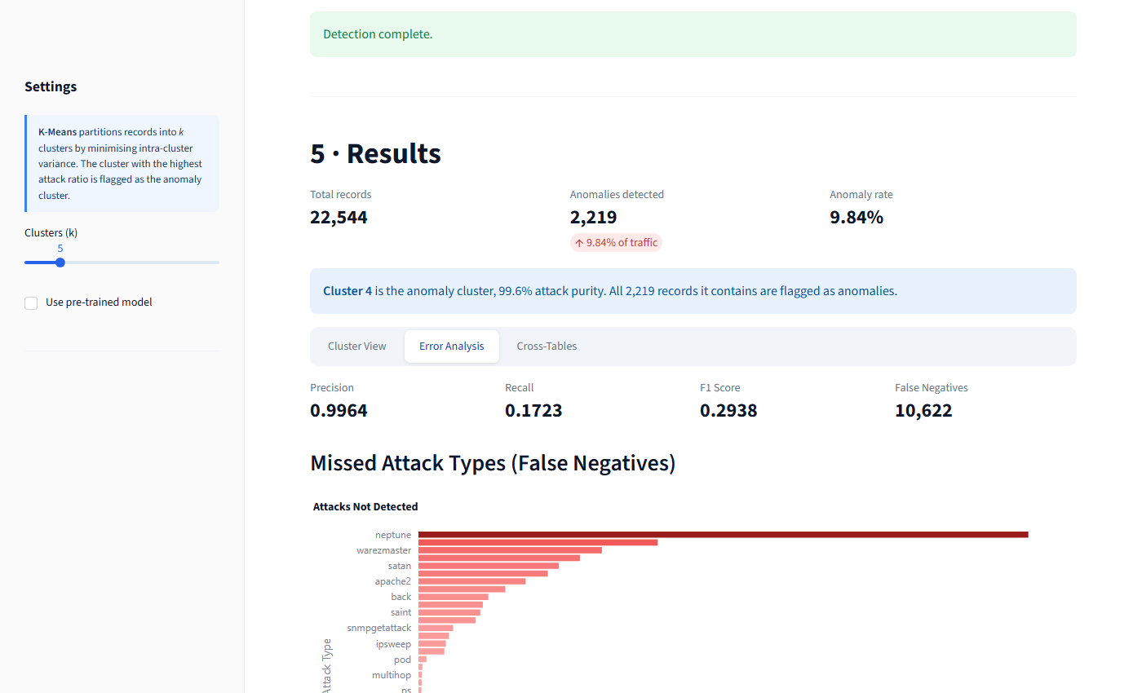
Step 5 — Error Analysis
Precision 0.9964 | Recall 0.1723 | F1 0.2938 | 10,622 false negatives
10,622 false negatives
Precision: 0.9964 - pure cluster
Recall: 0.1723 - mixed attacks missed
neptune = most missed attack
Why is recall low?
K-Means distributes all 5 attack types across 5 clusters. Only ONE cluster is flagged as anomalous. DoS attacks like neptune that end up in 'normal' clusters are not detected — this is the inherent trade-off of single-cluster anomaly flagging.
8 / 15

Slide 11
09
Model Selection
Comparing K-Means at k = 3, 4, 5 — and why K-Means was chosen
Internal clustering metrics (no labels required):
What the metrics measure
k
Silhouette Score (higher = better)
Davies-Bouldin (lower = better)
Silhouette Score
3
0.4203
1.0628
Measures how tightly packed each cluster is compared to its nearest neighbor cluster. A score of 0.44 indicates clearly separated clusters with limited overlap.
4
0.4254
0.9609
Davies-Bouldin Index
* 5
0.4404
0.8884
Average ratio of intra-cluster spread to inter-cluster distance. A score of 0.89 (below 1.0) confirms the five clusters are well separated in the 122-dimensional space.
k = 5 selected — best Silhouette AND lowest Davies-Bouldin simultaneously.
Adjusted Rand Index
Why K-Means?
Compares the discovered clusters against the true binary labels. A perfect match = 1.0. A value of 0.16 reflects the single-cluster limitation — only one of five attack groups is fully isolated.
Simple, fast, and interpretable — well-suited for initial anomaly triage on high-dimensional tabular data.
Why k = 5?
NSL-KDD traffic naturally groups into 5 behaviors: Normal, DoS, Probe, R2L, U2R. Five clusters match this structure without over-fragmenting.
9 / 15

Slide 12
10
Limitations & Future Work
Honest assessment — what works and what to improve next
Current Limitations
Next Steps
Recall = 17%
Auto k selection
Only one cluster is flagged. Attacks distributed across the remaining four clusters are missed. Single-cluster flagging is a known trade-off of this approach.
Implement Elbow method and Silhouette scan directly in the app. The user sees a curve and the optimal k is highlighted.
DBSCAN comparison
k must be set manually
Add a second algorithm tab. DBSCAN requires no k and naturally identifies noise points as anomalies — better recall at cost of interpretability.
The number of clusters is a parameter the user must choose. In production, the optimal k is not known in advance.
Modern datasets
Replace or supplement NSL-KDD with CICIDS 2017/2018, which includes modern web attacks, botnet, and DoS vectors.
NSL-KDD is academic
The dataset was created in 1999. It does not represent modern attack types (ransomware, supply-chain attacks, zero-days).
Real-time input
Stream live PCAP traffic through the preprocessing pipeline using Scapy. Classify each new flow against the trained cluster centroids.
Centroids are random
K-Means results can vary with different random seeds despite n_init=10. Results are reproducible within this codebase but may differ on other hardware.
Improve recall
Flag all clusters with attack ratio > threshold, not just the top one. This trades some precision for significantly higher recall.
10 / 15

Slide 13
11
Export & Analysis History
Three ways to persist and share results
CSV Download
PDF Report (fpdf2)
SQLite History (database.py)
Original dataset rows plus two appended columns:
Auto-generated single-page report containing:
Every saved run is stored in analysis_history.db.
cluster assigned cluster ID (0 to k-1)
File name and algorithm used
Columns: timestamp, filename, algorithm,
is_anomaly True / False flag
Total records and anomaly count
n_records, n_anomalies, anomaly_ratio,
Anomaly rate (%)
silhouette_score, davies_bouldin_score,
Opens in Excel, pandas, R, or any analysis tool.
Silhouette Score and Davies-Bouldin
adjusted_rand_index, params_json
Ready for downstream ML pipelines.
Adjusted Rand Index
Model parameters for full reproducibility
Auto-migration: schema upgrades gracefully
when new columns are added.
11 / 15

Slide 14
12
Testing
44 automated unit tests — pytest across 4 modules, all passing
44
unit tests — all passing
pytest 4 modules covers loader, preprocessor, model, metrics
Run with: python -m pytest
test_loader.py
File loading with CSV / Excel / .txt, column name assignment, schema validation, error handling for invalid files and missing columns.
test_preprocessor.py
Output matrix shape after fit-transform, feature name count, correct label separation, save-to-disk and load-from-disk round-trip for the .pkl file.
test_models.py
K-Means training on synthetic data, predict returns correct length array, anomaly mask shape, pre-trained .pkl model loads and predicts without errors.
test_metrics.py
Silhouette Score, Davies-Bouldin Index, Adjusted Rand Index, Precision, Recall, F1 Score — all computed correctly on known cluster assignments.
12 / 15

Slide 15
14
Conclusion
0.4404
0.8884
44 / 44
Silhouette Score
Davies-Bouldin
Tests Passing
k = 5 — best configuration
Lowest among all tested k
pytest — 4 modules
Delivered
Key Takeaway
Drag-and-drop upload with automatic validation
Unsupervised clustering can separate normal traffic from anomalies without any labeled training data — making it directly deployable in environments where attack samples are unavailable. Precision of 0.9964 confirms the anomaly cluster is extremely pure. Low recall reflects the single-cluster constraint — a known limitation addressed honestly and with concrete improvement paths. The complete pipeline runs in a browser with no setup: upload a file, click two buttons, export the results.
4 interactive EDA chart tabs (Plotly)
Automated preprocessing — zero configuration
K-Means with adjustable k + pre-trained k=5 model
Silhouette, Davies-Bouldin, ARI, Precision, Recall, F1
CSV export, PDF report, SQLite analysis history
44 automated unit tests across 4 pytest modules
15 / 15
Thank you — Questions welcome

