Slide 1
OpenComm: Sound Spatialization
Implementation of Simple Sound Spatialization Algorithm in Android (v1.0) - Jong Hwi Lee
Modified by Risa Naka, September 24, 2010

Slide 2
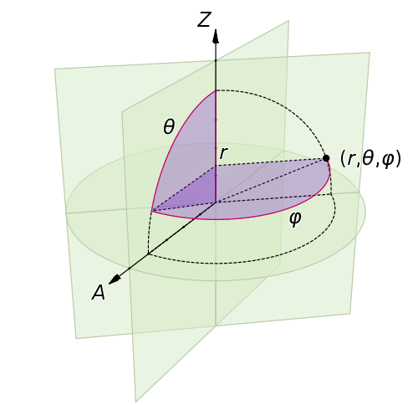
Theory of Spatial Hearing 101
2 different cues
  Direction (spherical coord. system)
    Horizontal
    Vertical
  Distance
Periphonic Sound Spatialization in Multi-User Virtual Environments – Florian Hollerweger

Slide 3
What’s sound spatialization?
Illusion of sound from a 3-D environment
Can be electroacoustically synthesized
  For multi-user virtual environments?
  Yes, but requires higher level of accuracy!

Slide 4
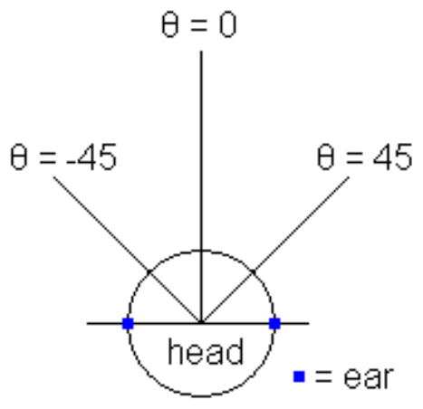
Our Sound Spatialization
2D
  Interaural Time Difference
  Volume Difference
Implementation
  2 Audio objects + mixer
Notes:
Interaural time difference: difference in arrival time of sound between two ears

Slide 5
Progress
Completed
  Concept and algorithm analysis
Things to do
  Implement the algorithm
  Implement/modify audio mixer
  Decode audio stream using codec processor
    Speex
  “Talk” to Positioner
  Stress test
  Demo on phone

Slide 6
Codes, codes, and more codes! ☺
Algorithm Implementation
  AudioPlayer class
    Recordings (Sep.29)
    Microphone (Sep.30)
Mixer Modification
  Mixer code (Oct.8)
Decoding Audio Stream
  Decoder (Oct.15/22)

Slide 7
Next 2 weeks…
Oct.1:
  Demo of sound spatialization algorithm
Oct.8:
  Feasability analysis on Decoder::Speex
  Modification of mixer code

