Slide 1
The sentinel

Slide 2
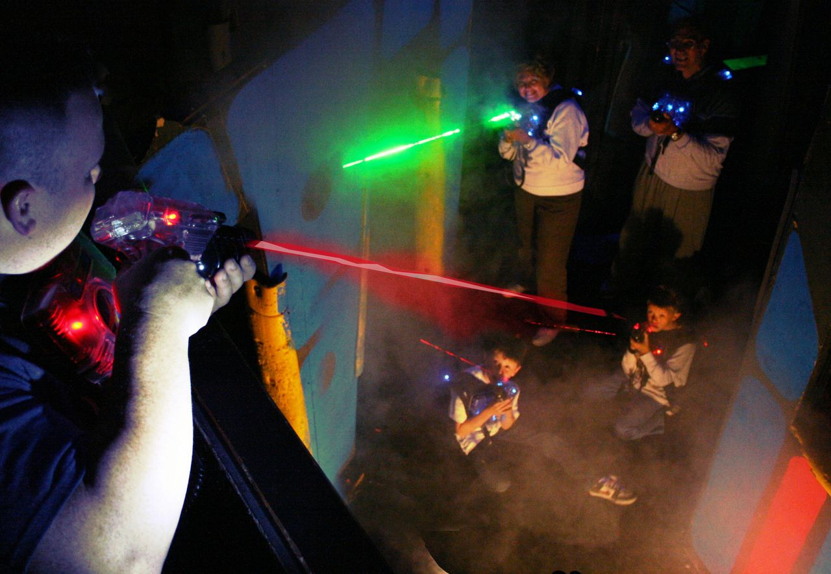
Background 背景
Laser Tag Game 激光枪战

Slide 3
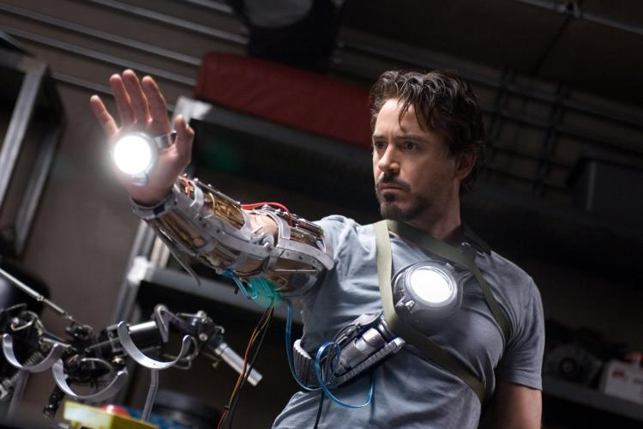
Our idea 想法
Weaponless field games, simulating the casting of spells and magic 没武器的场景游戏，模拟魔法效果
Make fantasy into reality
让虚幻变成现实

Slide 4
Plus points 优点
Lightweight
轻巧装备
different immersive experience
不同的游戏体验
potentially more variety of game interactions
加入不同魔法或武器音效和视觉效果

Slide 5
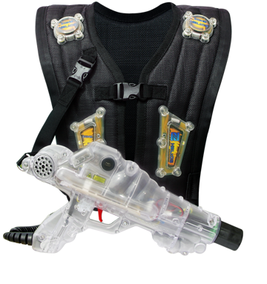
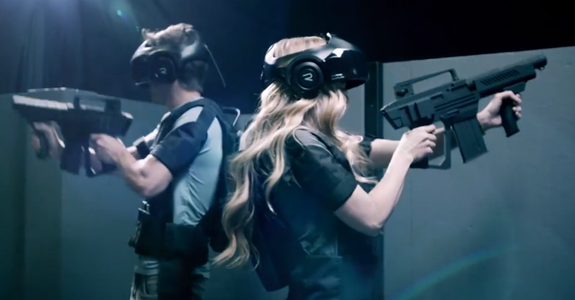
Existing products 现有产品
laser tag, VR laser tag

Slide 6
introduction/design 介绍/设计
Our concept 产品概念
an arm brace with myo band, speaker, led display, laser light, infrared emitter connected
手环(MYO, 扬声器, LED显示屏, 激光发射器, 红外线发射)
a vest with IR receiver, Pi/Arduino (processor)
背心(红外线接收器, 单片机)

Slide 7
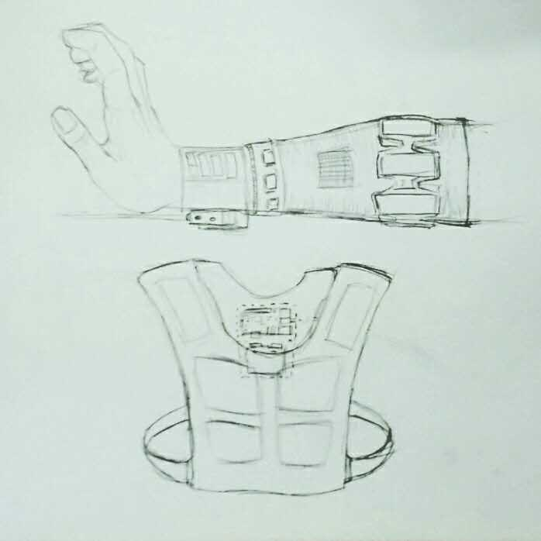
MYO Band
Speaker
LED Screen
Laser Emitter
Processor
IR Emitter
IR Receiver

Slide 8
prototyping/materials 模型/材料
Our First Prototype 第一个模型
what do we envision for our first prototype? 预期第一个模型
able to transmit data from MYO band to processor
让讯息从MYO手环传输到处理器
output laser and IR from processor based on different hand motions
根据手势释放不同的红外线数据和激光效果
receive IR signal on the vest and input into processor ( when person got hit )
接收红外线讯息再传输至处理器
electronic components needed 所需电子零件
IC 集成电路
Resistors 电阻
Capacitors 电容
ECT… 还有…

Slide 9
Testing 测试
Hardware: MYO to Processor, Processor to laser and IR, IR to processor
Software: Hand motions to MYO band signal
User Experience: Sensitivity of signal, comfort level of wearing the device
硬件方面：MYO手环至处理器, 处理器至激光和红外线, 红外线到处理器
软件方面：手臂肌肉讯息到MYO手环
用户体验：讯息敏感度, 穿戴舒适感

Slide 10
Timeline 预期进度
Week 5
Finalize design 定稿
Buying of components and materials 购买零件及材料
Major components – RASPI/Arduino, Laser light, IR emitter and receiver
Electronics - see how
preliminary testing of components
signal strength 讯息强度
Connectivity 讯息连接
Week 6-8
work on first prototype 模型制作
week 9
revise design based on feedback
回馈和调整设计
Add new features: sound, LED display
加入音效和LED显示
week 10-12
work on Second and Final prototype
制作第二个模型

Slide 11
help required ( mentoring, skills needed, money ) 所需帮助(督导, 所需技能, 资金)
Skills: Design of circuitry, Coding for MYO Access of facilities: Fabrication Lab (3D printer, laser cutter), Electronic Lab (solder station, basic electronic components)
Minimum budget for us to complete two prototypes and experience similar products ( laser tag games :D )
技能：电路设计及MYO编程
设备：3D打印，激光切割，焊接仪，基本电子零件
资金：完成两个模型及体验相似产品的资金

Slide 12
Future work 可扩展工作
Streamline product – make it more lightweight and compact 简洁及便携设计
server host – more complicated game setup with variety of game elements, interactions and environment 加入更多的游戏玩法及元素
Better signal emitter – Outdoor usage 加强信息传输强度(以便室内外兼容)
Combine with AR/VR technology to give a more immersive experience
融合虚拟实境以加强游戏体验

